Slide 1


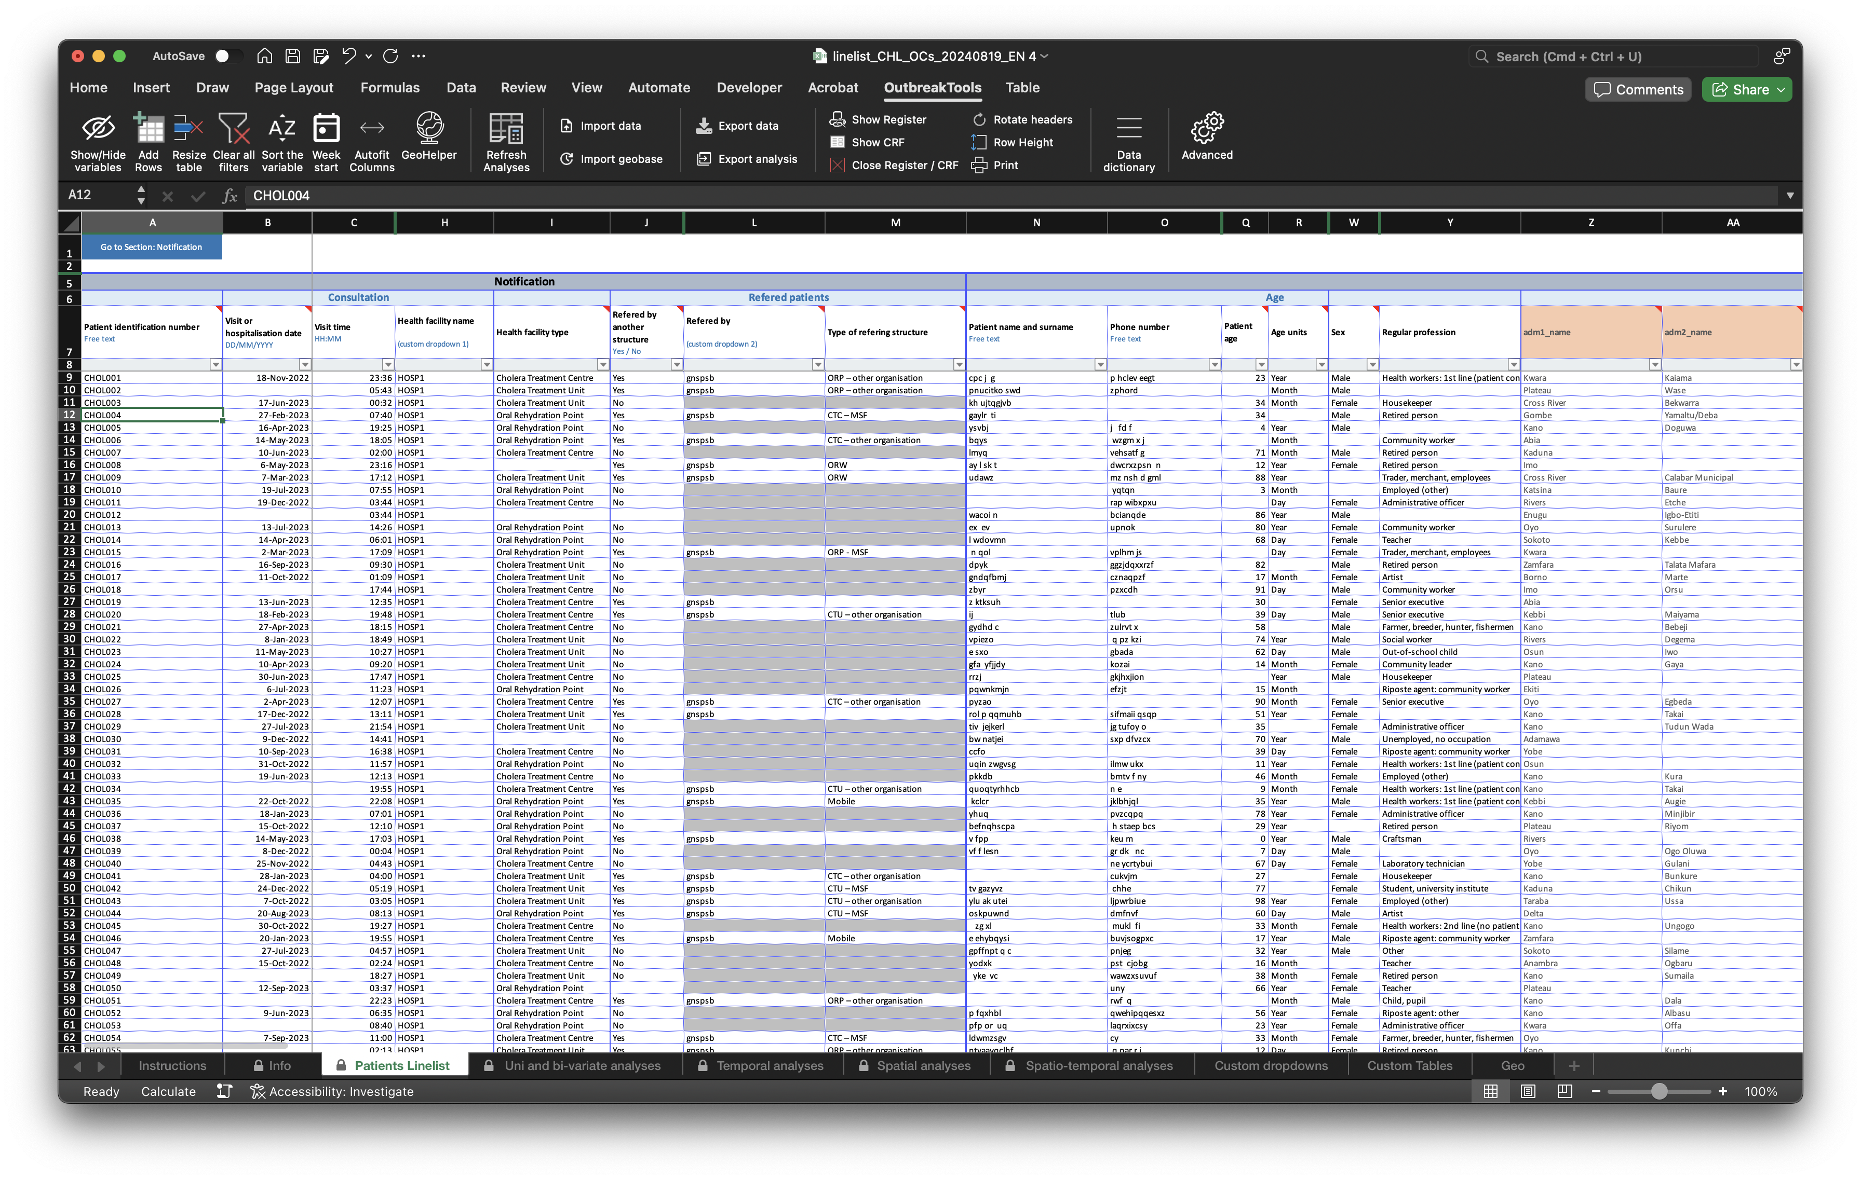

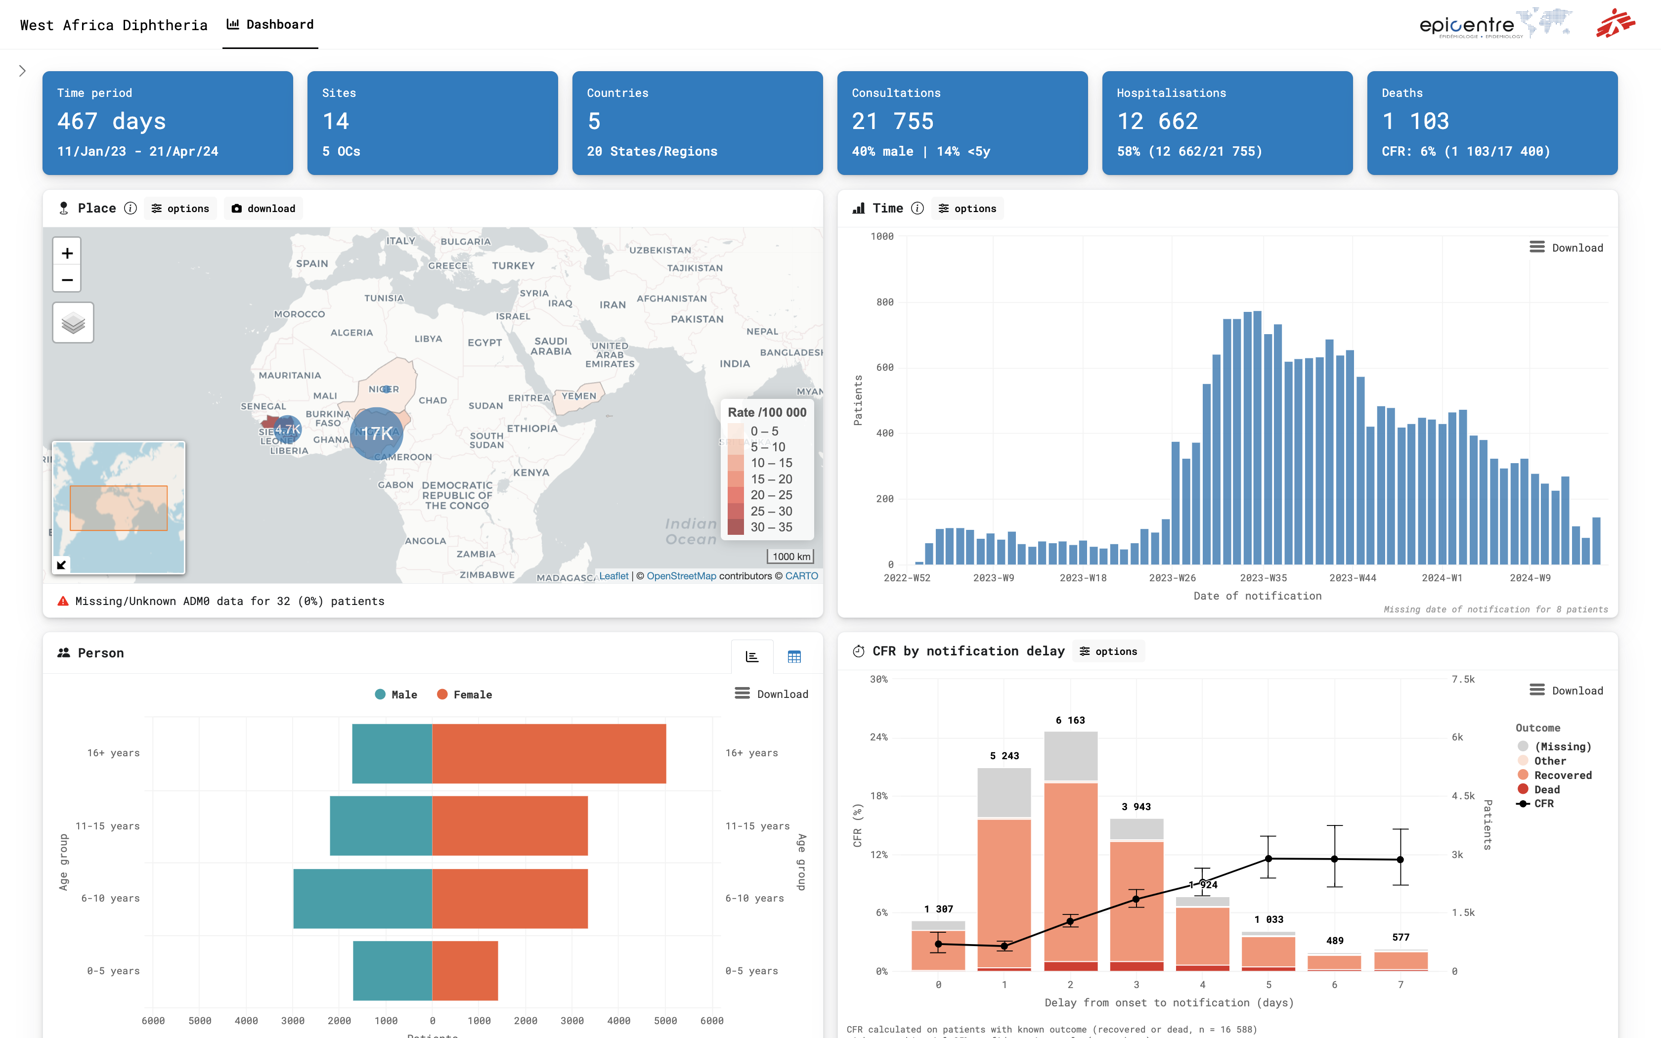
Export
data
Automatised centralisation
OBT linelists
Dashboard
MOH,
other partners

Slide 2

Setup file
Designer
Linelist
Import into
Generates
No VBA / advanced Excel skills needed
Adds all the standardised linelist functionalities
Standardised interface and functionalities

Slide 3
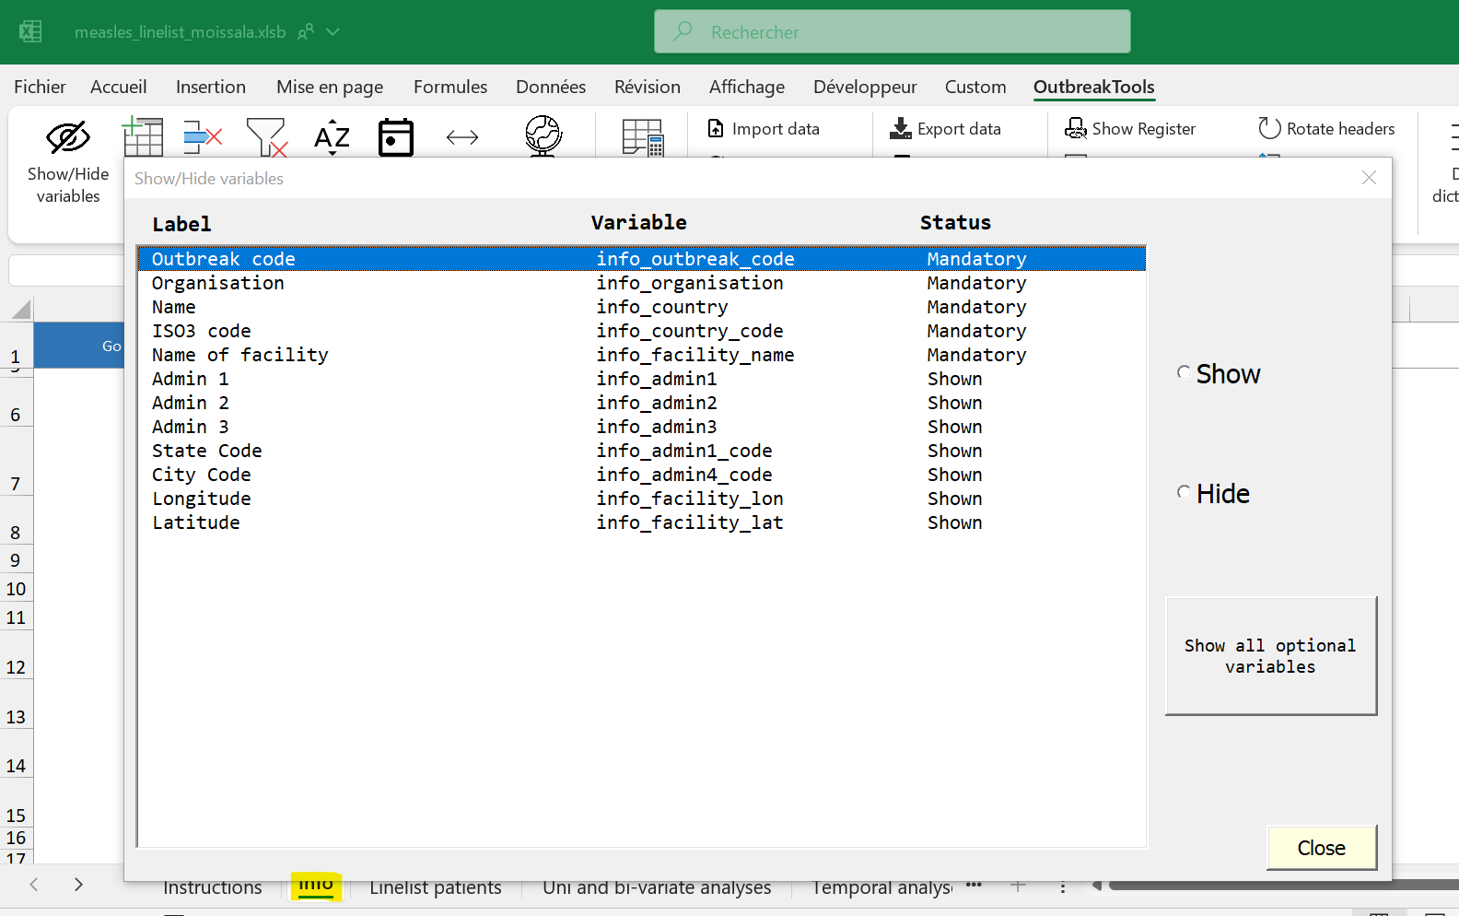

Slide 4
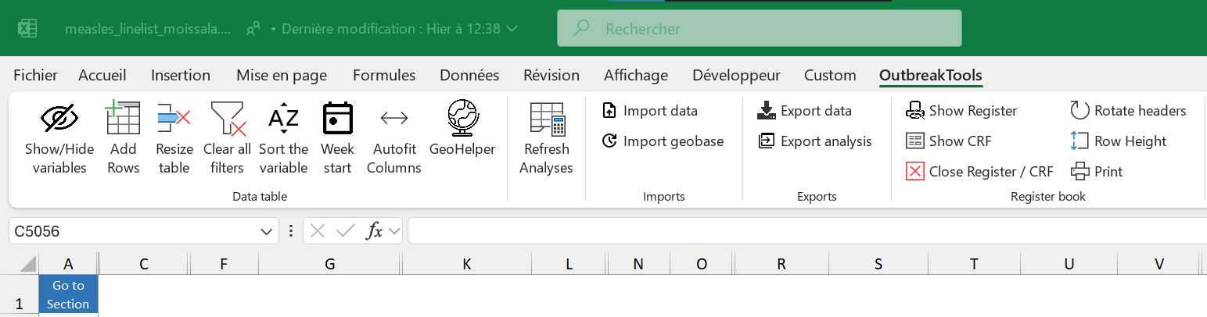

Slide 5
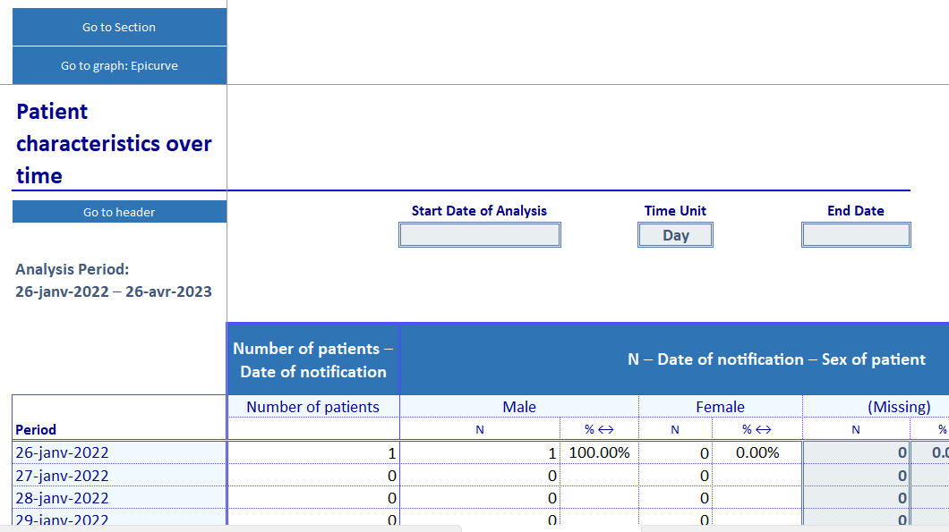

Slide 6
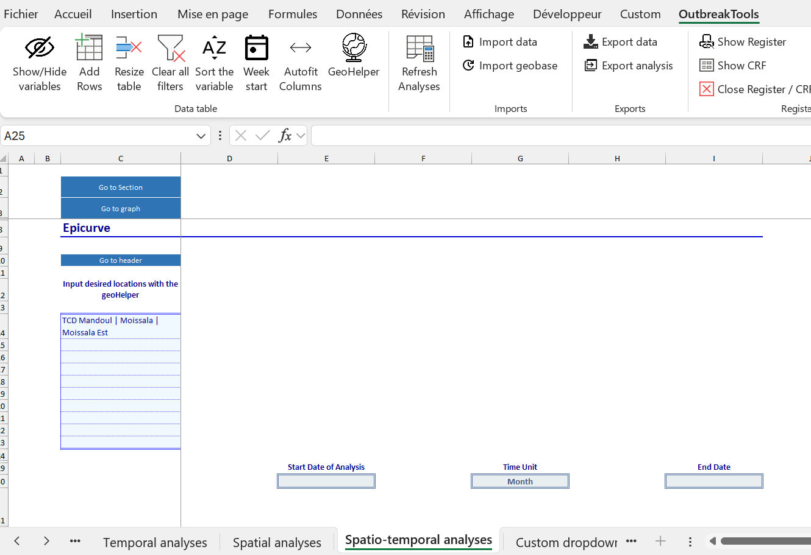
2
1
3

Slide 7
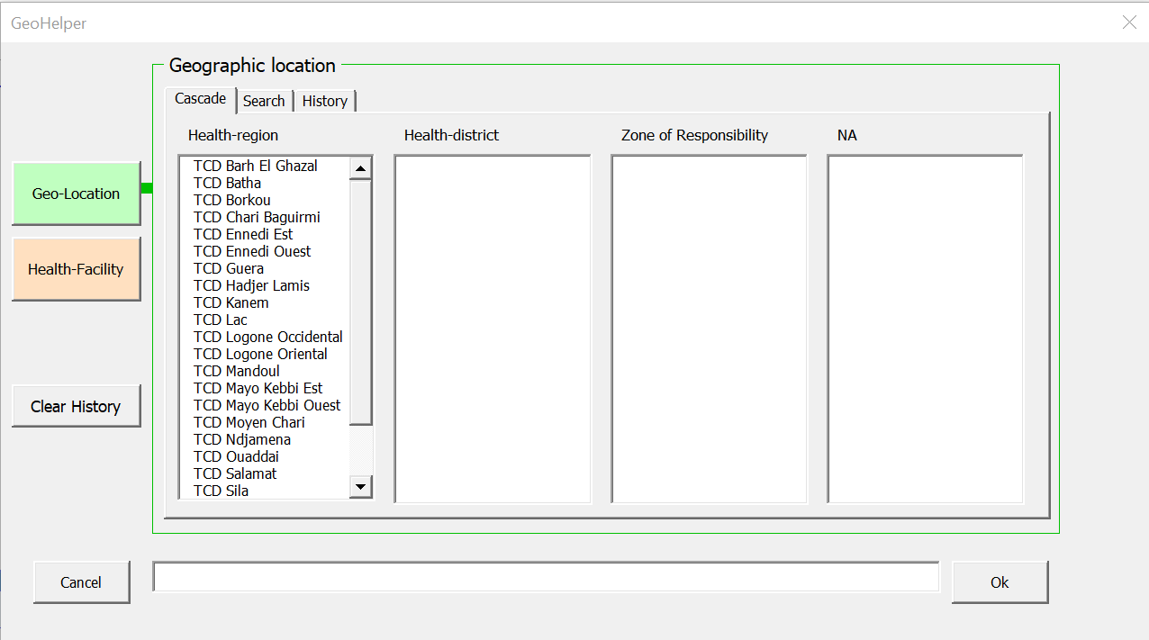

Slide 8
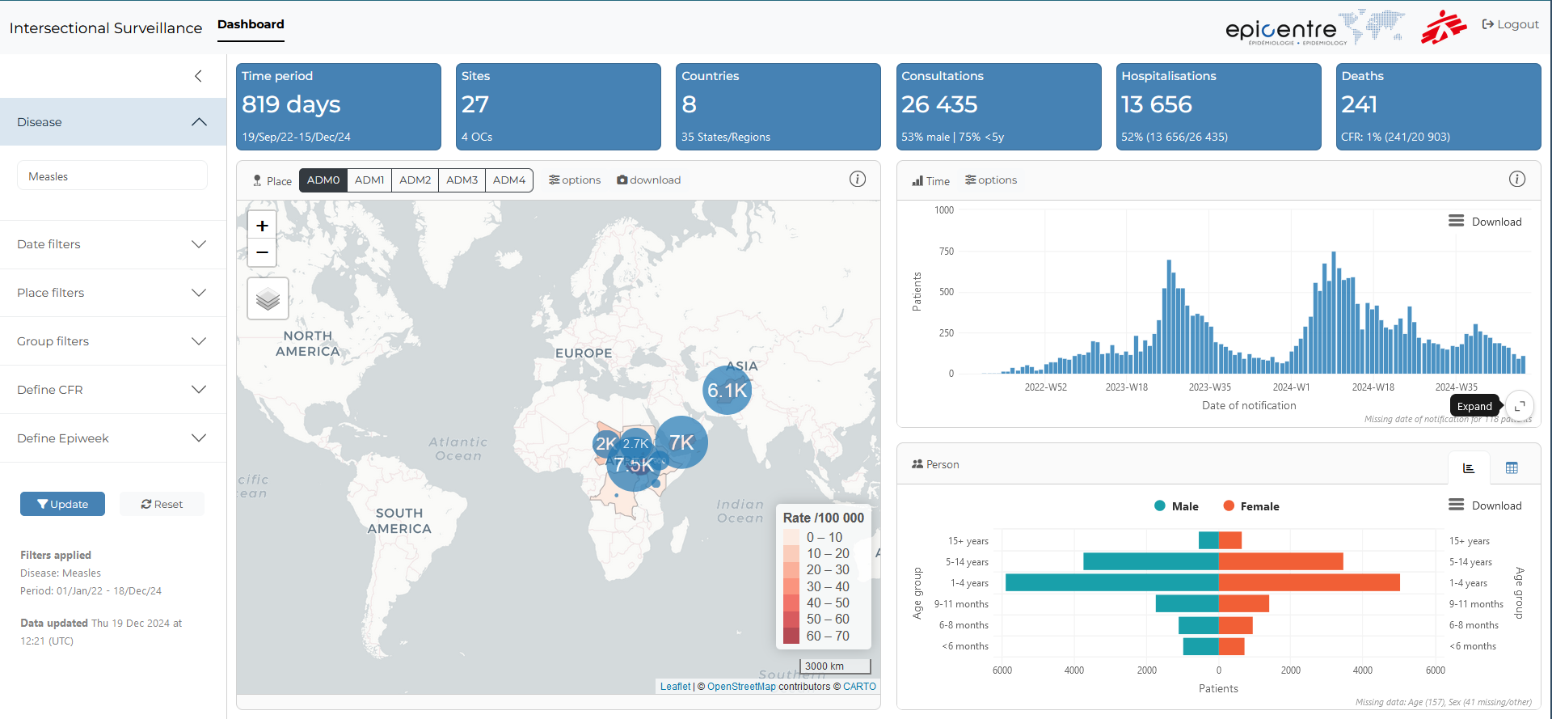
1
2
4
3
5

