Slide 1


Integrating Strategic, Tactical and Operational Decision-Making in Mining Using Discrete Rate Simulation
A Two-Area Production–Development Case Study
By
Jiang Bai
Jonathan Lamontagne Kratz

Slide 2

Table of content
1. Research Objective and Scope
2. Background and Research Gap
3. Strategic–Tactical–Operational & Hybrid DRS–DES Framework
4. Illustrative Two-Area Mining Case
5. Tactical Configuration and Operational Resource Policies
6. Evaluation Framework
7. Expected Contribution and Next Steps
8. Appendix

Slide 3

Research Objective and Scope

Slide 4
OBJECTIVE
Research Objective and Scope
Research objective
Investigate how a mine-level strategic objective can be translated into tactical operating configurations / modes and operational resource-allocation decisions within a Discrete Rate Simulation (DRS) framework.
Strategic
Maximize mine-level value
• NPV / discounted value
• value of throughput
• long-term ore accessibility
Tactical
Select / maintain operating configuration
• stockpile state & critical thresholds
• development / face readiness
• strategic risk and priorities
Operational
Execute the selected tactical state
• trucks / LHD allocation
• haulage, cycle time & constraints
• aggregate DRS or DES island
4

Slide 5
STRATEGIC OBJECTIVE
From Throughput to Discounted Mine Value
The strategic objective is to maximize the value created over the planning horizon after accounting for timing and development trade-offs.
1
Throughput → period value
2
Period value → cash flow
3
Discount cash flow & optimize
Vₜ = Σᵢ Qᵢ,ₜ · vᵢ,ₜ
CFₜ = Vₜ − Cprod,ₜ − Cdev,ₜ − Cfixed,ₜ
PVₜ = CFₜ / (1+r)^(t/365) max NPV* = Σₜ PVₜ
Qᵢ,ₜ = tonnes of ore type i processed in period t vᵢ,ₜ = net value per processed tonne (recovered metal value − variable processing / reagent cost)
Production creates current feed and cost.
Development creates cost today but no immediate plant revenue. Its benefit is future ore access / production capacity.
r = annual discount rate; t = simulation day Objective: choose policies that maximize NPV* subject to stockpile, capacity, development and mode constraints. *Technically “NPV proxy”, as full tax / capex / sustaining-capital items are not included.
Initial assumptions for the first model
Illustrative discounting
• Value is recognized when ore is processed, not when it is mined. • Start with fixed commodity price / recovery and a constant net value per tonne for each ore type. • Production and development use deterministic unit-cost rates; Area 2 production is enabled only after its development threshold is reached.
At r = 8%, the same $600k cash flow is worth: Today: $600k | 1 year later: $600k / 1.08 ≈ $556k
Decision rule: sacrifice short-term throughput for development only when the discounted future value gained exceeds today’s lost throughput value plus development cost.
5

Slide 6
Background and Research Gap

Slide 7
BACKGROUND
Prior Work: Operating Modes as Tactical Responses
Navarra et al. (2019)
Órdenes et al. (2026)
• Two concentrator modes (A / B), each with regular and contingency operation.
• Mode A is more productive but depletes the vulnerable Ore 2 stockpile; Mode B is recuperative and allows Ore 2 to rebuild.
• Total stockpile target and a critical Ore 2 level are tactical control parameters; mode changes can be restricted to scheduled shutdowns.
• Extends the logic to Configurations A / B and C / D, each with Regular, Contingency and Mine-Surging conditions.
• A critical Ore 2 level Y (often tested relative to total stockpile target X) can trigger a recuperative configuration at a campaign shutdown.
• Contingency responds to the likely stockout; mine surging addresses the less-likely stockout through increased mine-side response.
Extension opportunity
Extension opportunity: preserve this stockpile-triggered tactical logic, but add future development readiness and mine-value risk, then connect the selected tactical state to operational fleet allocation.
7

Slide 8
BACKGROUND
Prior Work: Individual-Equipment Haulage at the Operational Layer
Shelswell & Labrecque (2017)
• Models individual trucks, operators and LHD-serviced loadouts in a discrete-event simulation. • Represents dispatching, queues, traffic, maintenance, failures and refuelling explicitly. • Quantifies how fleet size, mechanical availability and operator crew size affect haulage productivity. • Produces benchmark curves for fleet sizing and crew planning.
However, strategic and tactical mine-planning decisions remain outside the haulage model.
Extension opportunity
Use Shelswell-style DES only where individual equipment interactions matter, while DRS coordinates the wider strategic and tactical mine system.
8

Slide 9
RESEARCH GAP
Research Gap within Shelswell & Labrecque (2017)
Local operational objectives
Global mine objective
Maximize: • availability • utilization • tonnes moved • current production These can look excellent over one shift while sacrificing future production readiness.
≠
Maximize: • mine NPV / discounted value • sustained downstream throughput • access to future ore • value over the planning horizon The objective must account for life of mine
Locally optimal may be globally suboptimal
9

Slide 10
Decision Hierarchy and Hybrid DRS–DES Framework

Slide 11
DECISION FRAMEWORK
Strategic–Tactical–Operational Decision Hierarchy
1 Strategic plan
Usually changes slowly unless major assumptions fail.
Objective: maximize mine NPV / value.
Defines long-term production–development priorities and future-access requirements.
2 Tactical controller
Monitors Ore 1 / Ore 2 inventories, critical thresholds and development readiness.
At campaign decision points: Mode A ↔ Mode B
Within the selected mode: Regular / Contingency / Mine Surging
3 Operational execution
Executes the selected tactical state each shift.
Allocates trucks/LHDs and routes ore / waste.
Represents cycle time, availability, queues and local bottlenecks at the required fidelity.
Operational results update stockpiles, development and readiness → state feedback to the tactical controller
11

Slide 12
DRS FRAMEWORK
DRS considerations
DRS provides the mine-wide dynamic backbone; operational detail can be selectively increased only where it changes decisions.
Mine-wide state
Tactical switching
Continuously tracks stockpiles, production, development progress, face readiness, value and operating state.
Use stockpile thresholds and readiness / value conditions to maintain or switch a tactical configuration. Regular, contingency and surging conditions can emerge within the selected configuration.
Key idea: detailed DES does not need to replace DRS everywhere—high-fidelity “islands” can be embedded inside the mine-wide DRS model.
12

Slide 13
HYBRID ARCHITECTURE
DES Islands in a Sea of DRS
DRS is the default mine-wide representation. A selected operational subsystem can be refined with individual-equipment DES only when the added detail materially affects decisions.
Strategic objective / plan
Mine value / NPV • long-term priorities
Mine wide DRS Frame
Tactical controller
Stockpiles + readiness + strategic risk → select / maintain operating configuration
Operational execution layer
refine if needed
Optional truck-level DES refinement
Operational execution — aggregate DRS (default)
Fleet counts + cycle time + availability + match factor → achievable rates
Use only for selected subsystems where queues, traffic, failures or dispatch interactions matter
Refines operational rates and delays; it does not replace the mine-wide DRS model
state feedback
Mine-system DRS backbone — state update
rates • stockpiles • development readiness • throughput • value
13

Slide 14
RESEARCH QUESTIONS
Research Question and Working Hypothesis
Primary research question
How can strategic mine-value objectives be translated into stockpile- and readiness-aware tactical switching between Mode A and Mode B, and then into operational resource-allocation decisions within a DRS framework?
Working hypothesis
A policy that sacrifices some short-term production for timely development can sustain future throughput and outperform a locally optimized policy on discounted mine value.
14

Slide 15
Illustrative Mining Case

Slide 16
ILLUSTRATIVE TACTICAL CONTEXT
Why the Tactical Controller Needs Both Mode A and Mode B
Ore balance explains the need for tactical switching
Average deposit supply
Mode A: higher throughput, Ore 2 is depleted
Ore 1 70%
Ore 2 30%
A requires 40% Ore 2 while the average deposit supplies 30%. Staying in A indefinitely creates Ore 2 stockout risk.
Mode A — Productive configuration
Ore 1 60%
Ore 2 40%
250 t/h
Mode B: lower throughput, Ore 2 can recover
B uses only 15% Ore 2 while the deposit supplies about 30%, allowing the vulnerable Ore 2 stockpile to rebuild.
Mode B — Recuperative configuration
Ore 1 85%
Ore 2 15%
225 t/h
A ↔ B is the tactical decision
Regular / Contingency / Mine Surging are operating conditions within the selected tactical mode—not separate tactical configurations.
Stay in A while Ore 2 is sufficiently protected. At an allowed decision point, switch to B when Ore 2 approaches the critical level Y; return to A after recovery.
Source: Navarra et al. (2019), Table 2
16

Slide 17
LINKING THE LEVELS
From Strategic Objective to Operational Action
Strategic objective
Maximize discounted mine value.
Defines future-access requirements, production timing, development priorities and economic trade-offs.
Tactical controller
Observes Ore 1 / Ore 2 stockpiles, target X, critical Ore 2 level Y and future readiness.
At allowable decision points: Mode A (productive) ↔ Mode B (recuperative)
Within the selected mode: Regular / Contingency / Mine Surging
Operational execution
Turns the selected tactical state into resource priorities and achievable production / development rates.
Use aggregate DRS by default; use a DES island when individual-equipment interactions materially change the result.
Operational outcomes update stockpiles and development readiness, allowing tactical decisions to respond not only to process inventory risk but also to future mine-value risk.
17

Slide 18
TACTICAL CONTROL
Current-Case Tactical Logic: Mode A ↔ Mode B
1 Monitor
inventory state
2 Campaign
decision point
3 Select
configuration
4 Operating
condition
Ore 1 level
Ore 2 level
Total stockpile target X
Critical Ore 2 level Y
Y is often tested as a fraction of X, but absolute inventory levels still matter.
At an allowed reconfiguration point (e.g., scheduled shutdown):
Ore 2 > Y
→ maintain productive configuration
Ore 2 ≤ Y
→ switch to recuperative configuration
Mode A — Productive
Higher throughput; draws more heavily on vulnerable Ore 2.
Mode B — Recuperative
Lower throughput; changes the blend so Ore 2 can rebuild.
Within the selected configuration:
Regular
Contingency — likely stockout
Mine surging — less-likely stockout / increased mine-side response
Compared with Órdenes et al. (2026) generalizes the same configuration logic across A/B and C/D, we add development readiness and mine-value risk to the tactical state; Mode A / B plus the operating condition then sets priorities for operational resource allocation.
18

Slide 19
SYSTEM STRUCTURE
Two-Area Production–Development Case
Area 1 — Current Production
Area 2 — Future Production
Downstream system
Developed at simulation start Production switch: ON Creates immediate ore and cash flow Operational question: how much fleet stays here?
Initially requires development Production switch: OFF Development progress unlocks a future face Operational question: how much fleet is allocated now?
Ore stockpiles → concentrator → throughput/value
Strategic consequence
Insufficient development today can make Area 2 unavailable when the future production plan needs it.
Area 2 unlock condition: development progress
≥
required threshold.
19

Slide 20
PRODUCTION–DEVELOPMENT TRADE-OFF
Development consumes resources but unlocks future production area
Short term
Long term
Fleet assigned to development
Waste hauled (no plant feed)
Ore access is advanced
Future Ore 2 production unlocked
Immediate trade-off
Global benefit
lower current production / cash flow
future face readiness, sustained throughput and potentially higher NPV
20

Slide 21
Tactical Configuration and Operational Resource Policies

Slide 22
BASELINE POLICY
Policy 1 — Local-Objective Baseline
A deliberately myopic benchmark that prioritizes current production and local operational KPIs.
Objective
Development logic
Expected risk
Maximize current tonnes / utilization / apparent productive use of equipment.
No explicit strategic target for Area 2 readiness beyond a minimum or residual allocation.
Strong short-term performance can leave the future production area underdeveloped and reduce later mine value.
Purpose of this policy: test whether a locally “good” operational policy can be globally inferior.
22

Slide 23
VALUE-ORIENTED POLICY
Policy 2 — Hierarchical Value-Oriented Control
The tactical controller selects Mode A or Mode B using the Navarra / Órdenes stockpile logic, extended with development readiness and mine-value risk. The operational layer then chooses how to execute that tactical state with available resources.
Observe system state
Choose tactical configuration
Operational resource policy
Ore 1 / Ore 2 inventories, total stockpile target X, critical Ore 2 level Y, development progress, face readiness, current configuration / condition and value-relevant constraints.
Mode A — Productive Mode B — Recuperative Within the selected mode: Regular / Contingency / Mine Surging
Translate the tactical state into execution priorities:
• production priority
• balanced production–development
• development priority
• dual-area production
Determines whether production or development must be prioritized to remain compliant with the strategic plan
Tactical chooses the mine configuration (A/B) and operating condition;
Operations decides how resources execute that decision.
23

Slide 24
Evaluation Framework

Slide 25
EXPECTED MECHANISM
Expected Mechanism: How Development Can Create Mine Value
Development today
Future face readiness
Tactical flexibility
Sustained throughput
Higher discounted mine value
Lower current production
Area 2 becomes available
More feasible operating modes
Less future stockout risk
Global objective
Working hypothesis
A small short-term production sacrifice can be economically rational when it prevents a larger future throughput or access loss.
25

Slide 26
KPIS & OUTPUTS
Evaluation Metrics: Separate Objective from Diagnostics
Global objective
System report outcomes
Operational KPIs
Primary: mine NPV or discounted mine-value proxy Possible proxy: Discounted ore/product value − production cost − development cost − penalties for future stockout
• downstream throughput • production timing • Area 2 unlock date • stockouts / contingency • development completion • lost production
• fleet availability • utilization • truck cycle time • match factor • idle / spare fleet • shift allocation by area/task
26

Slide 27
Expected Contribution and Next Steps

Slide 28
CONTRIBUTION
Expected Contribution and Next Steps
1 Decision hierarchy
2 Intertemporal mining
Link strategic mine value → tactical configuration / operating-state control → operational execution.
Represent the trade-off between production today and development that unlocks future production.
3 Local vs global
4 Multi-resolution hybrid modelling
Test when maximizing availability, utilization or short-term tonnes reduces long-run mine value.
Embed detailed DES islands for individual equipment inside a mine-wide DRS backbone when needed.
Next steps
1) Define mine-value / NPV proxy 2) Phase 1: validate Mode A Regular / Contingency / Surging + operational execution 3) Phase 2: implement Mode A ↔ Mode B tactical switching with development readiness 4) Phase 3: compare aggregate DRS vs hybrid DES execution under value-oriented control
29

Slide 29
Appendix A — Operational Face-Allocation Equations
Given:
f1, of each face (Face1=0.85), Face2=f2 = ore1 fraction 0.55)
ore1, total = target rates from the selected tactical configuration / operating condition
Solve for r1 (mass rate from Face1), then normalize to fractions:
The Equation
r1 = (ore1 - total·f2) / (f1 - f2)
r2 = total - r1
Clamped to [0, total], then fracs = [r1/total, r2/total].
Face 1 is ore1-rich (85%), Face 2 is balanced (55% ore1 / 45% ore2)
Mode | Ore1 t/d | Ore2 t/d | F1 frac (obj.) | F2 frac
A | 3600 | 2400 | 0.917 | 0.083
A Contingency | 3900 | 0 | 1.0 | 0.0
A Surging | X | 3600 | 0.904 | 0.096
B | 4600 | 800 | 0.0 | 1.0
B Contingency | 0 | 2900 | 1.0 | 0.0
B Surging | X | 800 | 0.0 | 1.0

Slide 30
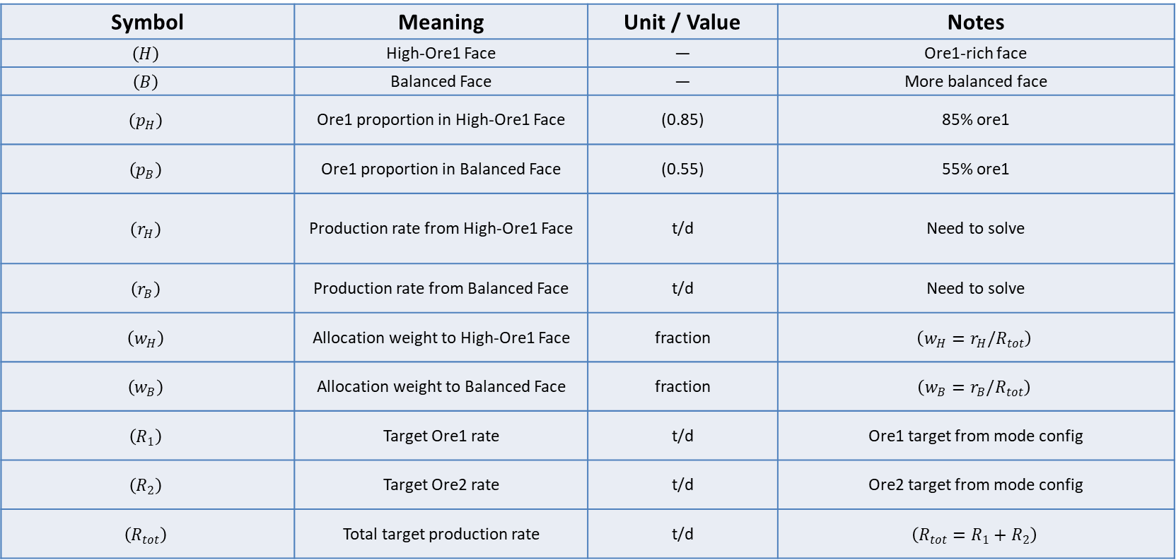
Appendix B — Symbols and Variables
Symbol | Meaning | Unit / Value | Notes
$$\left(H\right)$$ | High-Ore1 Face | — | Ore1-rich face
$$\left(B\right)$$ | Balanced Face | — | More balanced face
$$\left(p_{H}\right)$$ | Ore1 proportion in High-Ore1 Face | (0.85) | 85% ore1
$$\left(p_{B}\right)$$ | Ore1 proportion in Balanced Face | (0.55) | 55% ore1
$$\left(r_{H}\right)$$ | Production rate from High-Ore1 Face | t/d | Need to solve
$$\left(r_{B}\right)$$ | Production rate from Balanced Face | t/d | Need to solve
$$\left(w_{H}\right)$$ | Allocation weight to High-Ore1 Face | fraction | $$\left(w_{H}=r_{H}/R_{tot}\right)$$
$$\left(w_{B}\right)$$ | Allocation weight to Balanced Face | fraction | $$\left(w_{B}=r_{B}/R_{tot}\right)$$
$$\left(R_{1}\right)$$ | Target Ore1 rate | t/d | Ore1 target from mode config
$$\left(R_{2}\right)$$ | Target Ore2 rate | t/d | Ore2 target from mode config
$$\left(R_{tot}\right)$$ | Total target production rate | t/d | $$\left(R_{tot}=R_{1}+R_{2}\right)$$

Slide 31
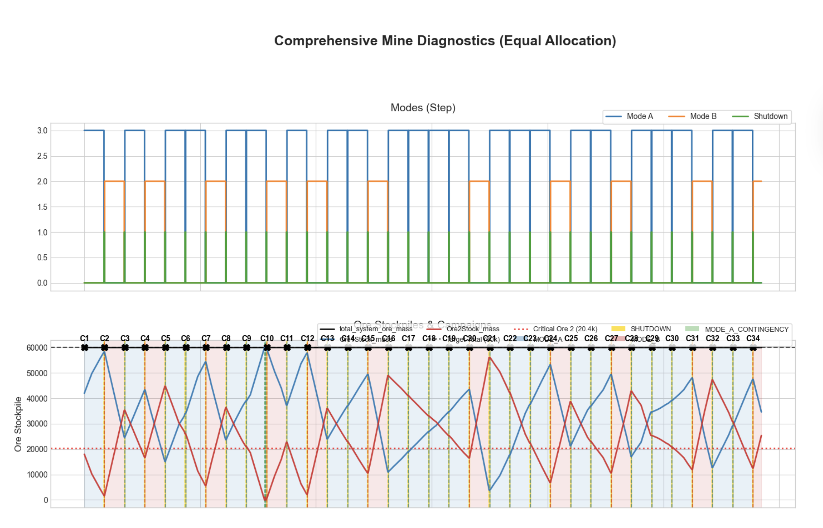
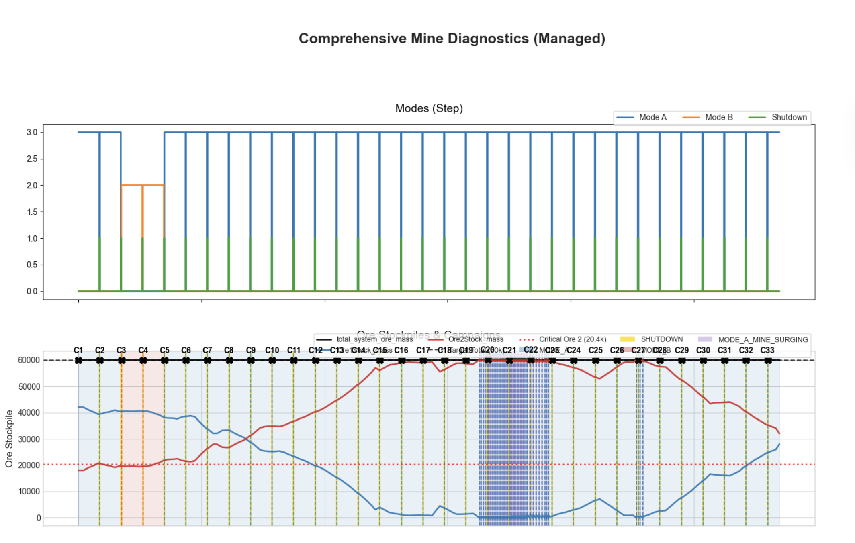
Appendix C — Current Simulation Diagnostics

Slide 32
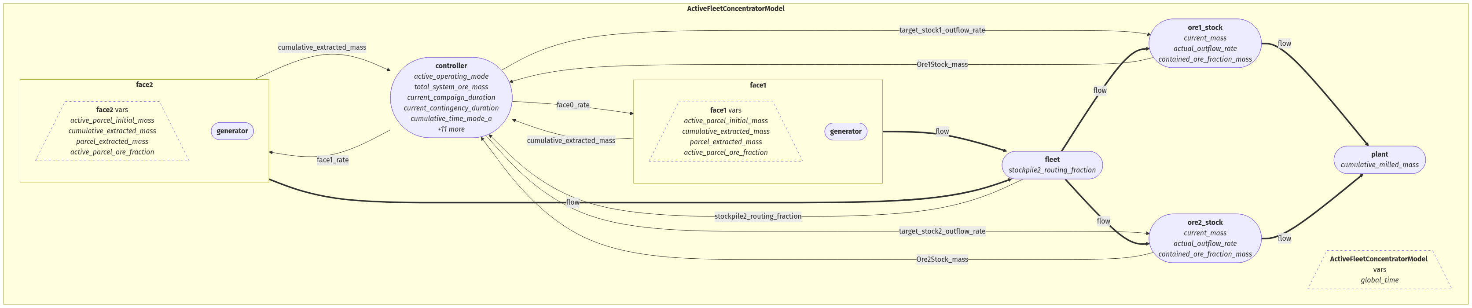
Appendix D — Current Code Flow Chart

