Slide 1
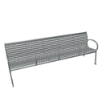
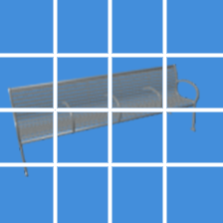
Linear
MatrixMult
Concat
SoftMax
像素级Q,K,V（pixel）
Scaled Dot-Product Attention
Scale
MatrixMult
q k v
Linear
Linear
Linear
Scaled Dot-Product Attention
Q K V
补丁级Q,K,V（patch）
Multi-Head Attention
Q,K,V都来自经过线性层的X

