Slide 1
Matrix Decomposition Algorithms
ED, SVD and PCA

Slide 2
Introduction
A few reasons we require dimensionality reduction:
Training a lot of parameters using a scarce data set can lead to overfitting and poor generalization.
High dimensionality also means very large training times
It is often true that despite residing in high dimensional space, feature space has a low dimensional structure
What is SVD and ED?
Both SVD and ED are matrix factorization methods that allow you to reduce the dimensionality of a matrix while retaining most of its information
Both can be used to approximate a matrix with a lower-rank matrix that has a smaller size or for removing noise from the matrix
Any matrix can be decomposed using SVD
However, ED can only exist for square matrices
What is PCA?
PCA utilizes ED or SVD to transform high-dimensional data into a lower-dimensional space
It helps in compressing data, removing noise, and identifying dominant features
It can also be used for ranking, regression and clustering

Slide 3







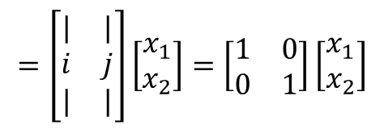

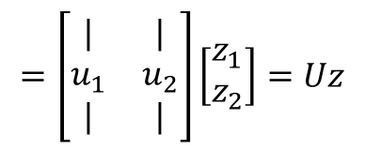



2D Rotation
How would you represent a point in the standard basis,
$i=\left[\begin{aligned}1 \\ 0\end{aligned}\right] j=\left[\begin{aligned}0 \\ 1\end{aligned}\right]$ ?
$$=\left[\begin{matrix}| & | \\ i & j \\ | & |\end{matrix}\right]\left[\begin{aligned}x_{1} \\ x_{2}\end{aligned}\right]=\left[\begin{matrix}1 & 0 \\ 0 & 1\end{matrix}\right]\left[\begin{aligned}x_{1} \\ x_{2}\end{aligned}\right]$$
$$x=\left[\begin{aligned}x_{1} \\ x_{2}\end{aligned}\right]$$
$$=ⅈx_{1}+jx_{2}$$
$$=Ix$$
${<u}_{1},u_{2}> =0$ and also$\left\|u_{1}\right\|=1$ ; $\left\|u_{2}\right\|=1$
How would you represent the same point in a different orthonormal basis ($u_{1}$ $and u_{2}$) ?
$$=\left[\begin{matrix}| & | \\ u_{1} & u_{2} \\ | & |\end{matrix}\right]\left[\begin{aligned}z_{1} \\ z_{2}\end{aligned}\right]=Uz$$
$$x=\left[\begin{aligned}x_{1} \\ x_{2}\end{aligned}\right]$$
$$=u_{1}z_{1}+u_{2}z_{2}$$
$$⇒ x=Uz$$
We know x and U, but how do we find z?
U is orthogonal $⇒$
$$U^{−1}=U^{T}$$
$$∴ z=U^{⊤}x$$

Slide 4
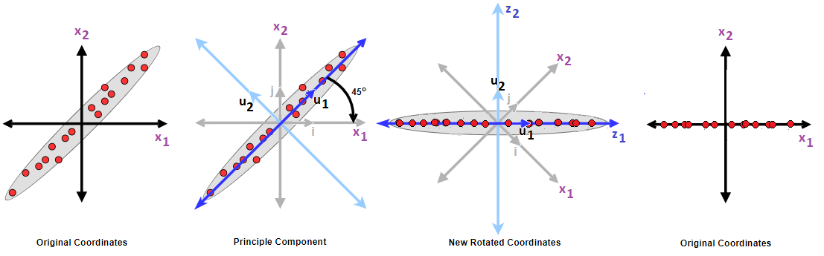





Principal Component Analysis (PCA)
Multiplying $x$with an orthogonal matrix $U$ produces a rotation (change of basis = rotation)
In PCA we aim to reduce the dimensionality after the encoding by removing the axis that has the smallest variance
$$ℝ^{D}$$
Encode
$$ℝ^{d}$$
Decode
$$ℝ^{D}$$
$$Z={U_{d}}^{⊤}X$$
$$X=U_{d}Z$$

Slide 5
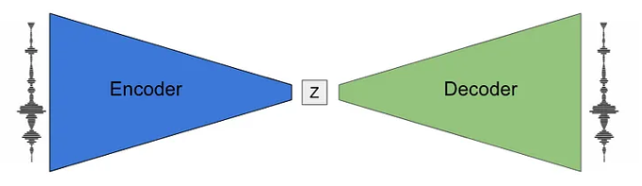


Principal Component Analysis (PCA)
$$X$$
$$\tilde{X}$$

Slide 6


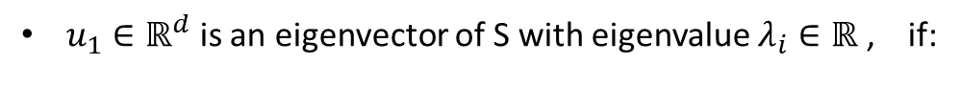


Eigendecomposition of a symmetric matrix
A few important facts/reminders:
$u_{1}∈ℝ^{d}$ is an eigenvector of S with eigenvalue $λ_{i}∈ℝ$ , if:
$$Su_{1}=λ_{i}u_{1}$$
All eigenvectors of a symmetric matrix are orthogonal (if the eigenvalues are different):
$$S=S^{T}∈ℝ^{d×d}$$
$$⇒$$
${<u}_{i},u_{j}> =0$
Eigendecomposition is the process of decomposing (or factorizing) a matrix into eigenvalues and eigenvectors
Reminder: Eigendecomposition can only exist for square matrices!

Slide 7
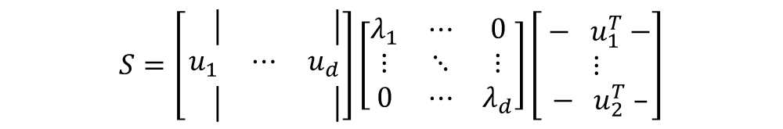






Eigendecomposition of a symmetric matrix
$$S\left[\begin{matrix}\left.\left.\right.\right| & & \left.\left.\right.\right| \\ { u}_{1} & ⋯ & { u}_{d} \\ \left.\left.\right.\right| & & \left.\left.\right.\right|\end{matrix}\right]=\left[\begin{matrix}\left.\left.\right.\right| & & \left.\left.\right.\right| \\ {λ_{1}u}_{1} & ⋯ & {λ_{d}u}_{d} \\ \left.\left.\right.\right| & & \left.\left.\right.\right|\end{matrix}\right]$$
Eigendecomposition of
$$S=S^{T}∈ℝ^{d×d}$$
$$SU=U\left[\begin{matrix}λ_{1} & ⋯ & 0 \\ ⋮ & ⋱ & ⋮ \\ 0 & ⋯ & λ_{d}\end{matrix}\right]$$
$$S=UΛU^{T}$$
$$SU=UΛ$$
$$S=\left[\begin{matrix}\left.\left.\right.\right| & & \left.\left.\right.\right| \\ u_{1} & ⋯ & u_{d} \\ \left.\left.\right.\right| & & \left.\left.\right.\right|\end{matrix}\right]\left[\begin{matrix}λ_{1} & ⋯ & 0 \\ ⋮ & ⋱ & ⋮ \\ 0 & ⋯ & λ_{d}\end{matrix}\right]\left[\begin{matrix}{ − u}_{1}^{T} − \\ ⋮ \\ { − u}_{2}^{T} –\end{matrix}\right]$$
Since $U$ is orthogonal ( $U^{T}U=UU^{T}=I$ ) :
$$S=UΛU^{T}$$
In PCA we always assume sorted eigenvalues:
$$λ_{1} ≥λ_{2}≥⋯≥λ_{d}$$

Slide 8






Covariance Matrix
The covariance matrix is symmetric positive semi-definite since it is symmetric and all its eigenvalues are non-negative
$Σ_{x}$ ≽ 0
$$Σ_{x}={Σ_{x}}^{T}∈ℝ^{d×d}$$
$$X=\left[\begin{aligned}&x_{1} \\ &⋮ \\ &x_{D}\end{aligned}\right]∈ℝ^{D}$$
1
$$Σ_{x}=E\left[\left(X−μ_{x}\right){\left(X−μ_{x}\right)}^{T}\right]$$
, $X$ is a random vector :
2
$$Var\left(X\right) =E\left[{\left\|X−μ_{x}\right\|}_{2}^{2}\right]$$
(a multivariate random variable)
We will first prove using
1
that:
All eigenvalues of the covariance matrix are non-negative

Slide 9

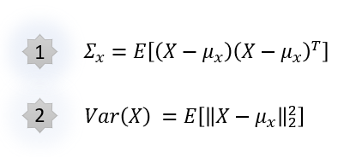







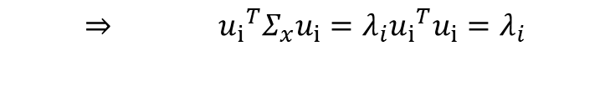
Covariance Matrix
Proof:
( we assume $μ_{x}$= 0 and $\left\|u_{i}\right\|=1$ )
$$Σ_{x}u_{i}=λ_{i}u_{i}$$
$$⇒ {u_{i}}^{T}Σ_{x}u_{i}=λ_{i}{{u_{i}}^{T}u}_{i}=λ_{i}$$
$${λ_{i}=u_{i}}^{T}Σ_{x}u_{i}$$
$$={u_{i}}^{T}E\left[XX^{T}\right]u_{i}$$
$=$ $E\left[{u_{i}}^{T}XX^{T}u_{i}\right]$
$=E\left[{({u_{i}}^{T}X)}^{2}\right]$ $≥0$
$$∴λ_{i}≥0$$

Slide 10
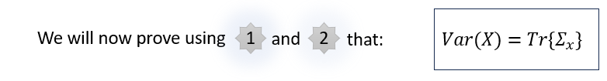












Covariance Matrix
Proof:
Let $\tilde{X}=X−μ_{x}$
$$Var\left(\tilde{X}\right)$$
$$=E\left[{\left\|\tilde{X}\right\|}_{2}^{2}\right]$$
$$=E\left[{\left\|X−μ_{x}\right\|}_{2}^{2}\right]$$
$$=Var\left(X\right)$$
$$Var\left(X\right)=Var\left(\tilde{X}\right)$$
$$=E\left[\tilde{X}{\tilde{X}}^{T}\right]$$
$$=Tr\left\{E\left[{\tilde{X}}^{T}\tilde{X}\right]\right\}$$
$$=E\left[Tr\left\{{\tilde{X}}^{T}\tilde{X}\right\}\right]$$
$$=E\left[Tr\left\{{\tilde{X}\tilde{X}}^{T}\right\}\right]$$
$$=Tr\left\{E\left[{\tilde{X}\tilde{X}}^{T}\right]\right\}$$
$$=Tr\left\{Σ_{x}\right\}$$

Slide 11
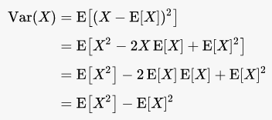












Constraint Optimization: 1D Projection
Let’s consider a 1D projection where X is a random variable: X $=uZ$ Z $=u^{T}X ε ℝ$
What is $E\left[Z\right]$?
( we assume $μ_{x}$= 0 and $\left\|u_{i}\right\|=1$ )
$$=E\left[u^{T}X\right]$$
$$=u^{T}E\left[X\right]$$
$$E\left[Z\right]$$
$$=u^{T}0=0$$
What is $Var\left(Z\right)$?
$$Var\left(Z\right)=E\left[Z^{2}\right]$$
$$= E\left[u^{T}XX^{T}u\right]$$
$$= u^{T}E\left[XX^{T}\right]u$$
$$= u^{T}Σ_{x}u$$
$$∴Var\left(Z\right)=u^{T}Σ_{x}u$$

Slide 12









Constraint Optimization: 1D Projection
We want to find $u$ such that $Var\left(Z\right)$ is maximal
Since our goal in PCA is to
maximize the variance
$$Var\left(Z\right)=u^{T}Σ_{x}u$$
$$\max_{{s.t. \left\|u\right\|}_{2}^{2}=1}u^{T}Σ_{x}u$$
$$⇔$$
$$\max_{{s.t. \left\|u\right\|}_{2}^{2}≤1}u^{T}Σ_{x}u$$
$$ℒ\left(u,λ\right)=u^{T}Σ_{x}u − λ\left(u^{T}u − 1\right)$$
$$∇_{u}ℒ\left(u,λ\right)=0$$
$$2Σ_{x}u − 2λ I u=0$$
$$⇒$$
$$⇒$$
$$Σ_{x}u =λu$$
$u$ is an eigenvector!
But, since $X ε ℝ^{D}$we have D eigenvectors!
Which one do we choose!?
$$Var\left(Z\right)={u^{T}Σ}_{x}u =λu^{T}u=λ$$
$∴Var\left(Z\right)$ is maximized by eigenvector $u$ that corresponds to the largest eigenvalue $λ$

Slide 13
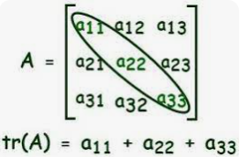
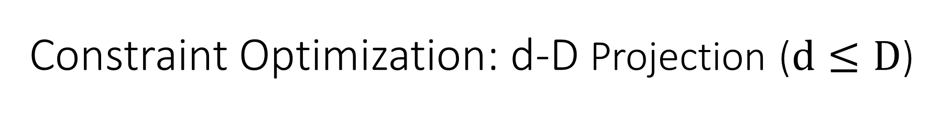


Constraint Optimization: d-D Projection ($d≤D$)
Let’s now consider a d-dimensional projection where X is a random vector: X $=U_{d}Z$ $ε{ ℝ}^{D}$ Z $={U_{d}}^{T}X ε{ ℝ}^{d}$
What is $E\left[Z\right]$?
( we assume $μ_{x}$= 0 and $\left\|u_{i}\right\|=1$ )
$$E\left[Z\right]=E\left[{U_{d}}^{T}X\right]={U_{d}}^{T}E\left[X\right]=0$$
What is $Var\left(Z\right)$?
$Σ_{z}=E[Z^{2}]=E[{U_{d}}^{T}XX^{T}U_{d}]={U_{d}}^{T}E[XX^{T}]U_{d}={U_{d}}^{T}Σ_{x}U_{d}$
$$⇒ Var\left(Z\right)=Tr\left\{Σ_{z}\right\}=Tr\left\{{U_{d}}^{T}Σ_{x}U_{d}\right\}$$

Slide 14









Constraint Optimization: PCA is not unique!
PCA searches for a semi-orthogonal matrix $U_{d}∈ℝ^{Dxd}$
Let $R$ be any rotation matrix ($⇒R$ is orthogonal)
If $U_{d}$ is a solution, so it $U_{d}R$
Proof:
Let ${\tilde{U}}_{d}=U_{d}R$
$${{\tilde{U}}_{d}}^{T}{\tilde{U}}_{d}=R^{T}U_{d}^{T}U_{d}R=R^{T}R=I$$
${\tilde{U}}_{d}$ is semi-orthogonal too!
$$⇒$$
$$Tr\left\{{{\tilde{U}}_{d}}^{T}Σ_{x}{\tilde{U}}_{d}\right\}$$
$$=Tr\left\{R^{T}U_{d}^{T}Σ_{x}U_{d}R\right\}$$
$$=Tr\left\{RR^{T}U_{d}^{T}Σ_{x}U_{d}\right\}$$
$$=Tr\left\{U_{d}^{T}Σ_{x}U_{d}\right\}$$
$$=Var\left(Z\right)$$
Same objective values!

Slide 15




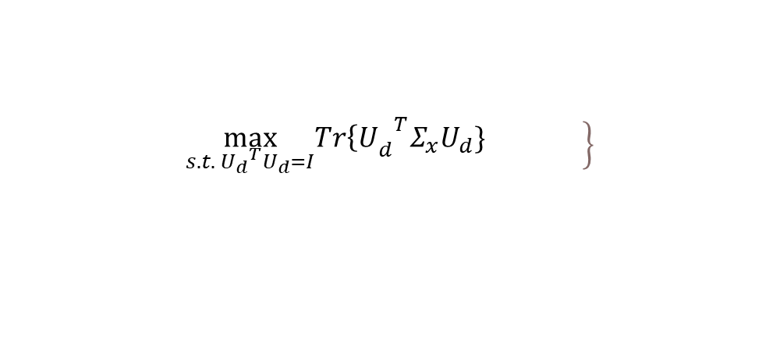

Constraint Optimization: d-D Projection ($d≤D$)
$${{Var\left(Z\right)=Tr\left\{U\right.}_{d}}^{T}Σ_{x}U_{d}\}$$
PCA searches for a semi-orthogonal matrix $U_{d}∈ℝ^{D×d}$ which solves:
$$\left.\max_{s.t. {U_{d}}^{T}U_{d}=I}{{Tr\left\{U\right.}_{d}}^{T}Σ_{x}U_{d}\} \right\}$$
$$ℒ\left(U_{d} , Λ_{d}\right)=Tr\left\{U_{d}^{T}Σ_{x}U_{d}\right\} − <Λ ,U_{d}^{T}U_{d} − I_{d}>$$
$$= Tr\left\{U_{d}^{T}Σ_{x}U_{d}\right\} − Tr\left\{Λ_{d}\left(U_{d}^{T}U_{d} − I_{d}\right)\right\}$$
$$∇_{U_{d}}ℒ(U_{d} , Λ_{d})=0$$
$$2Σ_{x}U_{d} − 2U_{d} Λ_{d}=0$$
$$Σ_{x}U_{d}=U_{d}Λ_{d} ⇒ Λ_{d}=U_{d}^{T}Σ_{x}U_{d}$$
Problem: $Λ_{d}$ may not be diagonal!
Solution: ${ \tilde{Λ}}_{d}=R^{T}Λ_{d}R$
(Let $R$ be any rotation matrix)
There is some ${\tilde{Λ}}_{d}$ from the infinite number of solutions that is diagonal since we can set R such that $Λ_{d}$ is diagonal

Slide 16

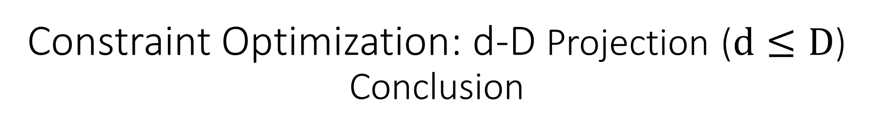
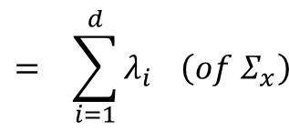


Constraint Optimization: d-D Projection ($d≤D$) Conclusion
$U_{d}$ are eigenvectors of $Σ_{x}$ with the corresponding eigenvalues on the diagonal of $Λ_{d}$
$$= \sum_{i=1}^{d}{λ_{i}} \left(of Σ_{x}\right)$$
$$Tr\left\{U_{d}^{T}Σ_{x}U_{d}\right\}$$
$$= Tr\left\{U_{d}^{T}U_{d}Λ_{d}\right\}$$
$$= Tr\left\{Λ_{d}\right\}$$
$∴$The objective is maximized by setting columns of $U_{d}$ with the top d eigenvectors
corresponding to the largest eigenvalues!
** PCA is the optimal linear autoencoder

Slide 17

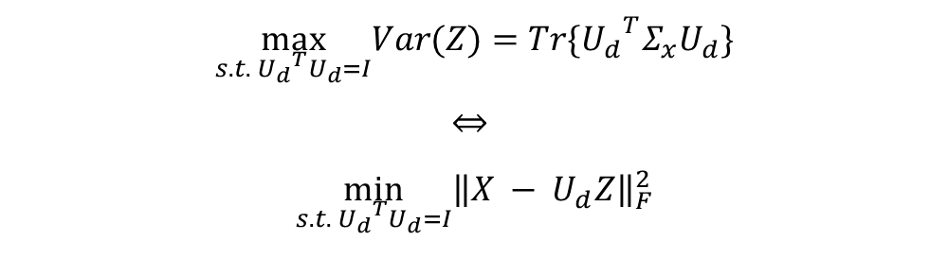
Constraint Optimization
We just solved the statistical PCA optimization problem
Geometric PCA solves PCA from a different viewpoint: minimize the reconstruction error
The same $U_{d}$ is optimal for both constraint optimization problems, thus they are equivalent:
$$\max_{s.t. {U_{d}}^{T}U_{d}=I}{{Var(Z)=Tr\{U}_{d}}^{T}Σ_{x}U_{d}\}$$
$$⇔$$
$$\min_{s.t. {U_{d}}^{T}U_{d}=I}{\left\|X − U_{d}Z\right\|}_{F}^{2}$$
Frobenius Norm

Slide 18

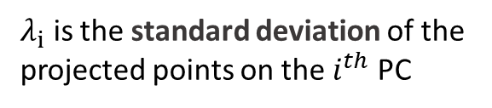

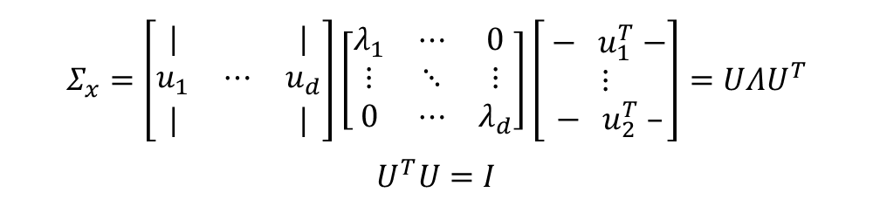


PCA Summary
Encode:$Z=U_{d}^{T}(X − μ_{x}) ε ℝ^{d}$
Eigendecomposition
Decode: $\tilde{X}=U_{d}Z+μ_{x} ε ℝ^{D}$
$$Σ_{x}=\left[\begin{matrix}| & & | \\ u_{1} & ⋯ & u_{d} \\ | & & |\end{matrix}\right]\left[\begin{matrix}λ_{1} & ⋯ & 0 \\ ⋮ & ⋱ & ⋮ \\ 0 & ⋯ & λ_{d}\end{matrix}\right]\left[\begin{matrix}{ − u}_{1}^{T} − \\ ⋮ \\ { − u}_{2}^{T} –\end{matrix}\right]=UΛU^{T}$$
$$U^{T}U=I$$
Reconstruction error: ${ ε}_{i} =x_{i} − \tilde{x_{i}}$
In PCA we are minimizing
the reconstruction error
$λ_{i}$ is the standard deviation of the
projected points on the $i^{th}$ PC
* $X$, $Z$ are random vectors

Slide 19



Singular Value Decomposition (SVD)
Any matrix can be decomposed using SVD, this is the reason SVD is a very important decomposition algorithm
When $D>N$ (dimension is larger than the number of samples), it is more efficient to compute the top d singular
vectors of $X$ than the top d eigenvectors of $Σ_{x}$
Example use case:
$${X∈ℝ}^{1,000,000 pixels ×500 images}$$
$$Σ_{x}∈ℝ^{500,000,000×500,000,000}$$
1000
IMAGE
We can’t store $Σ_{x}$ in memory nor decompose
it into eigenvectors and eigenvalues!
1000
But, we only have 500 images!
$$⇒$$
We can still perform PCA by bypassing the covariance matrix using dual PCA

Slide 20
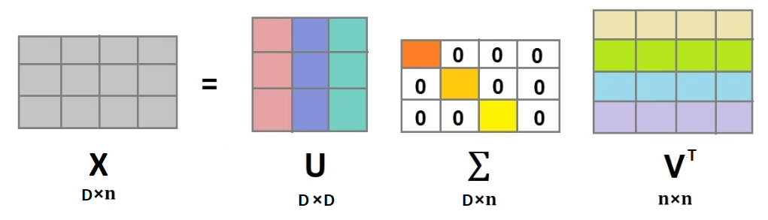
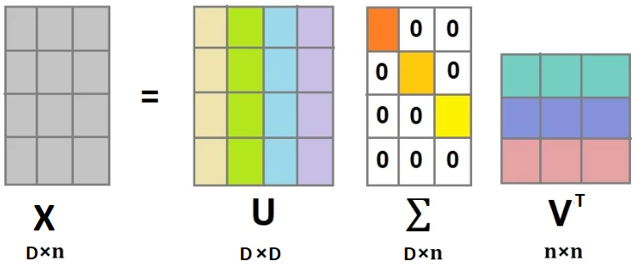

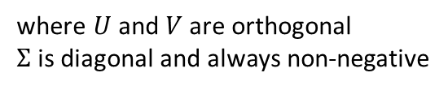









Singular Value Decomposition (SVD)
The SVD of a matrix, $X ∈ℝ^{D×n}$ is:
Note: $Σ$ is not the covariance!
$Σ$ contains the singular values of $X$
Columns of $U$ and $V$ are called the left
and right singular vectors
$$X=UΣV^{T}$$
The rank of the matrix $X$ is determined
by the number of non-zero singular values
where $U$ and $V$are orthogonal
$Σ$ is diagonal and always non-negative
$$D≤n$$
$$D≥n$$
$$U^{T}U=I$$
$$V^{T}V=I$$
$$U^{T}U=I$$
$$V^{T}V=I$$

Slide 21



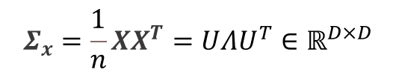



Singular Value Decomposition (SVD)
$X ∈ℝ^{D×n}$ ; $X=UΣV^{T}$ Has the following properties:
1
$U$ are the eigenvectors of ${XX}^{T}$
Proof of :
1
$V$ are the eigenvectors of $X^{T}X$
2
$$XX^{T}=(UΣV^{T})(VΣ^{T}U^{T})$$
$$=UΣΣ^{T}U^{T}$$
$$=UΣ^{2}U^{T}$$
3
${σ_{i}}^{2}=λ_{i} (of XX^{T})= λ_{i} (of { X}^{T}X$)
Proof of :
2
$$X^{T}X=(VΣ^{T}U^{T})(UΣV^{T})=VΣΣ^{T}V^{T}=VΣ^{2}V^{T}$$
$$Σ_{x}=\frac{1}{n}XX^{T}=UΛU^{T}∈ℝ^{D×D}$$
(where the eigenvalues are $λ_{i}= {σ_{i}}^{2}$)
The top $d≤D$ eigenvectors of $Σ_{x}$ are $U_{d}$(the top $d$ left singular vectors of $X$), where $Σ^{2}=Λ$

Slide 22







Dual PCA
Instead of computing the covariance $Σ_{x}$ to get $U_{d}$ , we can get $U_{d}$ using SVD!
As a reminder, to compute $U_{d}$ when $D$ >> $n$ , it’s more efficient to decompose $X^{T}X$ instead of $XX^{T}$
$X^{T}X=VΣ^{2}V^{T}$ ${ε ℝ}^{n×n}$
We now know $V$ and $Σ$
Problem: But how do we compute $Z=U_{d}^{T}X ε ℝ^{d×n}$ without deriving $U_{d}$ explicitly?
Solution : Use the SVD of $X$ !
$$Z=U_{d}^{T}X$$
$$=U_{d}^{T}UΣV^{T}$$
$$=Σ_{d}V_{d}^{T}$$
$$X=UΣV^{T}$$
$$U_{d}Σ_{d}=XV_{d}$$
$$U_{d}=XV_{d}Σ_{d}^{−1}$$
Crucially, $Σ_{d}$ is now
square and invertible

Slide 23







Dual PCA Summary
Encode:
$Z=Σ_{d}V_{d}^{T}$ $εℝ^{d×n}$
Note: reconstruction/decode still depends on D and will still be impractical if D is very large
Use Dual PCA when $D$ >> $n$
$X^{T}X=VΣ^{2}V^{T}$ $ε$ $ℝ^{n×n}$
Decode:
$\tilde{X}=U_{d}Z=XV_{d}Σ_{d}^{−1}$ $Z$ $ε ℝ^{D×n}$
$U_{d}=XV_{d}Σ_{d}^{−1}$ $ε$ $ℝ^{D×n}$
$${ ε}_{i} =x_{i} − \tilde{x_{i}}$$
Reconstruction error:
Advantage: There is no need to compute nor decompose the giant covariance matrix: $Σ_{x}=\frac{1}{n}XX^{T} ε ℝ^{D×D}$
We only decompose a much smaller matrix: $X^{T}X=VΣ^{2}V^{T}$ ${ε ℝ}^{n×n}$
* $X$, $Z$ are random vectors

Slide 24
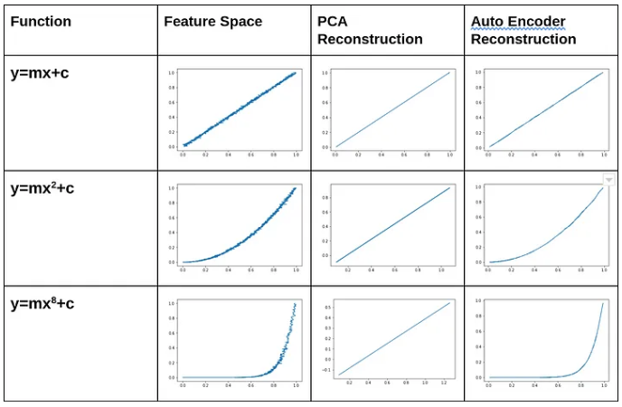
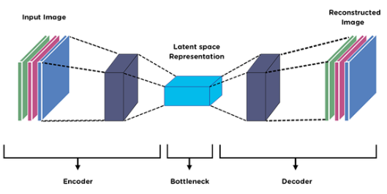
Benchmark: Autoencoders
Autoencoders
PCA
they are neural networks that can be used to reduce data into low dimensional latent space by stacking multiple non-linear layers, are trained using back propagation
features are entirely linearly uncorrelated since features are projections onto orthogonal basis
faster and computationally cheaper than autoencoders
capable of modeling complex non-linear functions
in case of a curved surface two dimensional PCA is not able to account for all the variance and thus loses information
autoencoded features might have correlations since they are just
trained for accurate reconstruction
prone to overfitting due to high number of parameters
if there is non-linearity or curvature in low dim structure than autoencoders can encode more information using less dimensions

Slide 25
References
Muaz, U. (2019, July 25). Autoencoders vs PCA: When to use ? Towardsdatascience. https://towardsdatascience.com/autoencoders-vs-pca-when-to-use-which-73de063f5d7
Ghodsi, A. (2006, September 25). Data Visualization [Lecture Notes]. https://www.math.uwaterloo.ca/~aghodsib/courses/f06stat890/notes/lec6.pdf
Reris, R., & Brooks, J. P. (2015). Principal Component Analysis and Optimization: A Tutorial. STATISTICAL SCIENCES AND OPERATIONS RESEARCH PUBLICATIONS. https://doi.org/http://dx.doi.org/10.1287/ics.2015.0016
Wasnik, A. (2020, November 30). Singular Value Decomposition (SVD) in Python. Askpython. https://www.askpython.com/python/examples/singular-value-decomposition
Sun, Y. (2015). Decomposition methods for semidefinite optimization [Doctoral dissertation, University of California]. https://escholarship.org/content/qt1cv6981p/qt1cv6981p_noSplash_9015c5957e695ec3e19d1f510eb59e46.pdf
Gowri, P., Senbaga Priya, K., Hari Prasath, R., & Pavithra, S. (2019). Image Compression Using Singular Value Decomposition. International Journal of Mathematics Trends and Technology (IJMTT), 65(8). http://www.ijmttjournal.org/Volume-65/Issue-8/IJMTT-V65I8P507.pdf
Lu, J. (2022). Matrix Decomposition and Applications
Rekha, M. (2019, September 9). Eigen Decomposition and PCA. Blog.Clairvoyantsoft. https://blog.clairvoyantsoft.com/eigen-decomposition-and-pca-c50f4ca15501
Hof, P. (2020). Eigendecomposition and PCA.
Yair, O. (2022). Dimensionality Reduction - Principal Component Analysis [Lecture].
[Mike X Cohen]. (2017, October 1). Eigendecomposition and PCA [Video]. YouTube. https://www.youtube.com/watch?v=-1iULsGndG8
[Steve Brunton]. (2020, February 7). Principal Component Analysis (PCA) 1 [Python] [Video]. YouTube. https://www.youtube.com/watch?v=Oi4SJqJIL2E
[Steve Brunton]. (2020, February 7). Principal Component Analysis (PCA) 2 [Python] [Video]. YouTube. https://www.youtube.com/watch?v=fu7uXxZMzC8
[MIT OpenCourseWare]. (2016, May 6). Singular Value Decomposition (the SVD) [Video]. YouTube. https://www.youtube.com/watch?v=mBcLRGuAFUk

