Slide 1
Channel Archiver Kay-Uwe Kasemir, LANL

Slide 2
ChannelArchiver
New Development, replacing AR
Goals:
  Fast (up to 10000 values/second)
  Networked
  Portable
  Extendable
Collaboration of LANL, JLab, DESY

Slide 3
Principle
Host
IOC
CA Server
EPICS Db
CA
CA
TCP/IP
CA
HTTP
HTTP
Archiver
Viewer
View Status
I/O Lib.
I/O Lib.

Slide 4
Configuration files (ASCII)
# Comments
<Channel Name> <Period [s]> <Flags>, e.g.
# Archive this every 5 secs:
SomeChannel 5
Flags:
  Monitor: Archive every change,
  Period becomes “expected time between changes”
  Disable: Channel stops archiving when value >0
!group “some_file_name”:
Read another cfg. file as group (disable is per group!)

Slide 5
Configuration files ...
!write_period <seconds>:
Time between writes to disk
!default_period <seconds>:
Default scan period when none given for channel
!get_threshold <seconds>:
CA ‘monitor’ is used for channels scanned below this rate
… more for opimizing performance:
  !file_size <hours>
  Time between creating new data files
  !buffer_reserve <# of buffers>
  Size of internal buffers

Slide 6
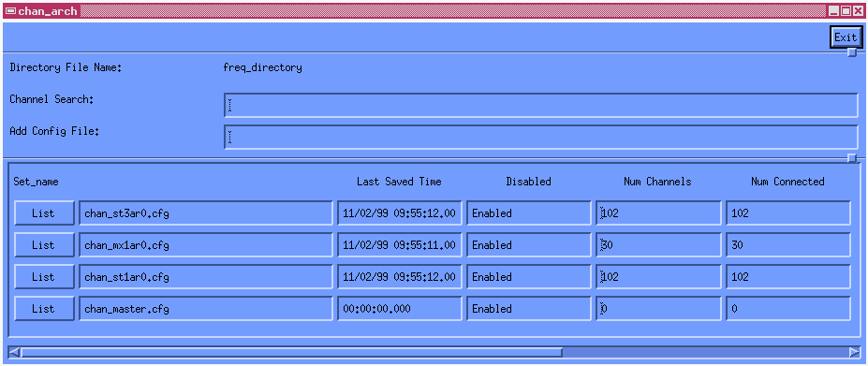
Current Archive Engine
UNIX only, build-in I/O code and X11 GUI
1 Year Operation for LEDA @ LANL

Slide 7
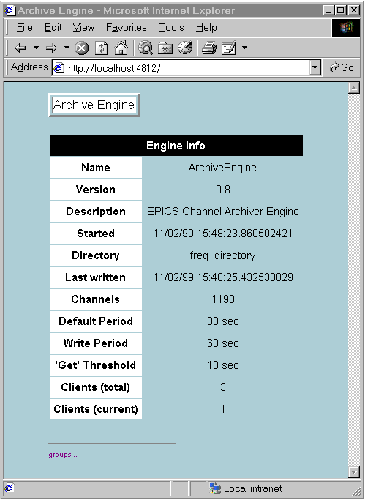
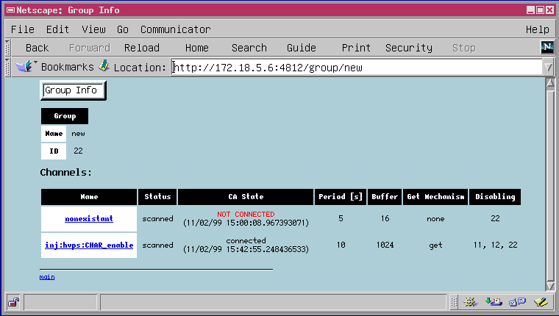
New Engine
Using I/O Library
Networked via HTTP
For WIN32, Linux, Solaris
Being Tested on LEDA @ LANL

Slide 8
I/O Library
Currently targeting proprietary storage format for fast access, but
Portable C++ code, handling e.g. necessary byte swapping
Based on generic “Iterator” type interface
Planned:
  Versions to access other storage formats like Oracle

Slide 9
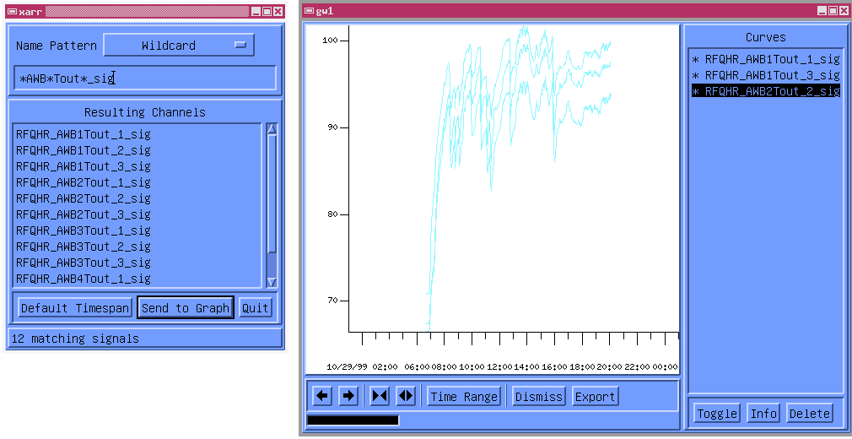
xarr (JLab)
UNIX (X11/Motif) view/export tool
Planned: Base on I/O Lib.

Slide 10
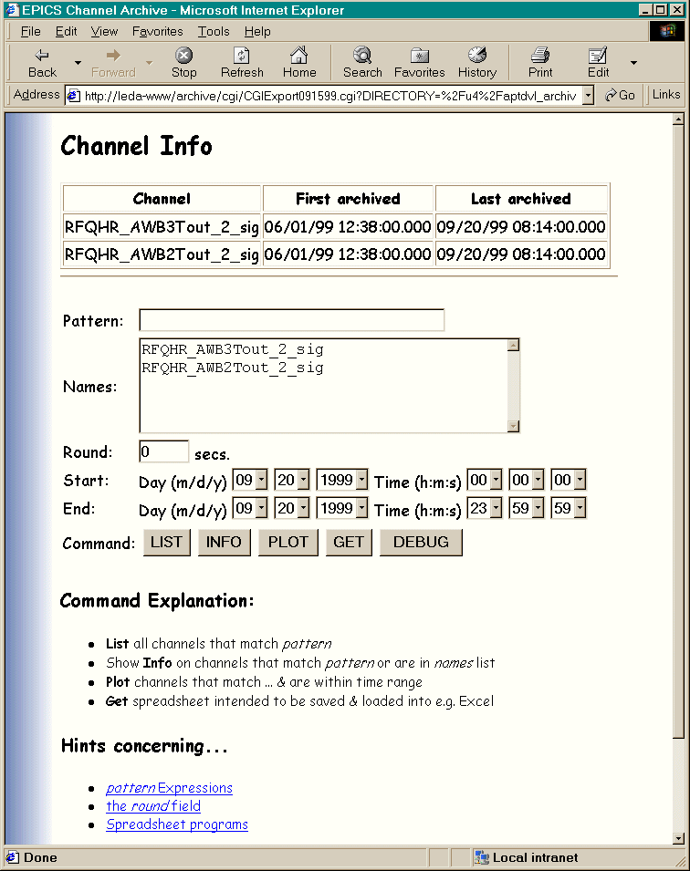
CGI View/Retrieval Tool
HTTP
CGI Tool
I/O Lib.
Available for WIN32, Linux, Solaris
Allows export in Spreadsheet format

Slide 11
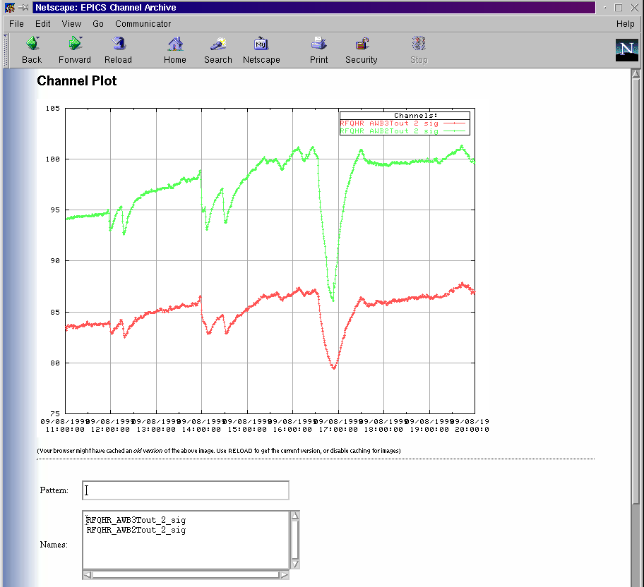
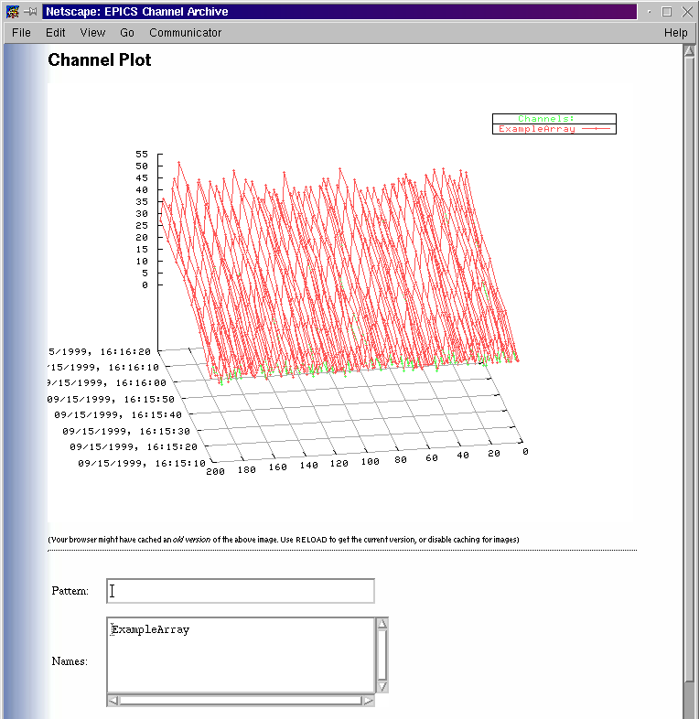
CGI Tool w/ GNUPlot

Slide 12
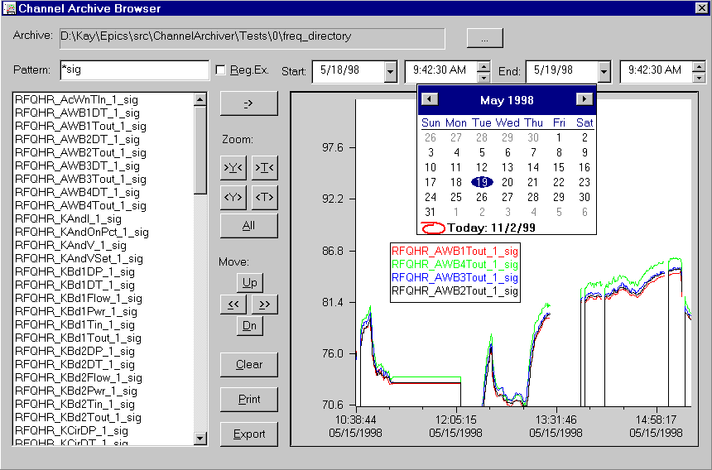
WIN32 Browser
Specifically designed for ChannelArchiver

Slide 13
More Information
http://mesa53.lanl.gov/lansce8/epics
  Good starting point for all EPICS documentation or at least links to it
specifically:
  .../PC/ArchiverLibrary
Bob: ldalesio@lanl.gov
Kay: kasemir@lanl.gov

