Slide 1
caputRecorder R1-4
Tim Mooney

Slide 2
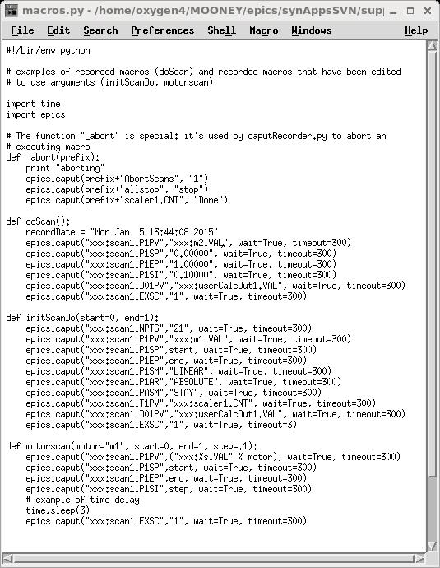
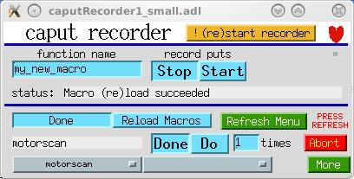
caputRecorder
Support for recording and playing back sequences of channel-access puts.
User interface for executing python functions (A.K.A. macros)

Slide 3
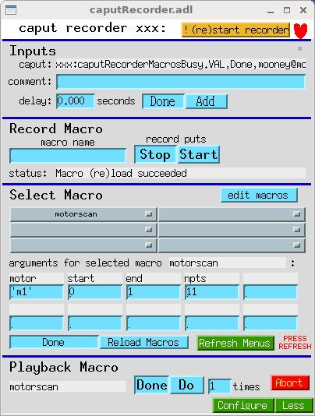
What caputRecorder does
IOC side intercepts caputs and publishes them to an EPICS PV
  “pvname,value,user@host”
Client side monitors one or more such PVs
Client side interacts with an EPICS database, which
  hosts user-interface PVs, and
  also serves as client API
Client side maintains macros file
  Adds a macro for each recording session (Start/Stop)
  Executes macro selected in the MEDM display

Slide 4
Inputs
While recording, you can add:
  Comments
  Time delays (time.sleep())

Slide 5
Record Macro
Macro name must meet python guidelines:
  caputRecorder will do this for you (replace illegal characters with underscores, etc.)
  Name is truncated to 25 chars
When done recording, python reloads macros file, and rewrites menu PVs
  BUT, MEDM doesn’t display the new menus until you press the “Refresh Menus” button

Slide 6
Select Macro
Select a macro using menu PVs
OR, a client can write the macro name to xxx:caputRecorderMacro
caputRecorder will fill out fields for arguments, if any
  As recorded, macros have no arguments, but…
  you can edit the macros file
    Press “Reload Macros” afterward
    If you deleted anything, press “!(re)start recorder”
    Press “Refresh Menus”

Slide 7
Playback Macro
Press “Do”
OR, client can write to xxx:caputRecorderExecuteMacro with a put_callback
Abort halts execution, and runs the “_abort()” function in the macros file
  You should edit the _abort() function so it stop motors, scans, etc., for your beamline
Note: you can add other hidden functions to the macros file:
  def _private()

Slide 8
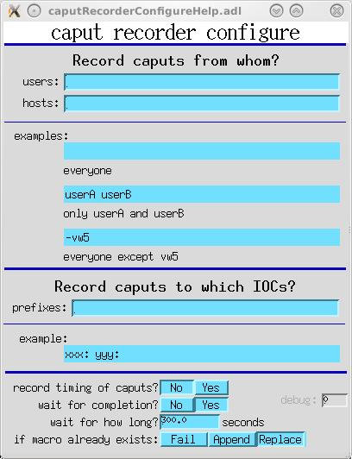
Configure
Select users and hosts
  Suggestion:
    users=“-vw5”
    hosts=“”
Select IOCs to monitor
  Specify the prefixes of the IOCs you want to monitor
  Can’t change this while recording
Can record timing of puts.
Can wait for completion on replay
  Can specify for how long to wait.
If macro exists, can specify Fail/Append/Replace
  If Replace, writes backup file

Slide 9
Configure
ioc2bmb:
ioc2bma:
IOC
USER
caputPoster.db
caputPoster.db
HOST
name,value,…
name,value,…
caputRecorder.db
areaDetector:
caputRecorder.py
caputPoster.db
name,value,…
ioc2ida:
caputPoster.db
name,value,…

Slide 10
Future work
What about cagets?
Multiple caputs, then wait for all to complete?

