Slide 1
Model 3
EPICS Motor Driver Support
Mark Rivers
University of Chicago

Slide 2
Motivation
Traditional step scanning overheads:
  Start and stop motors & mechanical systems
  Arm and read detectors.
Typically much more efficient to collect data on-the-fly as the motors are moving.
  Better detectors, more flux with APS Upgrade, don’t waste photons and time
However, on-the-fly scanning with EPICS has been subject to limitations.
  Typically limited to simple single-motor scans because EPICS did not provide a way to program motor controllers to perform synchronized motion of multi-axis controllers.
    Exception to this was the Trajectory Scanning software I wrote for the Newport XPS and MM4005 motor controllers.
    Not a clean solution: SNL program talking directly to the controller, “behind the back” of the motor record driver.
    PMAC does have motion control programs – good for fixed, simple geometry
  New solution that incorporates a coordinated motion API in the motor driver layer
SIS3801 and SIS3820 multi-channel scalers are typically used for collecting pulse counting data in on-the-fly scans.
  Drivers were previously not able to handle very large arrays (1,000,000 elements or more) without unacceptable slowing down the IOC response.
  Drivers have been rewritten to eliminate this problem, and to add a number of significant new features.
EPICS Collaboration Meeting, April 26, 2012

Slide 3
EPICS Motor Support
Top-level object is the EPICS motor record
  Lots of code has been written to this object:
    spec, IDL and Python classes, etc.
Next layer is EPICS device support
  Knows about the motor record, talks to the driver
Lowest layer is EPICS driver
  Knows nothing about motor record, talks to the hardware
3 models of device and driver support have developed over time
EPICS Collaboration Meeting, April 26, 2012

Slide 4
Model 1
Device-dependent device support and driver support for each controller type
Communication between device support and driver is custom for motor code and very limited
Cannot use other records to talk to driver, only motor record
Cannot take advantage of controller-specific features not supported by motor record
No provision for multi-axis coordination
Most drivers in the motor package are written this way for historical reasons
EPICS Collaboration Meeting, April 26, 2012

Slide 5
Model 2
Developed 2006 by APS and DLS
Uses standard asyn interfaces to communicate between device support and driver
A single device-independent device support file
A single device-independent driver support file for asyn interfaces
Device dependent driver file below the asyn one
Can use other records to talk to driver via asyn interfaces
Not as easy as it should be to do so
No implementation of multi-axis coordination
A few drivers in the motor package are written with Model 2
  Simulation driver, Newport XPS, Newport MM4000, ProDex MAXnet, Attocube ANC150, Aerotech Ensemble
EPICS Collaboration Meeting, April 26, 2012

Slide 6
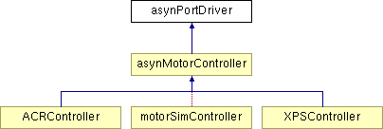

Model 3
New C++ model.
Two base classes, asynMotorController and asynMotorAxis.
Base classes provide much functionality, only need to write device-specific implementations.
Easy to support controller-specific features
Don’t have to use motor record (?)
Direct support for coordinated profile moves in the driver API.
EPICS Collaboration Meeting, April 26, 2012

Slide 7
asynMotorController
(Base class implementation can be used for most functions)
class epicsShareFunc asynMotorController : public asynPortDriver {
public:
/* This is the constructor for the class. */
asynMotorController(const char *portName, int numAxes, int numParams,
int interfaceMask, int interruptMask,
int asynFlags, int autoConnect, int priority,
int stackSize);
/* These are the methods that are new to this class */
virtual asynMotorAxis* getAxis(asynUser *pasynUser);
virtual asynMotorAxis* getAxis(int axisNo);
virtual asynStatus startPoller(double movingPollPeriod,
double idlePollPeriod,
int forcedFastPolls);
virtual asynStatus wakeupPoller();
virtual asynStatus poll();
/* These are the functions for profile moves */
virtual asynStatus initializeProfile(size_t maxPoints);
virtual asynStatus buildProfile();
virtual asynStatus executeProfile();
virtual asynStatus abortProfile();
virtual asynStatus readbackProfile();
EPICS Collaboration Meeting, April 26, 2012

Slide 8
asynMotorAxis
** Class from which motor axis objects are derived. */
class epicsShareFunc asynMotorAxis {
public:
/* This is the constructor for the class. */
asynMotorAxis(class asynMotorController *pController,
int axisNumber);
virtual asynStatus move(double position, int relative,
double minVelocity, double maxVelocity,
double acceleration);
virtual asynStatus moveVelocity(double minVelocity,
double maxVelocity,
double acceleration);
virtual asynStatus home(double minVelocity,
double maxVelocity, double acceleration,
int forwards);
virtual asynStatus stop(double acceleration);
virtual asynStatus poll(bool *moving);
EPICS Collaboration Meeting, April 26, 2012

Slide 9
asynMotorAxis
** Class from which motor axis objects are derived. */
virtual asynStatus setPosition(double position);
virtual asynStatus setHighLimit(double highLimit);
virtual asynStatus setLowLimit(double lowLimit);
virtual asynStatus setPGain(double pGain);
virtual asynStatus setIGain(double iGain);
virtual asynStatus setDGain(double dGain);
virtual asynStatus setClosedLoop(bool closedLoop);
virtual asynStatus setEncoderRatio(double ratio);
virtual asynStatus initializeProfile(size_t maxPoints);
virtual asynStatus defineProfile(double *positions,
size_t numPoints);
virtual asynStatus buildProfile();
virtual asynStatus executeProfile();
virtual asynStatus abortProfile();
virtual asynStatus readbackProfile();
Only a small number of functions that need to be implemented for a new motor.
Easy to support additional parameters with asynPortDriver methods writeInt32, writeFloat64, writeOctet, etc.
EPICS Collaboration Meeting, April 26, 2012

Slide 10
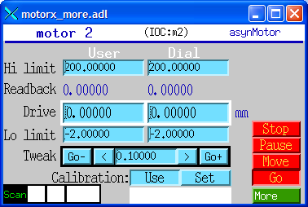
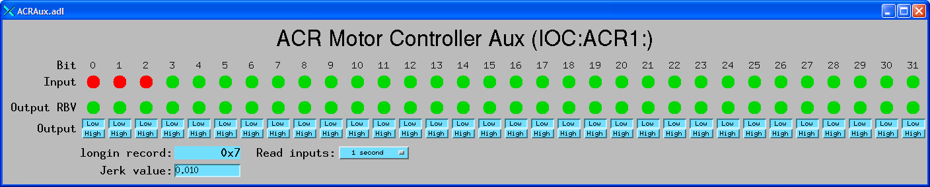
Parker ACR Model 3 Driver
650 lines of code total (ACRMotorDriver.h, ACRMotorDriver.cpp)
Supports Jerk parameter, and bi, bo, longin records via standard asynUInt32Digital interface for TTL I/O lines
Less than 100 lines of code for digital I/O support
EPICS Collaboration Meeting, April 26, 2012

Slide 11
Coordinated Motion: Motivation
Traditional step scanning overheads:
  Start and stop motors & mechanical systems
  Arm and read detectors.
Typically much more efficient to collect data on-the-fly as the motors are moving.
  Better detectors, more flux with APS Upgrade, don’t waste photons and time
However, on-the-fly scanning with EPICS has been subject to limitations.
  Typically limited to simple single-motor scans because EPICS did not provide a way to program motor controllers to perform synchronized motion of multi-axis controllers.
    Exception to this was the Trajectory Scanning software I wrote for the Newport XPS and MM4005 motor controllers.
    Not a clean solution: SNL program talking directly to the controller, “behind the back” of the motor record driver.
    PMAC does have motion control programs – good for fixed, simple geometry
  New solution that incorporates a coordinated motion API in the motor driver layer
EPICS Collaboration Meeting, April 26, 2012

Slide 12
Coordinated Motion
(Formerly called Trajectory Scanning)
Create arrays of target locations of each motor in a multi-axis controller
Create array of time per element
Define times/locations to output synchronization pulses to trigger detectors
Execute coordinated move
Optionally read back encoder positions when each synchronization pulse was output
Many controllers have this capability
  Newport MM4000, Newport XPS, Delta Tau PMAC, Prodex MAXv, Parker ACR series, etc.
We now have an API to take use this capability in a consistent way
Now done in same driver as for motor record, eliminates conflicts
EPICS Collaboration Meeting, April 26, 2012

Slide 13
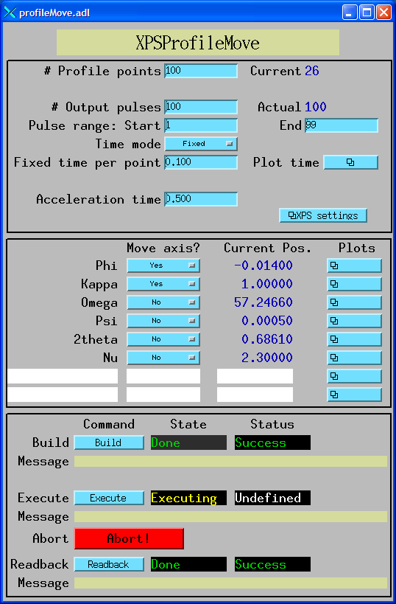
Coordinated Motion
; IDL program to build, execute and readback profile
; This program builds a profile and executes it.
nelements = 100 ; 100 elements in the profile.
npulses = 100 ; 100 pulses in the profile.
naxes=2 ; We will move the first 2 motors (Phi and Kappa)
; Define array of positions
positions = dblarr(nelements, naxes)
; The Phi profile is a sin wave with two complete periods and an
; amplitude of +-1 degrees
positions[*,0] = 1.*sin(findgen(nelements)/(nelements-1.)*4.*!pi)
; The Kappa profile is a sin wave with one complete period and an
; amplitude of +-1 degrees
positions[*,1] = 1.*sin(findgen(nelements)/(nelements-1.)*2.*!pi)
profile = 'IOC:Prof1:'
group = 'GROUP1'
time = 0.1 ; Fixed time per profile point
status = profile_move(profile, positions, group=group, maxAxes=6, $
build=1, execute=1, readback=1, time=time, $
npulses=npulses, actual=actual, errors=errors)
end
EPICS Collaboration Meeting, April 26, 2012

Slide 14
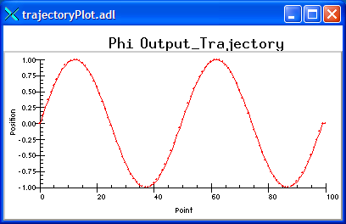
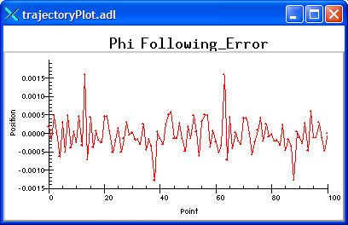
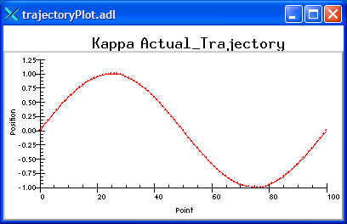
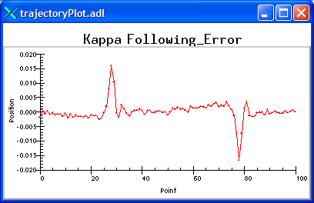
Phi output profile
Phi following error
Kappa readback profile
Kappa following error
EPICS Collaboration Meeting, April 26, 2012

Slide 15
SPEC Interface
SPEC macros have been written to allow SPEC to utilize profile moves via EPICS interface
Low level interface, all of SPEC's standard scans can be done "on-the-fly" with profile move software. Replacement macros for:
  _ascan # Used by all ascan and dscan macros
  Mesh
  hklscan # Used by hscan, kscan and lscan
  _hklmesh
  _hklline # Used by hkcircle, hlcircle, klcircle, hkradial, hlradial and klradial
  _scanabort resume
  _loop
EPICS Collaboration Meeting, April 26, 2012

Slide 16
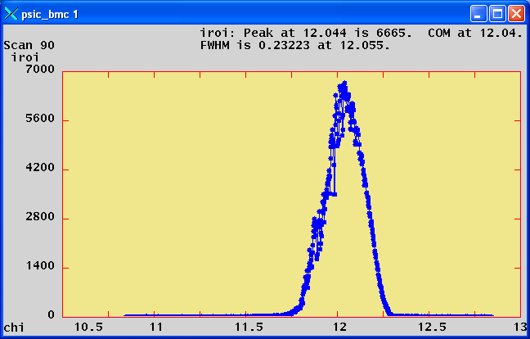
Performance Example with Pilatus driver
SPEC used to collect 1000 points using trajectory scanning mode with the Newport XPS motor controller. Hardware trigger of Pilatus from XPS.
Relative scan of the chi axis from -2 degrees to +2 degrees with 1000 points at .02 seconds/point
Coordinated motion of the phi, kappa and omega axes.
Theoretical time 20.0 second, actual time 20.8 seconds
Includes time to save all 1000 images to disk (366 MB), Pilatus driver to read each file, correct bad pixels and flat field, compute ROIs, and post the ROIs and 1000 images to EPICS.
Notes:
Test

Slide 17
Future Work
Convert Pro-Dex MAXv to Model 3
  Tim Mooney already has MAXv trajectory scanning running in SNL program
Support other controllers
  Delta Tau, etc. We are getting 2 Delta Tau GeoBrick LV IIS for new monochromators
Add additional features
We plan to implement coordinated synchronized motion of APS (and NSLS-II) undulator with multiple motors in the beamline monochromator
Work on replacement for motor record?
  In model 3 we can use standard EPICS records to control velocity, move the motor, etc.
  However, The motor record currently maintains the state information: soft limits, need to do backlash, etc.
  This could be moved into asynMotorAxis base class?
EPICS Collaboration Meeting, April 26, 2012

