Slide 1
softGlue
Run-time programmable digital electronics
Tim Mooney
3/3/2015

Slide 2
Overview
SoftGlue enables beamline users and staff to construct simple digital electronic circuits, and connect those circuits to field wiring, by writing to EPICS process variables (PVs).
SoftGlue also provides safe (throttled) user control over how hardware interrupts are generated by field I/O signals, and dispatched to cause EPICS processing.
SoftGlue circuits can be autosaved and restored, saved as text files, emailed to another user, and managed by configMenu.
SoftGlue does this by loading an IndustryPack FPGA-based digital I/O module with a predefined collection of circuit elements (logic gates, counters, flip-flops, etc.), whose inputs and outputs are connected to switches controlled by EPICS PVs.

Slide 3
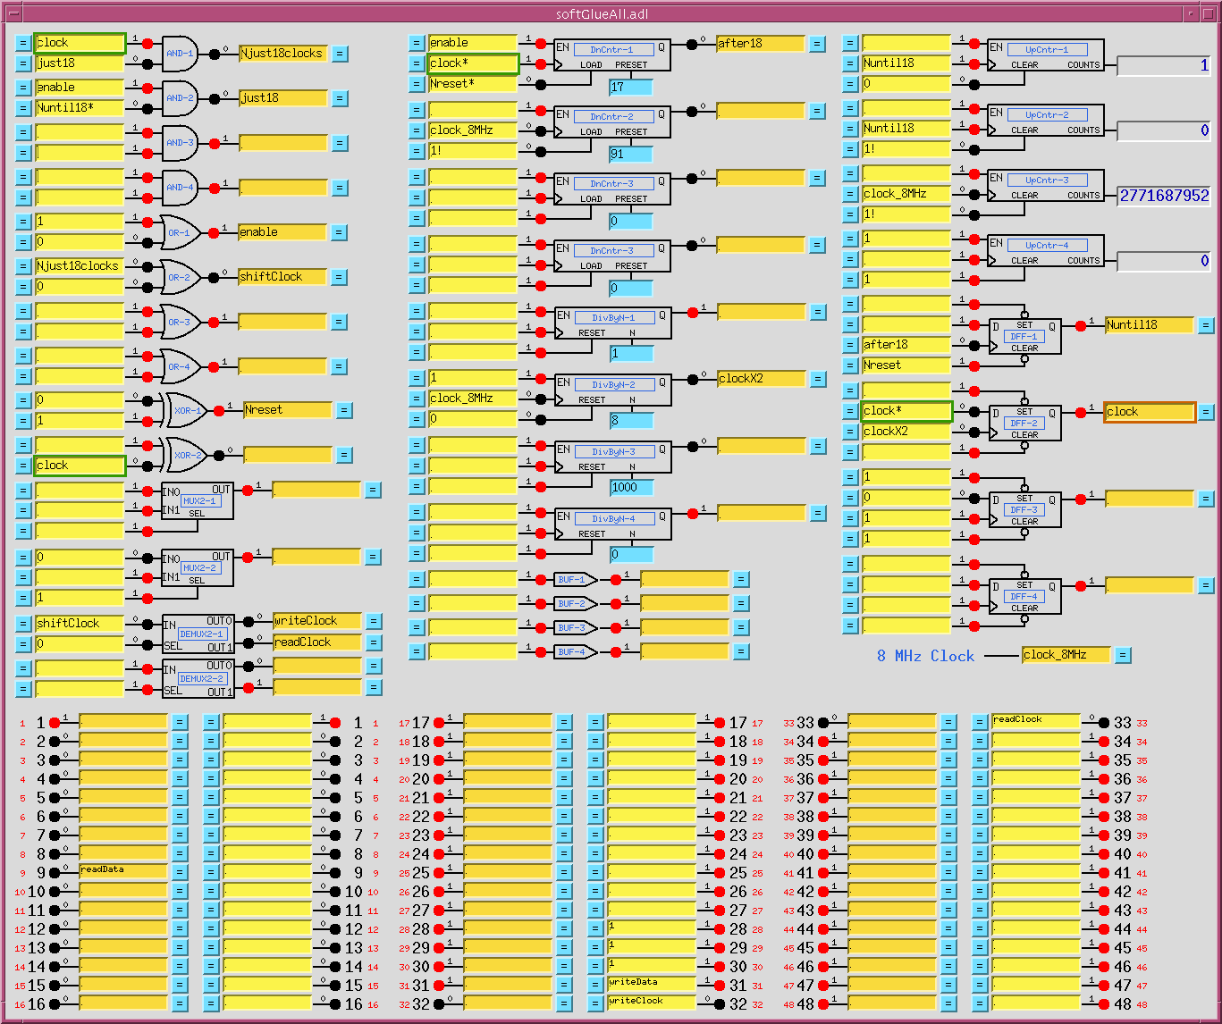
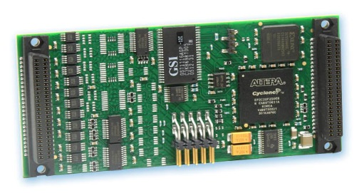
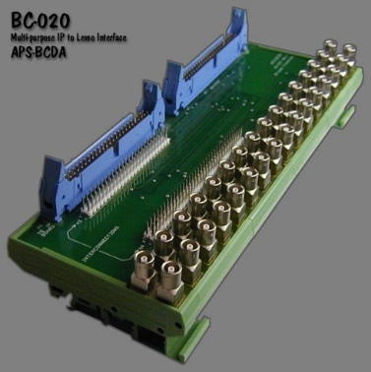
MEDM display

Slide 4
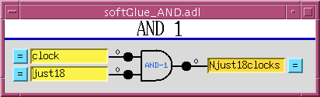
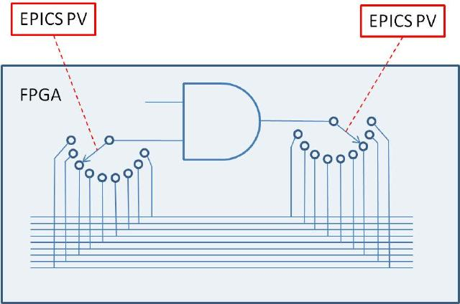
How it works, conceptually

Slide 5
Circuit-element inputs
option | example | result | comment
empty |  | 1
number | 1 0 1! 0! 0.499 | 1 0 Positive-going pulse Negative-going pulse 0 | ~6 μs ~6 μs
name | mySignal | Connected to all other inputs and output named “mySignal”

Slide 6
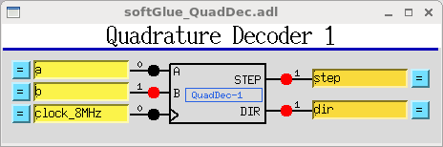
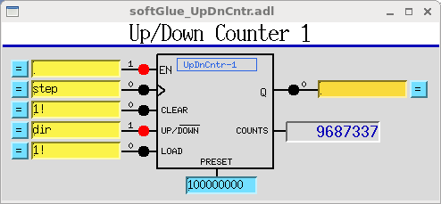
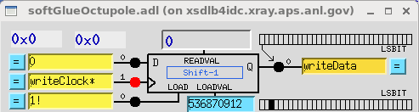
Additional circuit elements
Quadrature decoder
  read encoder
Up/Dn Counter
  count output signals from quadrature decoder
Shift register
  bit stream I/O
Other circuit elements are possible. See Kurt Goetze.

Slide 7
Example applications
With no user programming, softGlue is a digital I/O module.
Trigger a detector after every N steps of a motor.
Trigger a detector after every N[i] steps of an encoder.
Gate a detector off during a motor’s accel/decel time.
Trigger a detector 23.7 ms after a shutter.
Conditionally execute an EPICS record on the rising edge of an external signal.
Implement an extraordinarily smart oscilloscope trigger.
Cause an EPICS database to wait for 0.7 ms.
Count encoder pulses.
Convert encoder pulses to up/down pulses, for use with a multichannel scaler.
Send/receive a bit stream from external hardware.
Latch the value of an external signal.

Slide 8
Documented example circuits
https://subversion.xray.aps.anl.gov/admin_bcdaext/softGlue_examples
  Programmable pulse train
  Gated scaler
  Pulse burst
  Delay generator
  Motor accel/decel pulse gate
  Debouncer
  TTL Pulse Stretcher and Delay

Slide 9
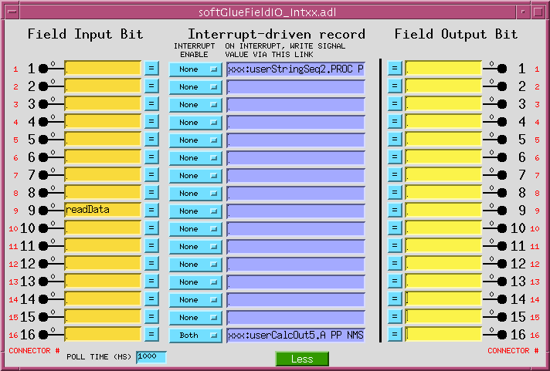
Field I/O
Connected just as are circuit elements
Interrupt can drive EPICS record on falling edge, rising edge, etc.

Slide 10
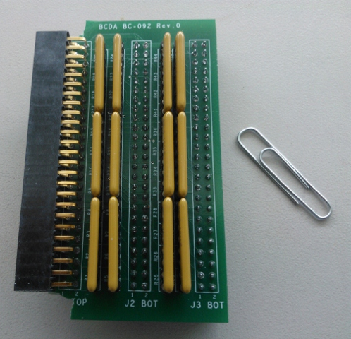
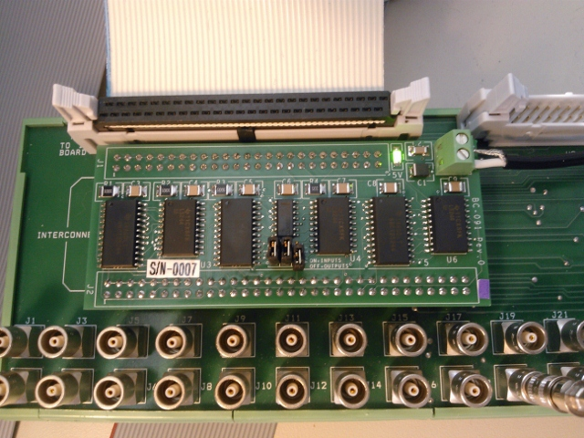
Field I/O cable termination
A: 100-Ohm series termination to ribbon cables
B: 50-Ohm line driver for RG58/RG174 coaxial cables
A
B

