Slide 1
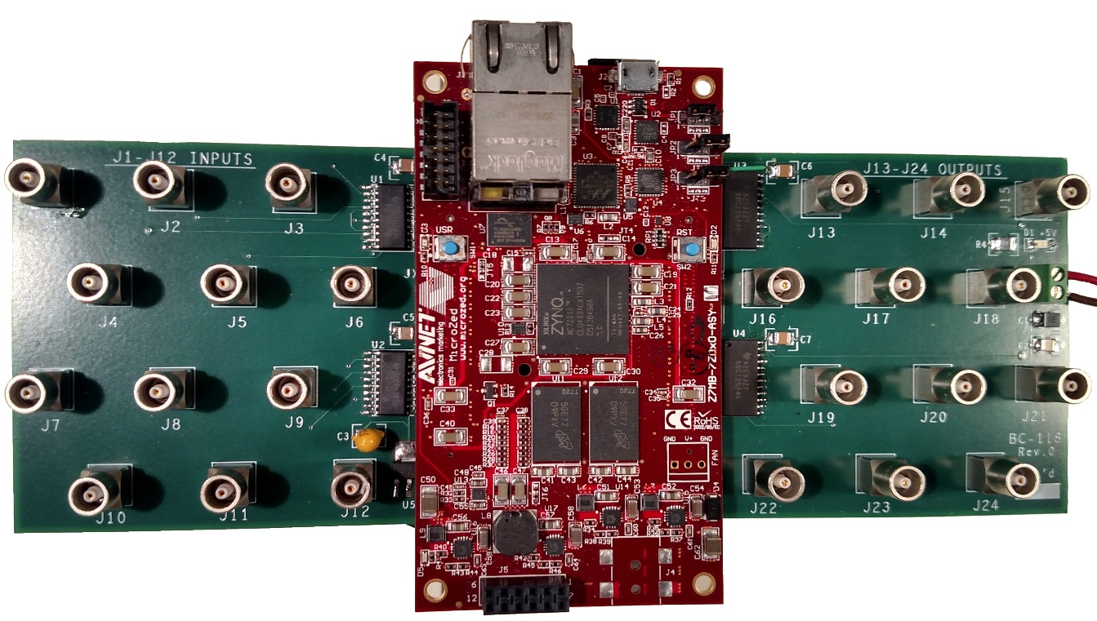
EPICS and Custom Beamline Electronics on the MicroZed
(softGlueZynq)
Tim Mooney
TWG - March16, 2017

Slide 2
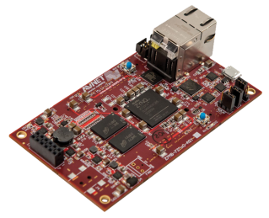
Overview
ZYNQ
ARM processor
FPGA
EPICS IOC
softGlueZynq
~Everything in synApps that doesn’t need VME hardware
Rewrite of softGlue for the Xilinx Zynq chip
Deployed and maintained in much the same way as a VME or Linux IOC

Slide 3
Overview
softGlueZynq enables beamline users to construct simple digital electronic circuits, and connect those circuits to field wiring, by writing to EPICS process variables (PVs).
softGlueZynq also provides user control over how hardware interrupts are generated by field I/O signals, and dispatched to cause EPICS processing.
softGlueZynq circuits can be autosaved and restored, saved as text files, emailed to another user, and managed by configMenu.
softGlueZynq does this by loading an Xilinx Zynq FPGA with a predefined collection of circuit elements (logic gates, counters, flip-flops, etc.), whose inputs and outputs are connected to switches controlled by EPICS PVs.

Slide 4
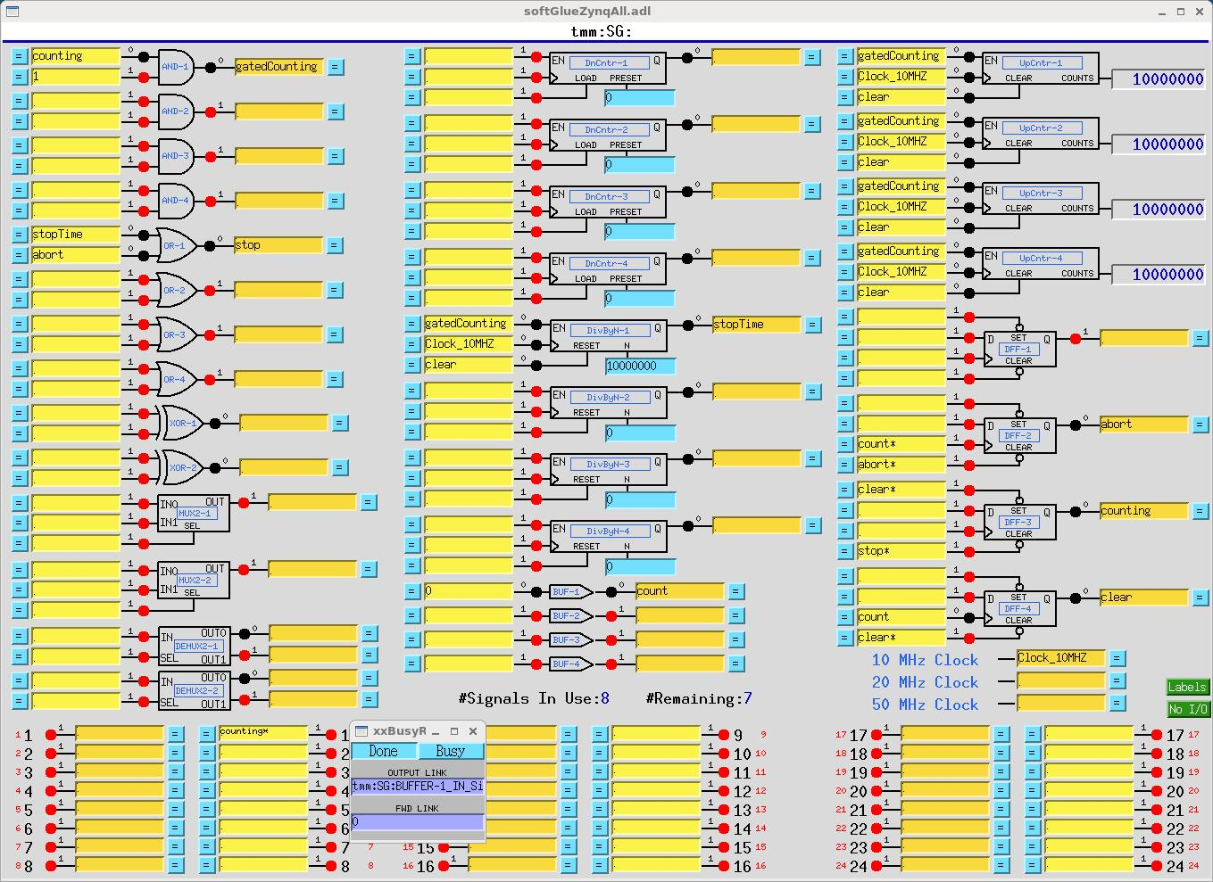
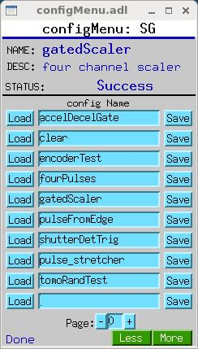
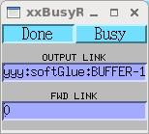
MEDM display

Slide 5
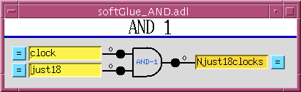
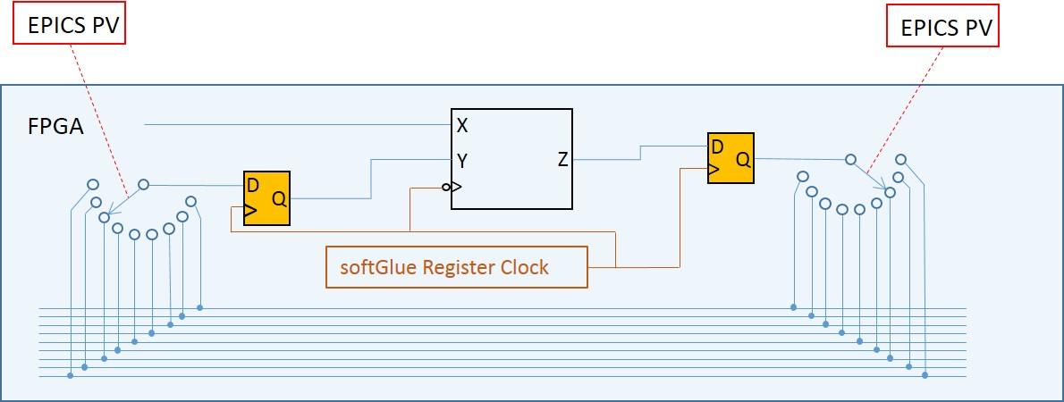
How it works, conceptually

Slide 6
Circuit-element inputs
option | example | result | comment
empty |  | 1
number | 1 0 1! 0! 0.499 | 1 0 Positive-going pulse Negative-going pulse 0 | ~3 μs ~3 μs
name | mySignal | Connected to all other inputs and output named “mySignal”

Slide 7
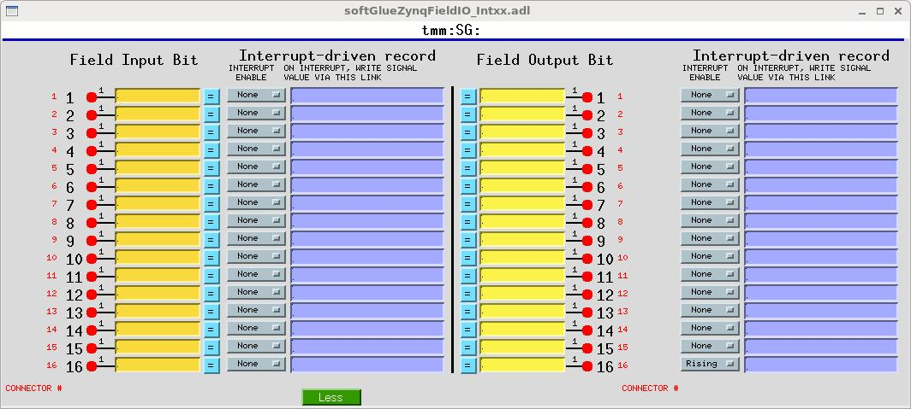
Field I/O
Connected just as are circuit elements
Interrupt can drive EPICS record on rising edge.

Slide 8
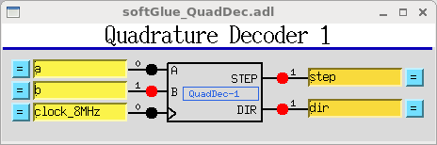
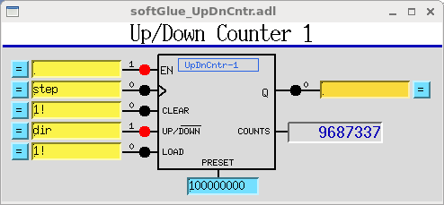
Additional circuit elements
Quadrature decoder
  Read encoder or interferometer
Up/Dn Counter
  Count output signals from quadrature decoder
The combination of these two can track an encoder.
Additional Up/Dn counter can generate triggers every N^{th} encoder pulse.

Slide 9
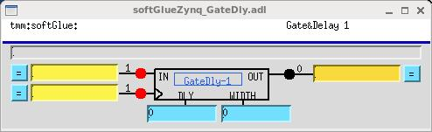
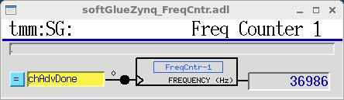
Additional circuit elements
Gate&Delay Generator
  Delay a signal.
  Optionally, specify output pulse width.
  20 ns time resolution (fast version has ~1 ns time resolution, but is buggy.)
Frequency Counter

Slide 10
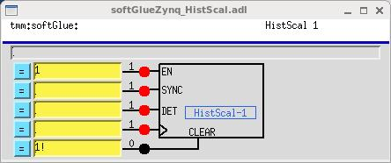
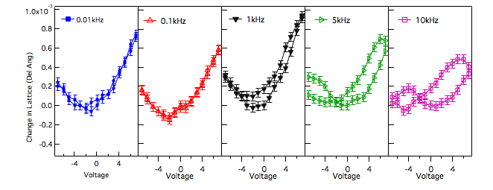
Additional circuit elements
Histogramming Scaler
  Like a MCS, but SYNC sets current channel to 0
  64 time bins, channel advance at up to 50 MHz (fast version up to 250 MHz)
piezoDiffraction data (Phil Ryan - 6idb)

Slide 11
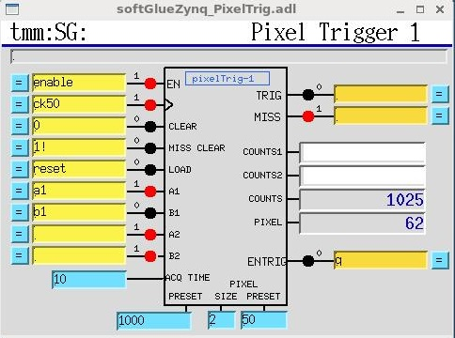
Additional circuit elements
pixelTrigger
  Track location of focal spot on sample (X_{ZP} –X_{SAMPLE})
  Generate triggers from focal spot motion.
  User specifies pixel size in interferometer ticks.
MIRROR
INTERFEROMETER
_
Up/Dn Counters

Slide 12
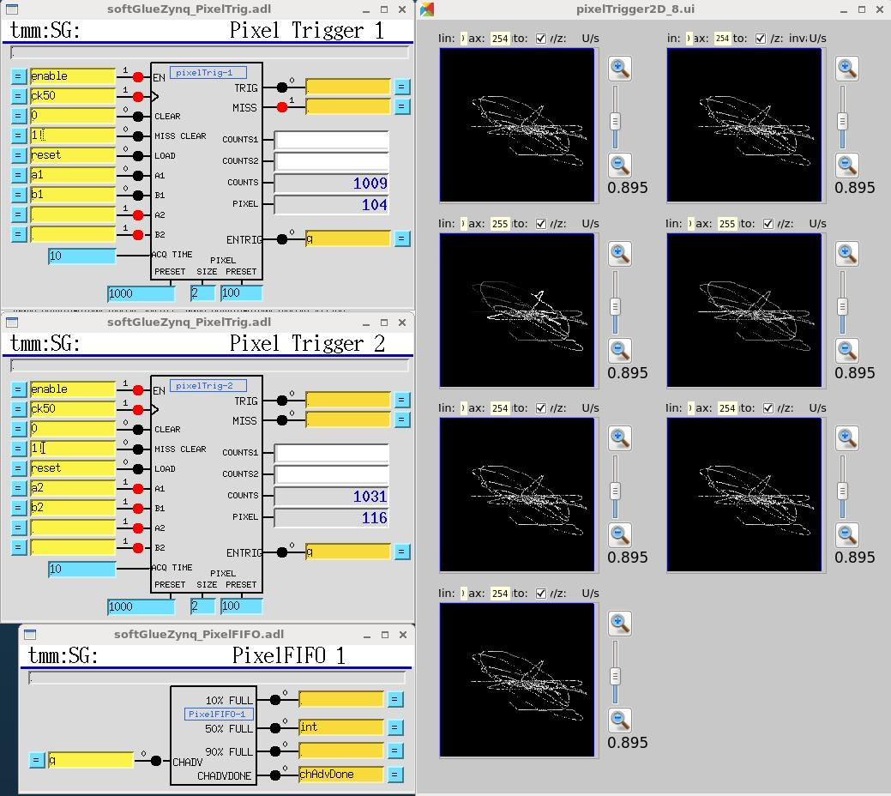
Application
X-ray microscope data-acquisition system (2D fly scan)
  Trigger when focal spot leaves a pixel
  Event data:
    (x,y)
    7 counters
  Events at <400 kHz
FIFO
FOCAL SPOT ON SAMPLE

Slide 13
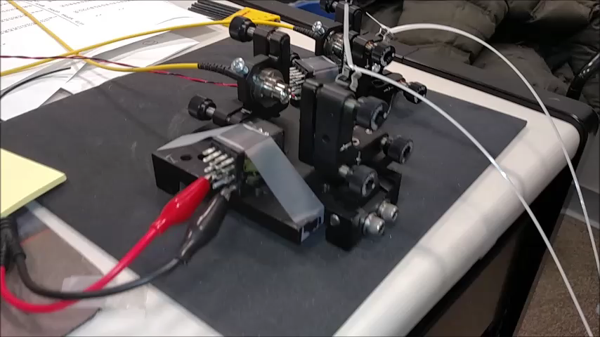
Application
pixelTrigger Demo: response to impulse

Slide 14
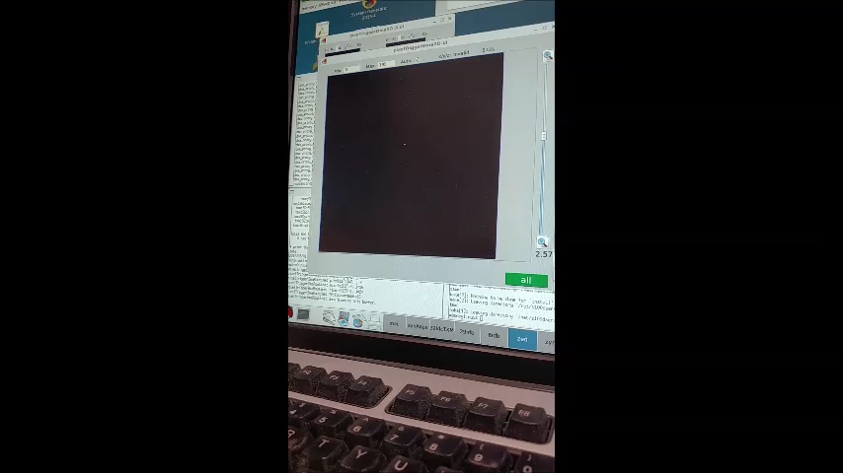
Application
pixelTrigger Demo: periodically driven x/y motion

Slide 15
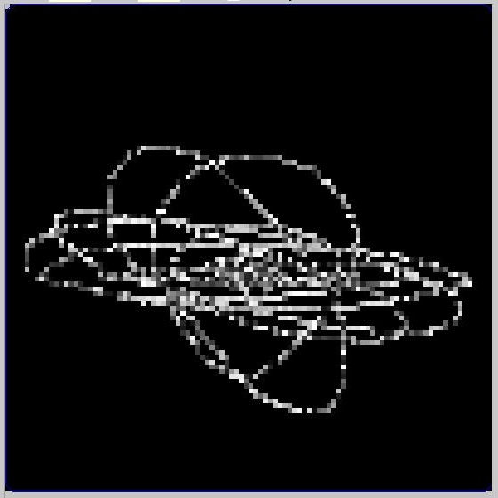
Application
Time resolved data acquisition (3D fly scan)
  Trigger on pixel OR time boundary
  Event data:
    (x,y)
    ΔT since sync
    6 counters
  dT > 2 μs

Slide 16
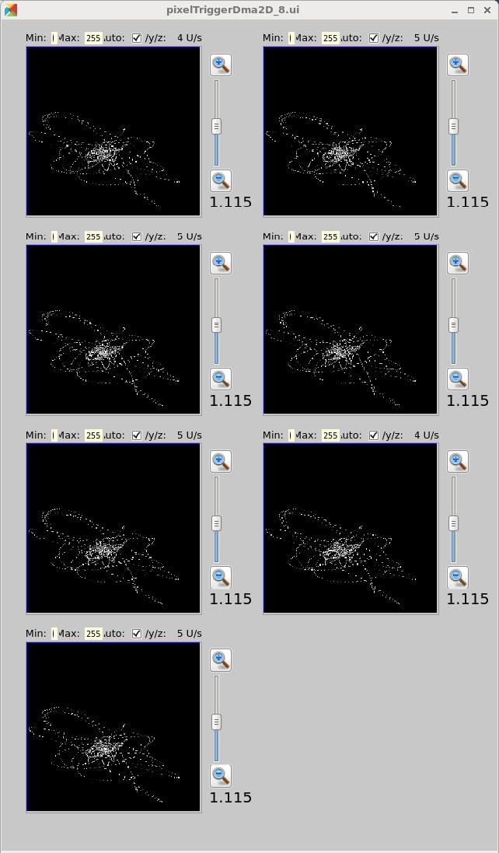
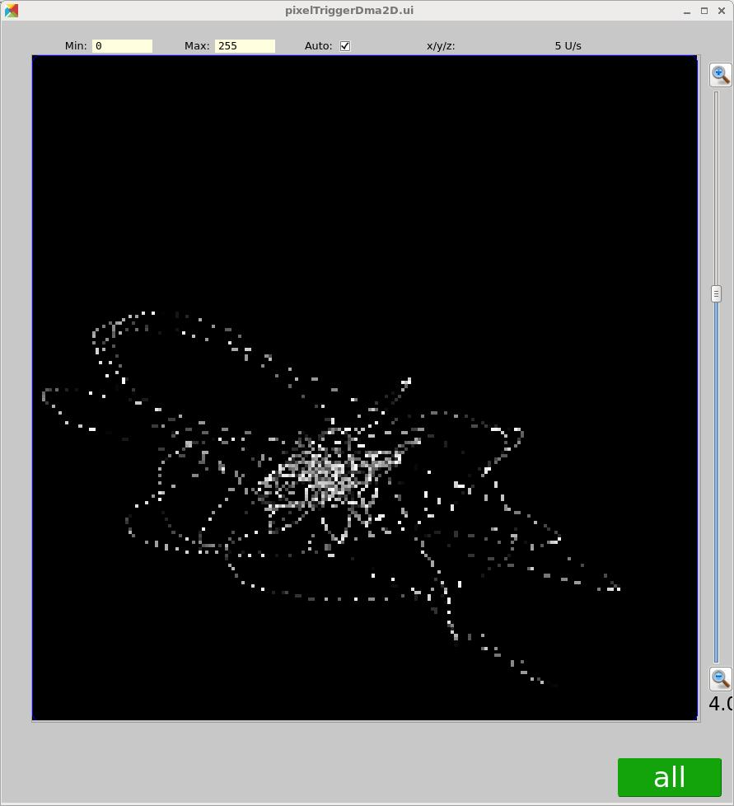
Application
Time resolved data-acquisition (3D fly)
  ΔT = 5 μs

