Slide 1

V3/V4 Interoperability
EPICS Meeting
April 2012
SLAC USA
Marty Kraimer and Matej Sekoranja

Slide 2
Overview of Talk
Main topic is Channel Access between V3 and V4.
Also brief description of current status and examples via easyPVA.
Terminology
  pvData is a way to define structured data.
  caV3 is the channel access that comes with EPICS base.
  pvAccess is channel access for PVData.
V4 client
  Default provider is pvAccess
  Provider for caV3 in progress.
PVIOC
  Java has support for PVData, pvAccess, CAV3 client/server
  C++ is just a beginning.
CAV3 IOC
  PVIOC in same process as V3 IOC.
  v3Channel is pvAccess server for V3 IOC records
SLAC April 2012
V3/V4 Interoperatibility

Slide 3
V4 Channel and Channel Provider
Channel
  Connects to data identified by channel name.
  Create methods:
    Get – get a fixed set of data from channel.
    Put – put a fixed set of data to channel
    PutGet – put a fixed set of data and then get fixed set
    Process – process the channel
    RPC – put new set of data and the get new set of data
    Array – get/put subarray
    Introspection – get introspection data for field of channel
    Monitor - monitor a fixed set of data from channel
Provider
  Something that implements Channel.
SLAC April 2012
V3/V4 Interoperatibility

Slide 4
More Terminology
pvData
  Memory resident structured data
  Introspection and data interfaces
pvAccess
  Network support for pvData
pvIOC – much like a V3 IOC
  Record + database of records
    A record has a top level structure
  Record scanning – periodic and event
  support – no distinction between record and device support
    any field can optionally have associated support
    standard: alarm, timeStamp, scan etc.
    extensible – can be used wherever appropriate
pvService
  Service layer for High Level Applications
  Current emphasis
SLAC April 2012
V3/V4 Interoperatibility

Slide 5
pvAccess Client Support
pvAccess supports multiple providers.
  A provider must present data as PVData.
  A provider must implement the Channel interface of pvAccess.
  OK if some methods return “not implemented”.
pvAccess is default provider: Fully supports all of pvData and pvAccess.
caV3 is provider that uses CAV3 for communication.
  Currently only implemented in pvIOCJava.
  Will be moved to pvAccess.
  Will be automatically a registered provider.
Note that providers for other systems could be implemented.
  Examples are TINI, Tango, etc.
  None exists today.
SLAC April 2012
V3/V4 Interoperatibility

Slide 6
PVIOCJava
Full support for pvData and pvAccess plus lots more
Channel Access Servers
  pvAccess – Full access to PVRecords.
  caV3 – Allows a CAV3 client to access fields of a PVRecords
    Scalar, Enum, and Array
    Alarm, TimeStamp, Display, Control
Channel Access Client
  caV3 is being moved to pvAccess
  Uses pvAccess client directly
Link support for pvAccess and CAV3
SLAC April 2012
V3/V4 Interoperatibility

Slide 7
V3 IOC Support
PVIOCCPP
  Only what is implemented so far is available
  Runs as separate threads in a V3 IOC.
V3Channel
  pvAccess server
  Provides access to data in V3 records
  Provides data equivalent to what CAV3 provides but via PVAccess
  Thus all data on network is using the pvAccess protocol.
SLAC April 2012
V3/V4 Interoperatibility

Slide 8
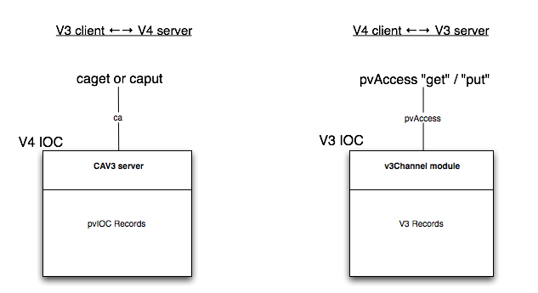
EPICS V3 ⇆ V4 INTEROPERATION

Slide 9
pvAccess client examples via EasyPVA
EasyPVA
  An easy to use interface for client side of pvAccess
  In early stages of development
  First example is really really simple
  Gets a single double value via pvAccess provider
EasyPVA easyPVA = EasyPVAFactory.get();
double value = easyPVA.createChannel(“QUAD345:BDES”).
createGet().getDouble();
System.out.println(channelName +" = " + value);
SLAC April 2012
V3/V4 Interoperatibility

Slide 10
EasyPVA examples continued
Get a double value via caV3 as provider
Only difference is extra argument to createChannel.
EasyPVA easyPVA = EasyPVAFactory.get();
double value = easyPVA.createChannel(“QUAD345:BDES”,”caV3”).
createGet().getDouble();
System.out.println(channelName +" = " + value);
SLAC April 2012
V3/V4 Interoperatibility

Slide 11
EasyPVA examples continued
The next example gets the value plus the alarm and timeStamp:
EasyPVA easyPVA = EasyPVAFactory.get();
EasyGet easyGet = easyPVA.createChannel(“QUAD345:BDES”).createGet();
double value = easyGet.getDouble();
Alarm alarm = easyGet.getAlarm();
TimeStamp timeStamp = easyGet.getTimeStamp();
System.out.printf( "%s %s %s %s%n",
channelName,Double.toString(value),
alarmToString(alarm),
timeStampToString(timeStamp));
SLAC April 2012
V3/V4 Interoperatibility

Slide 12
EasyPVA examples continued
The next example gets an array of doubles.
EasyPVA easyPVA = EasyPVAFactory.get();
double[] value = easyPVA.createChannel(“QUAD345:BDES”).createGet().getDoubleArray();
System.out.printf("%s%n[",channelName);
for(int i=0;i<value.length;i++) {
if(i%10 == 0) {
System.out.printf("%n ");
}
if(i!=0) System.out.printf(",");
System.out.printf("%f",value[i]);
}
System.out.printf("%n]%n");
SLAC April 2012
V3/V4 Interoperatibility

Slide 13
Efficient EasyPVA
The previous slides are not appropriate for repeated requests
Each does something like the following:
  Create an connect to a channel
    EXPENSIVE: broadcast, tcp connection
  Create a get request
    Creates objects on both client and server
  Request a get
    No new objects. Just transfer.
If same request repeated do each step over again.
Next slide shows more efficient way to do multiple gets.
SLAC April 2012
V3/V4 Interoperatibility

Slide 14
Efficient EasyPVA example
The next example is an efficient way to do multiple gets.
EasyPVA easyPVA = EasyPVAFactory.get();
Channel channel = easyPVA.createChannel(“QUAD345:BDES”);
ChannelGet get = channel.createGet();
double value = get.getDouble();
...
value = get.getDouble();
...
channel.destroy();
SLAC April 2012
V3/V4 Interoperatibility

