Slide 1
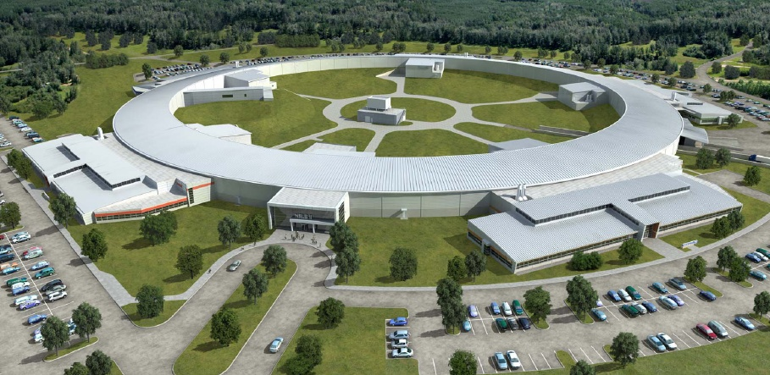
Control System Overview
Bob Dalesio, Control Group
HLA Review for NSLS-II Project
April 4. 2012

Slide 2
Outline
Control System Architecture
Relational Database Tools - IRMIS
EPICS Extensions
Control System Studio (CSS) Tools
Conclusions

Slide 3
EPICS V3
A narrow interface supports reusable clients
  DBR_ types included:
    Double, long integer, enumerated, string
    Metadata: time stamp, alarm severity, display and control
  Only monitored value, time stamp alarm severity
This narrow interface supported signals well
It is not easily extendible nor is it complete enough

Slide 4
DBR_TYPES in EPICS V4
Easily extendible
  thanks to work done by Marty Kraimer and Matej Sekorania
Can monitor metadata too –
  Only send structure elements that have changed
New data types:
  Extend the DBR_TYPES to higher level applications
  Extra metadata needed to complete description of type
  Heavy basis on Aida (Greg White – SLAC), in discussion with NSLS II team from controls and phsyics, Timo Korhonen (PSI), and James Rowland (Diamond)

Slide 5
Normative Types - Standard Support
PV List: list of PV names and relative order
Multi-Channel Array: synchronous array of PV List
Image: image with information to allow actions
Multi-dimensional arrays: 1 to N of same type
Statistics: high, low, median, average, standard deviation, start time, end time, number of samples
Histogram: Binned counts of one PV over time.
Set: Many PVs at one point in time
Sequence: One PV over a period of time
Table: Columns of values with rows of instances.
Ragged Table: Corba Any

Slide 6
EPICS Version 3 Architecture
XAL, MMLT, SDDS, GDA
Control System Studio
Thin HLA Client
Matlab, Python
PVManager
CAC
CAC
CAC
CAC
Ethernet
CAS
CAS
CAS
CAS
CAS
PS Database
RF Database
Vac Database
Util Database
CAS
Distributed Front-Ends
Diag & PS
Diag Database
Physical Device
Physical Device
Physical Device
Physical Device
Physical Device
Simulation

Slide 7
Services – V3 DBR Types from IOC
XAL, MMLT, SDDS, GDA
Control System Studio
Thin HLA Client
Matlab, Python
PVManager
CAC
PVAC
CAC
PVAC
CAC
PVAC
CAC
PVAC
Ethernet
CAS
PVAS
CAS
PVAS
CAS
PVAS
CAS
PVAS
CAS
PVAS
PS Database
RF Database
Vac Database
Util Database
CAS
PVAS
Distributed Front-Ends
Diag & PS
Diag Database
Physical Device
Physical Device
Physical Device
Physical Device
Physical Device
Simulation

Slide 8
Services – Channel Finder Service
XAL, MMLT, SDDS, GDA
Control System Studio
Thin HLA Client
Matlab, Python
PVManager
CAC
PVAC
CAC
PVAC
CAC
PVAC
CAC
PVAC
Ethernet
PVAS
Channel Finder Server
SQL
RDB
CAS
PVAS
CAS
PVAS
CAS
PVAS
CAS
PVAS
CAS
PVAS
PS Database
RF Database
Vac Database
Util Database
CAS
PVAS
Distributed Front-Ends
Diag & PS
Diag Database
Physical Device
Physical Device
Physical Device
Physical Device
Physical Device
Simulation

Slide 9
Services – Save Set and Retrieve
XAL, MMLT, SDDS, GDA
Control System Studio
Thin HLA Client
Matlab, Python
PVManager
CAC
PVAC
CAC
PVAC
CAC
PVAC
CAC
PVAC
Ethernet
PVAS
PVAS
Channel Finder Server
SaveSets (MASAR)
SQL
Python
RDB
IRMIS
CAS
PVAS
CAS
PVAS
CAS
PVAS
CAS
PVAS
CAS
PVAS
PS Database
RF Database
Vac Database
Util Database
CAS
PVAS
Distributed Front-Ends
Diag & PS
Diag Database
Physical Device
Physical Device
Physical Device
Physical Device
Physical Device
Simulation

Slide 10
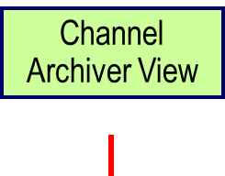
Services – Network Access to Archive Data
XAL, MMLT, SDDS, GDA
Control System Studio
Thin HLA Client
Matlab, Python
PVManager
CAC
PVAC
CAC
PVAC
CAC
PVAC
CAC
PVAC
PVAC
Ethernet
PVAS
PVAS
PVAS
Channel Finder Server
SaveSets (MASAR)
Archive Retrieval
SQL
Python
XML/RPC
RDB
Channel
Archiver
IRMIS
CAS
PVAS
CAS
PVAS
CAS
PVAS
CAS
PVAS
CAS
PVAS
PS Database
RF Database
Vac Database
Util Database
CAS
PVAS
Distributed Front-Ends
Diag & PS
Diag Database
Physical Device
Physical Device
Physical Device
Physical Device
Physical Device
Simulation

Slide 11
Services – Unit Conversion
XAL, MMLT, SDDS, GDA
Control System Studio
Thin HLA Client
Matlab, Python
PVManager
CAC
PVAC
CAC
PVAC
CAC
PVAC
CAC
PVAC
PVAC
Ethernet
PVAS
PVAS
PVAS
PVAS
Channel Finder Server
SaveSets (MASAR)
Archive Retrieval
Unit Conversion..
SQL
Python
XML/RPC
SQL
RDB
Channel
Archiver
IRMIS
IRMIS
CAS
PVAS
CAS
PVAS
CAS
PVAS
CAS
PVAS
CAS
PVAS
PS Database
RF Database
Vac Database
Util Database
CAS
PVAS
Distributed Front-Ends
Diag & PS
Diag Database
Physical Device
Physical Device
Physical Device
Physical Device
Physical Device
Simulation

Slide 12
Services – Orbit Service
XAL, MMLT, SDDS, GDA
Control System Studio
Thin HLA Client
Matlab, Python
PVManager
CAC
PVAC
CAC
PVAC
CAC
PVAC
CAC
PVAC
PVAC
Ethernet
PVAS
PVAS
PVAS
PVAS
PVAS
Channel Finder Server
SaveSets (MASAR)
Archive Retrieval
Unit Conversion..
Orbit/ Unit Conversion
SQL
Python
XML/RPC
SQL
CAC
RDB
Channel
Archiver
IRMIS
IRMIS
CAS
PVAS
CAS
PVAS
CAS
PVAS
CAS
PVAS
CAS
PVAS
PS Database
RF Database
Vac Database
Util Database
CAS
PVAS
Distributed Front-Ends
Diag & PS
Diag Database
Physical Device
Physical Device
Physical Device
Physical Device
Physical Device
Simulation

Slide 13
Services – Model Service
XAL, MMLT, SDDS, GDA
Control System Studio
Thin HLA Client
Matlab, Python
PVManager
CAC
PVAC
CAC
PVAC
CAC
PVAC
CAC
PVAC
PVAC
Ethernet
PVAS
PVAS
PVAS
PVAS
PVAS
PVAC
PVAS
Channel Finder Server
SaveSets (MASAR)
Archive Retrieval
Unit Conversion.
Orbit/ Unit Conversion
Model Server
SQL
Python
XML/RPC
SQL
CAC
CAC
RDB
Channel
Archiver
IRMIS
IRMIS
CAS
PVAS
CAS
PVAS
CAS
PVAS
CAS
PVAS
CAS
PVAS
PS Database
RF Database
Vac Database
Util Database
CAS
PVAS
Distributed Front-Ends
Diag & PS
Diag Database
Physical Device
Physical Device
Physical Device
Physical Device
Physical Device
Simulation

Slide 14
LS2 Physicists Use Services with Thin Apps
XAL, MMLT, SDDS, GDA
Control System Studio
Thin HLA Client
Matlab, Python
PVManager
CAC
PVAC
CAC
PVAC
CAC
PVAC
CAC
PVAC
PVAC
Ethernet
PVAS
PVAS
PVAS
PVAS
PVAS
PVAC
PVAS
PVAC
PVAS
Channel Finder Server
SaveSets (MASAR)
Archive Retrieval
Unit Conversion..
Orbit/ Unit Conversion
Model Server
Multichannel Array
SQL
Python
XML/RPC
SQL
CAC
CAC
RDB
Channel
Archiver
IRMIS
IRMIS
CAS
PVAS
CAS
PVAS
CAS
PVAS
CAS
PVAS
CAS
PVAS
PS Database
RF Database
Vac Database
Util Database
CAS
PVAS
Distributed Front-Ends
Diag & PS
Diag Database
Physical Device
Physical Device
Physical Device
Physical Device
Physical Device
Simulation

Slide 15
Conclusions
  Version 3 has provided adequate support for signal data for many years with a wide variety of clients developed against the interface.
  The need to extend the support for more complex data has been clear for near as many years as version 3 has existed.
  The approach to take use cases to extend the data types seems to be appropriate to find a minimum set of new data types that provide a wide range of functionality.
  The active engagement of many in our community to help define this set has been productive for physics applications.
  Reference middle layer services are written to integrate relational data, aggregated data, and computed data.
  A team of physicists and programmers at several labs are now focused on this effort with approaching deadlines
  A lot more work is needed.

