Slide 1

areaDetector: A module for EPICS area detector support
Slides by: Mark Rivers
GSECARS, Advanced Photon Source
University of Chicago
Slides stolen and presented by: Martin Gaughran
Diamond Light Source, United Kingdom

Slide 2
areaDetector Talk Outline
Introductory talk
Motivation & goals for areaDetector module
Overview of architecture
Drivers for detectors & cameras
Plugins for real-time processing
Viewers and other clients
Corrected links at end of presentation - Martin
Demo with simDetector

Slide 3
areaDetector - Goals
Drivers for many detectors, especially those used at synchrotron beamlines
Handle detectors ranging from >500 frames/second to <1 frame/second
Basic parameters for all detectors
E.g. exposure time, start acquisition, etc.
Allows generic clients to be used for many applications
Easy to implement new detector
Single device-driver C++ file to write. EPICS independent.
Easy to implement detector-specific features
Driver understands additional parameters beyond those in the basic set
Middle-level plug-ins to add capability like regions-of-interest calculation, file saving, etc.
Device independent, work with all drivers
Below the EPICS database layer for highest performance

Slide 4
areaDetector – Data structures
NDArray
N-Dimensional array.
Everything is done in N-dimensions (up to 10), rather than 2. This is needed even for 2-D detectors to support color.
Other types of devices (Xspress3 and xMAP x-ray spectrometers, quad electrometers also use NDArrays and areaDetector plugins.
This is what plug-ins callbacks receive from device drivers.
NDAttribute
Each NDArray has a list of associated attributes (metadata) that travel with the array through the processing pipeline. Attributes can come from driver parameters, any EPICS PV, or any user-written function.
Can store motor positions, temperature, ring current, amplifier gains, etc. with each frame.
Written to disk files for TIFF, netCDF, and HDF5 file formats.
NDArrayPool
Allocates NDArray objects from a freelist
Plugins access in readonly mode, increment reference count
Eliminates need to copy data when sending it to callbacks.

Slide 5
EPICS areaDetector Architecture
Layer 6
EPICS CA clients
Channel Access Clients (CSS, medm, Python, ImageJ, SPEC, etc.)
Layer 5 Standard EPICS records
ADBase .template
xxxDriver .template
NDPluginBase .template
NDPluginXXX. template
C++ Base classes (NDArray, asynPortDriver, asynNDArrayDriver, ADDriver, NDPluginDriver)
Layer 4
EPICS device support
Standard asyn device support (device-independent)
Layer 3 Plug-ins
File (HDF5, netCDF, TIFF, JPEG)
StdArrays
Process
ROI
Layer 2
Device drivers
Driver
Channel access
Record/device support
Layer 1
Hardware API
Vendor API
asynInt32, Float64, Octet
asynXXXArray
Hardware
asynGenericPointer (NDArray)
C library calls

Slide 6
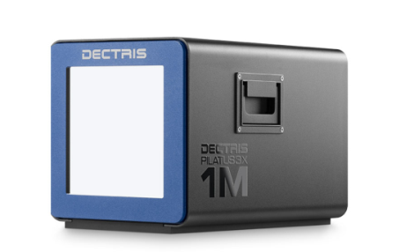
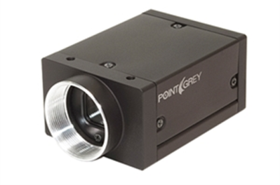
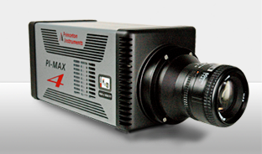
Detector Drivers
Currently ~35 detector drivers covering a wide variety of detectors.
Simulation driver
GigE cameras (Prosilica/AVT, Point Grey/FLIR, any GigEVision camera via aravis library)
FLIR and AVT USB-3.x cameras
Dectris Pilatus and Eiger pixel array detectors
Princeton Instruments and Photometrics detectors and spectrometers
Andor CCD and CMOS cameras
Perkin Elmer and Dexela flat panel detectors
Web cameras and Axis video servers
Many more (Basler, Pixirad, Photonic Sciences, etc.)

Slide 7
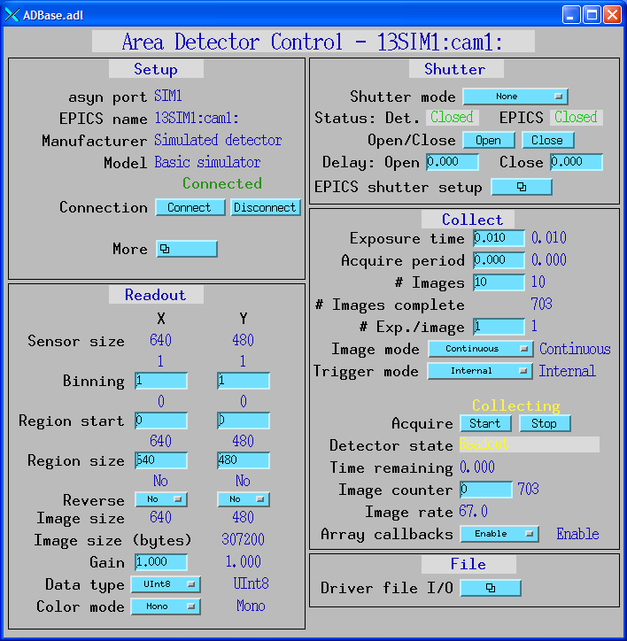
ADBase.adl – Generic control screen
Works with any detector
Normally write custom control for each detector type to hide unimplemented features and expose driver-specific features

Slide 8
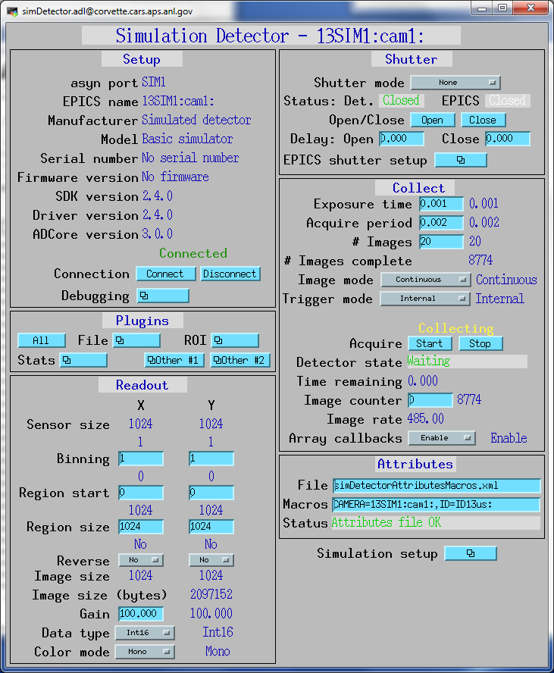
simDetector: Detector-specific screen
Example
1024x1024 pixels
16-bit integer images
485 frames/s
~1GB/s

Slide 9
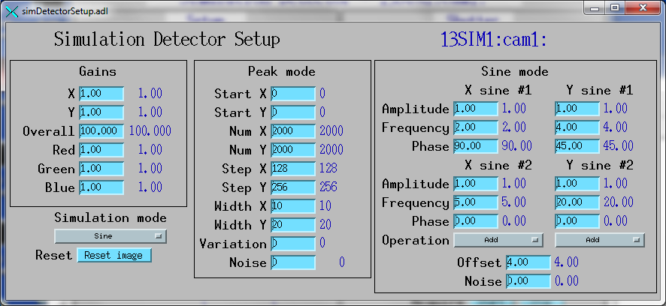
simDetector Driver
3 simulation modes, LinearRamp, Peaks, Sine Waves.
Independent gains for X, Y, Overall, Red, Green, Blue
Linear ramp has X and Y linear ramp with array index, each cycle just adds value to each pixel. Very fast.
Peak mode is array of Gaussian peaks plus noise. Slower.
Sine mode is 2 sine waves in each of Y and Y, summed or multiplied. Slower.

Slide 10
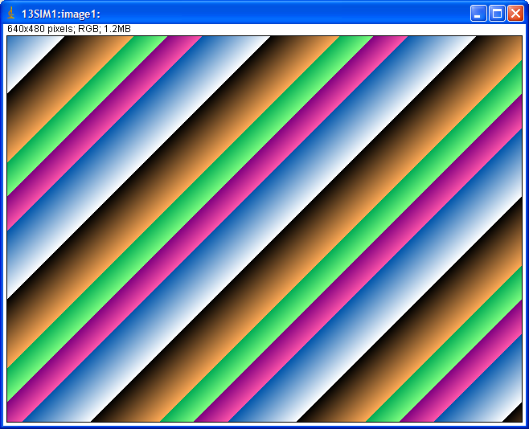
simDetector: Linear Ramp Mode

Slide 11
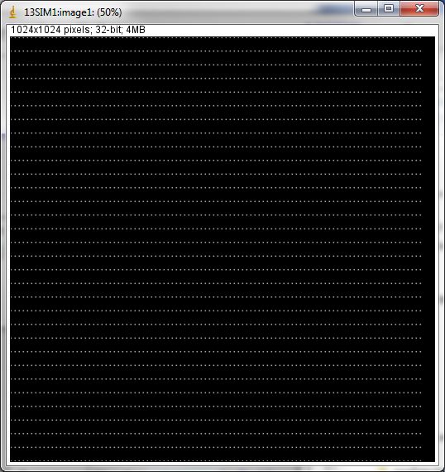
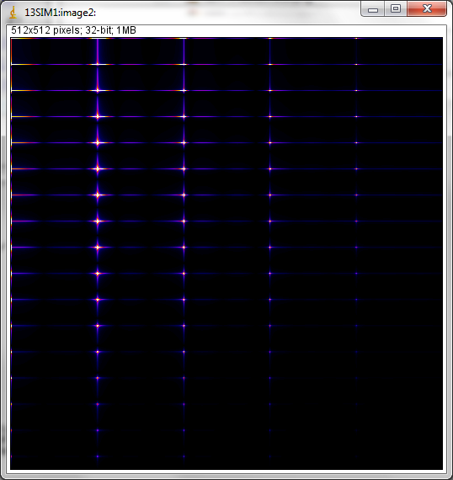
simDetector Peaks mode with FFT

Slide 12
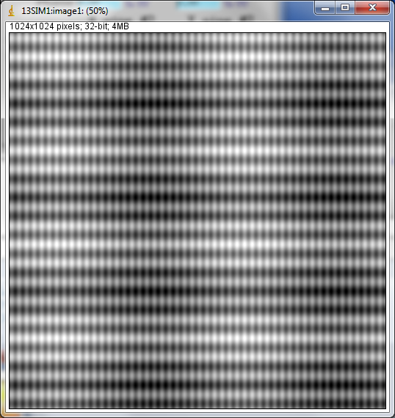
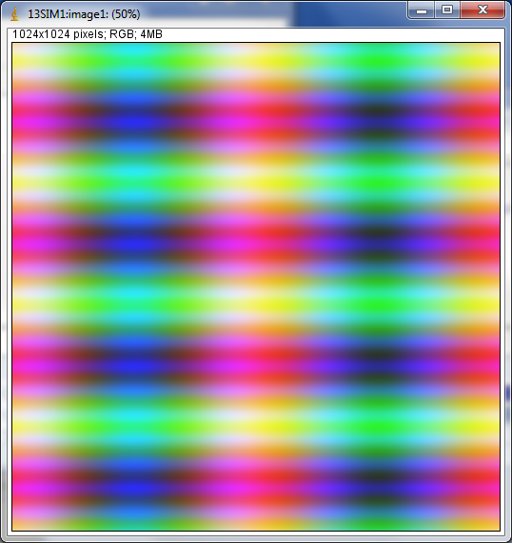
simDetector: Sine mode

Slide 13
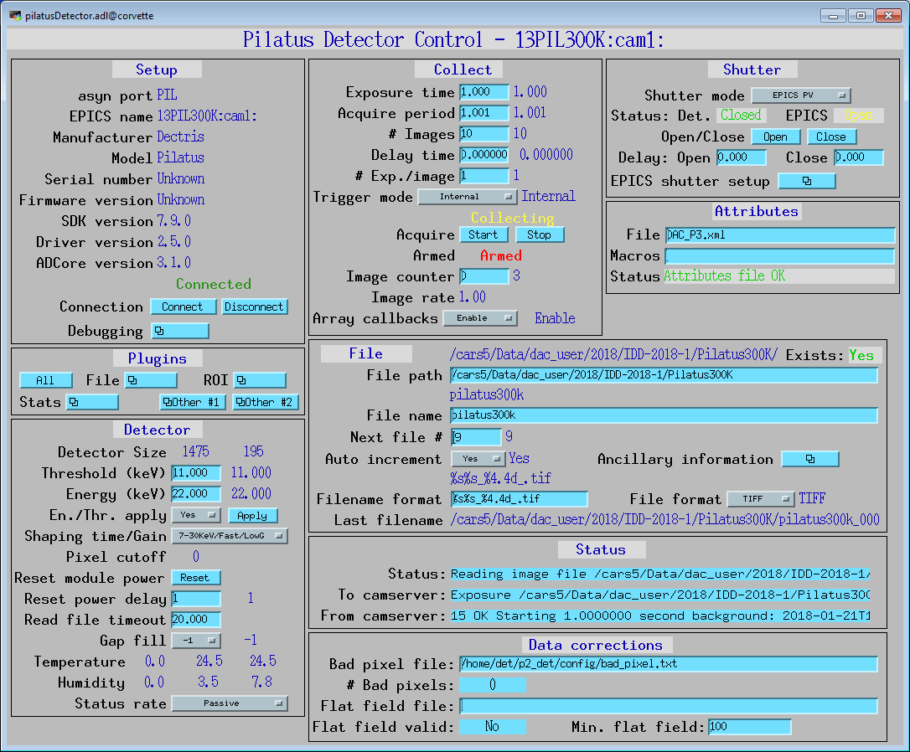
Pilatus specific control screen

Slide 14
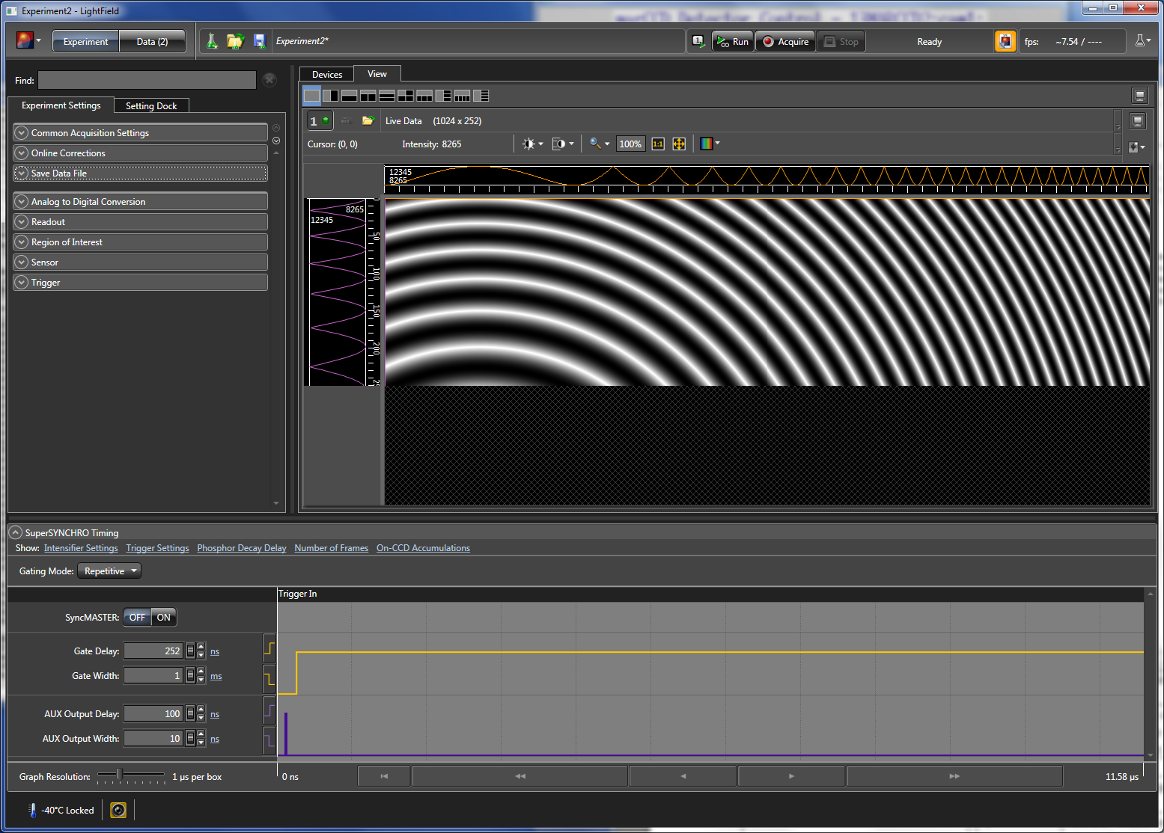
LightField driver

Slide 15
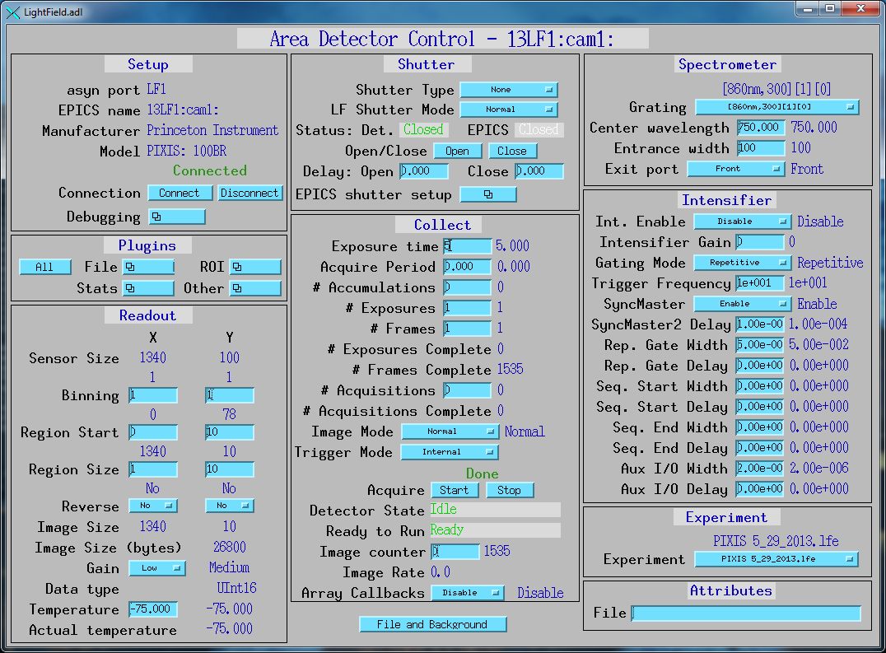
LightField driver

Slide 16
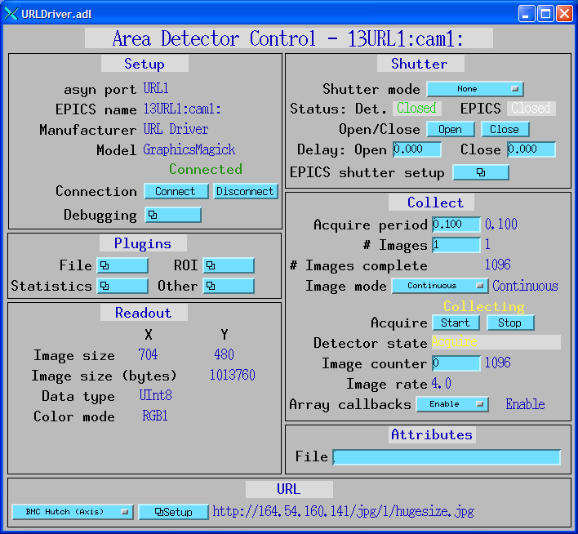
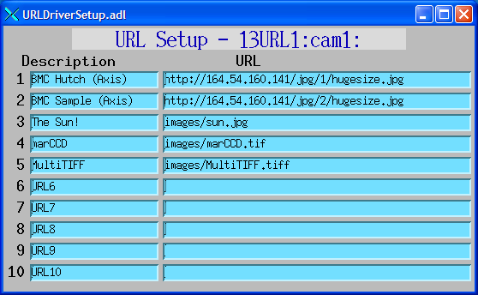
URL Driver
Driver that can read images from any URL.
Can be used with Web cameras and Axis video servers.
Uses GraphicsMagick to read the images, and can thus handle a large number of image formats (JPEG, TIFF, PNG, etc.).

Slide 17
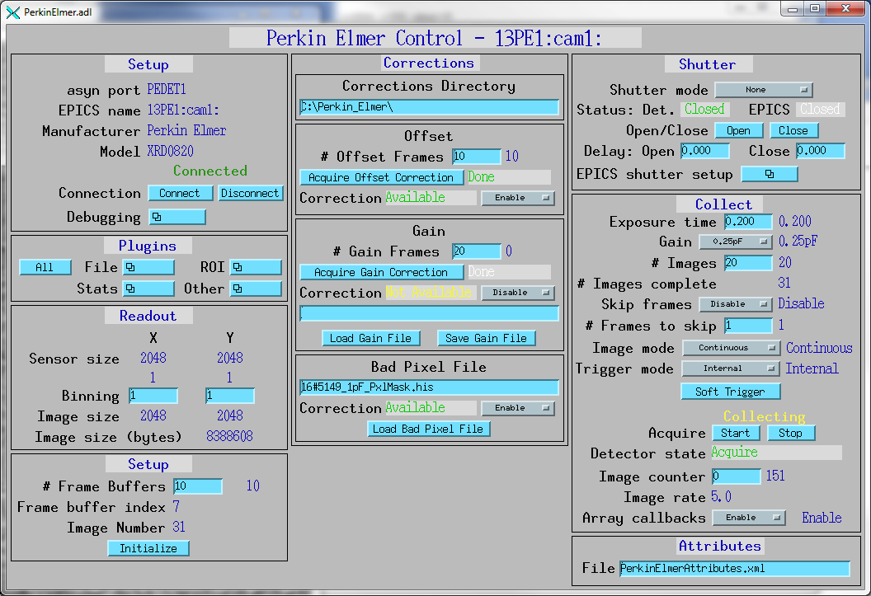
Perkin Elmer Flat Panel Driver

Slide 18
FLIR/Point Grey drivers
ADSpinnaker driver for all cameras from FLIR/Point Grey using their Spinnaker SDK.
GigE, USB 3.0, and 10 GigE camera
High performance, low cost
Example models:
Model | Interface | Resolution | Price | Measured Speed (frames/s) | Measured Speed (MB/s)
BlackFlyS BF2-PGE-13Y3M | 1-Gbit Ethernet | 1280x1024 | $325 | 83 frames/s | 104 MB/s
Grasshopper 3 GS3-U3-23S6M | USB-3 | 1920x1200 | $995 | 156 frames/s | 343 MB/s
Oryx ORX-10G-51S5M | 10-Bbit Ethernet | 2448x2048 | $2,258 | 163 frames/s | 779 MB/s

Slide 19
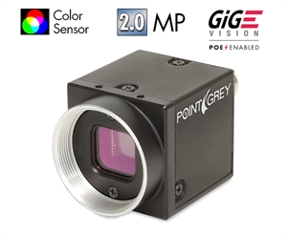
Point Grey GigE Camera BlackFly PGE-20E4C
e2v EV76C570 CMOS sensor
Global shutter
29 x 29 x 30 mm
Power Over Ethernet
4.5 micron pixels
1600 x 1200 pixels, color or mono)
50 frames/s
$525

Slide 20
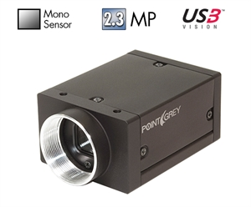
Point Grey USB-3.0 Camera Grasshopper3 GS3-U3-23S6M
1920 x 1200 global shutter CMOS
Sony IMX174 1/1.2
Dynamic range of 73 dB
Peak QE of 76%
Read noise of 7e-
12-bit or 8-bit data
Max frame rate of 162 fps
~356 MB/S, >3X faster than GigE
USB 3.0 interface
Used for tomography at 3 APS beamlines, replaced Andor Neo and PCO Edge
$995

Slide 21
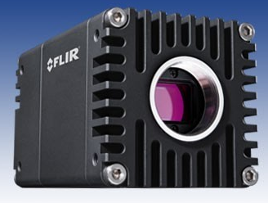
Point Grey 10-Gbit Ethernet Camera Oryx ORX-10G-310S9M
6464 x 4852 global shutter CMOS (31 MP)
Sony IMX342 3.45 micron pixels
Dynamic range of 66 dB
Peak QE of 65%
Read noise of 5.2e-
12-bit, 10-bit, or 8-bit data
Max frame rate of 26 fps
778 MB/S, >8X faster than GigE
$7,089
Used for tomography on 2 APS beamlines
Model | Resolution | Price | Speed (frames/s) | Speed (MB/s)
ORX-10G-310S9M | 6464x4852 | $7,089 | 26 frames/s | 778 MB/s
ORX-10G-123S6M | 4096x3000 | $4,666 | 68 frames/s | 797 MB/s
ORX-10G-51S5M | 2448x2048 | $2,258 | 162 frames/s | 774 MB/s
ORX-10GS-34S4M | 2048x1536 | $1,774 | 216 frames/s | 648 MB/s

Slide 22
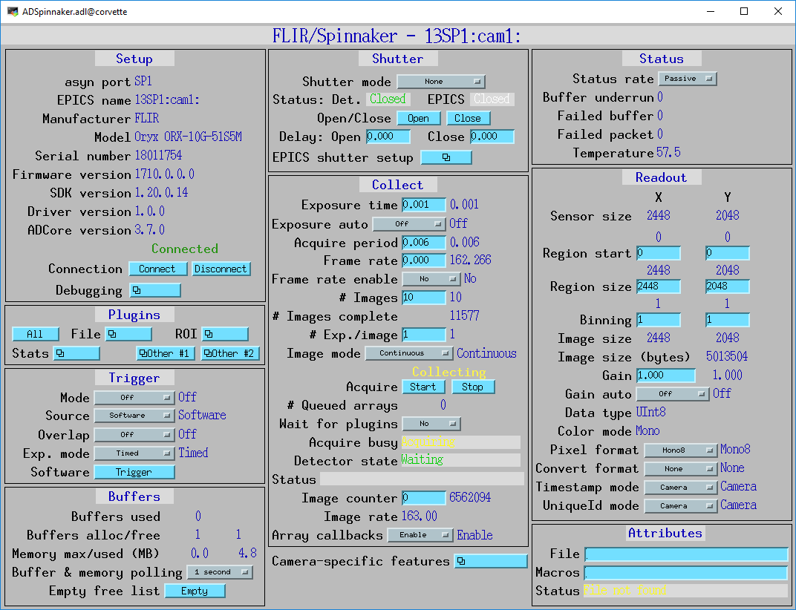
ADSpinnaker Driver

Slide 23
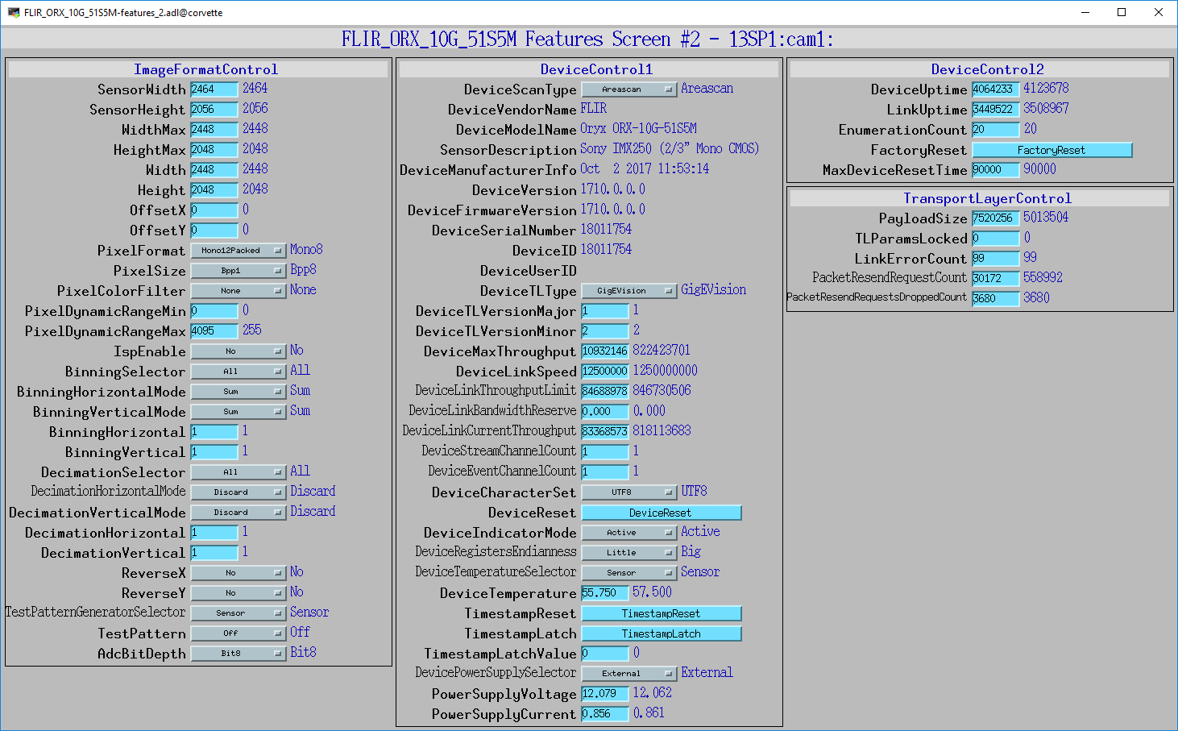
Camera-specific Features Screen (2/6)
Database file and OPI screens built from GenICam camera XML downloaded from the camera using Python script

Slide 24
Plugins
Designed to perform real-time processing of data, running in the EPICS IOC (not over EPICS Channel Access)
Receive NDArray data over callbacks from drivers or other plugins
Plug-ins can execute in their own threads (non-blocking) or in callback thread (blocking)
If non-blocking then NDArray data is queued
If executing in callback thread, no queuing, but slows driver
Allows
Enabling/disabling
Throttling rate (no more than 0.5 seconds, etc)
Changing data source for NDArray callbacks to another driver or plugin
Plugins can be sources of NDArray callbacks, as well as consumers
Allows creating a data processing pipeline running at very high speed, each in a different thread, and hence in multiple cores on modern CPUs.

Slide 25
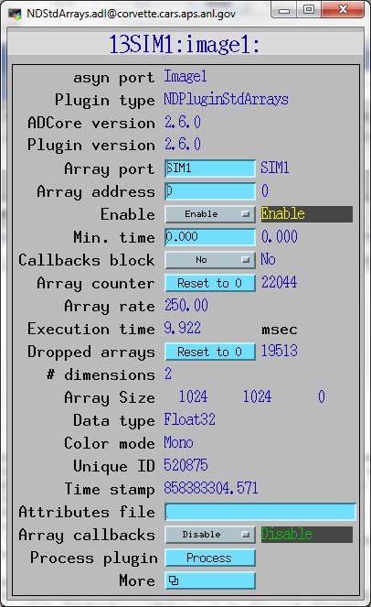
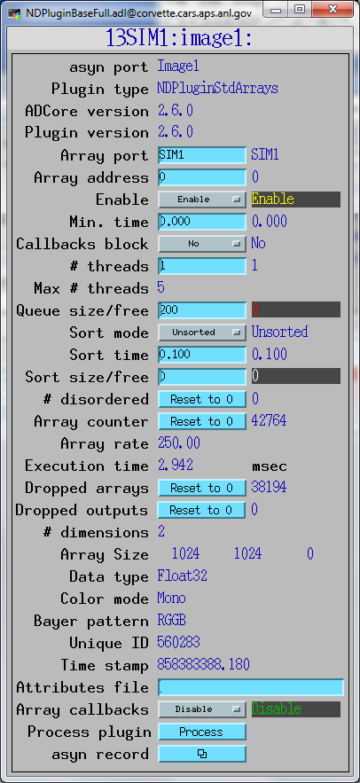
NDPluginDriver medm Screens

Slide 26
Plugins (continued)
Currently 20 plugins that perform wide variety of operations
NDPlugInStdArrays
Receives arrays (images) from device drivers, converts to standard arrays, e.g. waveform records.
This plugin is what EPICS channel access viewers normally talk to.
NDPluginPVA
Converts NDArrays to EPICS V4 NTNDArrays
Exports the NtNDArrays over PVAccess with internal V4 server
Can be used to send structured data to EPICS V4 clients
When used with the PVAccess driver then areaDetector plugins can be run on different machine from the detector driver
NDPluginROI
Performs region-of-interest calculations
Select a subregion. Optionally bin, reverse in either direction, convert data type.
Divide the array by a scale factor, which is useful for avoiding overflow when binning.
NDPluginTransform
Performs geometric operations (rotate, mirror in X or Y, etc.)

Slide 27
Plugins (continued)
NDPluginStats
Calculates basic statistics on an array (min, max, sigma)
Optionally computes centroid centroid position, width and tilt.
Optionally Computes X and Y profiles, including average profiles, profiles at the centroid position, and profiles at a user-defined cursor position.
Optionally computes the image histogram and entropy
NDPluginROIStat
Multiple ROIs with simple statistics in a single plugin
More efficient when many ROIs are needed, e.g. for peaks in a 1-D energy spectrum
Min, max, total, net, mean
Time-series of each of these statistics

Slide 28
Plugins (continued)
NDPluginProcess
Does arithmetic processing on arrays
Background subtraction.
Flat field normalization.
Offset and scale.
Low and high clipping.
Recursive filtering in the time domain.
Conversion to a different output data type.
NDPluginOverlay
Adds graphic overlays to an image.
Can be used to display ROIs, multiple cursors, user-defined boxes, text, etc.
ffmpegServer
MJPEG server that allows viewing images in a Web browser. From DLS.

Slide 29
Plugins (continued)
NDPluginAttribute
Extracts NDAttributes from NDArrays and publishes their values as ai records
Can collect time-series arrays of the attribute values
NDPluginCircularBuff
Buffers NDArrays in a circular buffer
Computes a trigger expression using up to 2 NDAttribute values
When trigger condition is met then outputs NDArrays
User-specified number of pre-trigger and post-trigger arrays to output
NDPluginTimeSeries
Accepts 1-D NDArrays[NumSignals] or 2-D [NumSignals,NewTimePoints] and appends to time-series buffer
Operates in fixed length (stop when full) or circular buffer modes
Optional time-averaging of input data

Slide 30
Plugins (continued)
NDPluginFFT
Computes FFT of 1-D or 2-D NDArrays
Exports NDArrays containing the absolute value (power spectrum) of the FFT
Exports 1-D arrays of the FFT real, imaginary, absolute values, and time and frequency data.
NDPluginColorConvert
Convert from one color model to another (Mono, RGB1 (pixel), RGB2 (row) or RGB3 (planar) interleave)
Bayer conversion removed from this plugin, now part of Prosilica and Point Grey drivers.

Slide 31
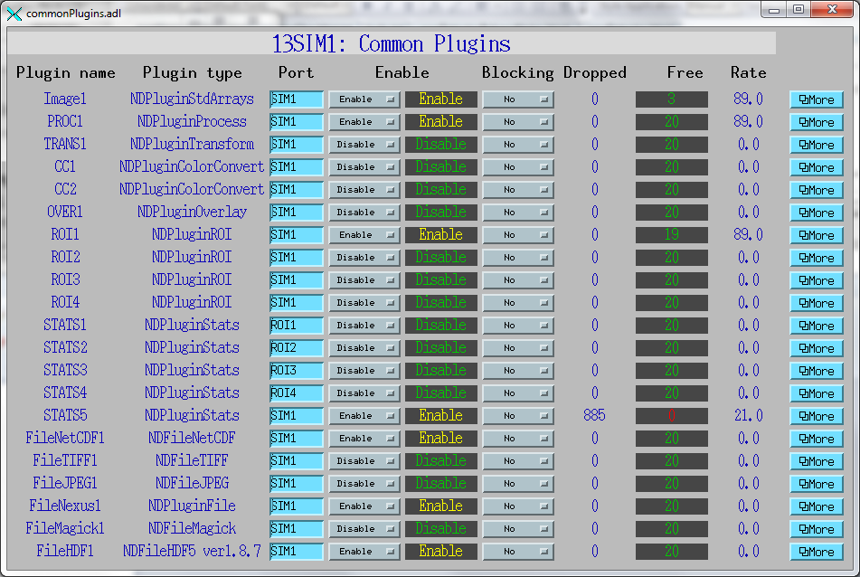
commonPlugins.adl All plugins at a glance

Slide 32
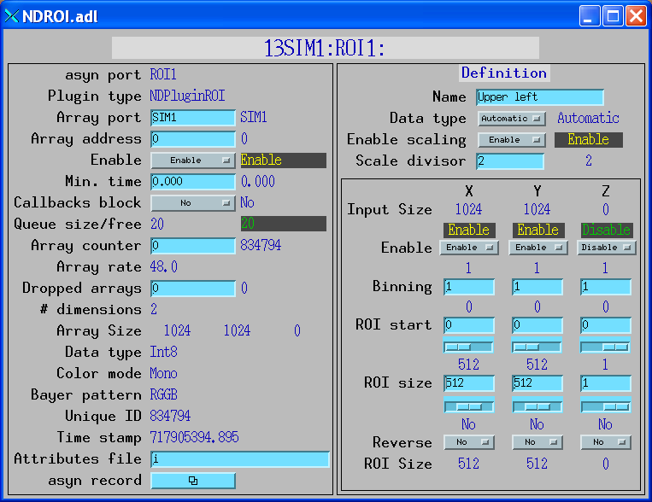
ROI plugin

Slide 33
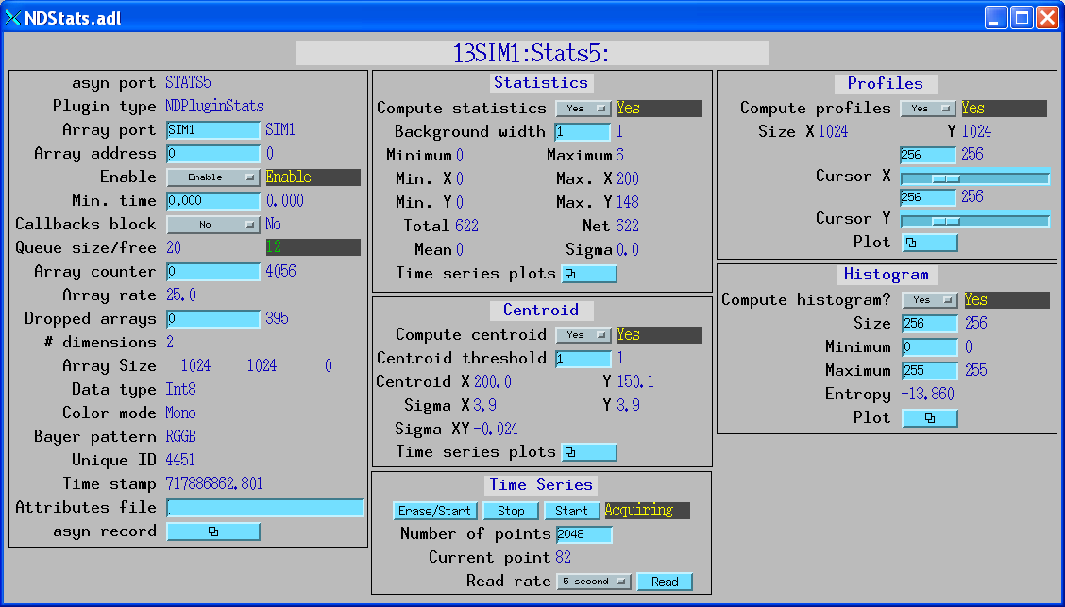
Statistics plugin

Slide 34
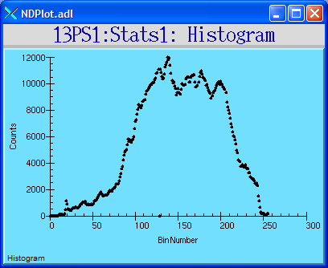
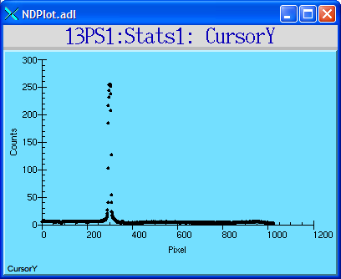
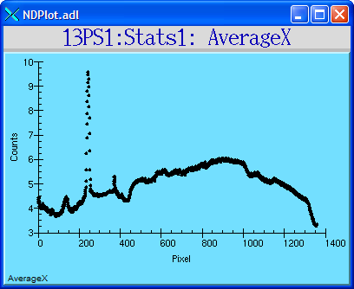
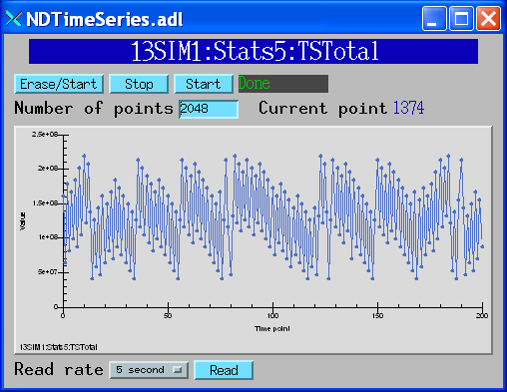
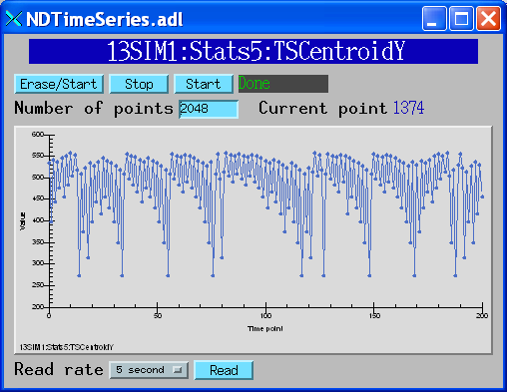
Statistics plugin (continued)

Slide 35
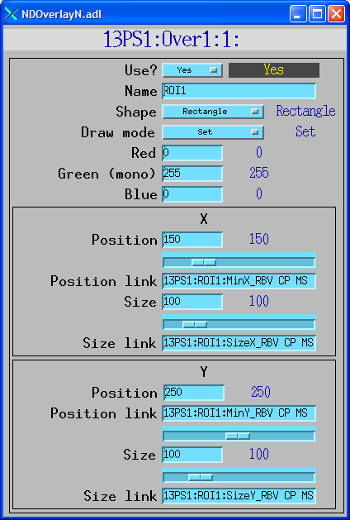
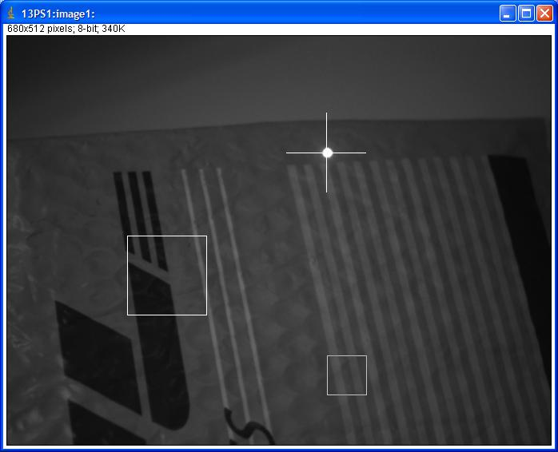
Overlay plugin
Centroid of laser pointer calculated by statistics plugin
Cursor overlay X, Y position linked to centroid

Slide 36
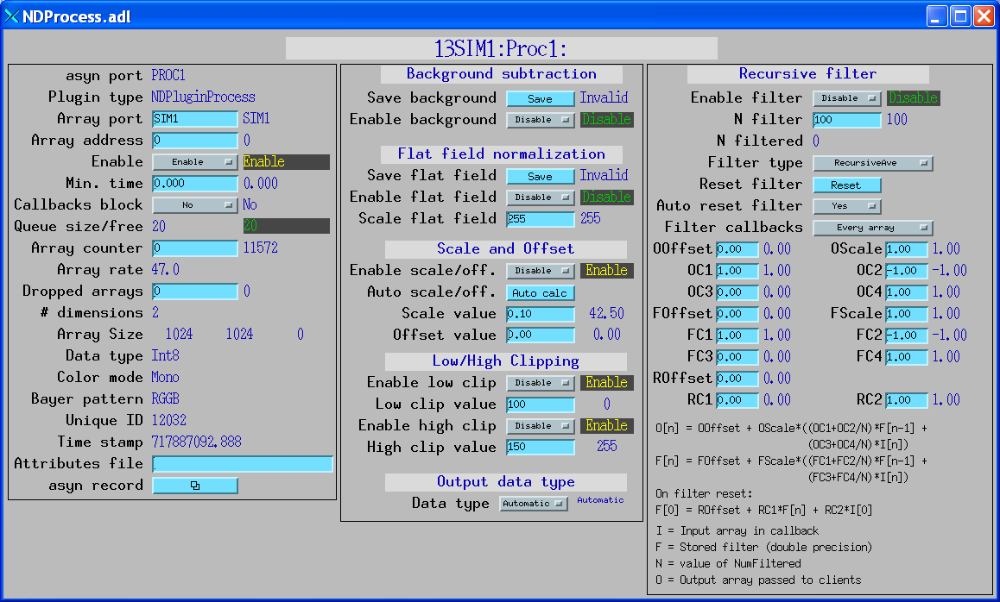
Processing plugin

Slide 37
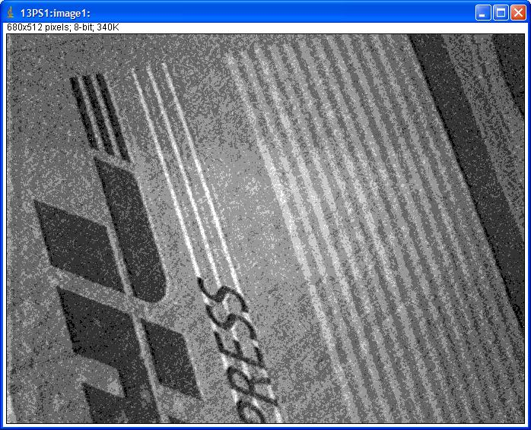
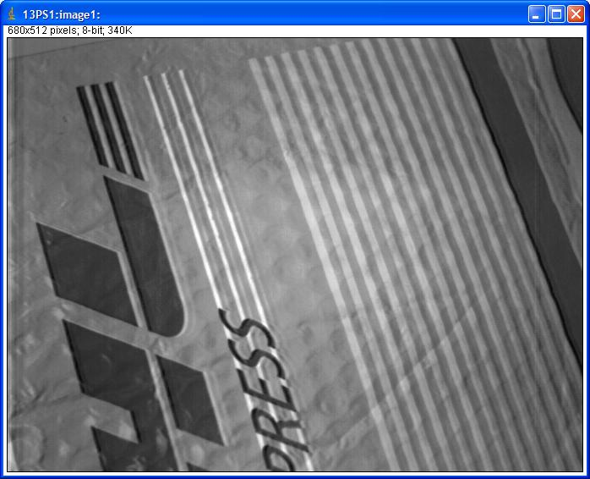
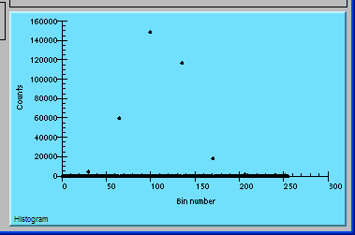
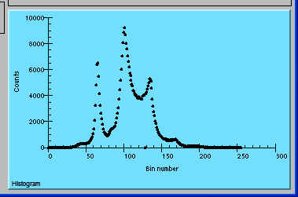
Processing plugin 30 microsec exposure time
No filtering
N=100 recursive average filter

Slide 38
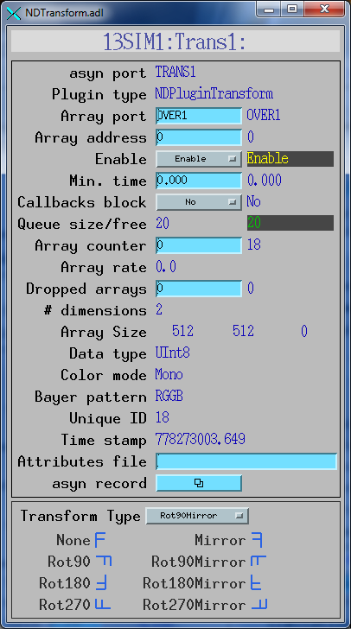
Transform plugin

Slide 39
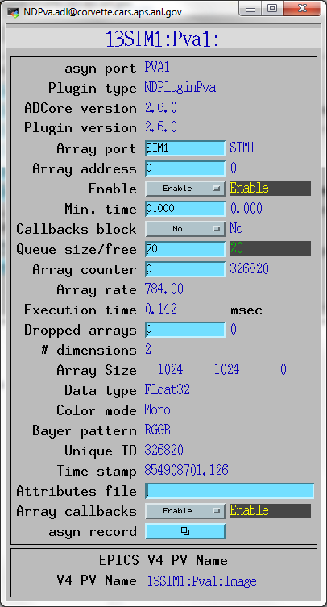
NDPluginPva (EPICS V4/7)
New plugin that converts NDArrays into the EPICS v4 normative type NTNDArray
Embedded EPICSv4 server serves the new NTNDArray structure as an EPICSv4 PV
High performance, ~3.2GB/s shown here
Can be received by any EPICS v4 client
Java, Python, C++ versions of pvAccess
CSS has a widget that can display NTNDArrays
New ImageJ plugin
Can include an NTNDArray receiver in another IOC
From Bruno Martins

Slide 40
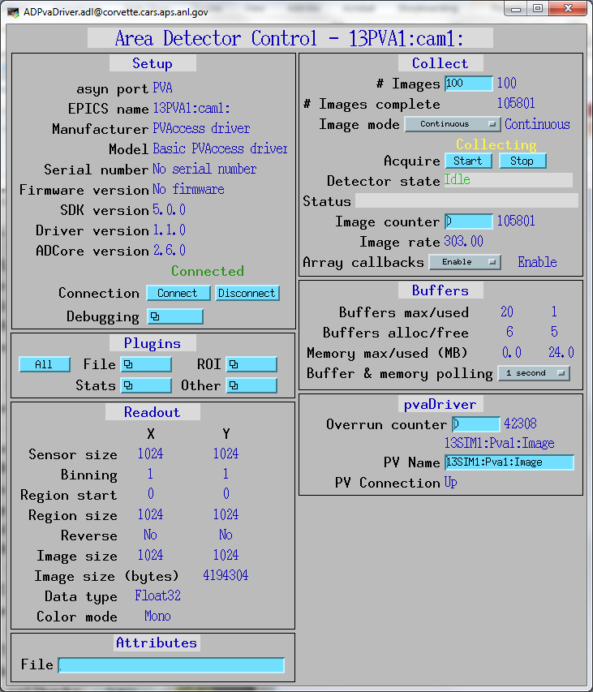
pvAccess Driver (EPICS V4)
Logical inverse of NDPluginPva
Receives NTNDArrays over the network, converts to NDArrays and calls plugins
Can be used to run areaDetector IOC and plugins on another machine or in another process
High performance:
~1.2 GB/s shown here with interprocess communication
Saturating 10 Gb Ethernet links has been demonstrated
From Bruno Martins

Slide 41
Plugins: NDPluginFile
Saves NDArrays to disk
3 modes:
Single array per disk file
Capture N arrays in memory, write to disk either multiple files or as a single large file (for file formats that support this.)
Stream arrays to a single large disk file
For file formats that support it, stores not just NDArray data but also NDAttributes

Slide 42
Plugins: NDPluginFile
File formats currently supported
NDFileTIFF
Supports any NDArray data type
Stores NDAttributes as ASCII user tags
NDFileJPEG
With compression control
NDFileNetCDF
Popular self-describing binary format, supported by Unidata at UCAR
NDFileHDF5
Writes HDF5 files with the native HDF5 API, unlike the NeXus plugin which uses the NeXus API. Supports 3 types of compression.
Supports using an XML file to define the layout and placement of NDArrays and NDAttributes in the HDF5 file
Support Single Writer Multiple Reader (SWMR). Only supported on local file systems, GPFS, and Lustre (not NFS or SMB)

Slide 43
Plugins: NDPluginFile
File formats currently supported
NDFileNeXus
Standard file format for neutron and x-ray communities, based on HDF5, which is another popular self-describing binary format; richer than netCDF
May be deprecated in a future release since NeXus files can now be produced with the NDFileHDF5 plugin using an appropriate XML layout file
NDFileMagick
Uses GraphicsMagick to write files, and can write in dozens of file formats, including JPEG, TIFF, PNG, PDF, etc.
NDFileNull
Used only to delete original driver files when no other file plugin is running

Slide 44
File saving with driver
In addition to file saving plugins, many vendor libraries also support saving files (e.g. marCCD, mar345, Pilatus, etc.) and this is supported at the driver level.
File saving plugin can be used instead of or in addition to vendor file saving
Can add additional metadata vendor does not support
Could write JPEGS for Web display every minute, etc.

Slide 45
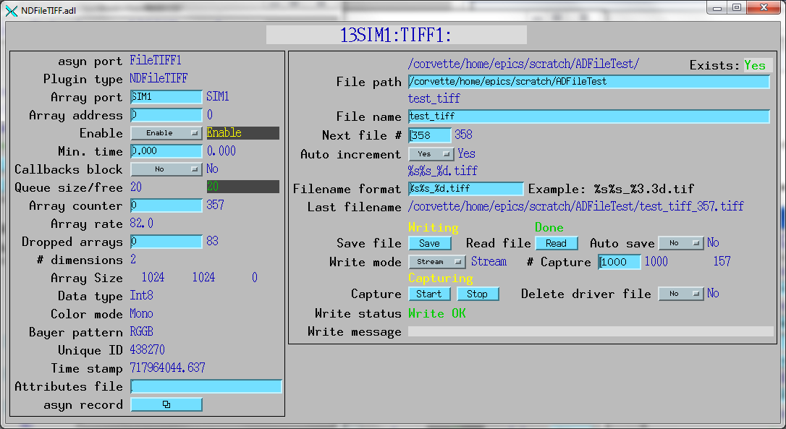
NDPluginFile display: TIFF
Example: saving 82 frames/second of 1024x1024 video to TIFF files, a few dropped frames.

Slide 46
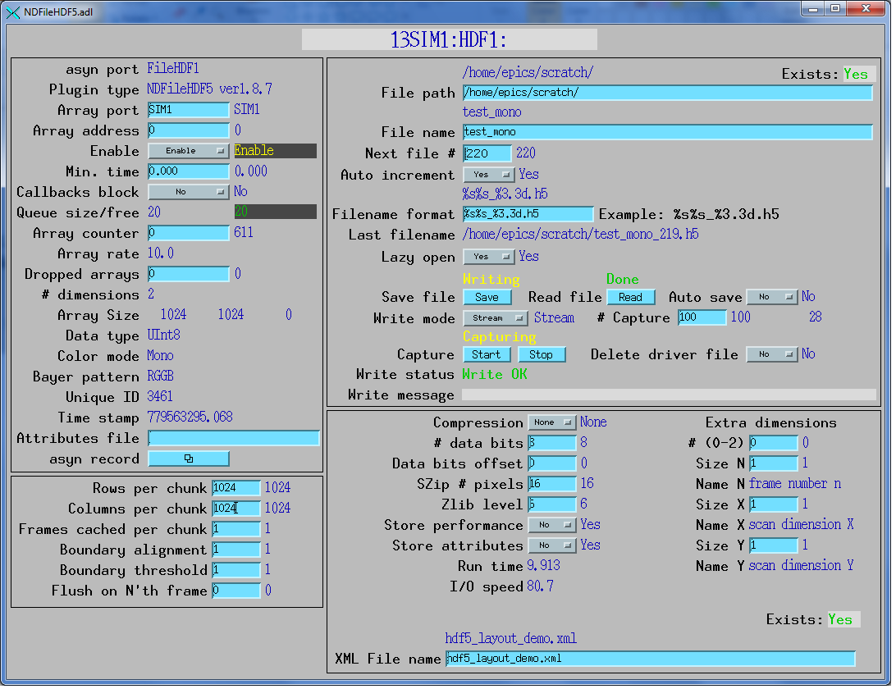
NDFileHDF5

Slide 47
NDFileHDF5 XML file to define file layout
<xml>
<group name="entry">
<attribute name="NX_class" source="constant" value="NXentry" type="string"></attribute>
<group name="instrument">
<attribute name="NX_class" source="constant" value="NXinstrument" type="string"></attribute>
<group name="detector">
<attribute name="NX_class" source="constant" value="NXdetector" type="string"></attribute>
<dataset name="data" source="detector" det_default="true">
<attribute name="NX_class" source="constant" value="SDS" type="string"></attribute>
<attribute name="signal" source="constant" value="1" type="int"></attribute>
<attribute name="target" source="constant" value="/entry/instrument/detector/data"
type="string"></attribute>
</dataset>
<group name="NDAttributes">
<attribute name="NX_class" source="constant" value="NXcollection" type="string"></attribute>
<dataset name="ColorMode" source="ndattribute" ndattribute="ColorMode">
</dataset>
</group> <!-- end group NDAttribute -->
</group> <!-- end group detector -->
<group name="NDAttributes" ndattr_default="true">
<attribute name="NX_class" source="constant" value="NXcollection" type="string"></attribute>
</group> <!-- end group NDAttribute (default) -->
<group name="performance">
<dataset name="timestamp" source="ndattribute"></dataset>
</group> <!-- end group performance -->
</group> <!-- end group instrument -->
<group name="data">
<attribute name="NX_class" source="constant" value="NXdata" type="string"></attribute>
<hardlink name="data" target="/entry/instrument/detector/data"></hardlink>
<!-- The "target" attribute in /entry/instrument/detector/data is used to
tell Nexus utilities that this is a hardlink -->
</group> <!-- end group data -->
</group> <!-- end group entry -->
</xml>

Slide 48
Multiple Threads per Plugin
Support for multiple threads running the processCallbacks() function in a single plugin.
Can improve the performance of the plugin by a large factor.
Linear scaling with up to 5 threads (the largest value tested) observed for most of the plugins that now support multiple threads.
Maximum number of threads that can be used for the plugin is set in constructor and in IOC startup script.
Actual number of threads to use controlled via an EPICS PV at run time, up to the maximum value.
Optional sorting of NDArrays by uniqueId to attempt to output them in the correct order.
Several new parameters to control this option
Plugins needed minor modifications to be thread-safe for multiple threads running in a single plugin object.
Most compute-intensive plugins now support multiple threads.

Slide 49
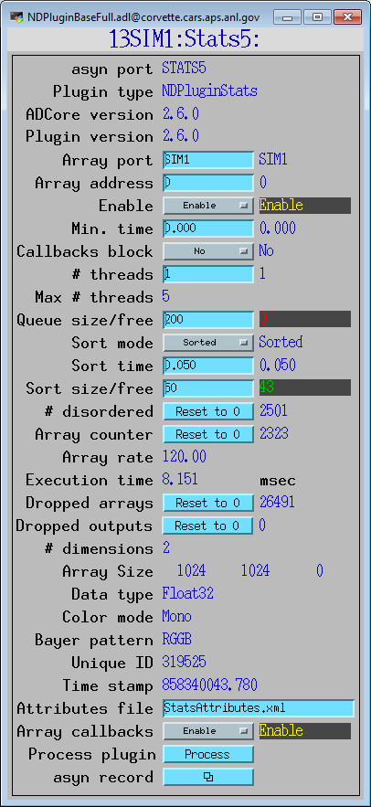
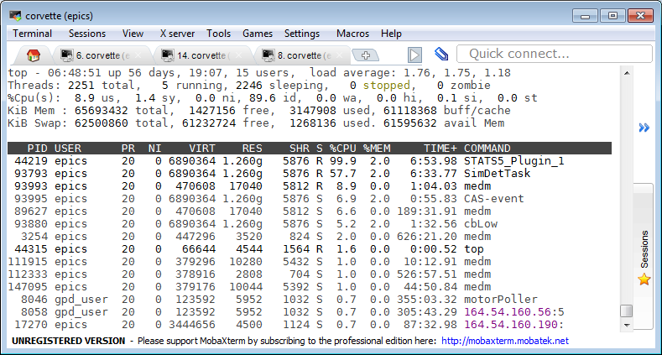
Multiple Threads per Plugin 1 Thread

Slide 50
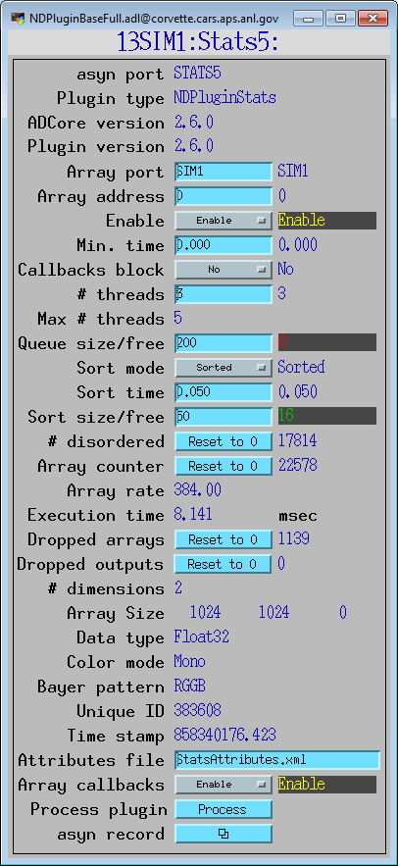
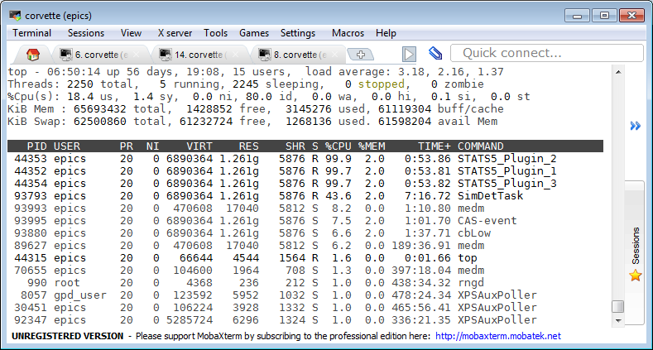
Multiple Threads per Plugin 3 Threads

Slide 51
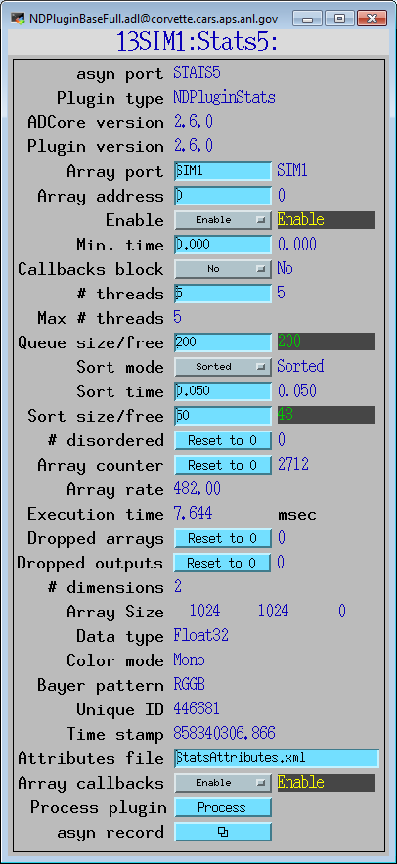
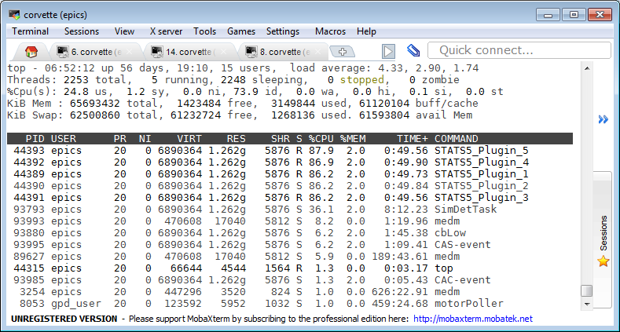
Multiple Threads per Plugin 5 Threads

Slide 52

NDPluginScatter
Used to distribute (scatter) the processing of NDArrays to multiple downstream plugins
Allows multiple instances of a plugin to process NDArrays in parallel, utilizing multiple cores to increase throughput.
Utilizes modified round-robin for choosing next output plugin
More complex than multiple threads in a single plugin, but allows the plugins running in parallel to have different configurations or even be different plugins
NDPluginGather
Merges NDArrays from multiple upstream plugins into a single output stream.
Designed to work with NDPluginScatter
Optional sorting by uniqueId

Slide 53
Distributed Processing with NDPluginScatter + EPICS V4
Distribute HDF5 file writing to multiple IOCs (4096 x 3078 8-bit)
IOC #1
IOC #2
IOC #3
IOC #4
ADSimDetector
NDPluginScatter
NDPluginPva
NDPluginPva
NDPluginPva
pvaDriver
pvaDriver
pvaDriver
NDFileHDF5
NDFileHDF5
NDFileHDF5
# IOCs | Files/sec | GB/sec
1 | 101.0 | 1.19
2 | 195.2 | 2.29
3 | 217.5 | 2.55

Slide 54
Viewers
areaDetector allows generic viewers to be written that receive images as EPICS waveform records over Channel Access
Current viewers include:
ImageJ plugin EPICS_AD_Display. ImageJ is a very popular image analysis program, written in Java, derived from NIH Image.
EPICS_NTNDA_Viewer. Same as above but uses pvAccess rather than Channel Access.
ffmpegServer allows image display in any Web browser
ffmpegViewer high-performance Qt-based viewer for MJPEG stream

Slide 55


EPICS_NTNDA_Viewer ImageJ plugin
New ImageJ plugin written by Tim Madden and Marty Kraimer
Essentially identical to EPICS_AD_Viewer.java except that it displays NTNDArrays from the NDPluginPva plugin, i.e. using pvAccess to transport the images rather than NDPluginStdArrays which uses Channel Access.

Slide 56
NDPluginPva Advantages
NTNDArray data transmitted "atomically" over the network
Channel Access requires separate PVs for the image data and the metadata (image dimensions, color mode, etc.)
With Channel Access data type of waveform record is fixed at iocInit, cannot be changed at runtime.
If the user wants to view both 8-bit images, 16-bit images, and 64-bit double FFT images then waveform record needs to be 64-bit double, adding a factor of 8 network overhead when viewing 8-bit images.
pvAccess changes the data type of the NTNDArrays dynamically at run-time, removing this restriction.
Channel Access requires setting EPICS_CA_MAX_ARRAY_BYTES
Source of considerable confusion and frustration for users.
pvAccess does not use EPICS_CA_MAX_ARRAY_BYTES and there is no restriction on the size of the NTNDArrays.

Slide 57
Viewers
EPICS_AD_Controller. Allows using the ImageJ ROI tools (rectangle and oval) to graphically define the following:
The readout region of the detector/camera
The position and size of an ROI (NDPluginROI)
The position and size of an overlay (NDPluginOverlay)
The plugin chain can include an NDPluginTransform plugin which changes the image orientation and an NDPluginROI plugin that changes the binning, size, and X/Y axes directions. The plugin corrects for these transformations when defining the target object.
Chris Roehrig wrote an earlier version of this plugin.

Slide 58
Other Drivers that use ADCore
NDArrays are not limited to 2-D detectors
File, ROI, and statistics plugs are useful for other types of detectors
Used for spectra arrays [NumMCAChannels, NumDetectors, NumPixels] for:
Xspress3 from Quantum Detectors
xMAP, Mercury and new FalconX from XIA
Used for time-series data [NumTimePoints, NumInputs] for the quadEM quad electrometer software
AH401, AH501, TetrAMM from CaenEls
Two types of electrometers from BNL Instrumentation group (Peter Siddons)

Slide 59
Conclusions
Architecture works well, easily extended to new detector drivers, new plugins and new clients
Base classes, asynPortDriver, asynNDArrayDriver, asynPluginDriver actually are generic, nothing “areaDetector” specific about them.
They can be used to implement any N-dimension detector, e.g. the XIA xMAP (16 detectors x 2048 channels x 512 points in a scan line)
Can get documentation and pre-built binaries (Windows) from our Web site:
http://cars.uchicago.edu/software/epics/areaDetector
Can get code from github
https://github.com/areaDetector

Slide 60
Updated links and details - Martin
User Guide – very helpful
https://areadetector.github.io/areaDetector/user_guide.html
GitHub organisation
https://github.com/areaDetector
NSLS-II EPICS Lecture Series
https://www.bnl.gov/nsls2/epics/
Top-level areaDetector module
https://github.com/areaDetector/areaDetector

