Slide 1
StreamDevice Introduction
Dirk Zimoch :: Paul Scherrer Institut
EPICS Collaboration Meeting October 2020

Slide 2
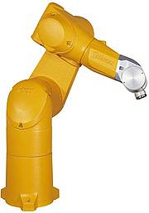
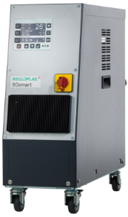
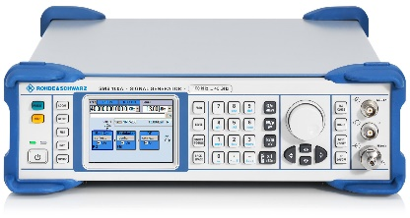
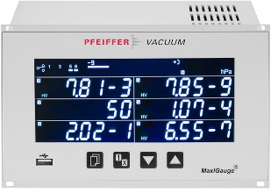
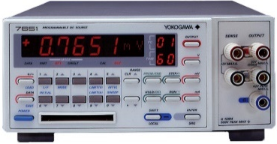
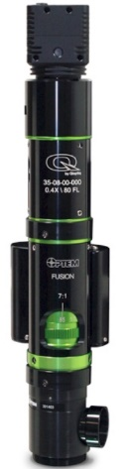
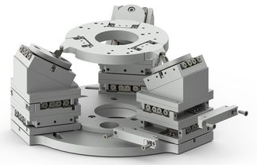
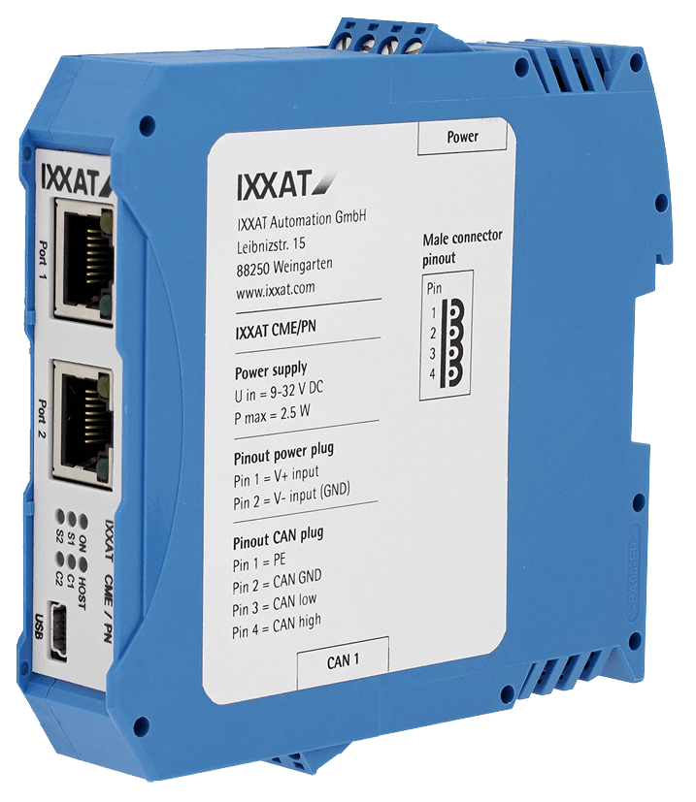
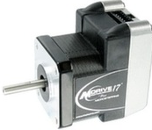
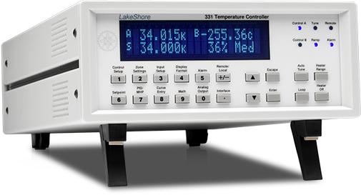
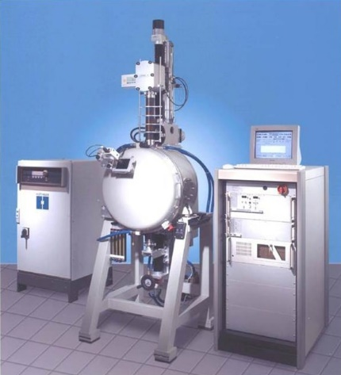
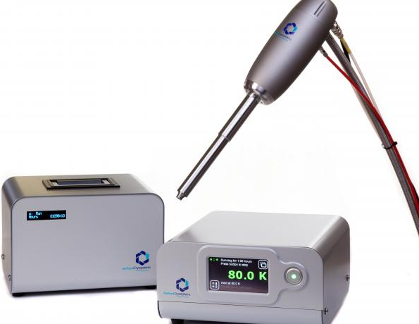
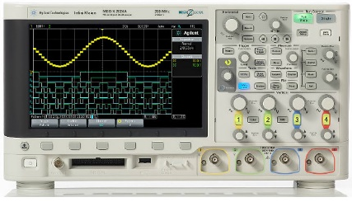
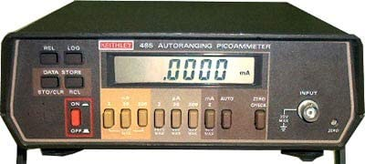
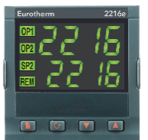
What is StreamDevice?
One generic EPICS driver for many different devices

Slide 3
How can a Device Driver be Generic?
Separate similarities from differences
What do many devices have in common?
What is different between those devices?
Command strings
Human readable Text
Fixed size (binary) “telegrams”
Command sets
Command words
Terminators
Limited set of buses
Serial (RS232, RS485, USB)
GPIB
Ethernet (TCP, UDP)
Value encoding
Formatting
Position in the command
Programming
Configuration

Slide 4
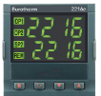
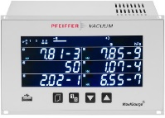
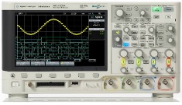
StreamDevice Architecture
Record database (templates)
ai
bo
stringout
...
waveform
StreamDevice
This is already done
%f
…
%b
Protocol file
%{…}
Modular design allows to plug in new functionality
%<…>
%/…/
This is what you need to do
asynDriver
This is already done
serial
Startup script
TCP
GPIB

Slide 5
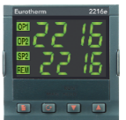
StreamDevice and asynDriver
Does StreamDevice replace asynDriver?
No. In fact it uses asynDriver to talk to the hardware.
To be exact: It uses the asynOctet interface.
But doesn’t asynDriver already come with device support?
Yes, but for string-based devices only stringin, stringout and char waveform.
https://github.com/epics-modules/asyn
StreamDevice does the string formatting and parsing and asynDriver does the hardware access.
https://github.com/paulscherrerinstitute/StreamDevice
Example:
3.1415 (double)
StreamDevice
"SET 3.14\r\n" (string)
ao VAL=3.1415
asynDriver
RS232
"SET %.2f\r\n"

Slide 6
Example: Read a Device in 3 Easy Steps
Read Kelvin temperature #1 from a LakeShore 218 via RS232
Command: "KRDG? 1" CR LF
Reply: "+273.15" CR LF
Configure serial port in startup script
drvAsynSerialPortConfigure LakeShore1 /dev/ttyS0
asynSetOption LakeShore1 0, baud 9600
asynSetOption LakeShore1 0, …
Write a protocol file, e.g. file LS218.prot
Terminator = CR LF; temp_K_1 { out "KRDG? 1"; in "%f"; }
Write a record connecting to protocol file, protocol, and port
record (ai, "$(DEVICE):TEMP1") {
field (DTYP, "stream") field (INP, "@LS218.prot temp_K_1 LakeShore1") field (EGU, "K")
field (PREC, "2") }

Slide 7
Protocol Files
Comment: # until end of line
Have one file for each device type
Best name it after device type
Set some global configuration of communication properties
Write one protocol for each function/command of device
Use out and in commands send and receive strings
Format/parse values with format converters like %f.
Format converters work on implicit variables, typically VAL or RVAL fields.
You can redirect to other fields or even other records
See: https://paulscherrerinstitute.github.io/StreamDevice/protocol.html
#LakeShore 218
Terminator = CR LF; ReplyTimeout = 1000; #ms ReadTimeout = 100; #ms
reset { out "*RST"; #no reply wait 2000; }
# read in Kelvin temp_K_1 { out "KRDG? 1"; in "%f"; }
# read in Celsius temp_C_1 { out "CRDG? 1"; in "%f"; }
Configuration variables
Protocol needs unique name within file
write constant string
read and parse reply string
if used by an ai record %f sets .VAL

Slide 8
Strings in StreamDevice
Only difference: no need to escape the other quote type
Strings can be single or double quoted.
"That's a string"
'This one too'
Strings can be written in chunks, with or without comma
"This is", ' one' " big" ' string'
Non-printable characters can be written in many ways: hex, oct, or dec number, escape sequence, symbolic name
0x0a 012 10 "\x0a" "\012" "\10" "\n" LF NL
0x00 0 "\x00" "\0" NUL
Alternatives can be freely mixed
0x1b "00", 'PR3' CR
See: https://paulscherrerinstitute.github.io/StreamDevice/protocol.html#str
This is the way to break long strings into multiple lines.
For a list of symbolic names and escape sequences see the documentation.

Slide 9
Formats as Known From printf/scanf
Standard formats
%f, %e, %E, %g, %G, %d, %i, %x, %o, %s, %c, %[…]
standard flags %0 -+# to modify format and %* to skip input
new flags %? for optional input and %= for input comparison
but no type modifiers like %hi or %lf
Additional formats and features
%b (bit strings like "10010001")
%r (raw machine format numbers)
%{…|…|…} (enumerations)
%<…> (checksums)
%/…/ (regular expressions)
Variable is implicit, usually VAL or RVAL field
Depends on converter type and record type
Can be redirected like %(EGU)s or %(record)f
See: https://paulscherrerinstitute.github.io/StreamDevice/formats.html
These are just some examples.
More formats can be added.
"redirection" is explained later

Slide 10
Protocol Parameters
Passing parameters from record to protocol can save typing.
Example: LakeShore218 has 8 temperatures
Terminator = CR LF; temp_K_1 {out "KRDG? 1"; in "%f";} temp_K_2 {out "KRDG? 2"; in "%f";} temp_K_3 {out "KRDG? 3"; in "%f";} temp_K_4 {out "KRDG? 4"; in "%f";} temp_K_5 {out "KRDG? 5"; in "%f";} temp_K_6 {out "KRDG? 6"; in "%f";} temp_K_7 {out "KRDG? 7"; in "%f";} temp_K_8 {out "KRDG? 8"; in "%f";}
Terminator = CR LF; temp_K {out "KRDG? \$1"; in "%f";}
Use parameter instead: "\$1" is 1st parameter
Pass value for 1st parameter
record(ai,"$(DEVICE):TEMP2") {
field(DTYP,"stream") field(INP,"@LS218.prot temp_K_2 $(BUS)") field(EGU,"K") field(PREC,"2") }
record(ai,"$(DEVICE):TEMP2") {
field(DTYP,"stream") field(INP,"@LS218.prot temp_K(2) $(BUS)") field(EGU,"K") field(PREC,"2") }
Up to 9 parameters possible.

Slide 11
Redirections
Normally format converters choose field automatically
VAL or RVAL, depending on format data type
Scaling (ASLO, AOFF) and smoothing (SMOO) are supported
But sometimes other fields or even other records are needed
e.g. when one message contains more than one value.
Examples:
Write value and units: out "%f %(EGU)s";
Read status and value: in "%(otherrecord)d,%f";
Other records must be on the same IOC.
Use parameters to avoid record names in protocols.
Like "%(\$1)d" or "%(\$1:STATUS)d"
If no field is given .VAL is assumed
pass full record name as parameter
pass only part of record name as parameter

Slide 12
Redirection Example
Example: "position?" request gives reply with 6 coordinates. "position( 1.2 , 2.1234, 23.12 ,-2.312 ,-12.33 ,24.4321)"
record (ai,"$(DEV):POS-X") {
field (DTYP,"stream") field (INP, "@$(PROT) pos($(DEV)) $(BUS)") field (EGU, "mm") field (PREC,"2") field (SCAN,"5 second")
field (FLNK,"…")
}
record (ai,$(DEV):POS-Y) {
field (EGU, "mm")
field (PREC,"2")
}
…
record (ai,$(DEV):POS-RZ) {
field (EGU, "deg")
field (PREC,"3")
}
pos { out "position?"; in "position(%f\_," "%(\$1:POS-Y)f\_," "%(\$1:POS-Z)f\_," "%(\$1:POS-RX)f\_," "%(\$1:POS-RY)f\_," "%(\$1:POS-RZ)f\_)";}
When FLNK is processed, the other records have already got their values.
Spaces around numbers:
%f accepts leading whitespace. Any amount of trailing whitespace is consumed by \_.
These records have SCAN="Passive" and DTYP="Soft Channel"
When redirecting to .RVAL use
DTYP="Raw Soft Channel"
Redirecting to other records uses dbPutField() and thus process the target if the field (here .VAL) is PP

Slide 13
Complex Protocol: Pfeiffer MaxiGauge
InTerminator = CR LF; # no OutTerminator because of ENQ pressure { out ESC "0\$1" "PR\$2" CR; in ACK; out ENQ; in "%(\$3:STATUS)d,%f"; }
Send device address (on RS485) ESC (0x1b) "aa"
aa is address 00, 01, …
Send pressure read command: "PRn" CR
n is sensor number 1 … 6
Each command is acknowledged with ACK (=0x06) CR LF
After acknowledge request value with ENQ (=0x05)
Receive status and pressure: "0,1.234E-5" CR LF
address
sensor
redirect status to other record
pass address, sensor and device name as 3 parameters
record (ai,"$(D):PRESSURE") {
field (DTYP,"stream") field (INP, "@Maxi.prot pressure($(A),$(S),$(D)) $(B)") }
record (mbbi,"$(D):STATUS") { field (ZRST,"OK") field (ONST,"Unterrange") field (TWST,"Overrange")
… }

Slide 14
Enum Format: %{…|…|…}
Translates integers to enumerated strings and back
Example1: Device can be switched with "STOP" and "GO".
Example2: Device may run forward or backward with different speeds (e.g. 1 or 5 mm/s) and reports this as "<<", "<", "=", ">", or ">>".
See: https://paulscherrerinstitute.github.io/StreamDevice/formats.html#enum
record (bo,"$(DEV):SWITCH") {
field (DTYP,"stream") field (OUT, "@XXX.proto switch $(BUS)") field (ZNAM,"off") field (ONAM,"on") }
record (longin,"$(DEV):SPEED") {
field (DTYP,"stream")
field (INP, "@XXX.proto speed $(BUS)") field (EGU, "mm/s")
}
0 = "STOP" 1 = "GO"
%#{ allows assignments: "<<" = -5 "<" = -1 "=" = 0 ">" = 1 ">>" = 5
switch { out "%{STOP|GO}"; }
speed { out "DIR?"; in "DIR=%#{<<=-5|<=-1|\=|>>=5|>=1}" }
Escape any literal | or } or = or \ in enum strings as \| or \} or \= or \\
>> before > to avoid wrong match
Input not matching any string raises INVALID/CALC alarm

Slide 15
Binary Protocols (aka “Telegrams”)
Example: Send/receive 5 bytes telegrams:
Address, command, 2 bytes value (little endian), xor-checksum
Confirmation is the same with bit 8 set in command byte
Use %r to send integers in "raw" machine code format
details on %r see next slide
Protocol does not use Terminators but has fixed size messages and checksums.
set_value { MaxInput=5; out $1 0x04 "%#.2r%<xor>"; in $1 0x84 "%=#.2r%<xor>"; }
get_value { MaxInput=5; out $1 0x44 0x00 0x00 "%<xor>"; in $1 0xc4 "%2r%<xor>"; }
pass address as parameter 1 (no \ outside quotes)
Add checksum
%= checks reply value
Test checksum
local configurations per protocol (overwrite globals)

Slide 16
Raw values: %r and %R
Output format: %<flag><width>.<precision>r
flag #: little endian (default is big endian)
width: number of bytes printed (sign extended, default 1)
precision: number of bytes taken from variable (default 1)
Example: value = 0xdeadbeef
out "%2r"; 0xff 0xef 1 byte sign extended to 2
out "%.2r"; 0xbe 0xef 2 bytes
out "%#.4r"; 0xef 0xbe 0xad 0xde 4 bytes little endian
out "%#4.2r"; 0xef 0xbe 0xff 0xff 2 bytes sign extended to 4
Input format: %<flag><width>r
width: number of bytes to read
flag #: little endian
flag 0: zero extend to long (default is sign extend)
%4R is float and %8R is double
See: https://paulscherrerinstitute.github.io/StreamDevice/formats.html#raw
Pitfall !
sorry for the mess out "%.2r" versus in "%2r"

Slide 17
Checksums: %<…>
Many types of checksums supported
sum, xor, crc (8,16,32 bit), adler32, …
Output: checksum is appended to output
Input: checksum is compared with input
Range selection: %<start>.<end><checksum>
start: number of bytes to skip from beginning of string (default 0)
end: number of bytes to skip just before %<...> (default 0)
Example: out "Example string%3.2<xor>";
Flag %0<…> switches to hex digits instead of raw bytes
Flag %#<…> switches to little endian for multi-byte checksums
See: https://paulscherrerinstitute.github.io/StreamDevice/formats.html#chksum

Slide 18
Regular expressions: %/…/
Regular expressions allow very powerful string parsing
either to read the string itself
or to find data that comes after some string
Example: Read title of a web-page. drvAsynIPPortConfigure "web","epics.web.psi.ch:80"
don't complain that we don't parse the whole page
%/…/ ignores all input before the match if the expression does not start with ^
OutTerminator = LF; ExtraInput = ignore;
title { out "GET http://\$1"; in "%.1/(?im)<title>(.*?)<\/title>/"; disconnect; }
(?im): case insensitive multi-line match.
These are Perl compatible regular expressions (PCRE) which are more powerful than Posix or GNU regex.
.1: get 1st sub expression, here: (.*?)
escape the /
web server disconnects after sending a page and so do we
record (stringin, "$(DEV):TITLE") {
field (DTYP,"stream")
field (INP, "@web.prot title(epics.web.psi.ch) web")
}

Slide 19
Asynchronous input: I/O Intr
Some devices send unsolicited data
Example: Temperature sensor sends periodically: "+27.3 C" CR LF
Asynchronous records have SCAN "I/O Intr"
Asynchronous protocols typically have only an in command.
Any input from that device is checked.
Including input going to other protocols
Record is processed whenever matching input is found.
Non-matching input is silently ignored (no error).
record (ai,"$(DEVICE):TEMP") {
field (DTYP,"stream") field (INP, "@$(PROT) temperature $(BUS)") field (EGU, "C") field (PREC,"1")
field (SCAN,"I/O Intr") }
Terminator = CR LF;
temperature { in "%f C"; }

Slide 20
I/O Intr vs. Redirection
Example: Read input line with two values x and y every second
record (ai,"$(D):x") {
field (SCAN,"1 second") field (DTYP,"stream") field (INP, "@XY.prot x $(BUS)") }
record (ai,"$(D):y") {
field (SCAN, "I/O Intr") field (DTYP, "stream")
field (INP, "@XY.prot y $(BUS)")
}
y is processed when x writes value to it
record (ai,"$(D):x") {
field (SCAN,"1 second") field (DTYP,"stream") field (INP, "@XY.prot x($(D)) $(BUS)") }
record (ai,"$(D):y") {
field (SCAN, "Passive") field (DTYP, "Soft Channel")
}
y is processed when anyone receives input that matches
x { out "xy?"; in "%f %(\$1:y)f"; }
x { out "xy?"; in "%f %*f"; }
y { in "%*f %f"; }
Redirection is more selective.
Only input from x goes to y.
Ignore second value
redirect second value
Be careful:
Any input with two numbers matches.
Ignore first value

Slide 21
Error Handling
All errors set SEVR to INVALID
STAT depends on error type
Reply timeout: device does not reply (TIMEOUT)
Read timeout: device stops sending unexpectedly (READ)
Write timeout: writing is not possible (WRITE)
Lock timeout: bus is blocked by other records (TIMEOUT)
Mismatch: input does not match format string (CALC)
Errors abort the protocol
but may trigger exception handlers
Errors are not propagated along redirections ☹
Redirects before mismatch are processed normally
Redirects after mismatch are not processed at all
Only active record gets error status
Mismatch in "I/O Intr" records is silently ignored

Slide 22
Exception Handlers
Jump to different protocol if something goes wrong
@mismatch, @replyTimeout, @readTimeout, @writeTimeout
Example: Device replies with value or error message
readValue { out "value?"; in "%f"; @mismatch { in "%(\$1:ErrorString)39c"; } }
if input does not match "%f" jump to @mismatch
If input does not match and the @mismatch handler starts with in, then the same input is parsed a second time.
reparse input and redirect
Exception handlers can be defined before or inside normal protocol.
record (ai,"$(DEVICE):Value") {
field (DTYP,"stream") field (INP, "@$(PROT) readValue($(DEVICE)) $(BUS)") }
record (stringin,"$(DEVICE):ErrorString") { }

Slide 23
Record Initialization
Output records can be initialized from hardware
Initialization is formally handled as an exception: @init
getVolt { out "VOLT?"; in "VOLT %f"; }
setVolt { out "VOLT %.2f"; @init {getVolt;} }
getFreq { out "FREQ?"; in "FREQ %f MHZ"; }
setFreq { out "FREQ %.6f MHZ"; @init {getFreq;} }
record (ai,"$(D):ReadVoltage") {
field (DTYP,"stream") field (INP, "@X.prot getVolt $(BUS)") }
record (ao,$(D):SetVoltage") { field (DTYP,"stream") field (OUT, "@X.prot setVolt $(BUS)") }
record (ai,"$(D):ReadFrequency") {
field (DTYP,"stream") field (INP, "@X.prot getFreq $(BUS)") }
record (ao,$(D):SetFrequency") { field (DTYP,"stream") field (OUT, "@X.prot setFreq $(BUS)") }
reference other protocol to insert all its commands
@init is executed in iocInit before scans are started and at re-connects.

Slide 24
Arrays
For arrays the format is repeated for each element with optional separator string in between.
Example: "{10.2,345.3,23.3,10.0}"
Input
reads max NELM elements
at least one element must be found
sets NORD to number of elements found
Output
writes NORD elements
readArray { Separator = ","; in "{%f}"; }
record (aai,"$(DEVICE):Array") {
field (FTVL,"FLOAT")
field (NELM,"100") field (DTYP,"stream")
field (INP, "@$(PROT) readArray $(BUS)") }

Slide 25
Recommended Reading
StreamDevice documentation
https://paulscherrerinstitute.github.io/StreamDevice
AsynDriver documentation:
https://epics-modules.github.io/master/asyn
Record Reference Manual
https://wiki-ext.aps.anl.gov/epics/index.php/RRM_3-14 https://epics.anl.gov/base/R3-15/8-docs/RecordReference.html
https://epics.anl.gov/base/R7-0/4-docs/RecordReference.html
EPICS How-To pages "Getting started"
https://docs.epics-controls.org/projects/how-tos

