Slide 1

ADEPT 101
Rev C

Slide 2
Agenda
Overview
Acquisitions
  DFN
    Overview
    COFF files
  ADEPT
    ADEPT Core
    Scripts
    AEA
Analysis
  AMA (ADEPT Manufacturing Application)

Slide 3
Overview
What is ADEPT?
ADEPT (Apollo Defect and Engineering Panel Tester) is the program to develop a new panel/detector tester platform based on PCDAS. PCDAS is the name of the project that developed the DFN (Detector Framing Node) board and the software to use it.
The DFN card handles all real time operations required to acquire images, send commands to the detector and change the status of RT bus signals. Since Windows is not a real time operating system, the application software has no real time control over the acquisition.
Detector
X-Ray/
LS Gen.
UI
monitor
Image
monitor
Conditioner
FC
RT
Heater
DFN
CPU
CAN/
Arcnet
Video
1
Video
2
USB/
Serial
Dosimeter
Windows PC

Slide 4
Overview
Tools
Analysis programs
IDA
Manufacturing App.
Image display
Panel definition
BPE & BFE
Test sequence def.
DL
Process step def.
PDA: Plot Display App.
Monitoring
Engineering App.
ICA: Image Conversion App.
Test report
Interactive access
ACL:ADEPT Component Lib.
UI for core functions
ADEPT Core
COM Interface (scriptable)
Acquisition control
Peripheral control
Detector config.
Image statistics
Image processing
Image display
Sequence manager
Image Archive
DFN script (Perl)
Event Compiler
DAS DLL
COFF file
DFN driver
ADEPT
Detector control interface
DFN board
FC
PC-DAS
Exposure control interface
EP
DAP
RT

Slide 5
DFN
DFN Overview
Diagnostic and Run modes
Real-time control of FC and RT events with 2 us resolution.
Linear or circular image buffer.
Any frame size. Support for reordering of rad/cardiac/angio/mammo images.
Image DMA to host
DFN autoscrub with synchronized detector commands
Event log (event timing, DMA information, errors and detector responses)
Internal test image generation

Slide 6
DFN
DFN Architecture
FB1
FB2
FB3
FB4
FB5
DAP
To
EP
DCB
FC
To
RS-
Local
XRAY
422
PLX
bus
To PCI

Slide 7
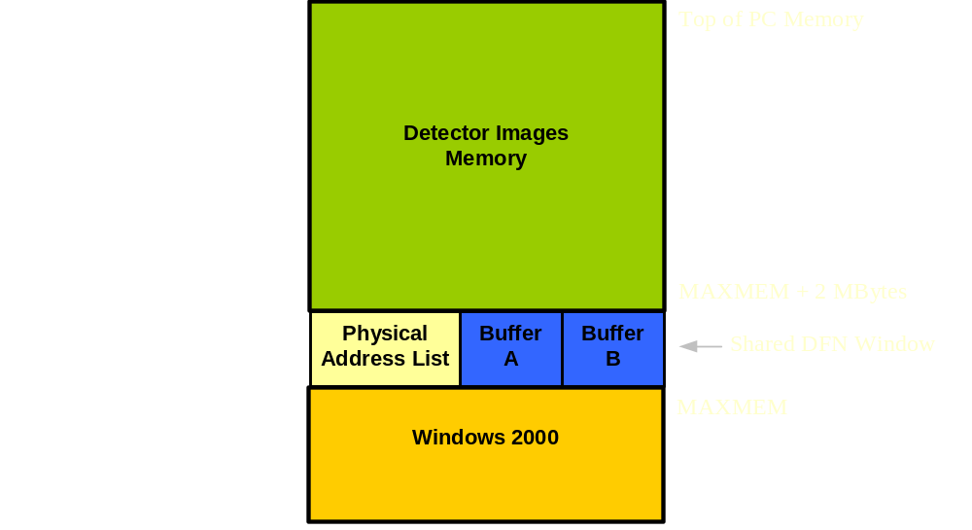
DFN
PC Memory distribution

Slide 8
DFN
DFN Autoscrub
Scrub
Any command
Scrub
Any command
Scrub
FC OUT
………
Autoscrub delay
FC Timeout
Autoscrub delay
FC Timeout
Remarks:
Only one command per DFN autoscrub period is possible
FC timeout must be lower than the DFN autoscrub period. Maximum FC timeout is 932ms.
Timing is preserved regardless of when/if the detector responds to the command

Slide 9
DFN
DFN EP functions
Send(Hdr1, Hdr2) | Transmit FC command to the detector. Hdr1 & Hdr2 are 32bit long.
SendI(Hdr1_qv, Hdr2_qv) | Transmit FC command to the detector only when a bit in one of the control registers is set. Hdr1_qv, Hdr2_qv are queue variables.
Delay(T) | Wait T*2us. T is 32 bit long.
Flag(F) | F is 3 bytes to control 8 bit signal on output port (host or RT bus).
LoopKF(K,F) | Repeat last K lines until flag F is received (from host or RT)
Wait(F) | Pause the execution of the queue until flag F is received.
LoopKN(K,N) | Repeat last K lines N+2 times

Slide 10
DFN
DFN Script Example
use event;
sub test_frame
{
$frame_name = 'test_frame';
%qv = (); %qp = ();
compile_init(@_, \%qp, \%qv, $frame_name);
Send(0x0,0); # Scrub command. Takes 2us
Delay(14769); # Wait 29538 us
Send(0x4020, 0x00028200); # Test pattern, TM0, etc..
Send(0x4080, 0x1); # ROI mode
#Frame for loop starts here
Delay(498); # Wait 1000 us
Flag(0x02FF00); # Set RT line #2 to state 1
Delay(497); # Wait 998 us
Flag(0x00FF00); # Set RT line #2 to state 0
Delay(889); # Wait 1782 us
Send(0x800000,0); # Image read out command. Takes 5946 us
Delay(11817); # Wait 23638 us
LoopKN(7,298); # Repeat last 8 lines 300 times
compile_finit();
}
sequence_begin();
test_frame (NULL, NULL, 1);
sequence_end();
Notes:
When the COFF file generated by this script is executed by the EP 300 frames are acquired @ 30fps. The RT bus signal is triggered 2.784ms before the start of frame readout. The comments about timing depend on the FC timeout and the detector firmware. Example assumes FC timeout = 10ms, Angio 4.5 detector firmware, DFN autoscrub on and stable running at 30fps.

Slide 11
DFN
DFN Script Example – Timing diagram
Scrub
Scrub
4020 & 4080 cmd
Frame readout cmd
Dead time. DFN waiting for response to cmd
FC OUT
………
33.332ms
29.548ms
3.784ms
5.946ms
23.638ms
33.332ms
FC IN
0x4020 and 0x4080 cmd ACK
Image data
………
RT #2
………
COFF file execution begins here. DFN is in auto-scrub mode.
………
Frame

Slide 12
ADEPT Core
ADEPT Core Overview
Image acquisition based on high level parameters.
Real-time image display during acquisition with offset/gain/window and level. Line repair correction.
High level interface for detector configuration and sensor read.
Sequence store to disk (full size or ROI). File has a 8192 bytes header with configuration and image sequence information.
Support of any peripheral that complies with a std. interface.
Support for any detector type via configuration file (Detector Information File). Detector firmware download.
Read acquisition, detector & peripheral parameters from acquisition configuration file.
X-ray and light exposure, dosimeter, collimator and interlock control.
Scriptable interface.

Slide 13
ADEPT Core
ADEPT Core configuration file: ACConfig.txt
This file contains parameters that affect the general behavior of ADEPT Core:
Maximum size of error log (ADEPT\Core\Log\AdeptCoreError.log)
Location of Detector Information Files and COFF files generated by ADEPT Core
Settings for RT bus exposure lines and timing information
Peripherals to be loaded:
  Generator
  Interlocks
  Light source
  Collimator
DFN Installed or not
Image monitor (0:no monitor, 1: main, 2: second monitor)
Ethernet detector and IP address.
Equilibration parameters for frame time changes.

Slide 14
ADEPT Core
Basic Acquisition Parameters
Number of frames before, during and after exposure.
Time between frames (TBF)
Expose time delay (ETD)
Acquisition type (Rad, Fluoro)
Dead time. DFN waiting for response to cmd
Frame readout cmd
FC OUT
………
FC IN
Image data
Image data
………
RT
………
Frame
………
RTR: Response To Read (DIF)
FRT: Frame Readout Time (DIF)
TBF
RTR
FRT
ETD

Slide 15
ADEPT Core
Detector Information File
The DIF is in ADEPT\Core\DetectorInfoFiles and contains:
Detector commands
Swap and reorder settings
Readout time (based on detector configuration)
Response to read time (based on detector configuration)
Image frame size (based on detector configuration)
Supported sensors, ramp, gain and other information.
For image acquisition, detector parameters present in the DIF must also be present in the configuration file for the header (DefaultImageInfoConfig.csv)
Correct timing information in DIF is required to ensure correct timing in COFF files generated by ADEPT Core
AC attempts to load the DIF based on the signature of the detector
Notes:
ADEPT Core will not “boot” the detector. If the detector is in boot firmware, ADEPT Core will not do anything to make it go to application firmware.

Slide 16
ADEPT Core
Header Configuration File
This file is in ADEPT\Core and contains:
All parameters that are put in the header (std and user).
Size allocated to each parameter and type of parameter
All versions of header.
The Image Information DLL provides methods to access header parameters.

Slide 17
ADEPT Core
Introduction to scripting ADEPT Core
In Windows, scripting is supported by the Windows Scripting Host (WSH). ADEPT Core has a scriptable COM interface. COM is a Microsoft standard for inter-process communication. COM is sometimes referred to as ActiveX.
Scripts in Windows can be written in several languages: JScript, VBScript, PerlScript, Perl.
The first requirement to use ADEPT Core is to create the object and then called mSysInit. At the end of the script call mSysFinish.
The functions that are available in ADEPT Core are documented in the ADEPT Core SDD (available in the GCO/Programs quickplace).
Windows scripts can be executed with cscript (command line) or wscript (windows).

Slide 18
ADEPT Core
AC Script Example 1 – Configure detector
<Job Id="WshShell"><script language=JScript>
var WshShell = WScript.CreateObject("WScript.Shell");
var AdeptCore = WScript.CreateObject("AdeptCore.ApolloTester");
try
{
  AdeptCore.mSysInit();
  WScript.Sleep(1000);
// Assuming ADEPT Core starts with this script, default detector
// configuration specified in DIF is set initially
AdeptCore.mSetDetectorParameter("SetAREF", 1.3);
AdeptCore.mSetDetectorParameter("FOVSelect", 1);
AdeptCore.mSetDetectorParameter("TimingMode", 4);
AdeptCore.mSetDetectorParameter("RampSelection", 7);
// ADEPT Core will NOT update the detector configuration table
// if parameters are set by sending commands to the detector
AdeptCore.mSendCommandToDetector(0x6001, 0xAD);
WScript.Sleep(4000);
}
catch(e)
{
WScript.Echo("Error: " + e.description);
}
AdeptCore.mSysFinish();
</script></job>
Notes:
The names of the detector parameters come from the $Commands section of the DIF. Since autoscrub is off, ADEPT Core will use the largest FC timeout to send the commands to set the requested parameters (one command for each parameter that changes). Only parameters set with mSetDetectorParameter will be put in the header of the acquired images.

Slide 19
ADEPT Core
AC Script Example 2 – Read sensors
<Job Id="WshShell"><script language=JScript>
var WshShell = WScript.CreateObject("WScript.Shell");
var AdeptCore = WScript.CreateObject("AdeptCore.ApolloTester");
try
{
var i, temp1, temp2;
AdeptCore.mSysInit();
AdeptCore.mSetDetCommandTimeoutInMicrosec(500000);
WScript.Sleep(1000);
for(i=0;i<10;i++)
{
temp1 = AdeptCore.mReadSensor("0x50");
temp2 = AdeptCore.mReadSensor("RefRegTemp2");
WScript.Echo("Temp1 = " + temp1 + ", Temp2 = " + temp2);
WScript.Sleep(4000);
}
}
catch(e)
{
WScript.Echo("Error: " + e.description);
}
AdeptCore.mSysFinish();
</script></job>
Notes:
Script to read sensors. Note that you can specify the sensor by its name or by its “number” (number is a string of the form “0x*”)

Slide 20
ADEPT Core
AC Script Example 3 – Simple acquisition
<Job Id="WshShell"><script language=JScript>
var WshShell = WScript.CreateObject("WScript.Shell");
var AdeptCore = WScript.CreateObject("AdeptCore.ApolloTester");
try
{
  AdeptCore.mSysInit();
  AdeptCore.mConfigSysAcq
        (16, // frames before
        5, // frames during
        4, // frames after
        0, // Interval between frames
        0, // frames to skip expose
        0, // acquisition Mode: 0=first, 1=last
        1); // fluoro Type: 0: cont, 1=pulsed
  AdeptCore.mSetDetCommandTimeoutInMicrosec(5000);
  AdeptCore.mSetTimeBetweenFramesInMicrosec(10000);
  AdeptCore.mSetExposeTimeDelayInMicrosec(100);
  AdeptCore.mEnableSyncAutoscrubWithSysAcq(1);
  AdeptCore.mEnableAutoscrub(1); WScript.Sleep(4000);
  var seqNumber = AdeptCore.mStartFluoroAcq(1); AdeptCore.mWaitForSystemIdle();
  AdeptCore.mStoreSequence(seqNumber, "C:\\Temp\\MyImages3.img");
AdeptCore.mWaitForSystemIdle();
}
catch(e)
{
WScript.Echo("Error: " + e.description);
}
AdeptCore.mSysFinish();
</script></job>
Notes:
Simple script to acquire 25 frames.

Slide 21
ADEPT Core
AC Script Example 4 – Last mode & det. config.
<Job Id="WshShell"><script language=JScript>
var WshShell = WScript.CreateObject("WScript.Shell");
var AdeptCore = WScript.CreateObject("AdeptCore.ApolloTester");
try
{
  AdeptCore.mSysInit();
  AdeptCore.mConfigSysAcq(16,150,4,0,0,1,1); // B,D,A,IBF,FTSE,AM,FT
  AdeptCore.mSetTimeBetweenFramesInMicrosec(10000); //~30fps (binned)
  AdeptCore.mSetExposeTimeDelayInMicrosec(100);
  AdeptCore.mSetDetCommandTimeoutInMicrosec(5000);
  AdeptCore.mEnableSyncAutoscrubWithSysAcq(1);
  AdeptCore.mEnableAutoscrub(1);WScript.Sleep(4000);
  var seqNumber = AdeptCore.mStartFluoroAcq(1); WScript.Sleep(10000);
  AdeptCore.mSetDetectorParameter(“SetVCommon1”, -11.2);
  WScript.Sleep(2000); AdeptCore.mStopAcq(1);
  AdeptCore.mWaitForSystemIdle();
  AdeptCore.mStoreSequence(seqNumber, "C:\\Temp\\MyImages4_B.img"); // 16
AdeptCore.mWaitForSystemIdle();
AdeptCore.mStoreSequence(seqNumber+1, "C:\\Temp\\MyImages4_D_A.img"); //154
AdeptCore.mWaitForSystemIdle();
}
catch(e)
{
WScript.Echo("Error: " + e.description);
}
AdeptCore.mSysFinish();
</script></job>
Notes:
This script starts an acquisition with default detector configuration (as specified in the DIF). The acquisition is in last mode, so two sequences will be acquired. The header of both sequences will have the initial detector parameters.

Slide 22

ADEPT Core
Image path
Host memory
DFN
1
2
Upper memory
Detector
FC
PCI
3
Windows memory
DOME
Steps 1 & 2 are independent from 3 & 4 when a linear buffer is used
Notes:
Image is acquired from the detector via the FC link
The DFN card organizes the data and transfers it to the upper memory of the host computer
The data is mapped to Windows memory for processing: corrections and window/level
Processed frame is transferred to the DOME card for display.

Slide 23
ADEPT Core
AC Script Example 5 – First mode & peripherals
<Job Id="WshShell"><script language=JScript>
var WshShell = WScript.CreateObject("WScript.Shell");
var AdeptCore = WScript.CreateObject("AdeptCore.ApolloTester");
try
{
  AdeptCore.mSysInit();
  AdeptCore.mConfigSysAcq(16,300,4,0,0,1,1); // B,D,A,IBF,FTSE,AM,FT
  AdeptCore.mSetProperty("GENERATOR", "ExposureTimeInMillisecs",1);
  AdeptCore.mSetTimeBetweenFramesInMicrosec(10000); //~30fps (binned)
  AdeptCore.mSetExposeTimeDelayInMicrosec(100);
  AdeptCore.mSetDetCommandTimeoutInMicrosec(5000);
  AdeptCore.mEnableSyncAutoscrubWithSysAcq(1);
  AdeptCore.mEnableAutoscrub(1);WScript.Sleep(4000);
  var seqNumber = AdeptCore.mStartFluoroAcq(1); WScript.Sleep(6000);
  AdeptCore.mGetProperty("DOSIMETER", "READ_DOSE");
  AdeptCore.mWaitForSystemIdle();
  AdeptCore.mStoreSequence(seqNumber, "C:\\Temp\\MyImages5.img");
AdeptCore.mWaitForSystemIdle();
}
catch(e)
{
WScript.Echo("Error: " + e.description);
}
AdeptCore.mSysFinish();
</script></job>
Notes:
This script starts an acquisition with default detector configuration (as specified in the DIF). The “ExposureTimeInMillisecs” property of the “GENERATOR” peripheral is set initially to 1msec. Some frames are acquired with that setting and then it is changed to 5msec. The acquisition continues until the buffer is filled.

Slide 24
ADEPT Core
ADEPT Core Script Example 6 – User provided COFF
<Job Id="WshShell"><script language=JScript>
var WshShell = WScript.CreateObject("WScript.Shell");
var AdeptCore = WScript.CreateObject("AdeptCore.ApolloTester");
try
{
  AdeptCore.mSysInit();
  AdeptCore.mSetUserSeqParams
      (30, // Buffer size
      1024, // number of rows
      1024, // number of cols
      "C:\\Temp\\myCOFF.bin", // frames to skip expose
      1, // wrap mode: 0 = off, 1 = on
      1); // seq. ID: 1 or 2
  AdeptCore.mSetDetCommandTimeoutInMicrosec(5000);
  AdeptCore.mSetAutoscrubDelayInMicrosec(28332);
  AdeptCore.mEnableAutoscrub(1);
  WScript.Sleep(4000);
  var seqNumber = AdeptCore.mStartUserSeq(1);
  AdeptCore.mWaitForSystemIdle();
  AdeptCore.mStoreSequence(seqNumber, "C:\\Temp\\MyImages6.img");
AdeptCore.mWaitForSystemIdle();
}
catch(e)
{
WScript.Echo("Error: " + e.description);
}
AdeptCore.mSysFinish();
</script></job>
Notes:
This script runs a user created COFF file and stores the acquired images.
A COFF file that does not acquire images can also be executed.

Slide 25
ADEPT Core
ADEPT Core Script Example 7 – Acq. config. file
<Job Id="WshShell"><script language=JScript>
var WshShell = WScript.CreateObject("WScript.Shell");
var AdeptCore = WScript.CreateObject("AdeptCore.ApolloTester");
try
{
  var acqFilename = “C:\\temp\\AcqConfig_Cardiac.txt”;
  var acqSectionName = “OffsetDisp_35C”;
  AdeptCore.mSysInit();
  AdeptCore.mLoadAcqFromCfgFile
      (acqFilename,
      acqSectionName);
  var seqNumber = AdeptCore.mStartNextAcq();
  AdeptCore.mWaitForSystemIdle();
  AdeptCore.mStoreSequence(seqNumber, "C:\\Temp\\MyImages7.img");
AdeptCore.mWaitForSystemIdle();
}
catch(e)
{
WScript.Echo("Error: " + e.description);
}
AdeptCore.mSysFinish();
</script></job>
Notes:
This script runs a user created COFF file and stores the acquired images.
A COFF file that does not acquire images can also be executed.

Slide 26
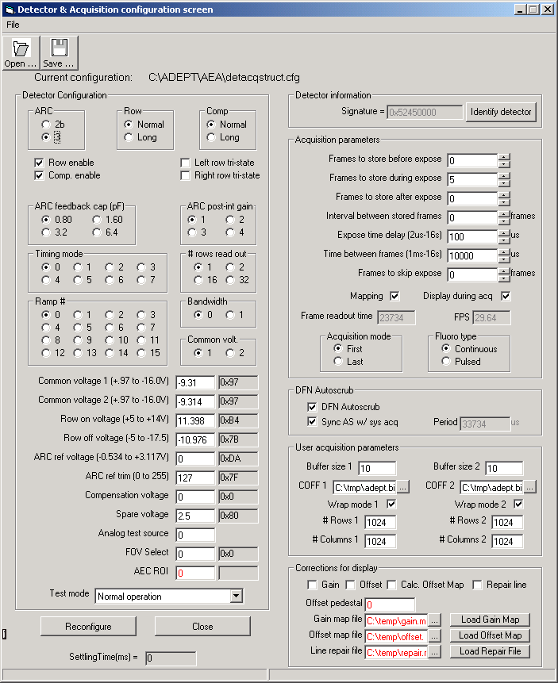
ADEPT Eng. Application
Configuration screen
Detector parameters
Acquisition settings
Image display settings
Notes:
This screen shows the major sections of the configuration screen of the ADEPT Eng Application

Slide 27
ADEPT Manufacturing
Architecture
Panel type config. file
Analysis Input file
Manufacturing App.
Test scripts
Analysis programs
Process step config. file
Panel definition
Test sequence def.
Test Sequence config. file
Process step def.
Monitoring
1
DL Test
DL
Test report
3
Test Association config. file
Analysis Config files
FW download and environment monitoring
2
Acq. Config files
Analysis Output files
ADEPT Core
Notes:
Lines in blue show the series of major events when a test script is launched. This example assumes that the script performs image acquisition first and then launches the analysis:
Script is launched
Script starts acquisition. AC reads acquisition parameters from acquisition configuration file.
Analysis program is launched to analyzed the images that were just acquired.

