Slide 1
synApps status and plans
Tim Mooney
Beamline Controls & Data Acquisition Group
June 13, 2006

Slide 2
What is synApps?
EPICS-based software for use at synchrotron beamlines
Commissioning-level software for ~80% of a new beamline
  Basic support for common beamline devices
Support for higher level, beamline-specific applications
  Code libraries, implementation tools, examples
Run-time tools to help users meet unanticipated needs
  Can build software machines, feedback loops, serial support
Support for collaborative development of beamline software
  A vehicle by which developers at one beamline can easily contribute to software running on other beamlines.
On the web:
  www.aps.anl.gov/aod/bcda/synApps

Slide 3
...What is synApps?
A collection of EPICS Applications for use at synchrotron beamlines
Tools for translating user requirements into running code:
  USER: “I need 40 motors, two scaler banks, an MCA, a monochromator, two optical tables, four current preamplifiers, 8 serial ports, four DAC channels, three slits, a mirror, run-time calcs, scans, ...”
  DEVELOPER: edit startup files to configure hardware and load databases

Slide 4
Scope
Mostly infrastructure and generic capabilities, as opposed to experiment/technique-specific programs
  E.g., things like motors, scalers, and scans, as opposed to things like EXAFS, small-angle scattering, and protein crystallography
  Why?
    Economics – Generic has the wider audience
    Information & expertise – beamline developers have it; we don’t.
    Control – Generic software allows us to contribute to user software without taking control.
Mostly IOC-resident code, as opposed to client-side programs
  E.g., scan software could run on workstations, but instead it runs on IOC’s
  Why?
    Access/coordination – IOC-resident code can be driven by anyone; clients generally cannot be driven by other clients.
    Distribution/deployment – EPICS handles this for ioc-resident code.

Slide 5
...Scope
Some statistics:
  19 EPICS modules
    autosave, calc, camac, ccd, dac128V, dxp, ebrick, ip, ip330, ipUnidig, love, mca, motor, optics, quadem, sscan, std, vme, xxx
  16 record types
    aCalcout, sCalcout, swait, transform, camac, dxp, motor, mca, table, busy, sscan, scanParm, epid, scaler, sseq, vme
  ~156 device types (~118 hard, ~38 soft)
  ~197 EPICS databases
  ~458 MEDM display files
  ~526 c, c++, SNL source files (~281,000 lines of code)
  ~77 documentation files (~38,000 lines of documentation)

Slide 6
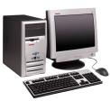




Architecture
Same as any other EPICS Application
Client side
  runs on Solaris, Linux, Windows
  interfaces to C, C++, java, IDL, Python, tcl, ...
Server side
  runs on vxWorks, Linux, Windows, Solaris
  can develop in C, C++, SNL
spec
transient
tool
Default
GUI
CA client interface
CA server interface
Driver
Driver
Driver
Driver

Slide 7
How is synApps used?
Copy xxx module, edit to fit beamline, boot crate
Excerpt from xxx-module’s st.cmd file:
dbLoadDatabase("../../dbd/iocxxx.dbd")
…
# Motors
dbLoadTemplate("motor.substitutions")
…
# Slits
dbLoadRecords("$(OPTICS)/opticsApp/Db/2slit.db","P=xxx:,SLIT=Slit1V,mXp=m3,mXn=m4")
dbLoadRecords("$(OPTICS)/opticsApp/Db/2slit.db","P=xxx:,SLIT=Slit1H,mXp=m5,mXn=m6")
…
# Monochromator
dbLoadRecords("$(OPTICS)/opticsApp/Db/kohzuSeq.db","P=xxx:,M_THETA=m9,M_Y=m10,
M_Z=m11,yOffLo=4,yOffHi=36")
…
iocInit
…
### startup State Notation Language programs
seq &kohzuCtl, "P=xxx:, M_THETA=m9, M_Y=m10, M_Z=m11, GEOM=1, logfile=kohzuCtl.log“

Slide 8
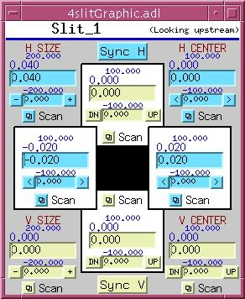
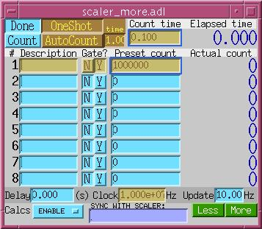
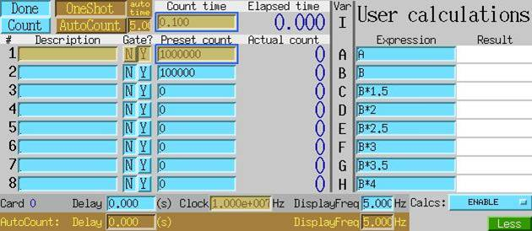
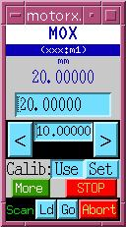
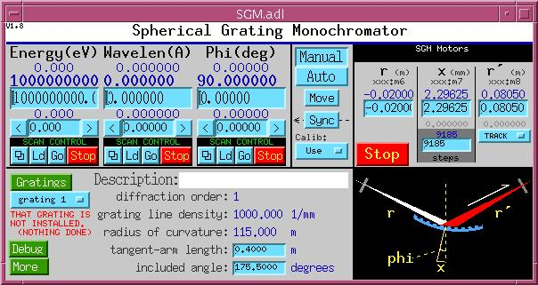
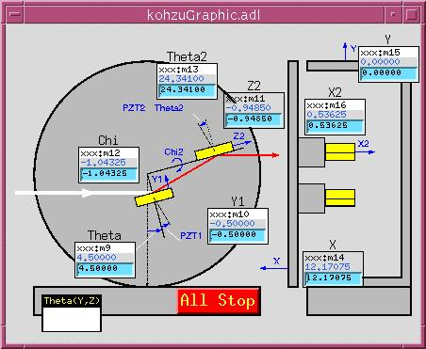
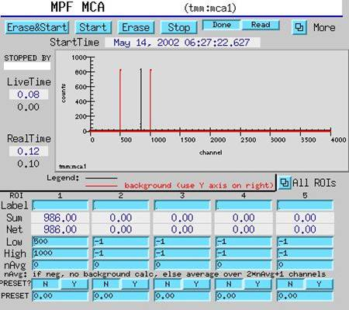
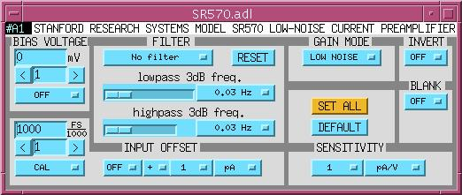
Sample user displays

Slide 9
synApps modules
autosave | parameter save/restore; maintains continuity through reboot
calc | run-time expression evaluation
camac | CAMAC support
ccd | CCD support
dxp | XIA DSP-based x-ray detector pulse analyzer
ebrick love | EPICS-brick application Love controllers (digital and analog I/O via serial)
Ip*, dac* | Serial, analog, and digital I/O
mca | multichannel analyzers and multichannel scalers
motor | stepper/servo motor
optics | monochromators, optical table, etc.
quadEM | four-channel fast analog input
sscan | scans, data storage
std | scalers, feedback, misc.
vme | VME hardware
xxx | runnable example of how everything in synApps is configured & used; typically controls a single experiment station

Slide 10
Who uses synApps?
Synchrotron beamlines
  ~20 sectors of APS
  Swiss Light Source
  NSLS (several beamlines)
  Diamond
  Australian Synchrotron
  CLS, LCLS ?
Other EPICS sites
  Many non-synchrotron sites use a few synApps modules, notably
    motor
    autosave
    calc

Slide 11
Content of a synApps module
Source code
  EPICS records
  EPICS device/driver support
  EPICS databases
  SNL and other code
autosave-request files
  Database author figures out how to survive reboot
MEDM-display files
  The default user-interface tool
Documentation
Some modules contain runnable examples

Slide 12
synApps depends on software written by others
Module | Developer Org. | Purpose
asyn | APS Controls & CARS-CAT | support for asynchronous message-based control
ipac | APS Controls | IndustryPack carrier support
seq | SLAC | State-Notation-Language compiler
genSub | Observatory Sciences | General-purpose subroutine record
vxStats | SNS/ORNL | vxWorks status/statistics
allenBradley | APS Controls | support for communicating with Allen-Bradley PLC’s
synApps also uses (“contains”? “second sources”?) some software written by others that is not in the form of a module
The idea is to avoid requiring synApps users to find, configure and test software that someone else has already found, configured, and tested.

Slide 13
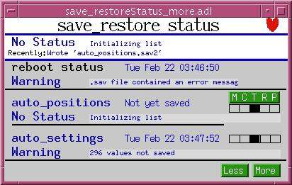
autosave module
Records values of selected EPICS Process Variables -- periodically, or in response to user-specified trigger
Restores saved values when the computer restarts
Can save/restore any scalar or array-valued PV
Developer chooses default PV’s to be saved; user can override
Defends saved values from incompetent file server, crash, etc.
Recent work:
  v4.1.3 (synApps 5.2 candidate)
  reduce sensitivity to errors
  status-PV name length fixed
Plans:
  no immediate plans

Slide 14
calc module
Evaluate expressions entered at run time
Records
  sCalcout – like calcout, but also supports string expressions; user can specify wait-for-completion.
  aCalcout – like sCalcout, but for arrays instead of strings;
  swait – like calcout, but uses recDynLink (no “PP MS” link attributes)
  transform – like 16 calcout records that share a PV data pool
Other code
  string/array-calc engines
  sCalcout soft device support (with wait-for-completion option)
  interpolation (lookup table), based on the genSub record

Slide 15
...calc module
Recent work:
  v2.6.1 (synAps 5.2 candidate)
  array calc
  ESC(), TR_ESC() added to sCalc
  sCalcout record uses device support (for streamDevice)
  interp array (lookup table) modifiable via PV’s at run time
  expression help in MEDM displays
Plans:
  Copy Andrew Johnson’s store-to-variable enhancement of the standard calc engine to string/array-calc engines.
  enhance aCalc with new operators/functions as needed
  Get rid of swait-record’s dependence on recDynLink

Slide 16
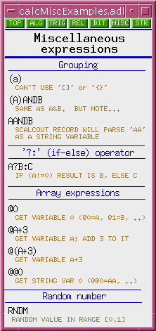
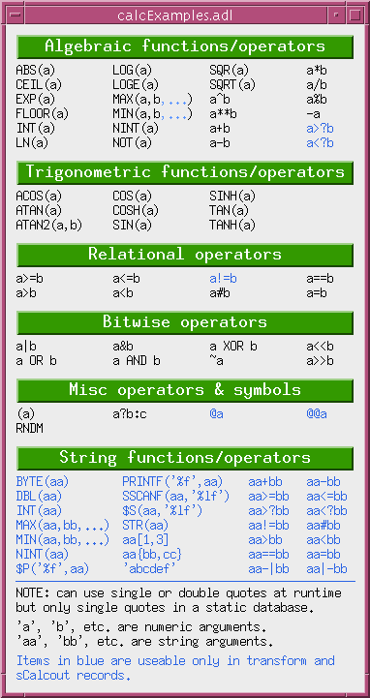
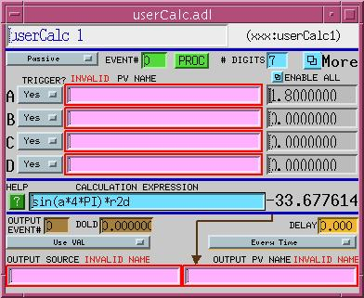
...calc module
Databases, medm displays for run-time programming
  userCalc,
  userStringCalc
  userArrayCalc
  userTransform
  userAve
  lookup table

Slide 17
ip module
Originally, all IndustryPack modules
Now, only support for message-based devices
device support, SNL code, databases, and MEDM displays for message-based devices
  digital multimeters, current preamplifiers, temperature controllers, etc.
deviceCmdReply
  Used to write support at run time for one command/reply message
  sCalcout to format output string
  asyn record to write/read device
  sCalcout record to parse reply
  handles messages with embedded nulls, selected checksums
devXxStrParm device support
  to be replaced by streamDevice/asyn

Slide 18
...ip module
Recent work:
  v2.6 (synApps 5.2 candidate)
  SR630 thermocouple scanner
  Pelco CM6700 video switch
Plans:
  New module manager (Kurt Goetze)
  integrate streamDevice
    as new module? (not currently in module form)
    as code within ip?

Slide 19
optics module
Slits and mirrors
Monochromators
  Nondispersive double-crystal
  Dispersive double crystal
  Spherical Grating
Optical table
Orientation matrix
  (H, K, L) ←→ (2θ,θ,φ,χ) + constraint
  User/client can write to underlying motors
Automated alignment for zone-plate microscope

Slide 20
...optics module
Recent work:
  v2.5 (synApps 5.2 candidate)
  Orientation matrix
  Automated microscope alignment
  Added ionization-chamber calibration support
Plans:
  Include SLS support for plane grating monochromator?
  general purpose alignment tools

Slide 21
sscan module
Support for user-programmable data-acquisition
  sscan and busy records
  saveData
  recDynLink
Recent work:
  number of data points limited only by IOC memory
  pipelined data storage
  can mix scalar and array detectors
  fixed some link-management bugs
  added Python code to read, write, and operate on scan-data files
  Include Dohn Arms’ (APS/XOR-7) C-code utilities for scan-data files
Plans:
  Support 2D-array detectors

Slide 22
std module
Epid record
  Extended PID record
Scaler record
  Controls a set of counters with a common clock, gate, and trigger
String-sequence record (i.e., ‘seq’ for strings or numbers)
  Can choose to wait for completion after each step in sequence
Soft-motor database
  Run-time programmable soft-motor/transform/hard-motor database
  Quick solution for driving a motor through a nonlinear transform
Timestamp record [stolen from Stephanie Allison @ SLAC]
  needed by SNS’ vxStats; currently not available in a module
4-step database
  Up to four steps of (set condition; read data) with an end calculation
  Originally developed for dichroism experiments

Slide 23
...std module
Recent work
  v2.5.2 (synApps 5.2 candidate)
  pvHistory – short-term history of PV
  String-sequence record: fixed link-management bug
Plans:
  Convert scaler record to use asyn-based device support

Slide 24
xxx module
Prototype user directory (i.e., deployable menu of synApps software)
  Builds everything in synApps into a load module
  Contains command files to load/configure everything in synApps
  Contains sample top-level MEDM-display file
  Contains sample script to start up the user interface
  Contains table of recommended address/interrupt configuration.
Recent work:
  load/config examples for new devices
Plans:
  more support for converting applications to new version of synApps

Slide 25
other directories
Top-level documentation directory
  How to build and deploy synApps
config directory
  Configures and builds all modules in or used by synApps
  MASTER_RELEASE – specifies all module versions
utils directory
  changePrefix -- Global search and replace of EPICS PV prefix within a copy of the xxx module
  copyAdl -- Find all MEDM-display files buried in a file tree; copy to specified directory

