Slide 1
BCDA Cross Training
Love Controller Support
David Kline
April 4, 2005

Slide 2
Contents
Overview,
Hardware Configurations,
Software Architecture,
  Common record initialization scenario,
  Read AI record scenario,
loveApp standalone application,
  Initialization scenario,
Reporting (dbior),
MEDM screens,
Distribution,
Improvements,
Acknowledgements,

Slide 3
Overview
Love Controller,
  Instrument to measure voltage, current, thermocouple,
  Support models 1600 and 16A,
  Communication is through 2-wire RS485,
Device support,
  Old support based on MPF,
  New support based on Asyn,
  The echoServer and devMPC were departure points,
  Includes an interpose interface,
  Standalone application is available,
  IP-Octal RS232 and RS485 modules can be used,
Purpose of the new device support,
  Use as a learning tool for Asyn-based device support,
  Migrate from the unsupported MPF to Asyn,
  Appoint one as the owner of the module,
  Provide OS independence,

Slide 4
Hardware Configuration – RS232 <-> RS485
IP-OCTAL
MVME5100
TVME200
SBS XM-Octal-IO
RS232
RS485
TD
B&B Electronics
485LDRC
Converter
A(-)
RD
B(+)
Love
Controller
Model 1600₁
Love
Controller
Model 16A₂
Love
Controller
Model 1600_{n-1}
Love
Controller
Model 1600_{n}

Slide 5
Hardware Configuration – RS485
IP-OCTAL
MVME5100
TVME200
SBS XM-Octal-IO
A(-)
B(+)
Love
Controller
Model 1600₁
Love
Controller
Model 16A₂
Love
Controller
Model 1600_{n-1}
Love
Controller
Model 1600_{n}

Slide 6
Software Architecture
EPICS
AI Record Support
EPICS
AO Record Support
EPICS
BI Record Support
EPICS
BO Record Support
EPICS
MBBI Record Support
EPICS
Asyn Record Support
(asynRecord)
Love Device Support (devAsynLove)
Lovelink Interpose Interface Layer (interposeLovelink)
asynDriver
asynOctet
asynManager
portDriver
Octal IP-Module (tyGSOctal)
Hardware Port

Slide 7
Common record initialization scenario
EPICS
Record Support
Love
Device Support
Asyn
EPICS
Utilities
XX__init()
lov__recordInit()
createAsynUser()
parseLink()
connectDevice()
findInterface()
validateParams()

Slide 8
Read AI record scenario
EPICS
Record Support
Love
Device Support
Asyn
Love
Interpose Interface
Love
Controller
ai_read()
queueRequest()
callback()
preProcess()
executeCommand()
write()
write
write message
read()
read
read response
process()
ai_read()
ioCompletion()

Slide 9
loveApp standalone application
Sample application,
New with the release,
Supports vxWorks and Linux,
Database with PVs for each command,

Slide 10
loveApp Initialization Scenario
Startup
Cmd File
Octal
IP Module
Asyn
Port Driver
Love
Interpose
EPICS
Love
Device Support
Init IP carrier
Init IP module
Create device
Init Serial Port
Config Serial Port
Init Interpose Lovelink
Load database
Register record,device,driver
Load database records
Init IOC
Init record inst.

Slide 11
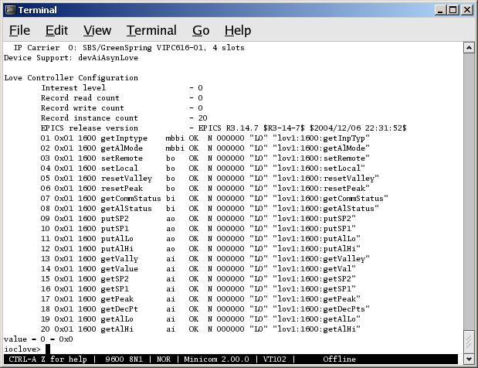
Reporting (dbior)
General
Information
Item
Number
Controller
Model
Record
Type
PACT
State
Controller
Address
Controller
Command
Asyn
Status
Access
Counter
Asyn
Port Name
PV
Name

Slide 12
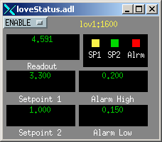
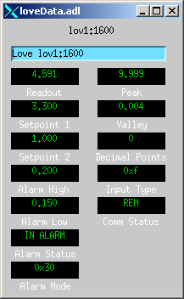
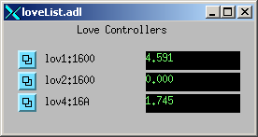
MEDM screens

Slide 13
Distribution
Standard directories,
  Configuration,
    Requires Asyn 4-2 and Ipac 2-8,
  Documentation,
    Model 1600 and 16A,
    485LDRC RS232/RS485 converter,
    Release notes, known issues,
    Wiring diagram,
  Database, record instance files,
  iocBoot for Linux and vxWorks (startup scripts),
  MEDM displays,
Contains the sources,
  devAsynLove.c,
  interposeLovelink.c,
  devLove.cc,
  loveServer.cc,

Slide 14
Improvements
Placement and usage of Asyn trace facility,
Usage of other Asyn interfaces,
Error reaction to communication timeout failure,
Further abstraction of record initialization methods,
???

Slide 15
Acknowledgements
Marty Kraimer,
Ron Sluiter,

Slide 16
Thank You
Code Inspections
Beamline Controls and Data Acquisition
APS Operations Division

