Slide 1
BCDA Cross Training
Love Controller Support
David Kline
April 4, 2005

Slide 2
Contents
Overview,
Hardware Configurations,
Communication protocol,
Software Architecture,
  Common record initialization scenario,
  Read AI record scenario,
loveApp standalone application,
  Initialization scenario,
Reporting (dbior),
MEDM screens,
Distribution,
Improvements,
Acknowledgements,

Slide 3
Overview
Love Controller,
  Instrument to measure voltage, current, thermocouple,
  Support models 1600 and 16A,
  Communication is through 2-wire RS485,
Device support,
  Old support based on MPF,
  New support based on Asyn,
  The echoServer and devMPC were departure points,
  Includes an interpose interface,
  Standalone application is available,
  IP-Octal RS232 and RS485 modules can be used,
Purpose of the new device support,
  Use as a learning tool for Asyn-based device support,
  Migrate from the unsupported MPF to Asyn,
  Appoint one as the owner of the module,
  Provide OS independence,

Slide 4
Hardware Configuration – RS232 <-> RS485
IP-OCTAL
SBS 626 (TVME200)
MVME5100
SBS XM-Octal-IO
RS232
RS485
TD
B&B Electronics
485LDRC
Converter
A(-)
RD
B(+)
Love
Controller
Model 1600₁
Love
Controller
Model 16A₂
Love
Controller
Model 1600_{n-1}
Love
Controller
Model 1600_{n}

Slide 5
Hardware Configuration – RS485
IP-OCTAL
SBS 626 (TVME200)
MVME5100
SBS XM-Octal-IO
A(-)
B(+)
Love
Controller
Model 1600₁
Love
Controller
Model 16A₂
Love
Controller
Model 1600_{n-1}
Love
Controller
Model 1600_{n}

Slide 6
Communication
2-wire RS485,
Master/slave protocol, command, response messages,
Message format (simple),
  Sent and received as ASCII hex,
  Cmd:
    Read: <STX>L<ADDR><CMD><CS><ETX>
    Write: <STX>L<ADDR><CMD><VALUE><CS><ETX>
  Rsp:
    Data: <STX>L<ADDR><RSP><CS><ACK>
    Err: <STX>L<ADDR>N<CODE><ACK>
How does device support know commands?
  INP/OUT fields,
  field(INP,”@asyn(PORT,ADDR) CMD MODEL”)

Slide 7
Software Architecture (coarse granularity)
EPICS
AI Record Support
EPICS
AO Record Support
EPICS
BI Record Support
EPICS
BO Record Support
EPICS
MBBI Record Support
EPICS
Asyn Record Support
(asynRecord)
Love Device Support (devAsynLove)
Lovelink Interpose Interface Layer (interposeLovelink)
drvAsynSerialPort
Octal IP-Module (tyGSOctal)
Hardware Port

Slide 8
Software Architecture (fine granularity)
devAsynLove
AI
AO
BI
BO
MBBI
interposeLovelink
asynOctet
drvAsynSerialPort
asynOption
asynCommon
interposeEos
asyn Port “S0”
asynOctetBase
asyn Port “S0”
asynOctet

Slide 9
Common record initialization scenario
EPICS
Record Support
Love
Device Support
Asyn
EPICS
Utilities
XX__init()
lov__recordInit()
createAsynUser()
parseLink()
connectDevice()
findInterface()
validateParams()

Slide 10
Read AI record scenario
EPICS
Record Support
Love
Device Support
Asyn
Love
Interpose Interface
Love
Controller
ai_read()
queueRequest()
callback()
preProcess()
executeCommand()
write()
write message
read()
read response
process()
ai_read()
ioCompletion()

Slide 11
loveApp standalone application
Sample application,
New with the release (R3-0-0),
Supports vxWorks and Linux,
Database with PVs for each command,

Slide 12
loveApp Initialization Scenario
Startup
Cmd File
Octal
IP Module
Asyn
Port Driver
Love
Interpose
EPICS
Love
Device Support
Init IP carrier
Init IP module
Create device
Init Serial Port
Config Serial Port
Init Interpose Lovelink
Load database
Register record,device,driver
Load database records
Init IOC
Init record inst.

Slide 13
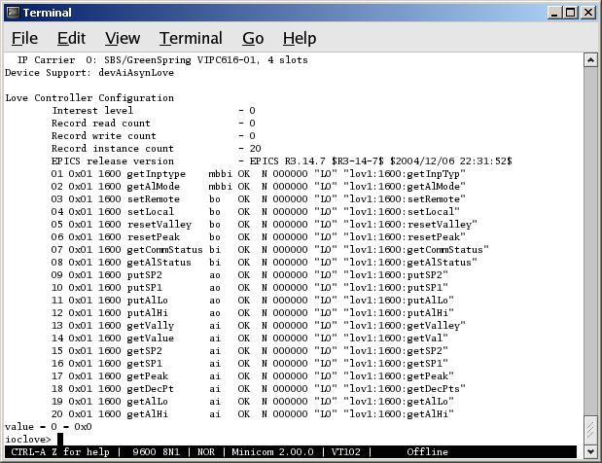
Reporting (dbior)
General
Information
Item
Number
Controller
Model
Record
Type
PACT
State
Controller
Address
Controller
Command
Asyn
Status
Access
Counter
Asyn
Port Name
PV
Name

Slide 14
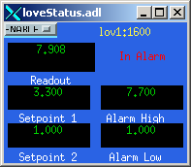
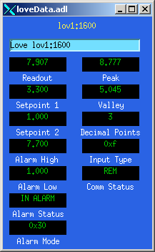
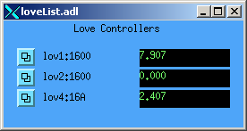
MEDM screens

Slide 15
Distribution
Standard directories,
  Configuration,
    Requires Asyn 4-2 and Ipac 2-8,
  Documentation,
    Controller and converter Information,
    Release notes, known issues,
    Wiring diagram,
  Database, record instance files,
  iocBoot for Linux and vxWorks (startup scripts),
  MEDM displays,
Contains the sources,
  devAsynLove.c,
  interposeLovelink.c,
  devLove.cc,
  loveServer.cc,

Slide 16
Improvements
Current issues,
  Cannot easily debug an individual controller,
  Tight coupling between device support and model type (i.e. INP/OUT),
  Device support controls the command / response processing,
Solutions,
  Develop a multidevice driver,
  Employ different approach to reduce coupling,

Slide 17
Improvements – Multidevice port driver
Develop a multidevice port driver,
Replaces the existing interposeLovelink layer,
Placed on top of drvAsynSerialPort,
Creates multiple connections to an Asyn port,
Allows connections to individual controllers,
Monitor individual controller communication,

Slide 18
Improvements – Multidevice port driver
devAsynLove
AI
AO
BI
BO
MBBI
“L0” addr=1
addr=1
addr=3
addr=4
addr=5
drvLove
asynOctetBase
asyn Port “L0”
asynCommon
asynOctet
drvAsynSerialPort
asynOption
asynCommon
interposeEos
asynOctetBase
asyn Port “S0”
asynOctet

Slide 19
Improvements – Different approach
Modify the information supplied to INP/OUT,
Employ the drvAsynSerialPort and drvLove drivers,
Implement an interpose at layer to,
  Define interfaces for the specific model (i.e. love1600),
  Provide a method to map the controller address to model type,
  Reduces the need for conditional statements,
  Introducing new model type is cleaner,

Slide 20
Improvements – Different approach, cont…
devAsynLove
AI
AO
BI
BO
MBBI
“L0” addr=1
addr=1
addr=3
addr=4
addr=5
interposeLove
asynOption
love1600
love16A
drvLove
asyn Port “L0”
asynOctetBase
asyn Port “L0”
asynCommon
asynOctet
drvAsynSerialPort
asynOption
asynCommon
interposeEos
asynOctetBase
asyn Port “S0”
asynOctet

Slide 21
Acknowledgements
Marty Kraimer,
Ron Sluiter,

Slide 22
Observation
…it’s all about the interfaces and the methods that implement that interface…

Slide 23
Thank You
Cross Training
Beamline Controls and Data Acquisition
APS Operations Division

