Slide 1

VisualDCT Spreadsheet View
Sunil Sah
sunil.sah@cosylab.com

Slide 2
Introduction
VisualDCT: Visual representation of EPICS database
Benefits: Spatial data organization
  Logical grouping
  Visible data dependencies
  Traceable processing patterns
Drawbacks: Type oriented information is dispersed
  Does not enable grouping of similar records
  Does not enable editing of multiple fields belonging to one type
Solution: multiple views
  spatial + spreadsheet

Slide 3
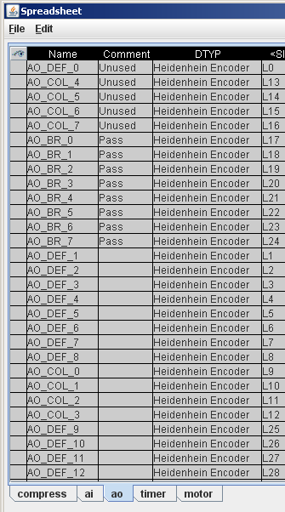
Spreadsheet View
Provides:
  Organization by type
  Overview of the whole database
  Interface to other spreadsheet applications
Whole dataset - too much information; solutions:
  Spatial selection of input
  Customization of the view
Customizations are stored in the database file
  Transfer data together with view

Slide 4
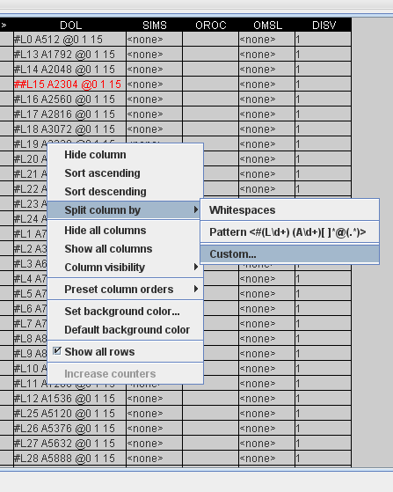
Features
Data transfer:
  Copy/Paste, Drag and Drop
  Rectangular blocks or rows
  From/to Excel, OpenOffice, ...
Support for attaching counters
Hiding rows and columns
Undo/Redo changes
Row sorting
Column repositioning
  By preset orders
  By Drag and Drop
Column splitting:
  Manipulate data below the level of a field value
  Split by simple delimiters or specify the field structure using regular expressions

Slide 5
Thank You for Your Attention

