Slide 1
Cooking Recipe
Group 2: Le Thanh Hai
Bui Nguyen Bao Ngoc

Slide 2
Overview
The project provides cooking recipes that help users having a reliable source to gain knowledge about cooking
Cooking Recipe

Slide 3


Users
Clients
Admins

Slide 4

Clients
Login/Logout/Sign up
Search for recipes
Get recipe detail
Save recipes for your own
Comment about recipe

Slide 5

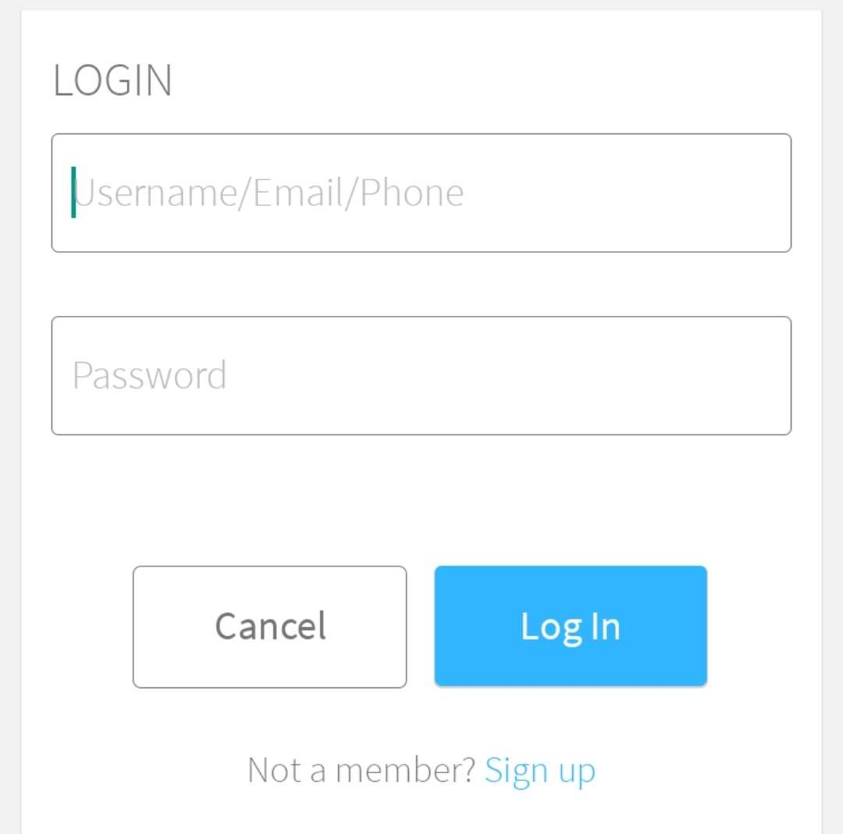
You can login with a account or register a new one for advanced work
Log out after finishing your work

Slide 6

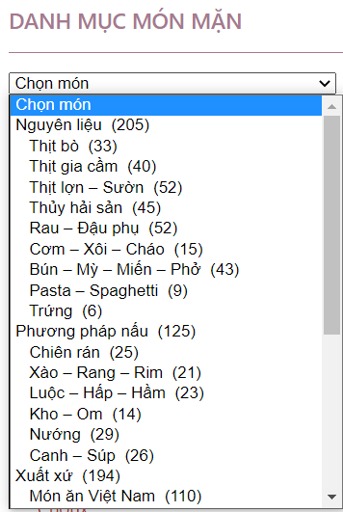
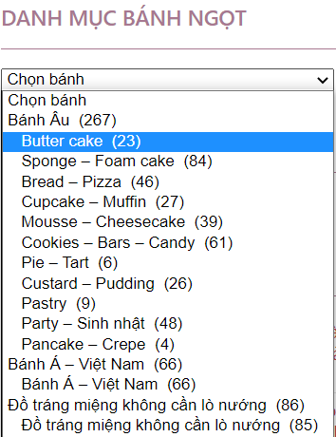


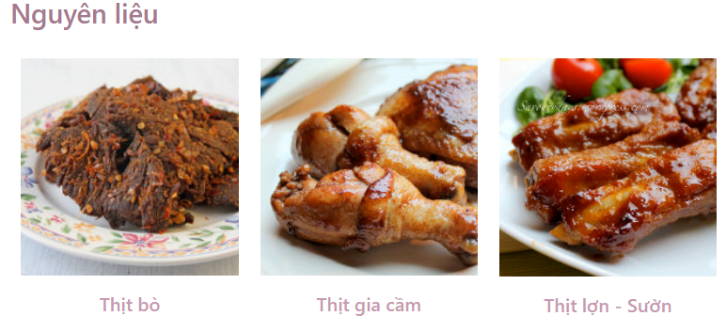
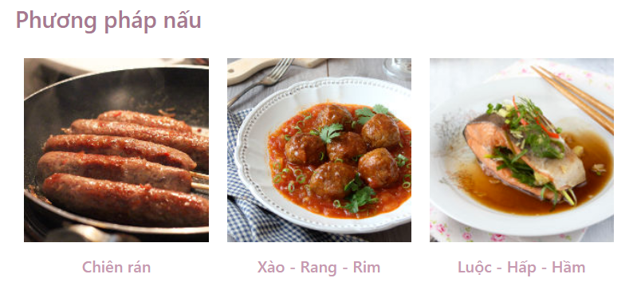

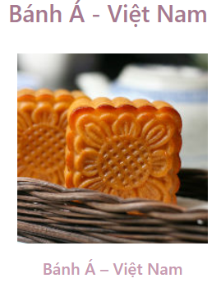
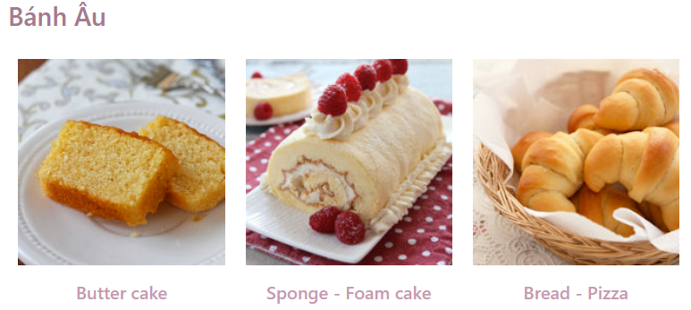
Searching
Searching with category
Searching with a scroll
Know exactly how many recipes in a tag
Attractive pictures
Fast and convenient
Easy to understand the tag

Slide 7
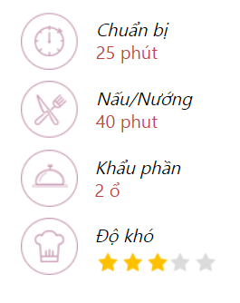
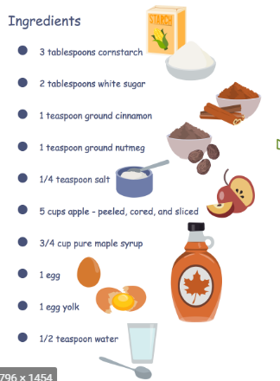

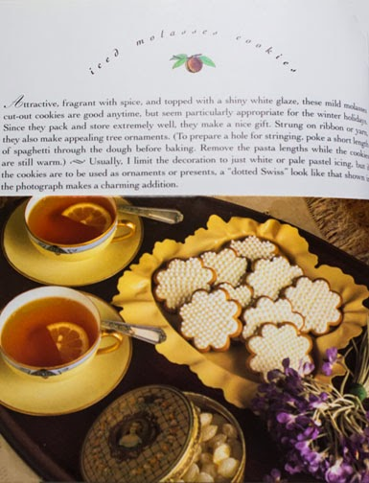
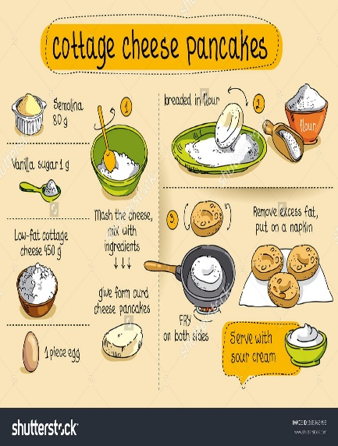
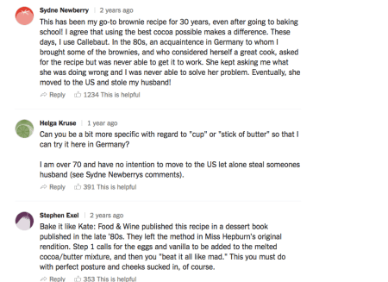
Recipe Detail
First Introduce
Others clients comments
How to do
The first introduce of the writer about overview or reason for making this recipe
The detail introduction, divided by step
All others comments to help you to see more aspect of the recipe
Brief Infomation
Ingredients
Writer’s
note
All of the ingredients for the recipe and the amount required
The personal note of the writer to have a best cooking
Some basic and brief information: time of preparing, difficulty,…

Slide 8
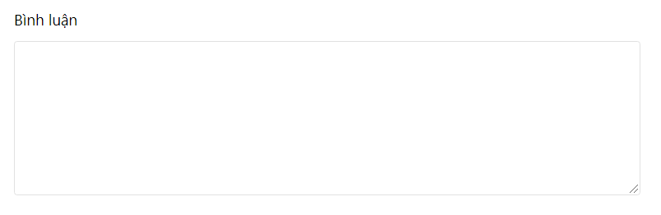
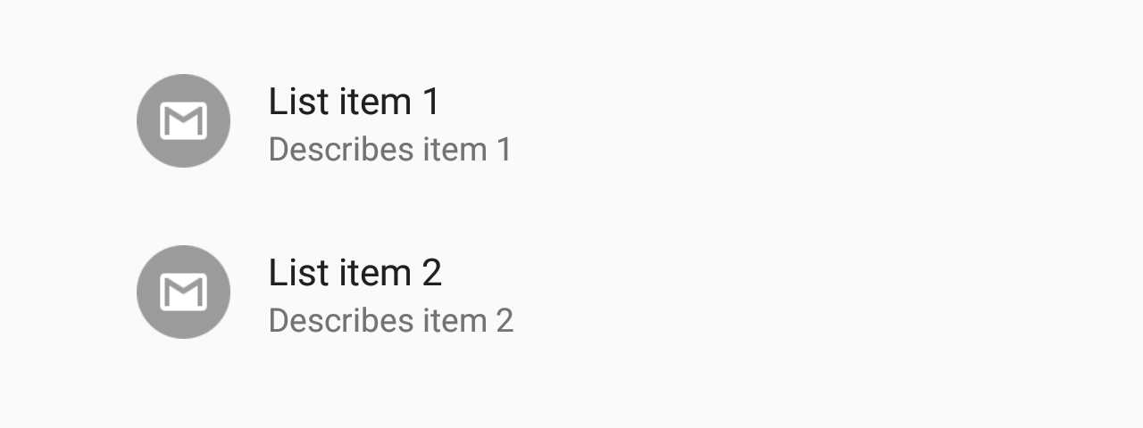

More activities
Make comments
Save recipe
Write your comments
If today you don’t have time to do the cook, you can save it for other day for convenient
Save recipe
Write your comments to express your opinion or share some experience of yourself

Slide 9

Admins
Login/Logout/Sign up
Search for recipes
Similar to clients
Get recipe detail
Comment about recipe
Manage recipe databases
Add/Remove/Adjust items

Slide 10
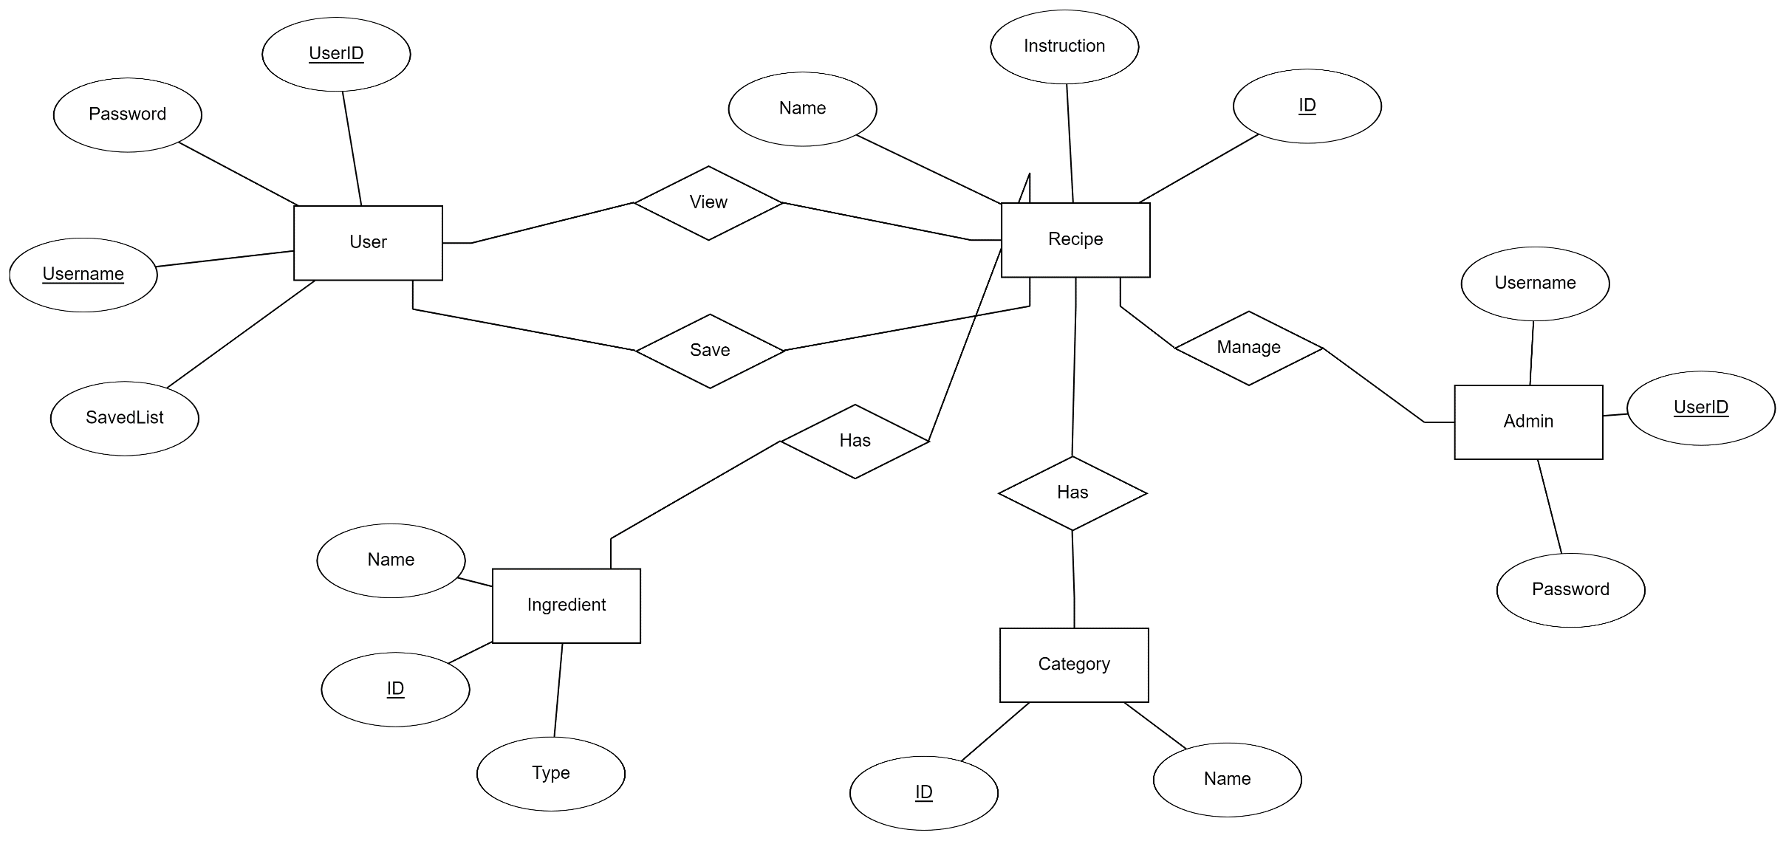
Entites-Relationship Diagram

Slide 11
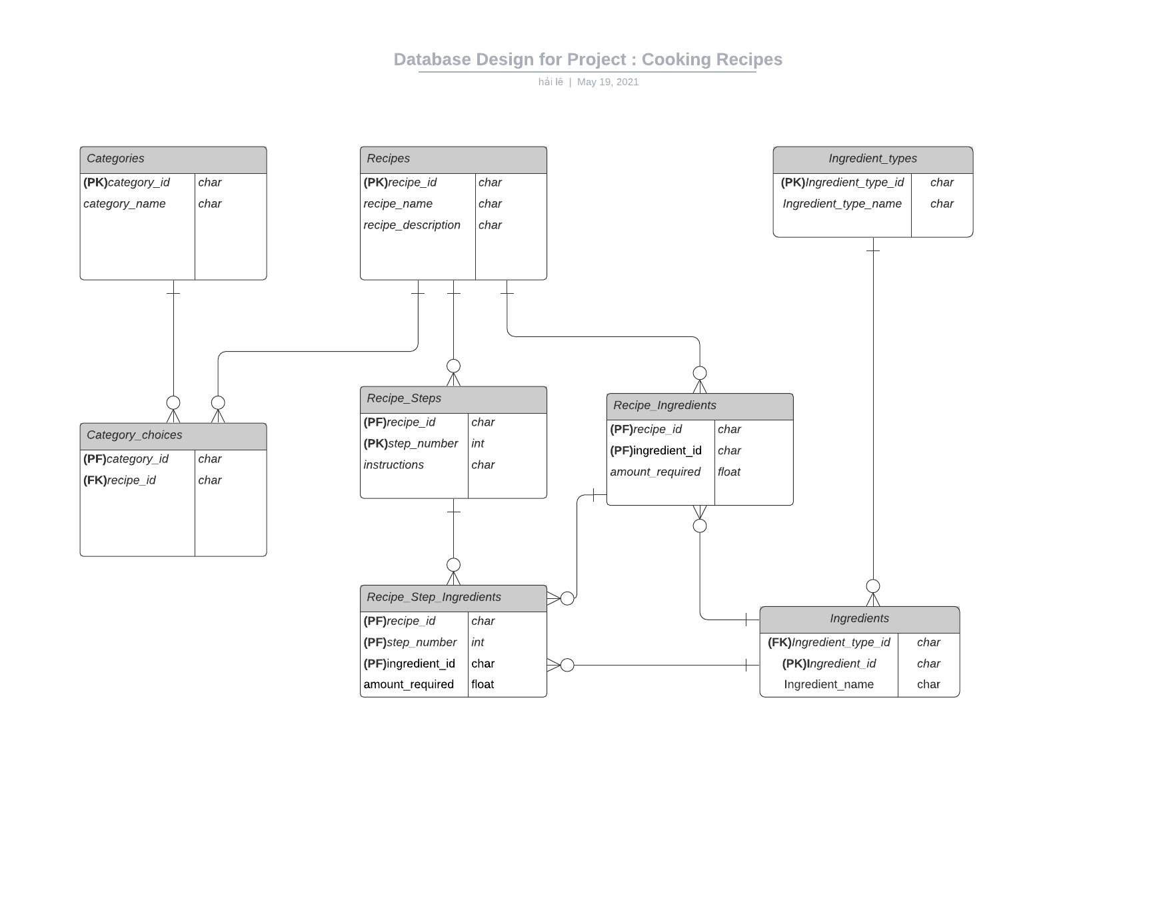
Entites-Relationship Diagram

Slide 12
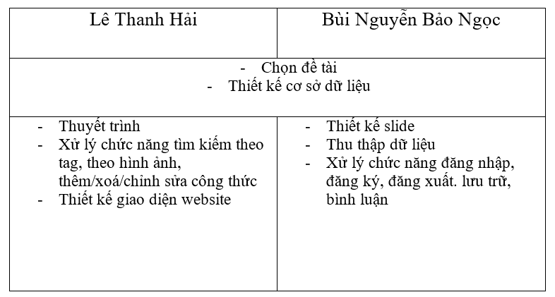
Member Job

