Slide 1

DriverPass
System Analysis
Student Name
Notes:
No speaker notes required for this slide.

Slide 2

System Requirements
Functional Requirements
Online reservation scheduling for driving lessons
User account management with password reset
Nonfunctional Requirements
Cloud-based hosting with automatic backups
Accessible from any device via web browser
Notes:
Welcome to the DriverPass System Analysis presentation. Today I will walk you through our proposed system design for your driver training business.
The DriverPass system is designed to help your customers prepare for their DMV driving tests through online classes, practice tests, and on-the-road training sessions. Our goal is to create a comprehensive platform that allows you to manage all aspects of your business from anywhere with an internet connection.
Let me begin by explaining the key requirements we identified for your system.

Slide 3
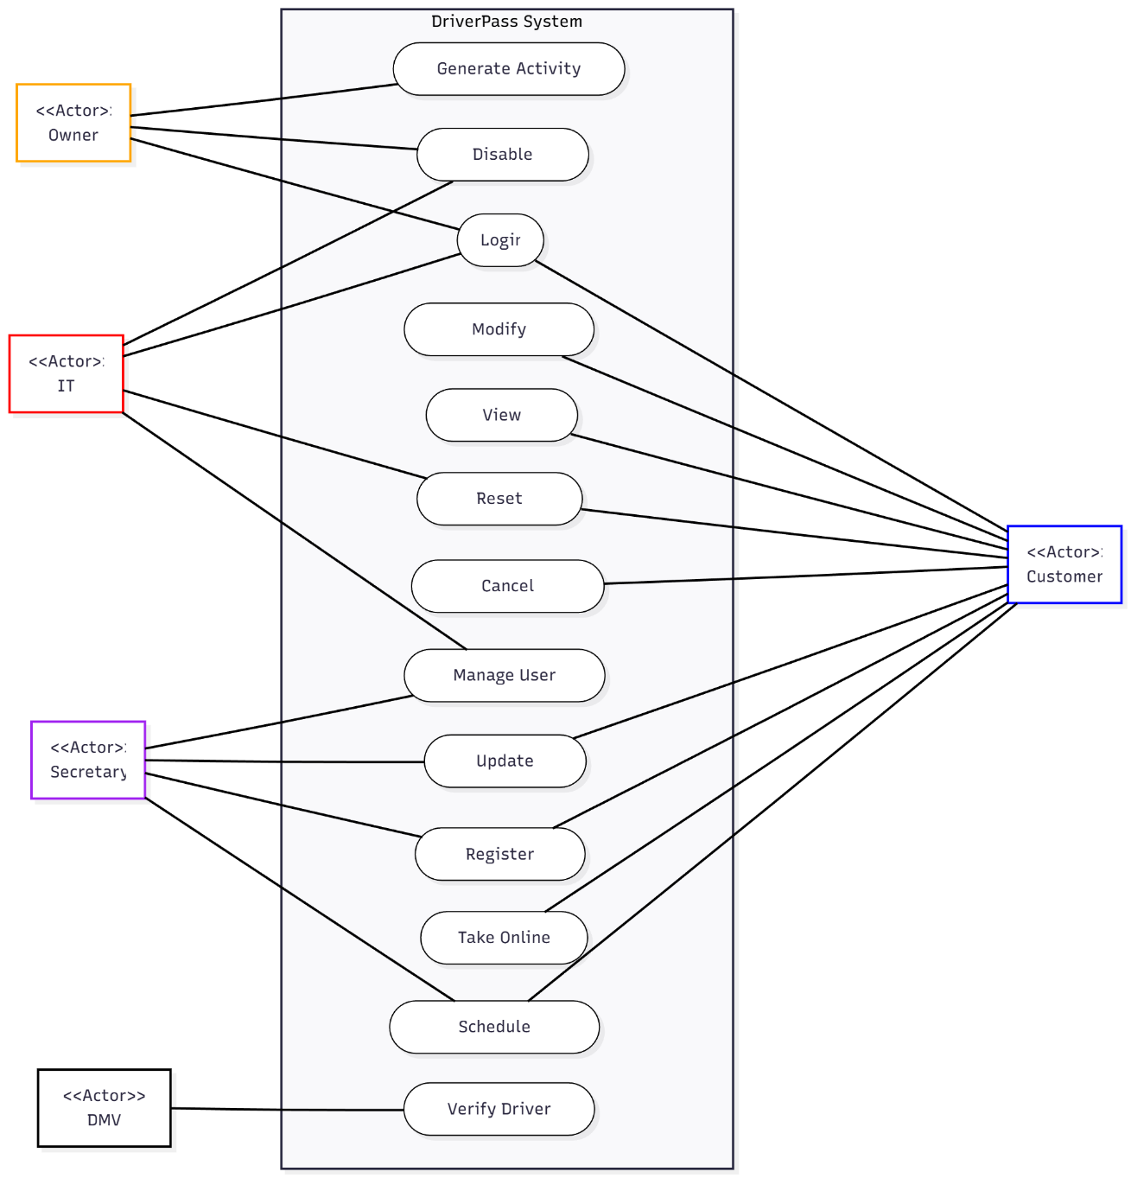
Use Case Diagram
Notes:
This diagram shows all the people who will interact with the DriverPass system and what they can do.
On the left side, we have your internal team: You as the owner can generate activity reports and disable packages. Your IT officer Ian can manage all user accounts, reset passwords, and block access when needed. Your secretary can help customers schedule appointments and register new users.
On the right side, we have your customers. They can log into the system, view their information, make and modify reservations for driving lessons, take online practice tests, and register for your services.
At the bottom, we show the connection to the DMV, which will send updates about rules and policies to keep your training materials current.
This design ensures that each person has access to exactly what they need which helps keep your data secure and your operations running smoothly.

Slide 4
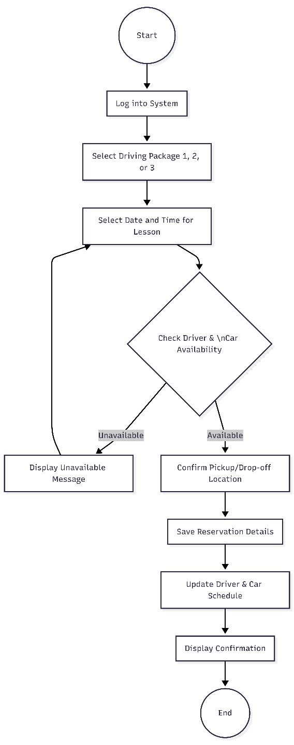
Activity Diagram
Notes:
This diagram shows the step-by-step process for scheduling a driving lesson, which is one of the most important features your customers will use.
First, the customer logs into the system and selects which package they want - Package One with six hours, Package Two with eight hours, or Package Three with twelve hours of training.
Next, they choose their preferred date and time for their two-hour lesson. The system then checks if a driver and car are available at that time.
If the requested time slot is taken, the system shows a message asking them to pick a different time. If the slot is available, the customer confirms their pickup location, and the system saves all the reservation details.
Finally, the driver and car schedules are updated, and the customer receives a confirmation of their booking.
This automated process reduces the workload on your secretary and allows customers to book lessons 24/7 from any device.

Slide 5
Security
Role-based access control for different user types
Secure password storage with reset capability
Encrypted data transmission (SSL/TLS)
Activity tracking and audit logs
IT admin control over user accounts
Notes:
Security was a major focus in our design because you are handling sensitive customer information including credit card numbers.
First, we implemented role-based access control. This means each type of user has different permissions. For example, only Ian as IT officer can reset passwords or block accounts.
Second, all passwords are stored securely and customers can reset their own passwords automatically through email, reducing the burden on your staff.
Third, all data transmitted between the customer's device and your servers will be encrypted using industry-standard security protocols. This protects credit card information and personal data from being intercepted.
Fourth, the system tracks all changes to reservations, including who made them and when. This creates an audit trail so you can print activity reports and determine who is responsible if any issues arise.
These security measures protect both your business and your customers while meeting industry standards for data protection.

Slide 6
System Limitations
Internet connection required for all updates
Package customization requires developer support
DMV integration depends on external availability
System relies on third-party cloud provider
Notes:
While our design addresses your core needs, there are some limitations to be aware of.
First, the system requires an internet connection for any updates or changes. While you can download reports for offline review in Excel, you cannot make modifications to data without being connected.
Second, if you want to add or remove training packages in the future, this will require developer assistance. We designed the system so you can enable or disable existing packages yourself, but creating entirely new package types needs technical support.
Third, the connection to the DMV for receiving rule updates depends on their system being available. If the DMV system is down, your system may not receive the latest updates immediately.
Fourth, because we are using a cloud hosting service for backups and security as you requested, your system depends on that provider being operational. We recommend selecting a reputable provider with strong uptime guarantees.
These limitations are common in web-based systems and represent reasonable tradeoffs for the convenience and accessibility you requested.

