Slide 1

Brauner et al. (2020)
NPI: mask wear, gatherings, closed businesses, schools closed, lockdown
Countries: 41 countries, 34 European and 7 non-European.
Dates: January – May 2020
Model: semi-mechanistic hierarchical Bayesian. Flaxman et al (2020) extension.
Output: estimated daily infections, estimated daily deaths, estimated reproduction number (Rt).
Flaxman et al. (2020)
NPI: school closure ordered; case-based measures; public events banned; social distancing encouraged; lockdown decreed; and the time of the first and last intervention. Data: Death data from 11 countries
Countries: Austria, Belgium, Denmark, France, Germany, Italy, Norway, Spain, Sweden, Switzerland and the UK.
Dates: 3 Feb – 4 May 2020
Model: semi-mechanistic hierarchical Bayesian
Output: estimated daily infections, estimated daily deaths, estimated reproduction number (Rt).
Qian et al. (2020)
NPI: school closure, workplace closure, travel restrictions, event cancellation, public transport (9 NPI) + 36 socio-economic & demographic data
Countries: 170 countries.
Dates: 22 Jan – 8 May 2020
Model: 2-layer SVIGP model.
Output: estimated daily infections, estimated daily deaths, estimated reproduction number (Rt).
Unwin et al. (2020)
NPI: mobility data from Google, grocery & pharmacy visits; parks; transit stations; retail & recreation; residential; workplace.
Countries: 50 US states.
Dates: 3 Feb – 1 June 2020
Model: semi-mechanistic hierarchical Bayesian. Flaxman et al (2020) extension.
Output: estimated daily infections, estimated daily deaths, estimated reproduction number (Rt).

Slide 2


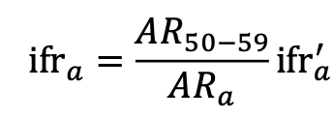

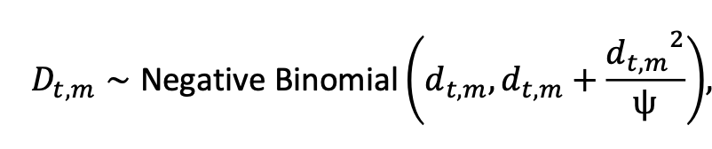
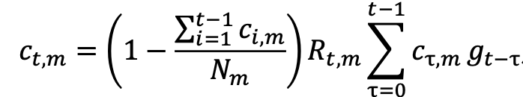

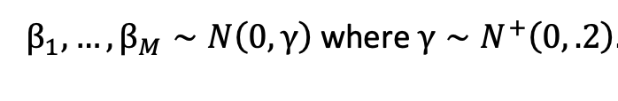

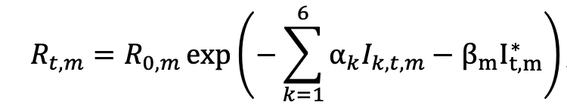

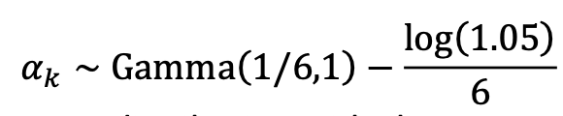
Flaxman et al. (2020)

Slide 3



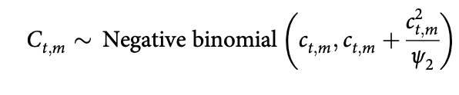








Unwin et al. (2020)

Slide 4


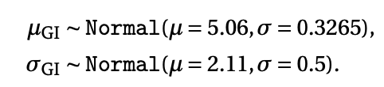


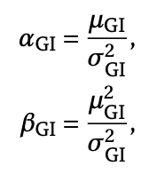

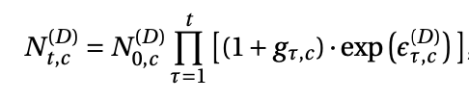
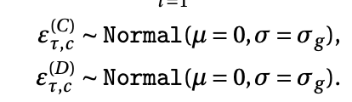

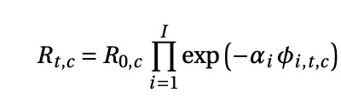





Brauner et al. (2020)

Slide 5




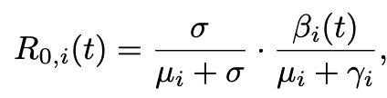




Qian et al. (2020)

