Slide 1

Jira Automation Using Python How To Add Comment To Jira Issue From Rest Api Using Python Tutorial :6

Slide 2
Api Doc Link
https://developer.atlassian.com/cloud/jira/platform/rest/v3/api-group-issue-comments/#api-rest-api-3-issue-issueidorkey-comment-post

Slide 3
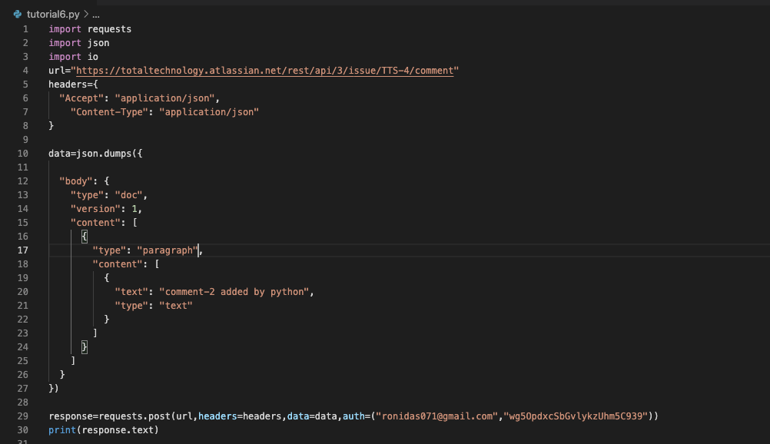
Add comments to jira issue

