Slide 1

Jira Automation Using Python How To Get All Issue From Jira Rest Api Using Python Tutorial :8

Slide 2
Api Doc Link
https://developer.atlassian.com/cloud/jira/platform/rest/v3/api-group-issue-search/#api-rest-api-3-search-get

Slide 3
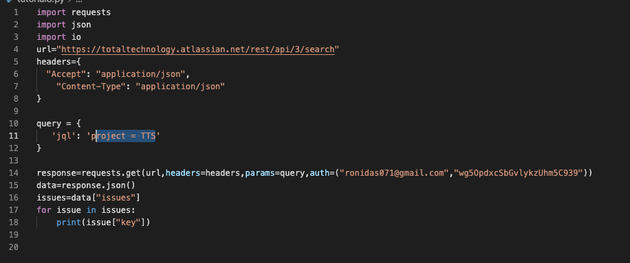
How to get all jira issue

