Slide 1

Jira Automation Using Python Setup Jira & Connect Rest Api Tutorial :1

Slide 2
Pre-requisites
Jira setup
Token setup
https://developer.atlassian.com/cloud/jira/platform/rest/v2/api-group-issues/
Test the rest api

Slide 3
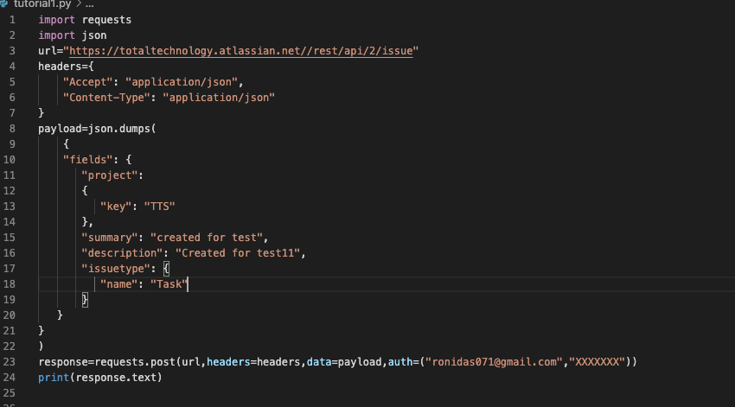
Get all projects from rest api using python

