Slide 1

Jira Automation Using Python Create Users In Jira From Rest Api Using Python Tutorial :3

Slide 2
Api Doc Link
https://developer.atlassian.com/cloud/jira/platform/rest/v3/api-group-users/

Slide 3
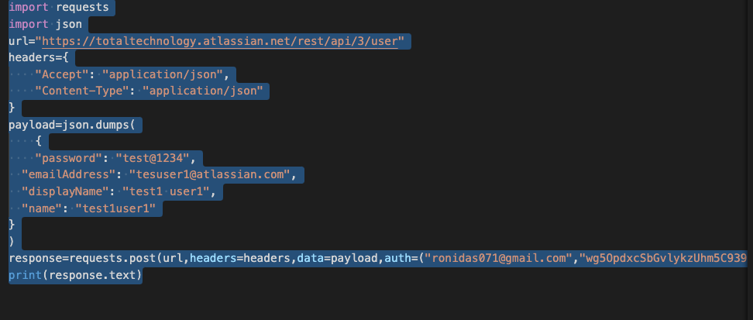
Create Single User

Slide 4
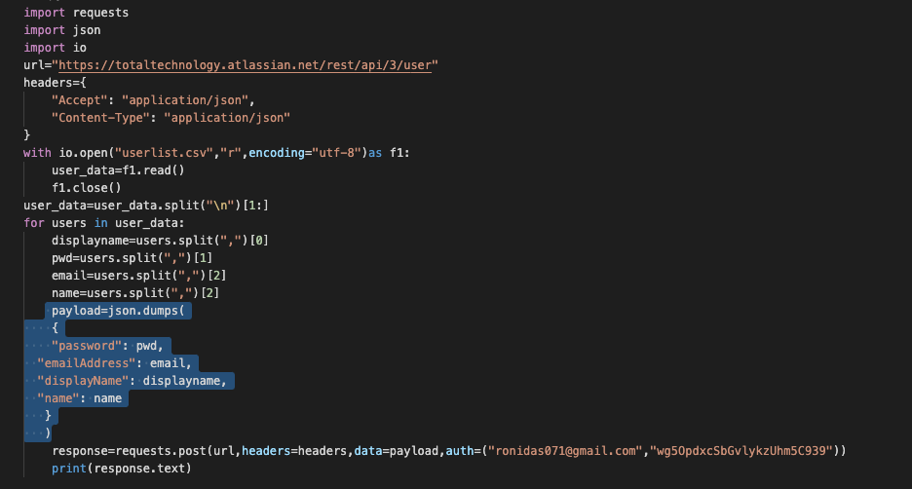
Create User In Bulk From Csv Input

