Slide 1

Jira Automation Using Python How To Get All Issue Status From Jira Rest Api Using Python Tutorial :9

Slide 2
Api Doc Link
https://developer.atlassian.com/cloud/jira/platform/rest/v3/api-group-issues/#api-rest-api-3-issue-issueidorkey-get

Slide 3
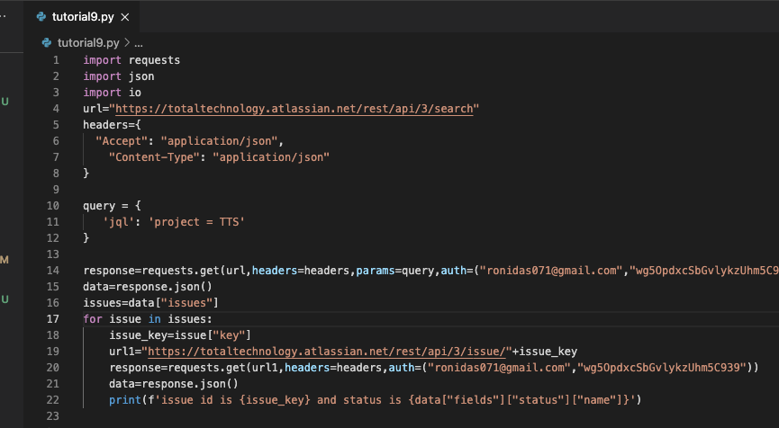
How to get all jira issue status

