Slide 1

Jira Automation Using Python How To Get All Jira Issue Comments From Rest Api Using Python Tutorial :5

Slide 2
Api Doc Link
https://developer.atlassian.com/cloud/jira/platform/rest/v3/api-group-issue-comments/#api-rest-api-3-issue-issueidorkey-comment-id-get

Slide 3
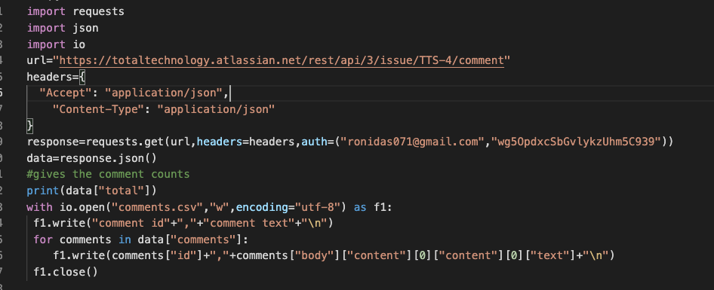
Get comments from jira issue

