Slide 1

Jira Automation Using Python Get All Jira Users From Rest Api Using Python Tutorial :2

Slide 2
Api Doc Link
https://developer.atlassian.com/cloud/jira/platform/rest/v3/api-group-users/#api-rest-api-3-user-get

Slide 3
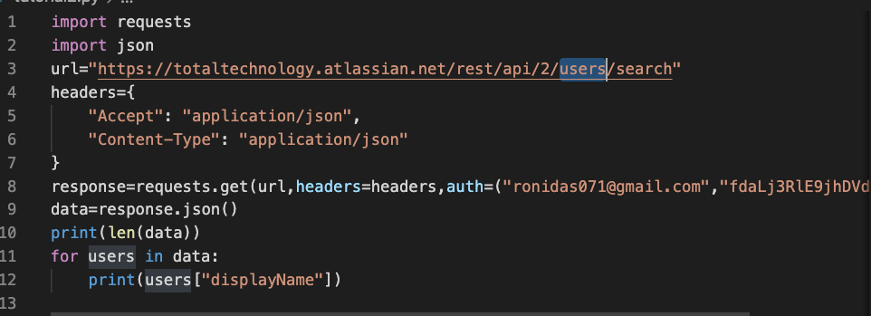
Get all users from rest api using python

