Slide 1







Set of sequences
Clade assignment model (reference tree)
Clade designation
Observed clade counts
Estimated vs observed clade proportions
A
A
AGCTACCTA
A
AGCTACCTA
t = t₁
B
B
C
𝜃
AGCTACGAA
AGCTACGAA
𝛕 = 𝛕₁
C
𝛕
𝛕
B
D
D
AGCTACCTA
A
AGCTACCTA
B
t = t₂
E
AGCTACGAA
B
AGCTACGAA
E
C
𝜃
C
E
AGCTACGTA
AGCTACGTT
AGCTACGTA
AGCTACGTT
𝛕
𝛕
𝛕 = 𝛕₁
𝛕 = 𝛕₂
𝛕 = 𝛕₁
𝛕 = 𝛕₂
C
A
AGCTACCTA
AGCTACCTA
B
t = t₂
A
AGCTACGAA
B
AGCTACGAA
B
C
𝜃
A
AGCTACGTA
AGCTACGTT
AGCTACGTA
AGCTACGTT
C
𝛕
𝛕
𝛕 = 𝛕₁
𝛕 = 𝛕₂
𝛕 = 𝛕₁
𝛕 = 𝛕₂
Sequences from t₂
Clade assignment model from t₁
All sequences from t₂ assigned the clade they would have been assigned if available at t₁
Evaluation of t₁ estimates using clade assignment as of t₁ but sequences as of t₂
”Final” count of the number of sequences of each clade
Notes:
Illustration of clade assignment using different combinations of dates when sequences are available and versions of the reference tree. Two dates are relevant: the nowcast date, tau_1, and the evaluation date, tau_2. (A). Clade assignment of sequences reported as of the nowcast date using the reference tree available as of the nowcast date; used for model estimation. (B). Clade assignment of sequences reported as of the evaluation date using the reference tree available as of the evaluation date; not used. (C). Clade assignment of sequences reported as of the evaluation date using the reference tree available as of the nowcast date; used for nowcast evaluation. Clade assignments using different reference trees are not comparable, so the same reference tree is used when creating data for model fitting and for evaluation.

Slide 2
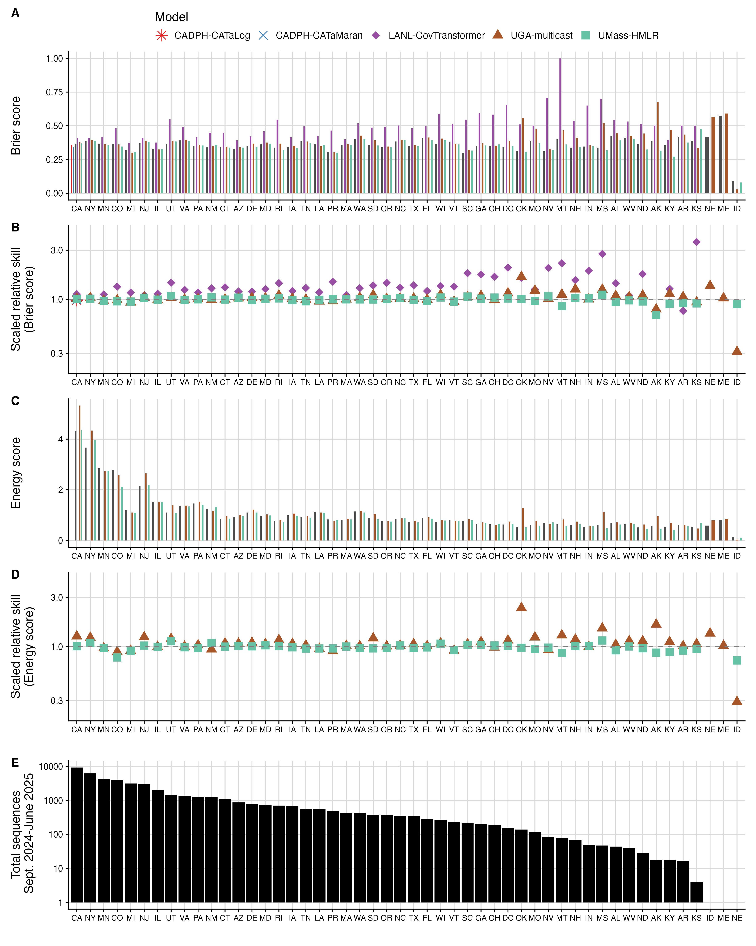
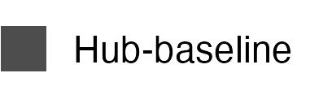

Slide 3
