Slide 1
S1.1
Figure S1.1 | Field site water chemistry. Carbonate chemistry and temperature from collection site 3 (42.681764, -70.813498) including a detailed tidal cycle measurement in summer 2016 (A-C) and daily average pH and temperature over 2.5 months in summer 2017 (D). In summer 2016, seven samples were collected for alkalinity and DIC starting approximately 3 hours prior and continuing until 3 hours post low tide. Blue lines represent the low tide for the nearest NOAA buoy, which had an approximately 2 hour lag compared to the collection site. Measured salinity, temperature, alkalinity and DIC were used in CO₂Sys to determine the complete carbonate chemistry including, pCO₂ (A), carbonate (B), and calcite saturation state (C). The red line indicates the critical calcite saturation state. In panel D, daily mean pH (black diamonds, mean土SE) and temperature (blue circles) over the course of summer 2017.

Slide 2
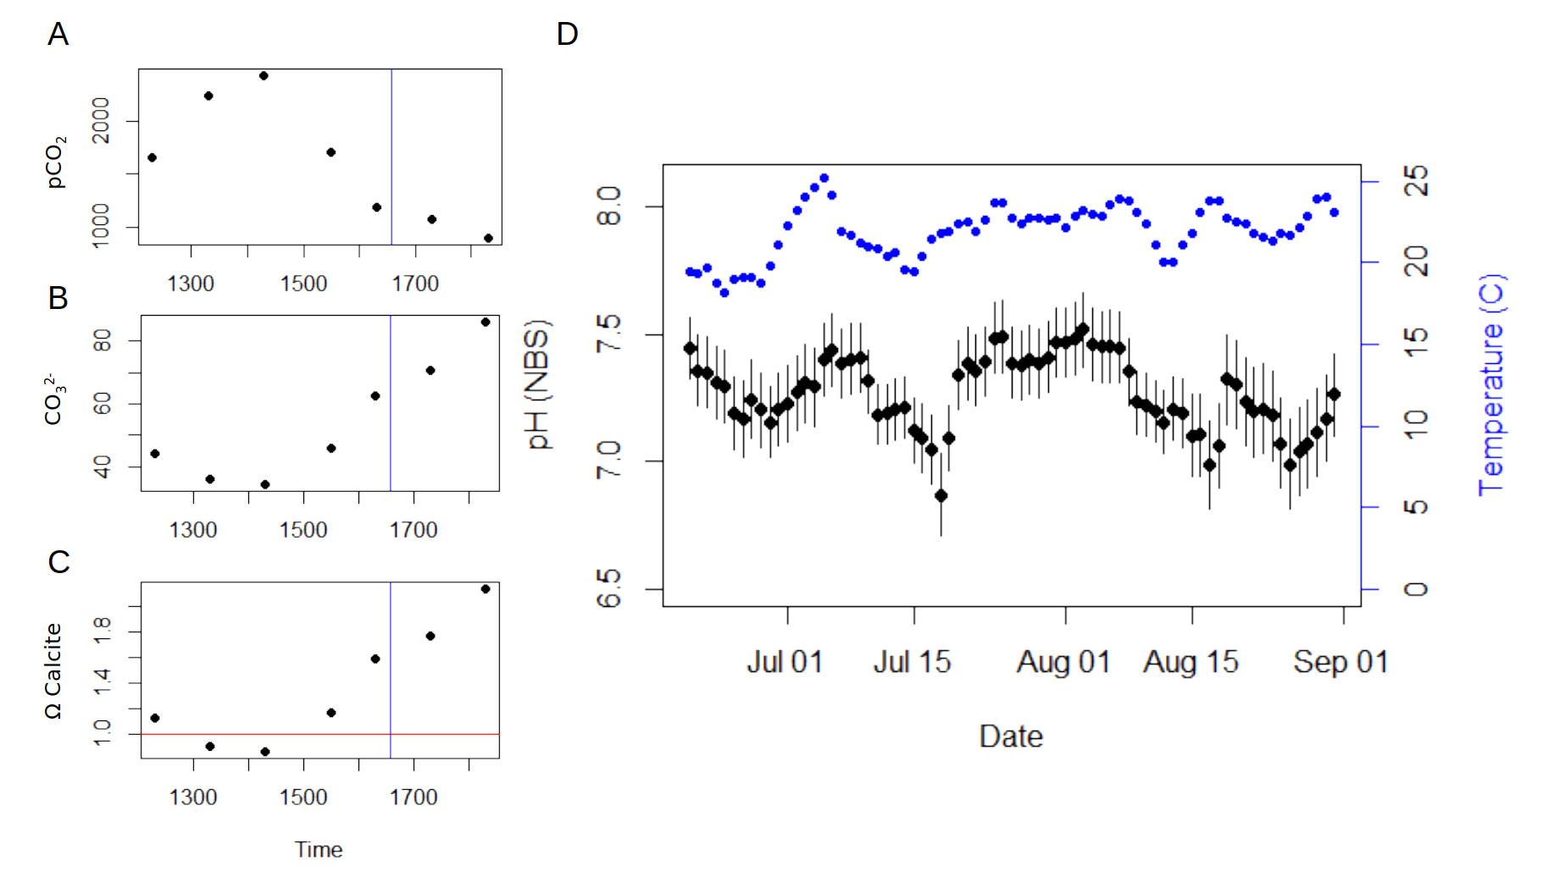

Slide 3
S1.2
Figure S1.2 | Mean weekly water chemistry. Mean temperature (A) and seawater pH (total scale) (B) during the experimental exposure. Lines represent means across the 6 replicate tanks per treatment with vertical bars showing the 95% CI. Grey box highlights the ~12 day period where the temperature was increased by 2.5 degrees C.

Slide 4
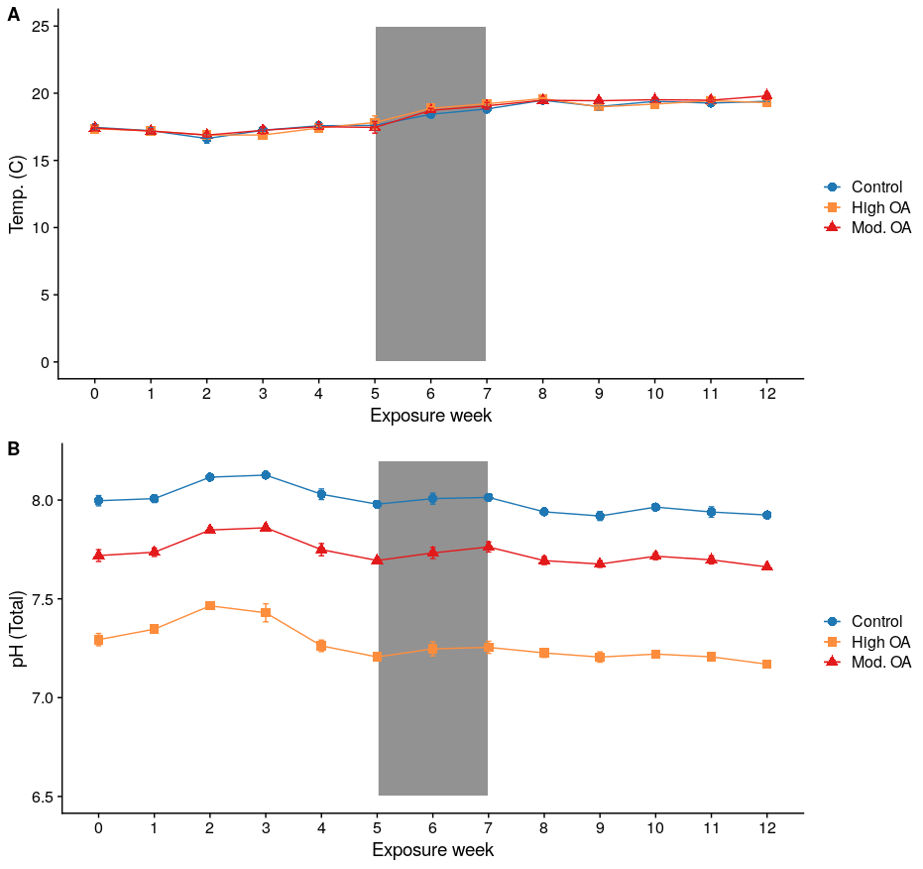

Slide 5
S2.1
Figure S2.1 | Buoyant weight compared to dry weight. Buoyant and dry weights for oysters from oysters collected during the first and second buoyant weight measuring timepoints. Linear regression was used to evaluate the relationship between the two variables, estimate the slope and intercept, and determine the degree of correlation.

Slide 6
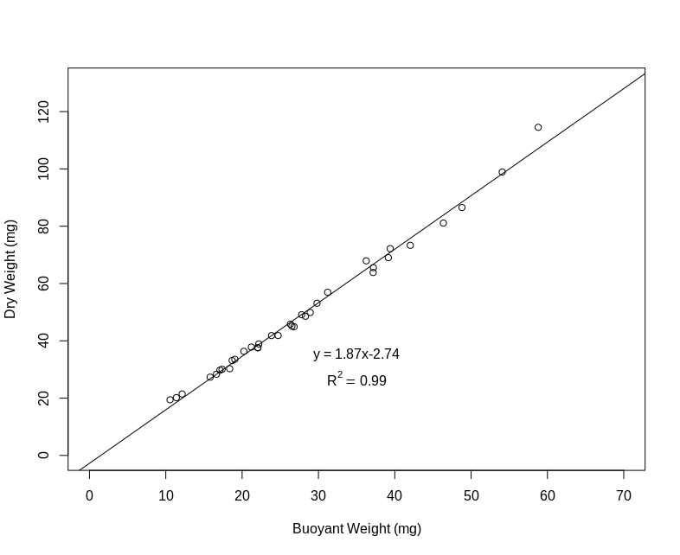

Slide 7
S3.1
Figure S3.1 | Gene by CpG Coverage. Orange circles show the number of genes that have a minimum percent of CpGs covered within a gene for a range of percent thresholds. The purple line indicates the 20% minimum coverage threshold used.

Slide 8
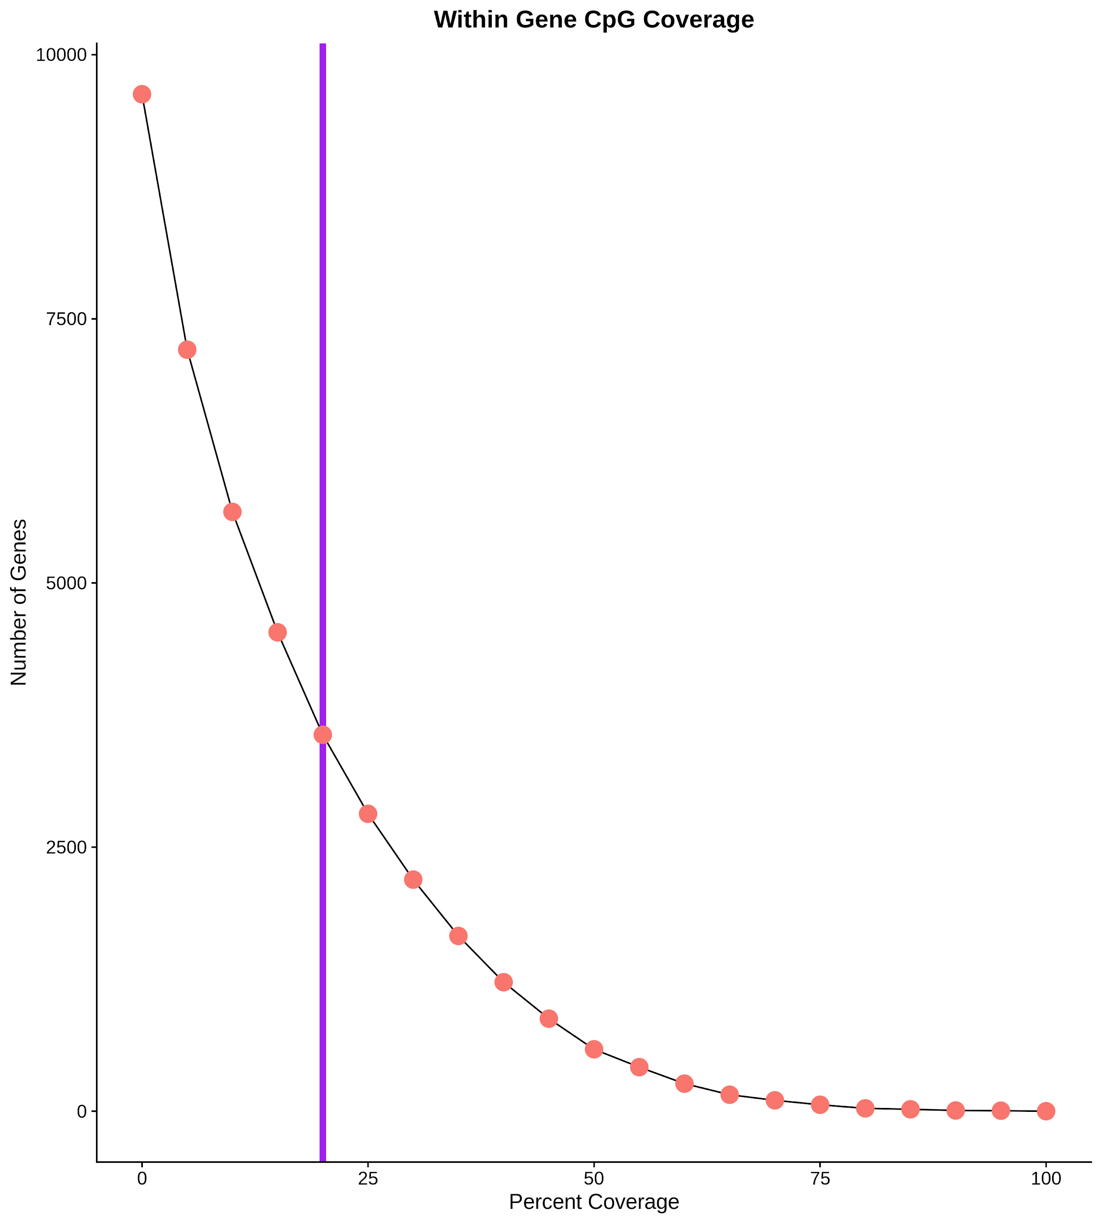

Slide 9
S3.2
Figure S3.2 | Gene Summary PCAs for all minimum thresholds. First two principal components from a principle component analysis that included gene level summary variables for various attributes, expression, and methylation based on (A) no filter, (B) 20%, (C) 50%, (D) and 80% coverage thresholds. Thresholds based on the percent of CpGs with the minimum sequence coverage (i.e., 20% coverage only includes genes with at least 20% CpG sequence coverage in the PCA).Variable loadings plotted as arrows, with the length of the arrow corresponding to the relative contribution to PC variance.

Slide 10
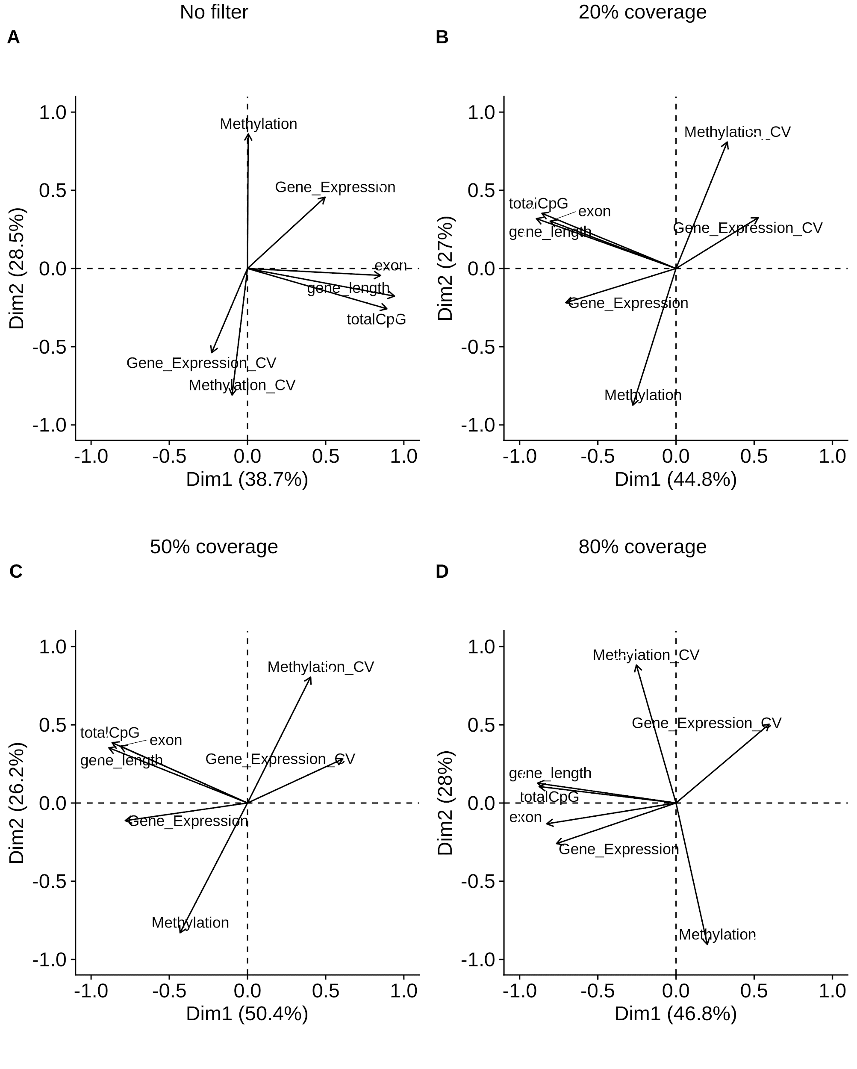

Slide 11
S3.3
Figure S3.3 | Principle component contributions. Relative contribution (percent) for each variables (loading) for the first (column 1), second (column 2), and third (column3) principal components of the PCA for all genes (A), genes with coverage for at least 20% (B), 50% (C), and 80% (D) of all CpGs. The dotted redlines indicate the default 15% contribution significance threshold for individual variables.

Slide 12
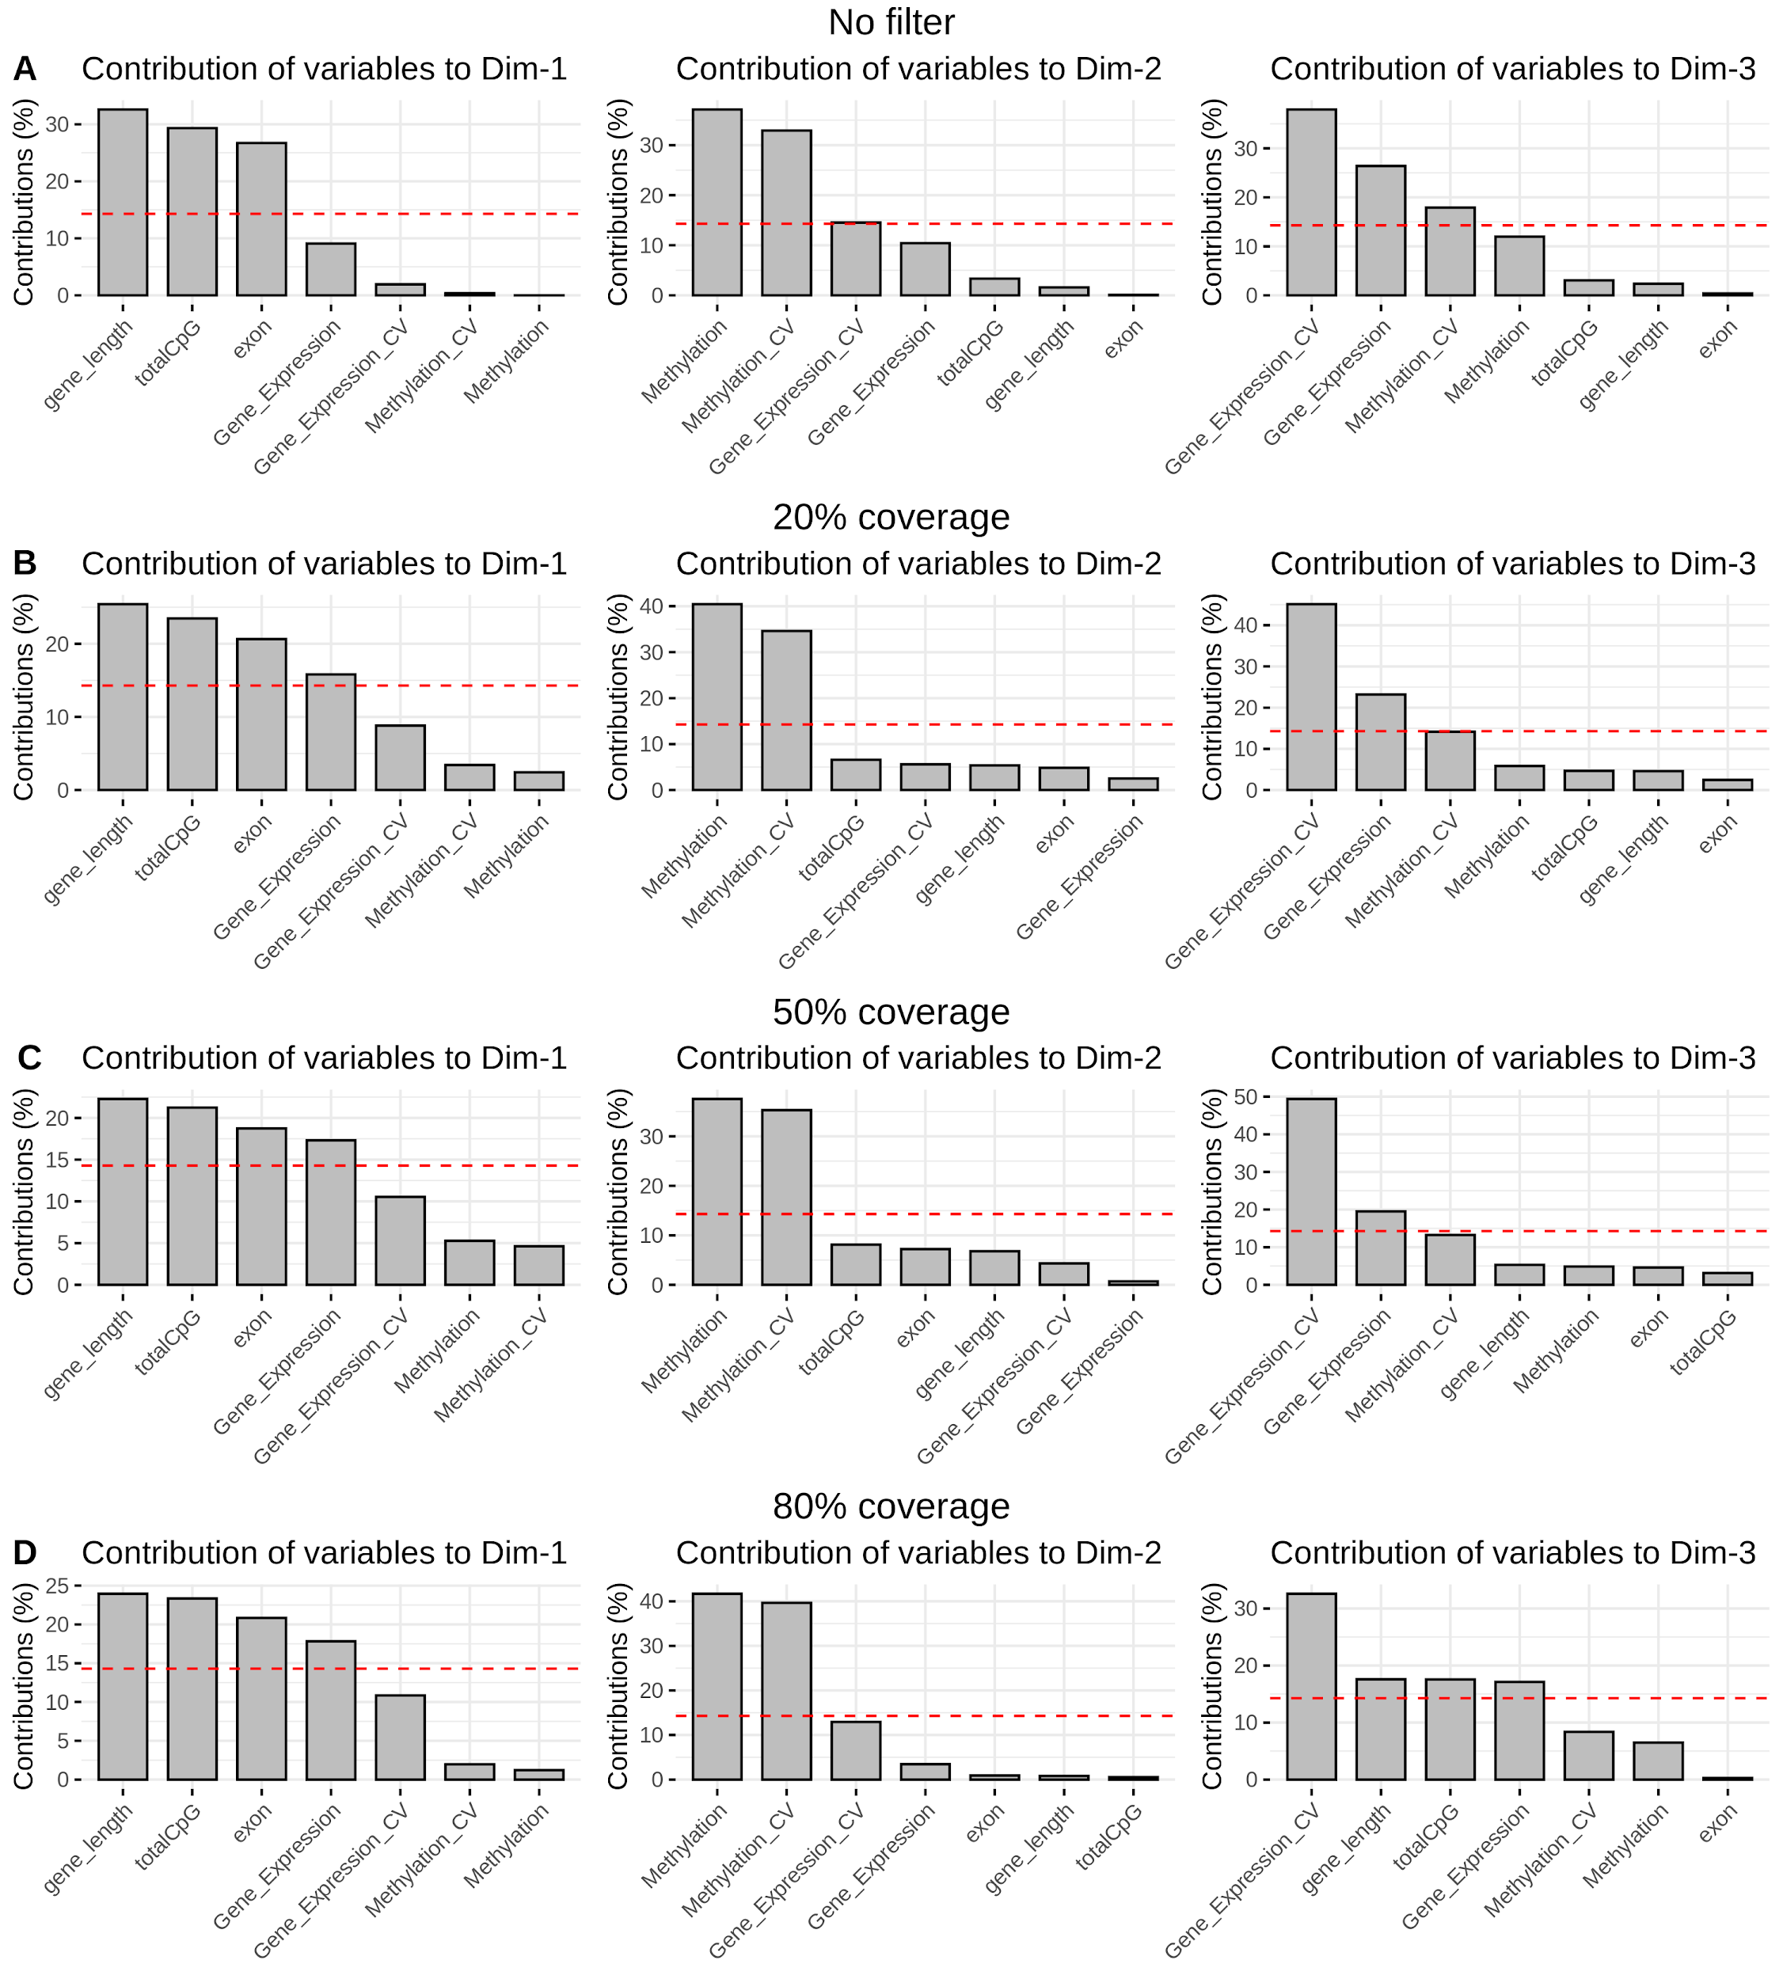

Slide 13
S3.4
Figure S3.4 | Venn Diagram of OA-induced DML among mantle and gonadal tissue in C. virginica. OA-induced DML in the gonadal tissue were from Venkataraman et al. (2020) and downloaded from: https://github.com/epigeneticstoocean/paper-gonad-meth.

Slide 14
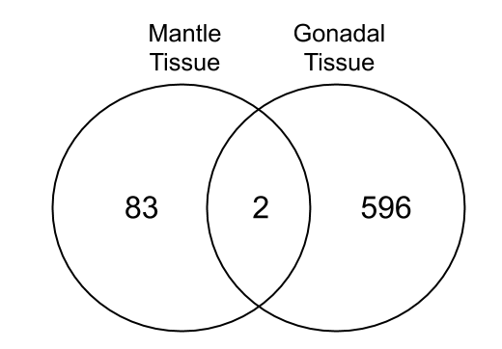

Slide 15
S4.1
Figure S4.1 | Gene expression of biomineralization associated genes. Boxplots based on mean expression per individual for major biomineralization genes identified from the literature (see Table 4.3 for complete list of abbreviations; n refers to the number of copies for each putative gene in the C. virginica genome). For each gene none of the fixed effects (treatment, time, or their interaction) were significant.

Slide 16
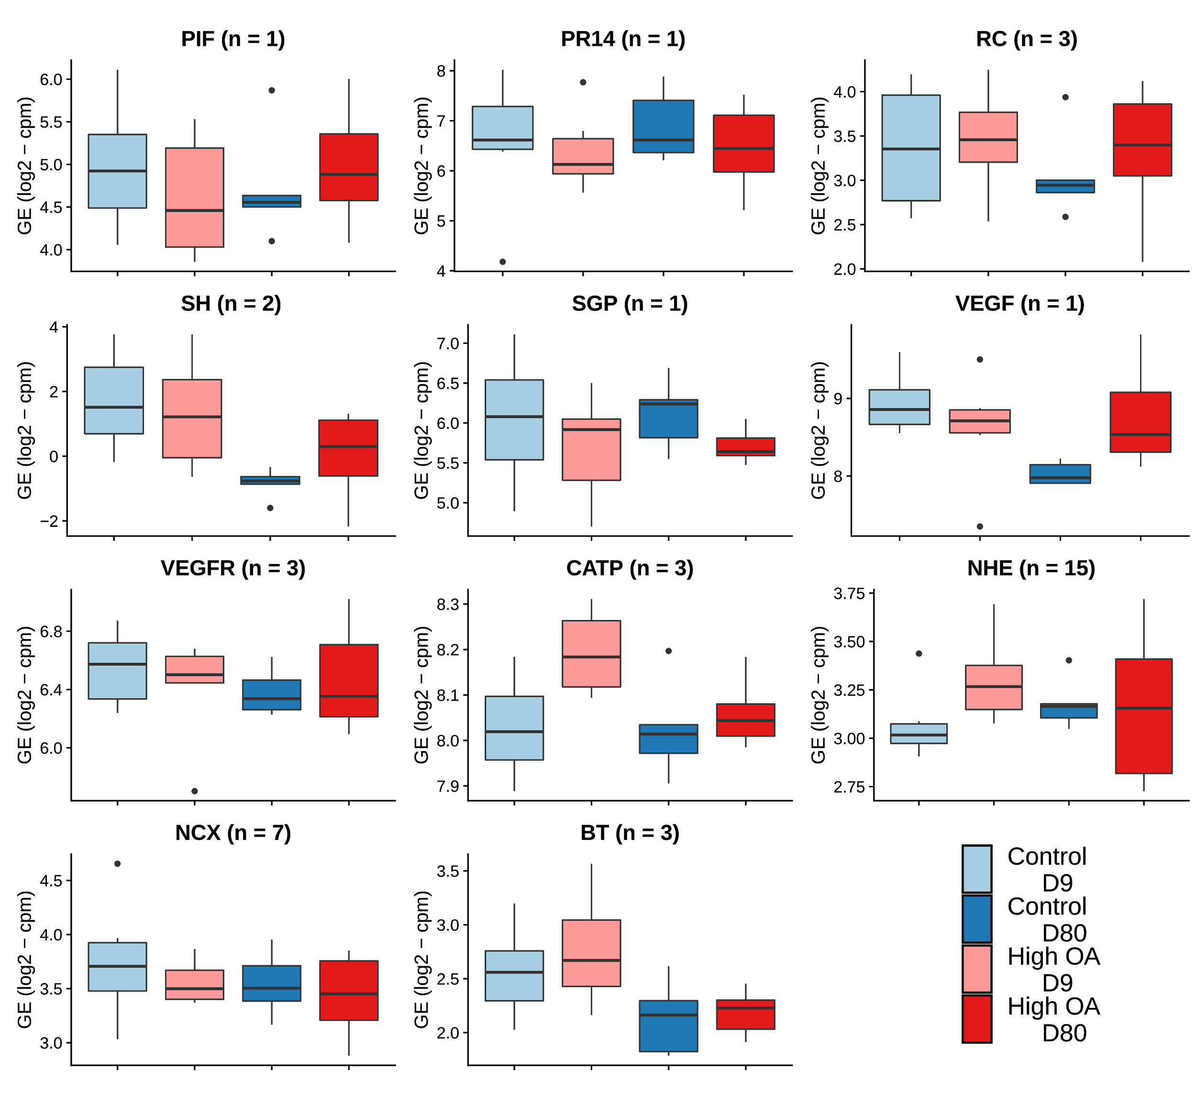
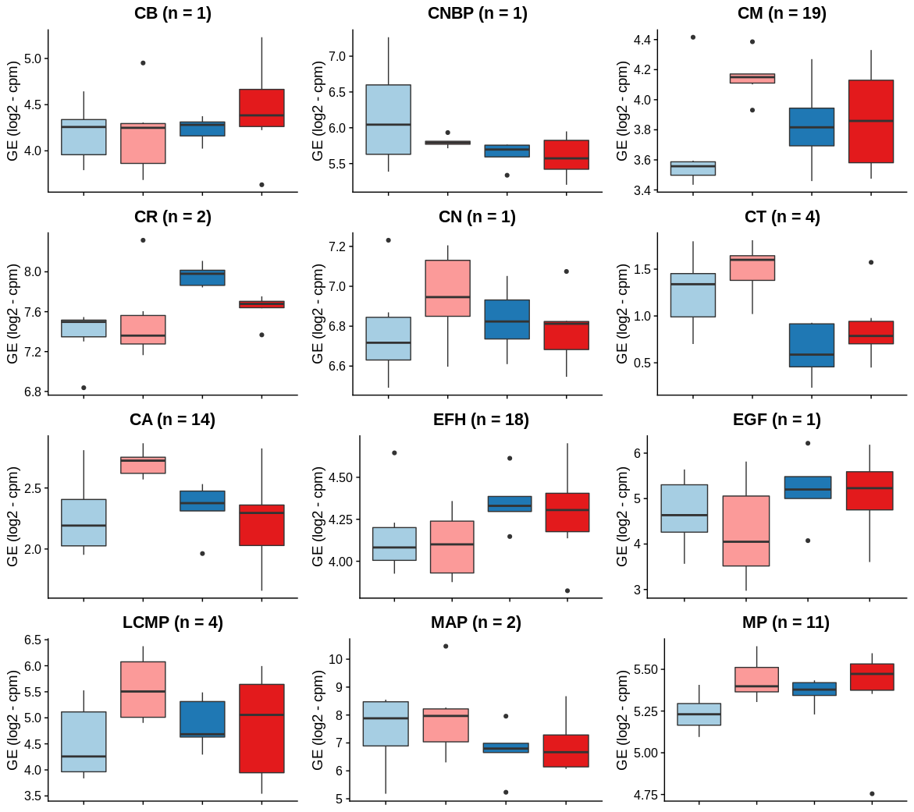

Slide 17
S4.2
Figure S4.2 | Density plot of expression in all genes vs. biomineralization genes. Dark vertical lines indicate the median expression for all genes (red, n = 20387) and biomineralization genes (blue, n = 119); these represent statistically different medians (P = 0.02719, Mann Whitney U rank sum).

Slide 18
