Slide 1
Unified Speech and Audio Representation Learning
DSP&AI Lab., Yonsei University
Hyomin Kim
2026.08.07

Slide 2
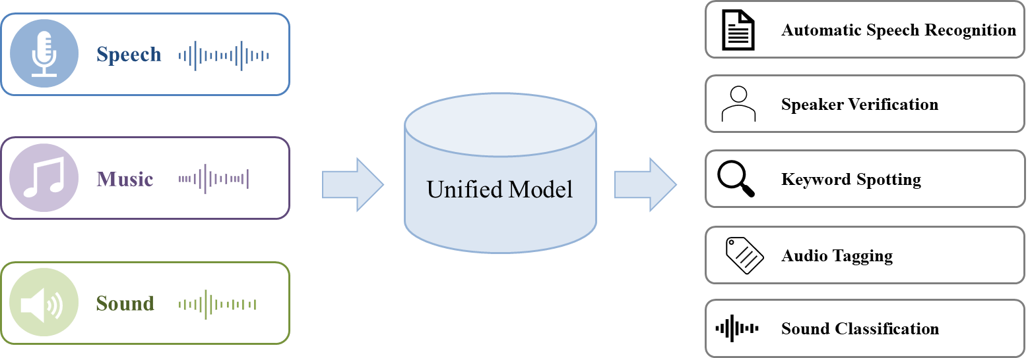
Overview
< Illustration of a unified model for speech and audio representations >
Unified Model of Speech and Audio Representations
Learn speech, sound, and music in a unified representation space
Unify domain-specific representations for better generalization across tasks
Motivation
Real-world scenario contains speech, sound, and music simultaneously
Existing SSL models are domain-specific, requiring multiple models to run in parallel for real applications

Slide 3
Contents
Background
WavLM
ATST
Introduction
USAD
SPEAR
Proposed Method
Experiments
Conclusion

Slide 4
Contents
Background
WavLM
ATST
Introduction
USAD
SPEAR
Proposed Method
Experiments
Conclusion

Slide 5
Background

Slide 6
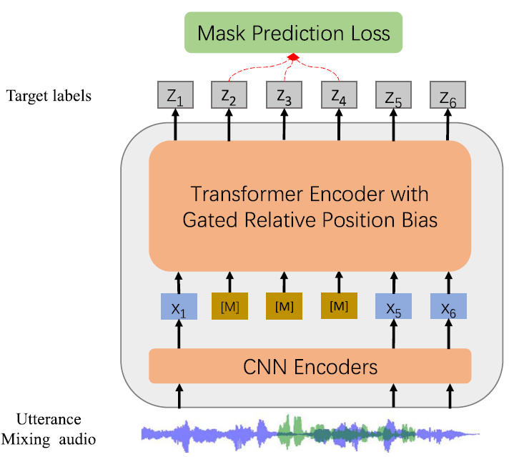
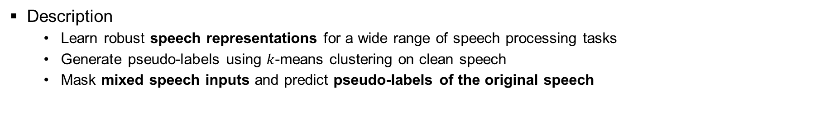
WavLM
S. Chen et al., "WavLM: Large-Scale Self-Supervised Pre-Training for Full Stack Speech Processing," IEEE Journal of Selected Topics in Signal Processing, 2022.
< Framework of WavLM >
Description
Learn robust speech representations for a wide range of speech processing tasks
Generate pseudo-labels using $k$-means clustering on clean speech
Mask mixed speech inputs and predict pseudo-labels of the original speech

Slide 7
WavLM
S. Chen et al., "WavLM: Large-Scale Self-Supervised Pre-Training for Full Stack Speech Processing," IEEE Journal of Selected Topics in Signal Processing, 2022.
< Framework of WavLM >
Description
Learn robust speech representations for a wide range of speech processing tasks
Generate pseudo-labels using $k$-means clustering on clean speech
Mask mixed speech inputs and predict pseudo-labels of the original speech

Slide 8
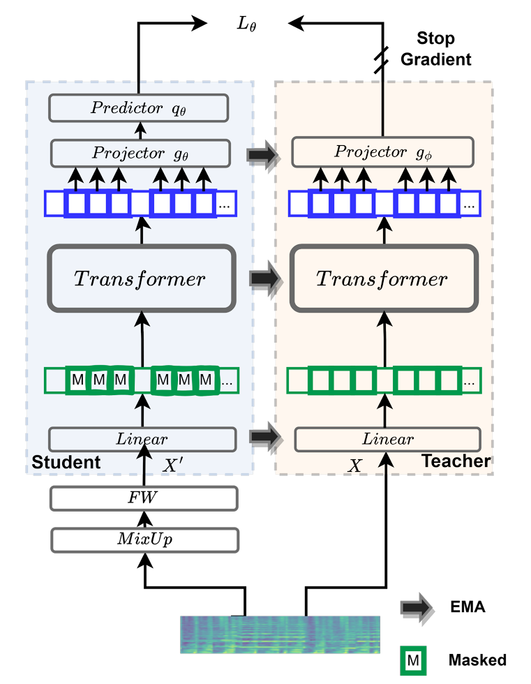
ATST
X. Li et al., "Self-Supervised Audio Teacher-Student Transformer for Both Clip-Level and Frame-Level Tasks," IEEE/ACM Transactions on Audio, Speech, and Language Processing, vol. 32, pp. 1336–1351, 2024.
Description
Learn audio representations through teacher-student self-supervised learning
Predict teacher frame embeddings from masked audio inputs
Update the teacher network via exponential moving averaging (EMA)
< Framework of ATST >

Slide 9
Introduction

Slide 10
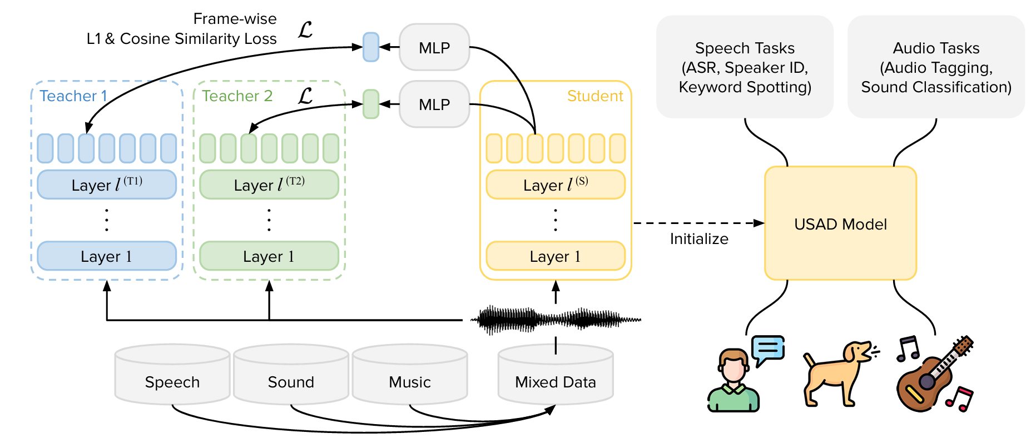
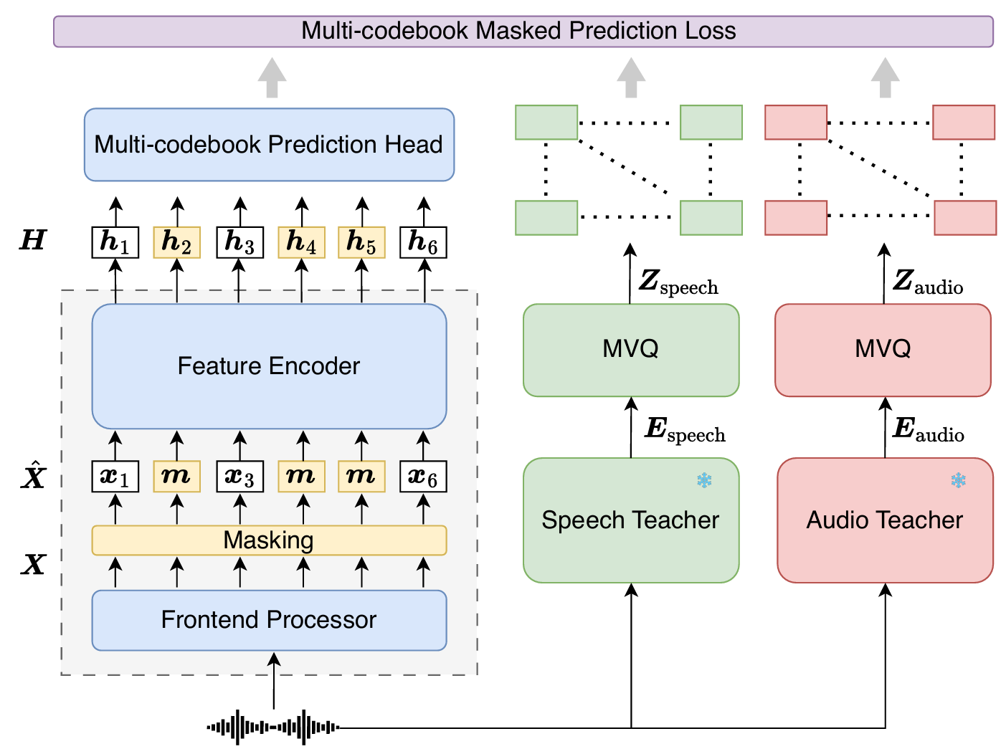
Related Works
H.-J. Chang, et al., “USAD: Universal Speech and Audio Representation via Distillation,” ASRU 2025.
X. Yang et al., "SPEAR: A Unified SSL Framework for Learning Speech and Audio Representations,” ICML 2026.
USAD
Distill continuous representations from speech and audio teachers into a unified student
Apply sparse layer-to-layer distillation with frame-wise L1 and cosine similarity losses
SPEAR
Convert speech and audio teacher representations into discrete multi-codebook targets via quantization
Train the student using masked and unmasked token prediction
< Framework of USAD >
< Framework of SPEAR >

Slide 11
Related Works
Previous Approach
Distill knowledge from Speech SSL and Audio SSL teachers into a unified student encoder
Apply a single encoder to diverse downstream tasks, including ASR, speaker verification, and audio event classification
Limitations of Existing Unified Models
Lack adaptive specialization to capture the distinct characteristics of speech and audio inputs
Thus, jointly learning speech and audio information within shared parameters may cause interference between their distinct characteristics

Slide 12
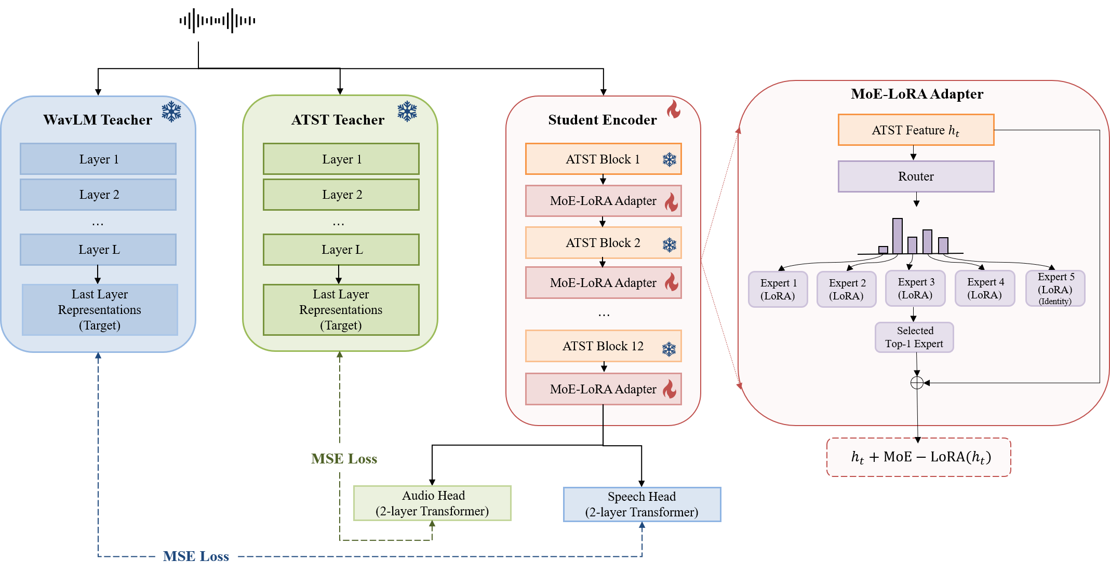
Proposed Method
Proposed Idea
Extend a pretrained audio SSL encoder toward unified speech-audio representation learning
Enable adaptive specialization for diverse speech and audio inputs through MoE-LoRA routing

Slide 13
Proposed Method
Construction of Student Encoder
Insert MoE-LoRA adapters into a pretrained ATST while keeping the backbone frozen
Configure four LoRA experts and one identity expert to preserve the original ATST representation when adaptation is unnecessary
Select a single expert for each input using top-1 routing

Slide 14
Proposed Method
Training Strategy
Keep both ATST and WavLM teachers frozen during training
Utilize the final-layer representations of each teacher as modality-specific distillation targets
Employ separate Transformer prediction heads for audio and speech
Train the student encoder with MSE losses for both modalities

Slide 15
Experiments

Slide 16
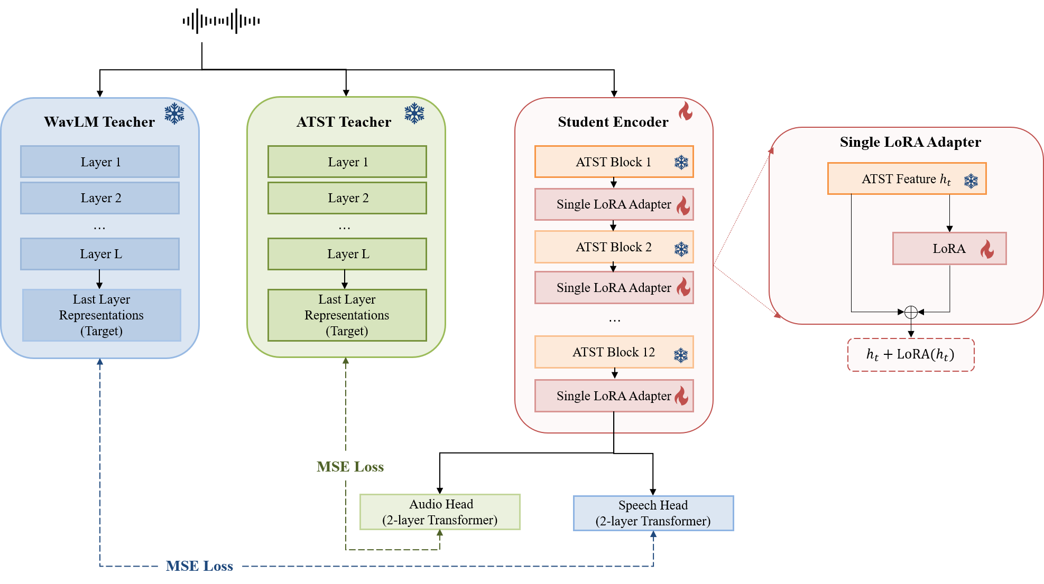
Experiments
Experiment #1: Proposed Model Evaluation
Evaluate whether the proposed model improves speech performance while preserving audio performance
Assess the model on speech and audio downstream tasks
Experiment #2: MoE Structure Analysis
Assess the effectiveness of the proposed MoE structure for unified speech-audio learning
Analyze expert routing and compare MoE-LoRA with a standard LoRA baseline
< Framework of experiment #1 >
< Framework of experiment #2 >

Slide 17
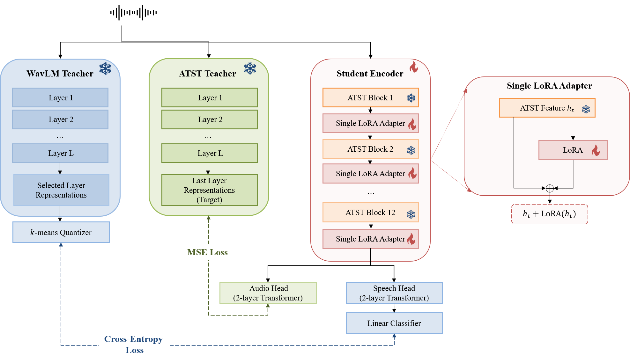
Experiments
< Framework of experiment #3 >
Experiment #3: Distillation Target Analysis
Assess the effect of different speech distillation targets on speech representation learning
Compare continuous representation distillation with discrete prediction using targets from different WavLM layers

Slide 18
Experimental Setup
[1] https://www.openslr.org/141/
[2] https://annotator.freesound.org/fsd/release/FSD50K/
Dataset Setup
Model Setup
Domain | Dataset | Duration
Speech | LibriTTS^{[1]} | 100 hours
Audio | Freesound^{[2]} | 100 hours
Encoder dimension | 768
# Experts | 5
Routing | Top-1
Lora rank | 8
Training steps | 400k
Learning rate | 3e-4

Slide 19
Experimental Setup
[1] S.-w. Yang et al., "SUPERB: Speech Processing Universal PERformance Benchmark," in Proc. Interspeech, pp. 1194–1198, 2021.
[2] J. Turian et al., "HEAR: Holistic Evaluation of Audio Representations," in Proc. NeurIPS 2021 Competitions and Demonstrations Track, vol. 176, pp. 125–145, 2022.
[3] https://www.openslr.org/12/
[4] https://github.com/karolpiczak/ESC-50
Evaluation
< Settings of downstream task in SUPERB^{[1]} >
Category | Task | Dataset | Downstream model | Loss function | Evaluation metrics
Content | Automatic Speech Recognition (ASR) | LibriSpeech^{[2]} | 2-layer BLSTM | CTC loss | Word error rate (WER)
< Settings of downstream task in HEAR^{[3]} >
Category | Task | Dataset | Downstream model | Loss function | Evaluation metrics
Environmental Audio | Environmental Sound Classification (ESC) | ESC-50^{[4]} | A linear layer | Cross-entropy loss | Accuracy (ACC)

Slide 20
Experiment #1
< Comparison on baselines and proposed framework >
Domain | Model | Pre-train data | ASR ↓ (%) | ESC-50 ↑ (%)
Audio | ATST | 5.8k | 18.8 | 89.0
Speech | WavLM | 94k | 3.92 | 68.6
Unified | USAD | 126k | 7.70 | 82.2
Unified | SPEAR | 97k | 3.79 | 83.8
Unified | Proposed | 200 hours | 23.27 | 80.9
< Proposed framework >
Results
Show lower performance than ATST on both ASR and ESC-50 downstream tasks
Result in no clear improvement in speech performance despite adding speech-teacher distillation

Slide 21
Experiment #2
< Overall expert usage distribution >
< Comparison with the standard LoRA baseline >
Expert | E1 | E2 | E3 | E4 | E5
Audio | 0% | 0.7% | 9.5% | 7.0% | 82.7%
Speech | 0% | 0.2% | 5.8% | 5.7% | 88.4%
Domain | Model | MoE | ASR ↓ (%) | ESC-50 ↑ (%)
Unified | Proposed | O | 23.27 | 80.9
Unified |  | X | 17.03 | 85.6
Analysis on Mixture of Experts
Reveal expert collapse, with both modalities strongly biased toward the identity expert (E5)
Show similar expert usage patterns across speech and audio, indicating limited modality-specific specialization
Improve both speech and audio performance after removing MoE
Indicate limitations in the current routing and expert configuration
Notes:
Experiment 2 was conducted to identify the affects underlying the limited performance observed in the previous experiment

Slide 22
Experiment #3
< Comparison with the distillation strategy >
Domain | Model | MoE | Training Target | WavLM Layer | # Clusters | ASR ↓ (%) | ESC-50 ↑ (%)
Unified | Proposed | X | Continuous | Final | - | 17.03 | 85.6
 |  |  | Discrete | 6 | 500 | TBU | TBU
 |  |  |  | 9 |  | 16.72 | 84.9
 |  |  |  | Final |  | 16.96 | 86.4
Distillation Target Analysis
Discrete speech targets improve ASR performance compared with continuous distillation
The choice of target layer affects the balance between speech and audio representation quality

Slide 23
Conclusion
Summary
Build a unified framework based on a pretrained audio SSL backbone
Incorporate speech knowledge through MoE-LoRA-based adaptation
Identify limited expert specialization in the current MoE routing and expert configuration
Improve both speech and audio performance by removing MoE
Analyze the effects of speech learning objectives and distillation targets
Show the effectiveness of discrete targets for speech representation learning
Future Works
Investigate the effect of different starting points for unified SSL learning
Compare Audio SSL-based adaptation, Speech SSL-based adaptation, and scratch-based
Explore learning objectives and distillation strategies for incorporating speech knowledge

Slide 24
Future Works - Datasets
Domain | Dataset | Duration | Average Duration
Speech | Voxpopuli (en) | 532 hours | 10.3 seconds
 | Libriheavy | 60k hours | 12 seconds
 | Gigaspeech | 10k hours | 4.35 seconds
 | Voxlingua (en) | 49 hours | 11 seconds
Audio | Audioset | 5k hours | 10 seconds
 | Freesound | 109 hours | 7.6 seconds
 | VGGSound | 550 hours | 10 seconds
 | Music4all | 910 hours | 30 seconds
 | MTG-Jamendo | 3.8k hours
Total | Domain | Duration | Ratio
 | Speech | 70.6k hours | 87.2%
 | Audio | 10.4k hours | 12.8%
 |  | 81k hours

Slide 25
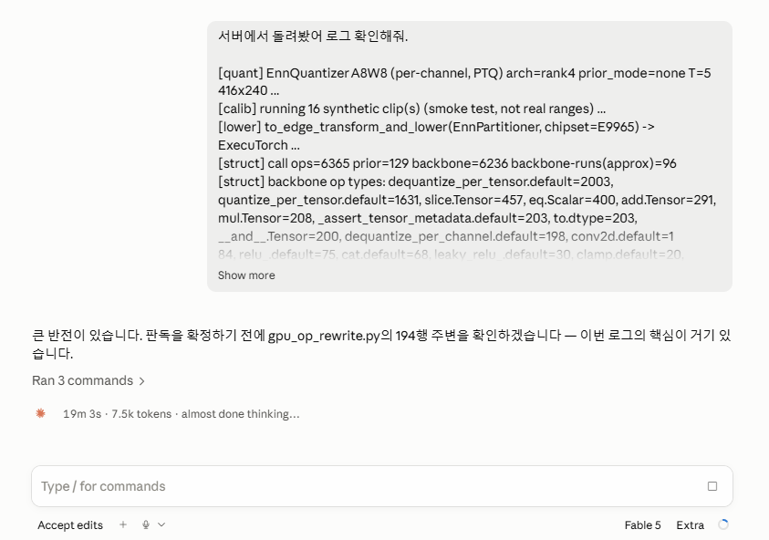
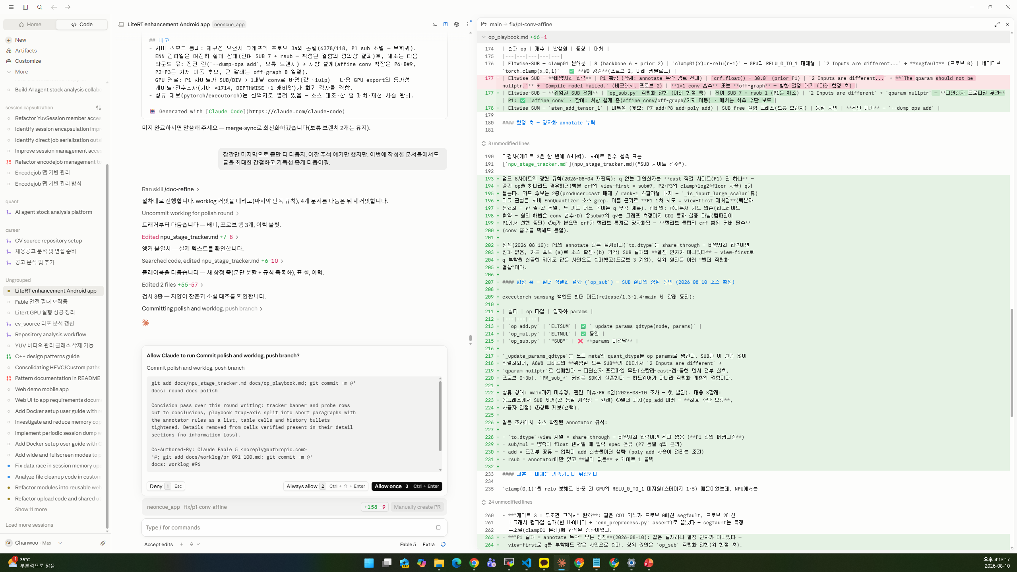

Slide 26
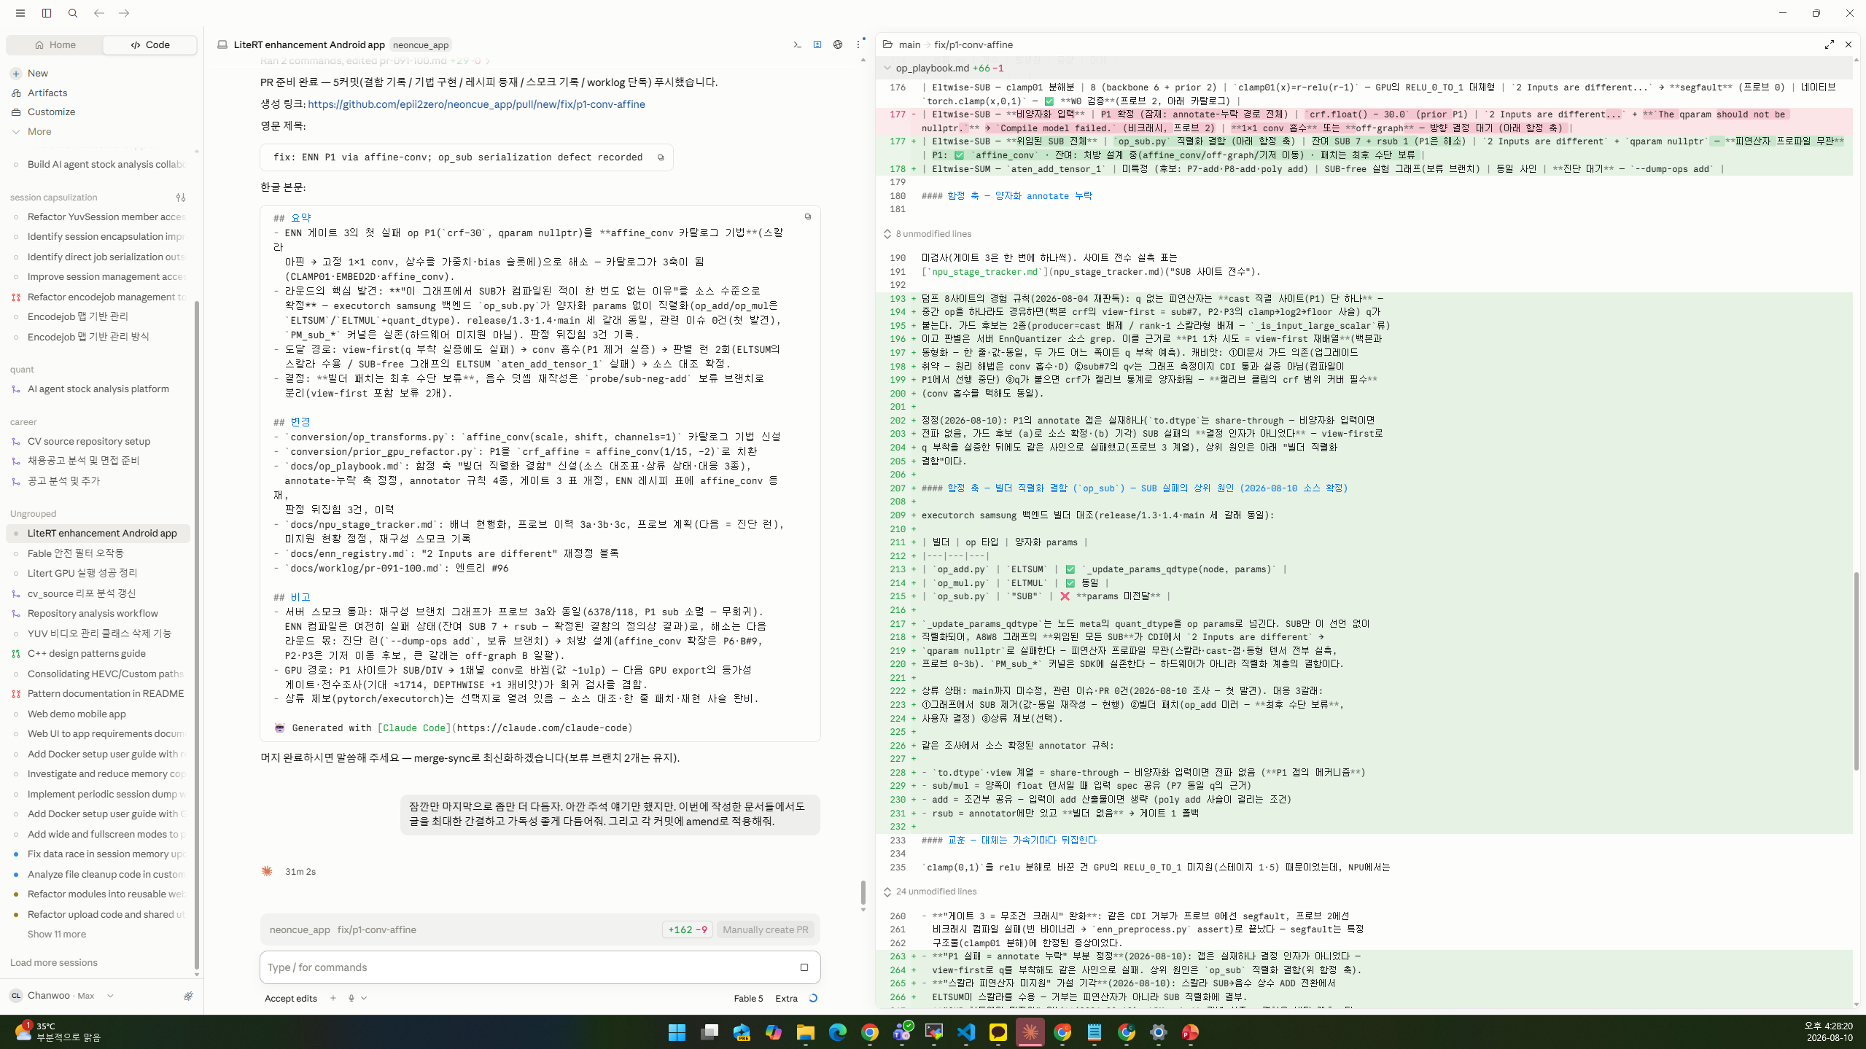

Slide 27
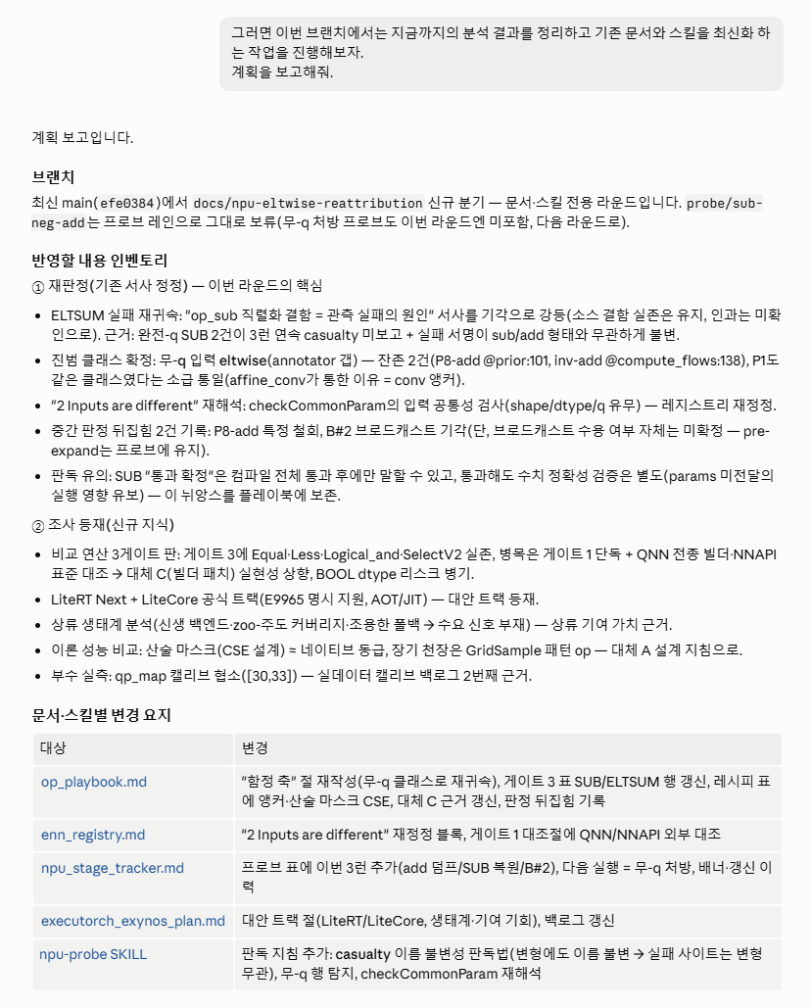

Slide 28
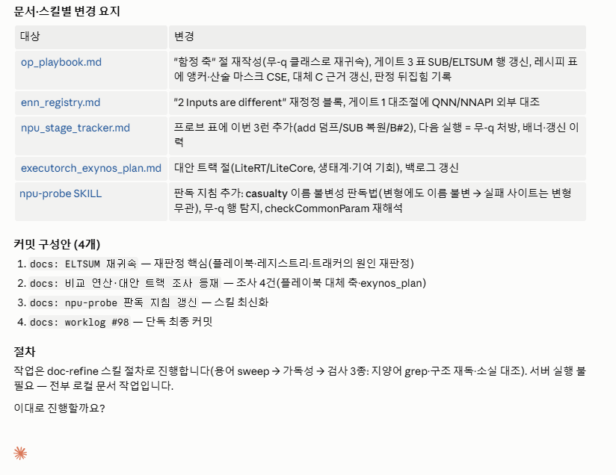

Slide 29
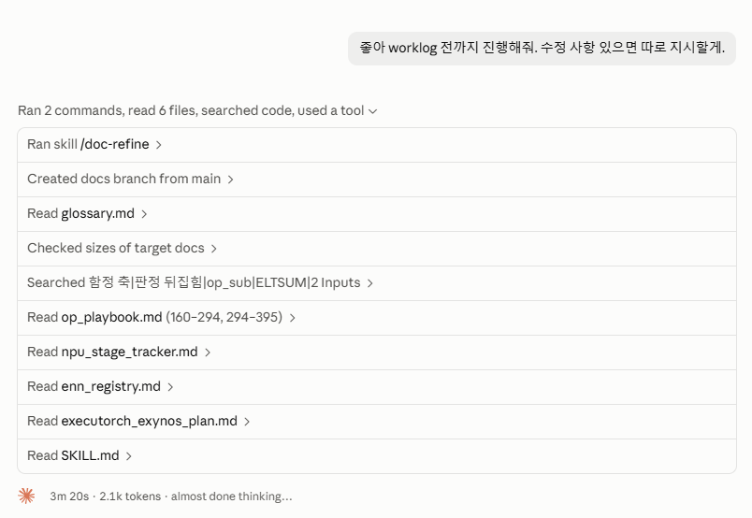

Slide 30
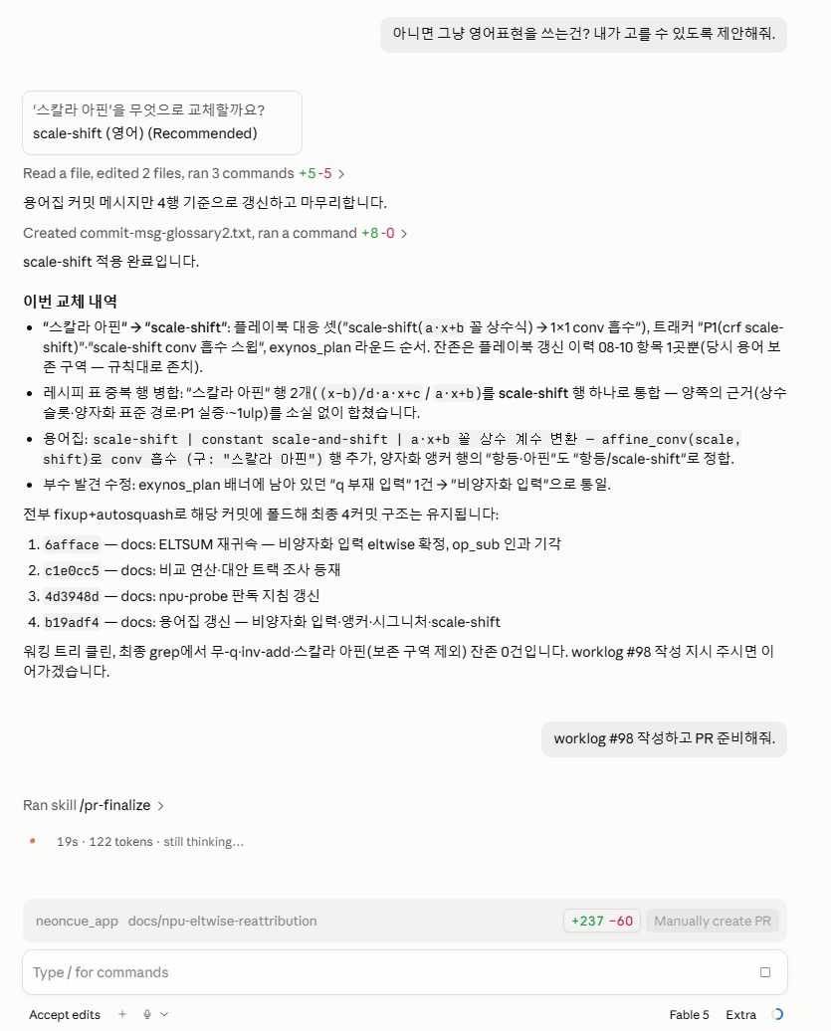
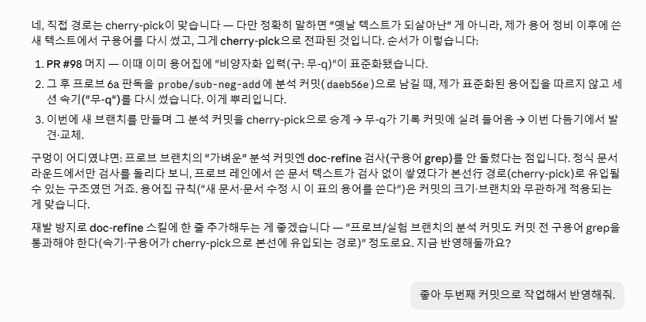

Slide 31
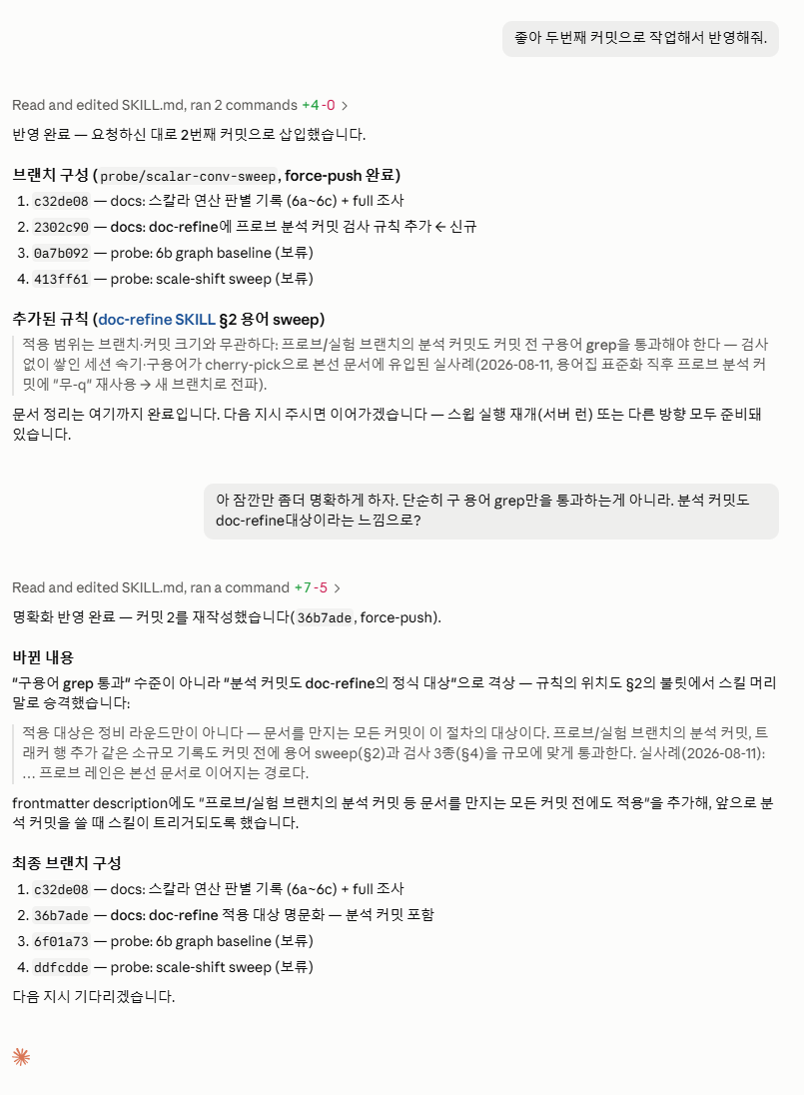

Slide 32
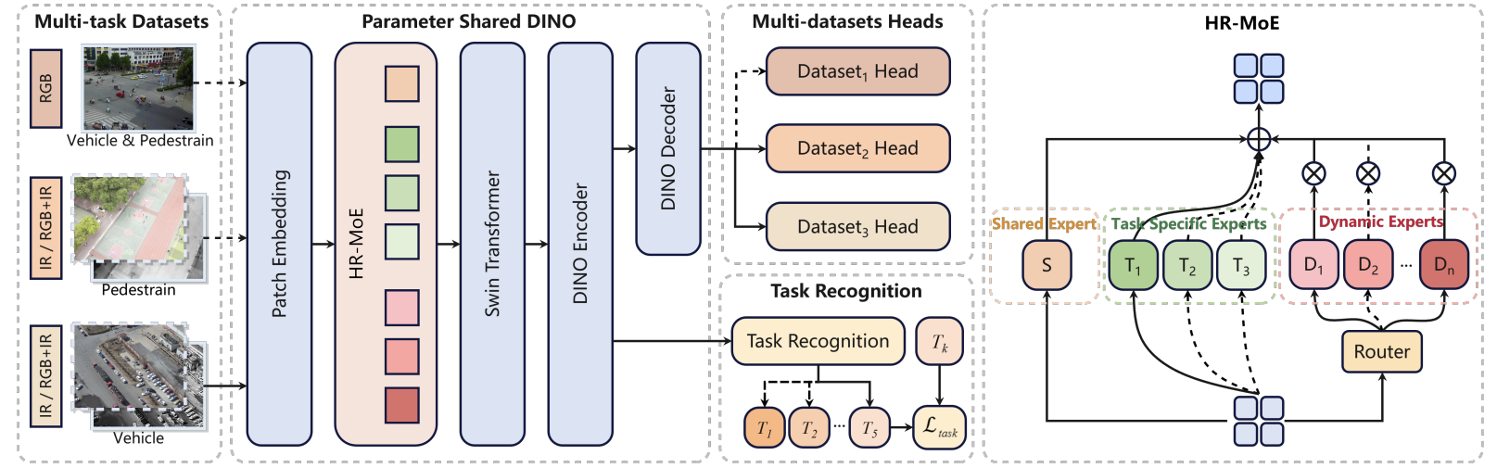
DroneDINO
Dong dong Li et al., "DroneDINO: Towards Heterogeneous Routed Mixture of Experts for Drone-based Unified Object Detection, ICML 2026.
< Framework of DroneDINO >
Description
Handle multiple drone detection tasks with different input modalities using a unified model
Divide experts into three functional groups
Learn shared representations through the shared expert
Capture task-specific representations using task-specific experts
Select top-k Dynamic Experts via routing to model intra-task variations

