Slide 1
Project 1：CT Image Reconstruction
Optimization Theory and Algorithm
Fall 2026

Slide 2
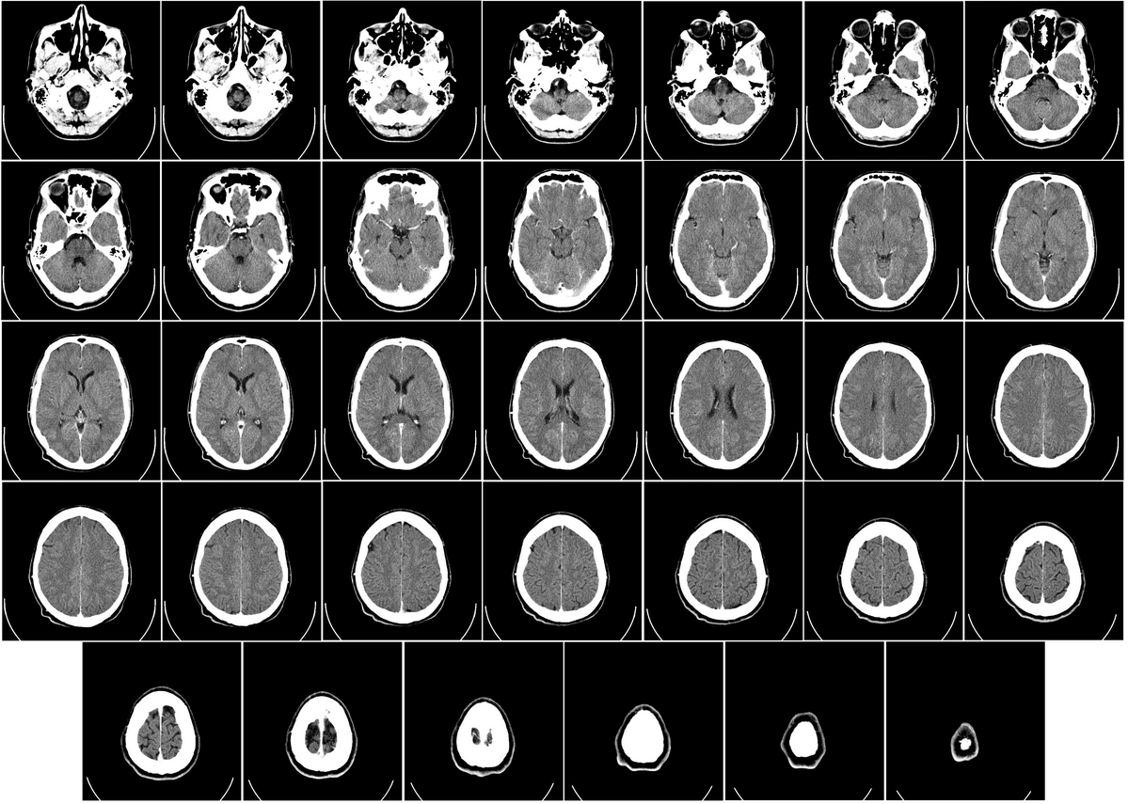
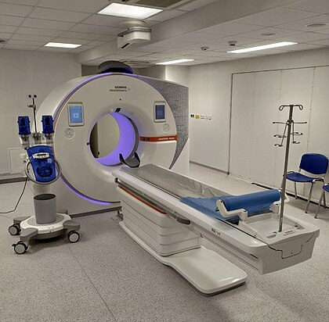
Background
CT: Computer Tomography
  A medical imaging technique used to obtain detailed internal images of the body
Modern CT scanner
Computed tomography of human brain

Slide 3
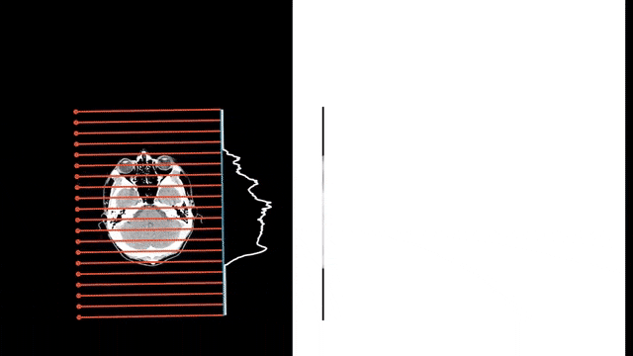
Motivation
CT Reconstruction
  A classical inverse problem (projection data to image)
  Basically, CT image is reconstructed by solving a linear system
Scan line
Angle
Scan line
Angle
*(This is Radon transform)
Multi-angle scanning
Projection data

Slide 4
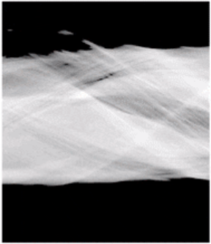
Problem Formulation
Projection data to image
HOW ？
Projection data
Image

Slide 5
Problem Formulation
Ax = b
The linear system:
A
N_{l}
.
=
N_{a} × N_{l}
N_{a}
Column-wise
Vectorization
N_{x} × N_{y}
Unknown
N_{x} × N_{y}
N_{a} × N_{l}
x
b
N_{y}
Column-wise
Vectorization
N_{x}

Slide 6
Problem Formulation
Ax = b
The linear system:
Row-wise view:
a^{T}x = b
a^{T}: the i+(j-1)N_{l}-th row of A
b: the i+(j-1)N_{l}-th element of b
i = [1, …, N_{l}] is the i-th scan line
j = [1, …, N_{a}] is the j-th projection angle

Slide 7
Problem Formulation
In the current problem:
Ax = b is an overdetermined linear system
(N_{a} × N_{l} ) > (N_{x} × N_{y})

Slide 8
Methods: LS Reconstruction
1. Least-square Reconstruction
Ax = b
x = (A^{T}A)⁻¹A^{T}b
Q: b is contaminated by noise in real world.
  Electrical noise, thermal noise, eta.

Slide 9
Methods: LS Reconstruction
Algorithm
Algorithm: LS reconstruction
Input: A and b x = (A^{T}A)⁻¹A^{T}b Return: x

Slide 10
Methods: ART Reconstruction
Basic model of Algebraic Reconstruction Technique:
Ax = b
a^{T}_{i,j} projects x into the i-th scan line of j-th angle
The projection data is b_{i,j}
a^{T}x = b
<=> Projecting x into a hyperplane

Slide 11
Methods: ART Reconstruction
Interpretation
a^{T}x = b
<=> Projecting x into a hyperplane
Projection point b* =
Ax = b
<=> Projecting x into N_{a} × N_{l} hyperplanes

Slide 12
Methods: ART Reconstruction
Geometric interpretation
Ax = b
…
a^{T}₁x = b₁
Alternating and iterative projections.
a^{T}₂x = b₂

Slide 13
Methods: ART Reconstruction
Algorithm
Algorithm: ART reconstruction
Input: A and b Initialization: b = 0 (optional) for k = 1 to K for i = 1 to N_{a} × N_{l} x_{i+1}^{(k)} = projection x_{i}^{(k)} into the hyperplane: a_{i}^{T}x = b_{i}; x(x<0) = 0; end until convergence. end Return: x

Slide 14
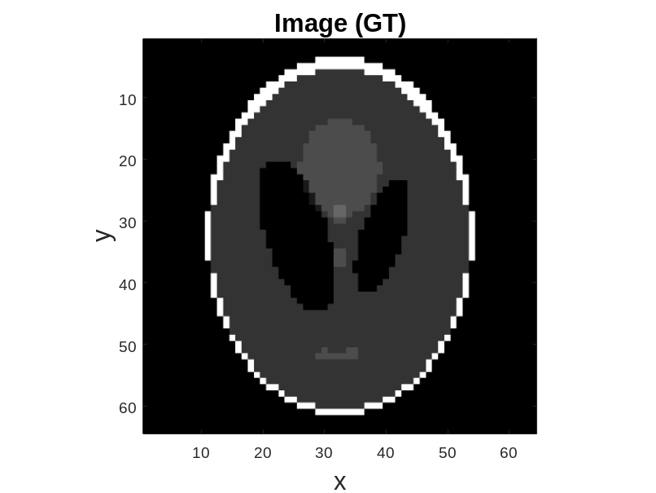
Task
Dataset #1
  Shepp Logan 64
  N_{a} = 90 (from 0° to 179° at a constant step of 2°)
  N_{l} = round(sqrt(2)*N_{x})
  N_{x} = N_{y} = 64
Shepp Logan 64

Slide 15
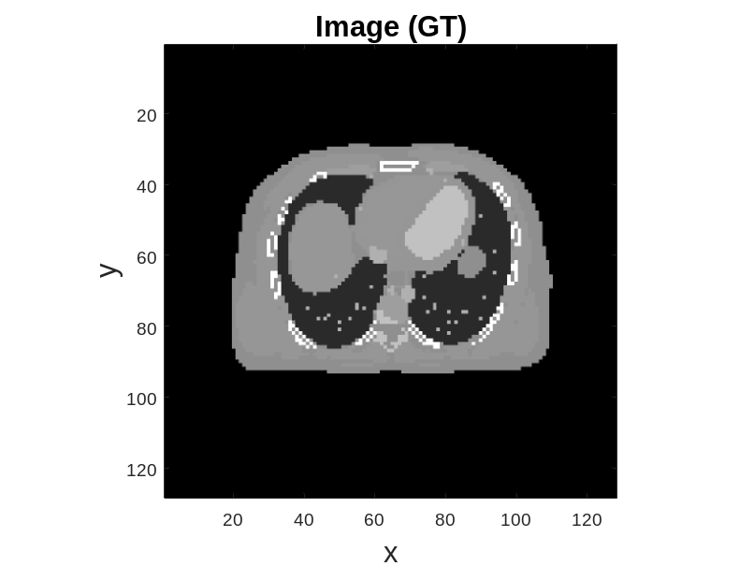
Task
Dataset #2
  XCAT 128
  N_{a} = 90 (from 0° to 179° at a constant step of 2°)
  N_{l} = round(sqrt(2)*N_{x})
  N_{x} = N_{y} = 128
XCAT 128
(Human chest)

Slide 16
Regular Task (80%)
What you have
  Two datasets, i.e., ground truths
  The corresponding A and noised b (15 dB, 20 dB, 25 dB, 30 dB)
What you need to do
  Reconstructing x via LS .
  Reconstructing x via ART.
  Adding regularizations (L₂, L₁, TV…) to your reconstructions.
  Analyzing your results.

Slide 17
Extension (20%)
An underestimated Ax = b system by reducing No. angles
  Low-dose CT, which is helpful to reduce X-ray radiation.
Other solutions
  AI-assisted reconstruction?
  AI-assisted denoising?

Slide 18

Q & A

