Slide 1
Latin Hypercube Sampling
Rachel Gicquelais - Epid 814
Oct 25, 2017

Slide 2
Latin Hypercube Sampling: Incorporate Parameter Uncertainty through Stratified Random Sampling
Challenge when have lots of parameters and do not know their exact values: simulate model across all possible parameter values in a computationally efficient way.
Random sampling would require tons of simulations to fully sample the parameter space or, with too few simulations may not provide a representative sample of space.
Solution: Latin hypercube sampling
Take random samples within strata/partitions of the parameter space (stratified sampling without replacement).
Requires parameters are independent.
Specify ranges and/or distribution of each parameter (maybe through lit review, expert knowledge, previous work, etc).
Helpful slides: Li X. Numerical Methods for Engineering Design and Optimization.
Notes:
Citation
Li X. Numerical Methods for Engineering Design and Optimization. Accessed online from: https://users.ece.cmu.edu/~xinli/classes/cmu_18660/Lec25.pdf

Slide 3
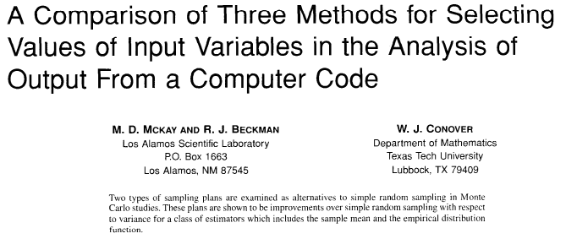

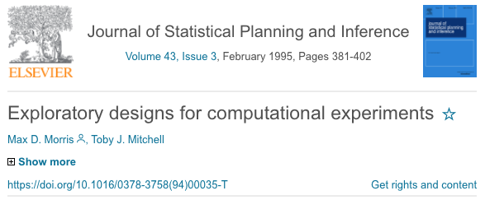
LHS References
Originally proposed by Mckay et al. (1979) as improvement over random and stratified sampling
Marino et al. (2008) review application of LHS in uncertainty analysis
Morris & Mitchell (1995) propose other LHS application, which Marisa mentioned might be preferred over Marino et al.

Slide 4
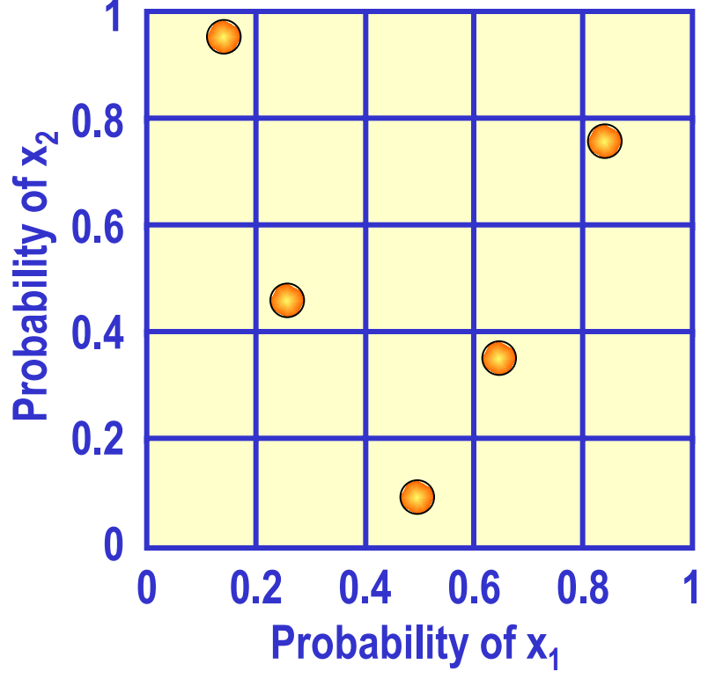
2 Parameter Example of LHS
Grid up sample space into strata
Randomly sample within space so we get 1 representative of each row/column combo.
Logic extends to >2 parameter examples
Li X.
Notes:
Citation
Li X. Numerical Methods for Engineering Design and Optimization. Accessed online from: https://users.ece.cmu.edu/~xinli/classes/cmu_18660/Lec25.pdf

Slide 5
Other (Kinda Related) Things
Importance sampling
Li X. Numerical Methods for Engineering Design and Optimization &
Huang, Hami, & Radi ‘Overview of Structural Reliability Analysis Methods – Part II: Sampling Methods
Adaptive sampling
Huang, Hami, & Radi ‘Overview of Structural Reliability Analysis Methods – Part II: Sampling Methods.
Sensitivity analysis with partial (rank) correlation coefficients and extended Fourier amplitude sensitivity test (eFAST)
Marino et al. A methodology for performing global uncertainty and sensitivity analysis in systems biology. (2008). Journal of Theoretical Biology,254: 178-196.

