Slide 1
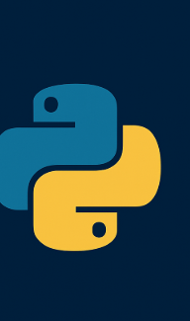


Building Interactive Dashboards with Dash and AWS RDS
A practical talk for Python developers and data enthusiasts
Speaker:
Ing. Erick J. Pineda Amézquita

Slide 2


Slide 3
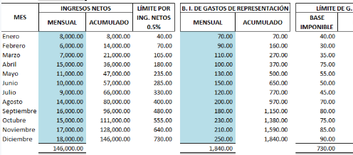

Slide 4
Importance of Dashboards
Centralize and visualize key data in real-time
Enable faster, data-driven decision making
Improve communication between technical and non-technical teams
Help monitor KPIs, trends, and anomalies
Enhance transparency and accountability

Slide 5
Agenda
1. Introduction
2. What is Dash?
3. Why use AWS RDS?
4. Building the Dashboard (Live Demo / Code Walkthrough)
5. Deployment Tips
6. Q&A

Slide 6

What is Dash?

Slide 7
What is Dash?
Open-source framework by Plotly
Built on top of Flask, Plotly.js, React.js
No need for HTML, CSS, JS knowledge
Used for interactive, data-driven apps

Slide 8
Install Libraries
pip install dash # Dash: framework for building interactive web dashboards
pip install plotly # Plotly: graphing library used for charts in Dash
pip install pandas # Pandas: data manipulation and DataFrame support
pip install numpy # NumPy: numerical computing with arrays and math operations
pip install mysql-connector-python # MySQL driver from Oracle, for connecting to MySQL on RDS
pip install pymysql # Lightweight MySQL driver, works well with SQLAlchemy
pip install sqlalchemy # SQLAlchemy: SQL toolkit and ORM for Python-database integration
pip install statsmodels # Statsmodels: statistical modeling and forecasting library
Optional:
pip install psycopg2 # PostgreSQL driver, used to connect to AWS RDS (PostgreSQL)
pip show dash # Shows details about the Dash package (version, location, etc.)

Slide 9
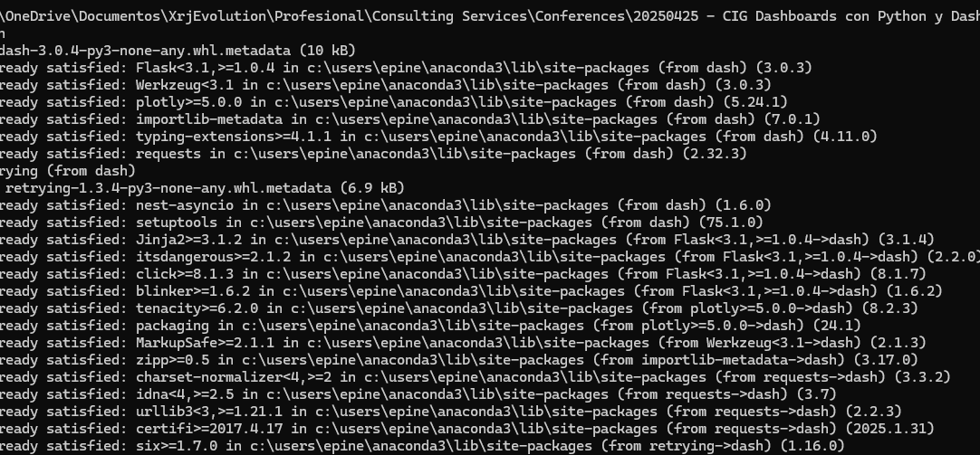

Slide 10
Dash Basic Example
import dash
from dash import html
app = dash.Dash(__name__)
app.layout = html.Div([
html.H1("Hello Dash"),
html.P("Basic dashboard example.")
])
if __name__ == '__main__':
app.run_server(debug=True, port=8050)

Slide 11
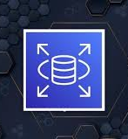
What is AWS RDS?
• Relational Database Service by AWS
• Supports PostgreSQL, MySQL, SQL Server, etc.
• Managed, scalable, with built-in backups

Slide 12
Connecting to AWS RDS
# db_connection.py
import mysql.connector
import pandas as pd
def get_data():
connection = mysql.connector.connect(
host="epdb.cul1rokptvup.us-west-1.rds.amazonaws.com",
user="admin",
password="AmezziTech19",
database="pycon_demo"
)
query = "SELECT * FROM daily_habits"
df = pd.read_sql(query, con=connection)
connection.close()
return df

Slide 13
Integrating with Dash (Bar Chart)
import pandas as pd
import plotly.express as px
from dash import dcc, html
fig = px.bar(df, x="product", y="amount")
app.layout = html.Div([
html.H2("Sales Dashboard"),
dcc.Graph(figure=fig)
])

Slide 14
Changing the Dash Port
app.run_server(debug=True, port=8080)
• You can change to any available port
• Use host="0.0.0.0" for external access

Slide 15


Slide 16

First Example: $> python 0.MyFirsDashboard.py

Slide 17

Web
http://127.0.0.1:8050/

Slide 18

Second Example: BD Connection
1.Connect to BD MySQL
(AWS RDS)
2. Crearte BD y Load data:
2.1.Script_Schema_Table_Inserts.sql
3. File with Connection String:
db_connection.py
4. Create Dashboard app.

Slide 19

Deployment Tips
Use environment variables for credentials.
Apply pagination or query limits for large datasets.
Use Dash callbacks for real-time interactivity.
Consider Dockerizing the app for deployment on EC2 or ECS.

Slide 20




Thanks!
https://github.com/epinedaWorks
epineda.amezquita@gmail.com

