Slide 1
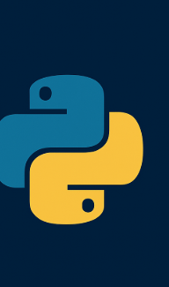


Building Interactive Dashboards with Dash and AWS RDS
A practical talk for Python developers and data enthusiasts
Speaker:
Ing. Erick J. Pineda Amézquita

Slide 2


Slide 3
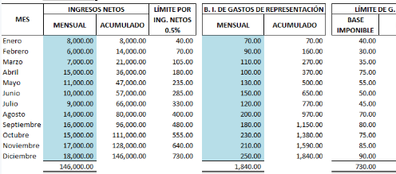

Slide 4
Importance of Dashboards
Centralize and visualize key data in real-time
Enable faster, data-driven decision making
Improve communication between technical and non-technical teams
Help monitor KPIs, trends, and anomalies
Enhance transparency and accountability

Slide 5
Agenda
1. Introduction
2. What is Dash?
3. Why use AWS RDS?
4. Building the Dashboard (Live Demo / Code Walkthrough)
5. Deployment Tips
6. Q&A

Slide 6

What is Dash?

Slide 7
What is Dash?
Open-source framework by Plotly
Built on top of Flask, Plotly.js, React.js
No need for HTML, CSS, JS knowledge
Used for interactive, data-driven apps

Slide 8
Install Libraries
pip install dash # Dash: framework for building interactive web dashboards
pip install plotly # Plotly: graphing library used for charts in Dash
pip install pandas # Pandas: data manipulation and DataFrame support
pip install numpy # NumPy: numerical computing with arrays and math operations
pip install mysql-connector-python # MySQL driver from Oracle, for connecting to MySQL on RDS
pip install pymysql # Lightweight MySQL driver, works well with SQLAlchemy
pip install sqlalchemy # SQLAlchemy: SQL toolkit and ORM for Python-database integration
pip install statsmodels # Statsmodels: statistical modeling and forecasting library
Optional:
pip install psycopg2 # PostgreSQL driver, used to connect to AWS RDS (PostgreSQL)
pip show dash # Shows details about the Dash package (version, location, etc.)

Slide 9
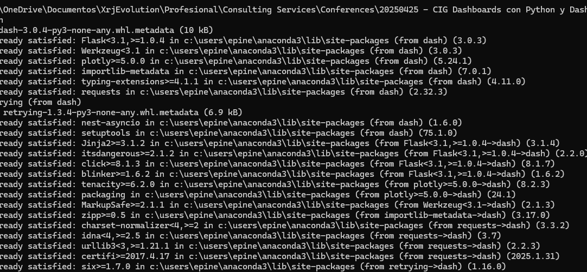

Slide 10
Dash Basic Example
import dash
from dash import html
app = dash.Dash(__name__)
app.layout = html.Div([
html.H1("Hello Dash"),
html.P("Basic dashboard example.")
])
if __name__ == '__main__':
app.run_server(debug=True, port=8050)

Slide 11

What is AWS RDS?
• Relational Database Service by AWS
• Supports PostgreSQL, MySQL, SQL Server, etc.
• Managed, scalable, with built-in backups

Slide 12
Connecting to AWS RDS
# db_connection.py
import mysql.connector
import pandas as pd
def get_data():
connection = mysql.connector.connect(
host="epdb.cul1rokptvup.us-west-1.rds.amazonaws.com",
user="admin",
password="AmezziTech19",
database="pycon_demo"
)
query = "SELECT * FROM daily_habits"
df = pd.read_sql(query, con=connection)
connection.close()
return df

Slide 13
Integrating with Dash (Bar Chart)
import pandas as pd
import plotly.express as px
from dash import dcc, html
fig = px.bar(df, x="product", y="amount")
app.layout = html.Div([
html.H2("Sales Dashboard"),
dcc.Graph(figure=fig)
])

Slide 14
Changing the Dash Port
app.run_server(debug=True, port=8080)
• You can change to any available port
• Use host="0.0.0.0" for external access

Slide 15


Slide 16

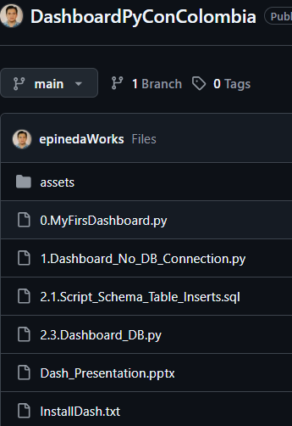
Go to Github
https://github.com/epinedaWorks/DashboardPyConColombia

Slide 17

First Example: $> python 0.MyFirsDashboard.py

Slide 18

Web
http://127.0.0.1:8050/

Slide 19

Second Example: BD Connection
1.Connect to BD MySQL
(AWS RDS)
2. Crearte BD y Load data:
2.1.Script_Schema_Table_Inserts.sql
3. File with Connection String:
db_connection.py
4. Create Dashboard app.

Slide 20
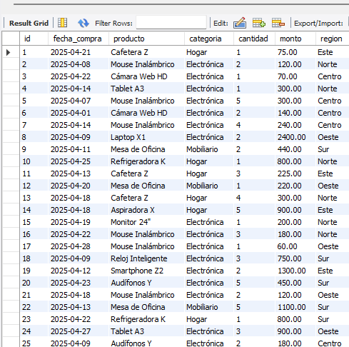
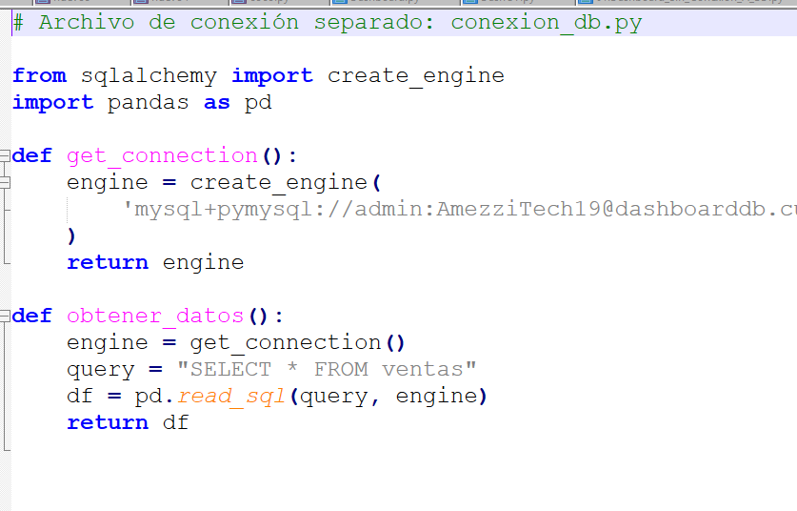
Create RDS and Run Script

Slide 21
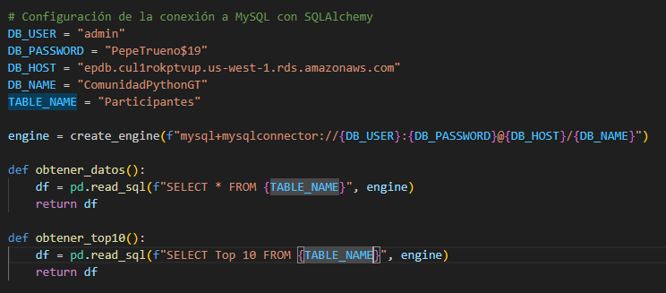
DB Connection

Slide 22
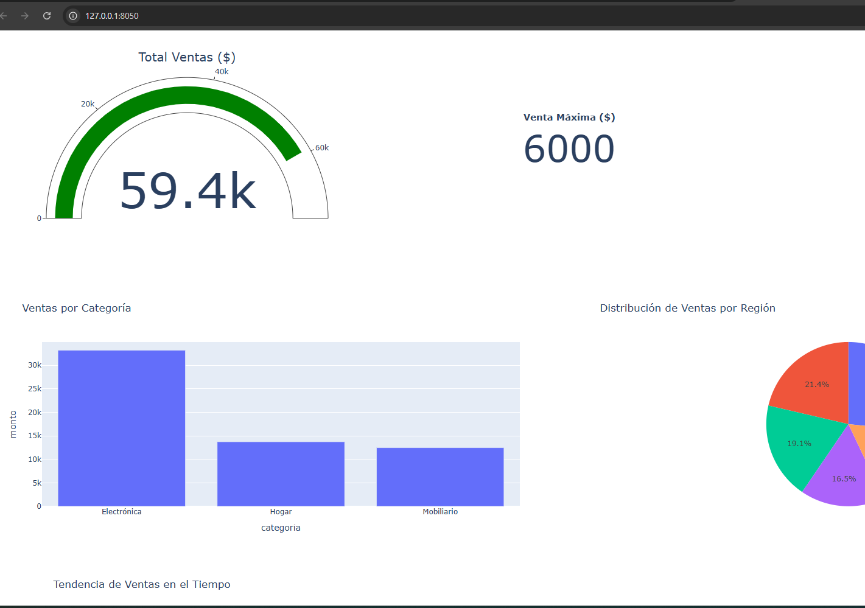

Slide 23

Deployment Tips
Use environment variables for credentials.
Apply pagination or query limits for large datasets.
Use Dash callbacks for real-time interactivity.
Consider Dockerizing the app for deployment on EC2 or ECS.

Slide 24




Thanks!
https://github.com/epinedaWorks
epineda.amezquita@gmail.com

