Slide 1
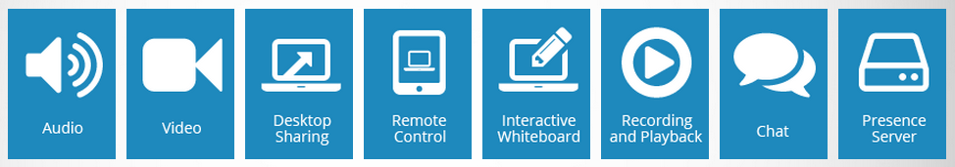
We make pricing easy!
We don’t limit the number of attendees for a specific meeting.
Of course, iMeet provides everything you need to have meetings:
However, iMeet was built to provide a collaborative experience with capabilities beyond just meetings.
We provide a complete collaborative environment!
Project Management to plan and manage collaborative activities
Knowledge Management to manage and evolve the collaborative knowledge base
Enterprise Social Networking so collaborators can interact socially
Each collaborator fully engages in the complete collaborative environment in which meetings take place, but meetings alone are just a part of the collaborative endeavor. A complete collaborative environment requires Project and Knowledge Management, plus Social Networking to fully engage collaborators in the process.
We have it all! So can you!

Slide 2
35+ Collaborators
35 - 21 Collaborators
20 - 6
Collaborators
Up to 5 Collaborators
@
@
@
@
$10
per / monthly
$20
per / monthly
$30
per / monthly
$40
per / monthly
Level 4 | Collaborators | Price | Monthly
Min | 36 | $10 | $360
Pick - 36 or more | 39 | $10 | $390
Level 3 | Collaborators | Price | Monthly
Min | 21 | $20 | $420
Max | 35 | $20 | $700
Pick - 21 up to 35 | 28 | $20 | $560
Level 2 | Collaborators | Price | Monthly
Min | 6 | $30 | $180
Max | 20 | $30 | $600
Pick - 6 up to 20 | 13 | $30 | $390
Level 1 | Collaborators | Price | Monthly
Min | 1 | $40 | $40
Max | 5 | $40 | $200
Pick - 1 up to 5 | 3 | $40 | $120
GO
GO
GO
GO

Slide 3
Guys, this a calculator, double-click and make changes to extrapolate with pick options or change level values:

Slide 4
35+ Collaborators
35 - 21 Collaborators
20 - 6
Collaborators
Up to 5 Collaborators
@
@
@
@
$10
per / monthly
$20
per / monthly
$30
per / monthly
$40
per / monthly
Collaborators ---->> 1 . . . 5 ---->> . . . . . . . . . 20 ---->> . . . . . . . . . 35 Unlimited - only
$40 per / monthly $30 per / monthly $20 per / monthly $10 per / monthly

Slide 5
The slides below this one are from version 1 if you need to review.

Slide 6
From our pricing discussion:
[1/20/2014 3:04:50 PM] John Chowdhury: I think we should do $25 per user for 10 or less
$20 for 11 to 200
$18 for 200+
[1/20/2014 3:26:11 PM] John Chowdhury: for free is for limited time... Initially for 3 months... later for 1 month...
they can have up to 3 participants (free that is)
So, if we translate these into monthly amounts?
$0 per user per month – for 3 or less users = (3 * $0) = $0 a month (3 months only)
$25 per user per month – for 10 or less users = (10 * $25) = $250 a month
$20 per user per month – for 11 to 200 users = (11 * $20) = $220 a month
$18 per user per month – for 200+ users = (201 * $18) = $3,618 a month
We may want to change the last one and make it really appealing to choose, say, make it $5 per user per month:
(201 * $5) = $1,005 a month or $12,060 per year for 24/7 unlimited users.
Check next slide for one way we could display above on pricing page:

Slide 7
$0
Per seat per month
$25
Per seat per month
$20
Per seat per month
$5
Per seat per month
Up to 3 Users
Up to 10 Users
Up to 200 Users
Unlimited
Users
$0
monthly
$250
monthly
$220
monthly
$1005
call for details
I like the way Cisco set pricing, see next slide:

Slide 8
Up to 10 Collaborators
10+ Collaborators
35 Collaborators
35+ Collaborators
@
$15
$10
Per License
$25
per
$20
$250
Monthly @ 10 Licenses
$250
Monthly @ 10 Licenses
$250
Monthly @ 10 Licenses
$250
Monthly @ 10
I like the way Cisco set pricing, see next slide:

Slide 9
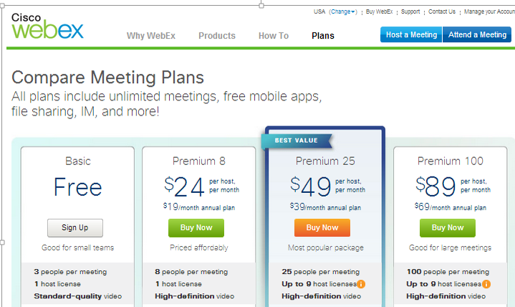
Maybe these guys know pricing, they have good market share and may have pricing figured out:

