Slide 1

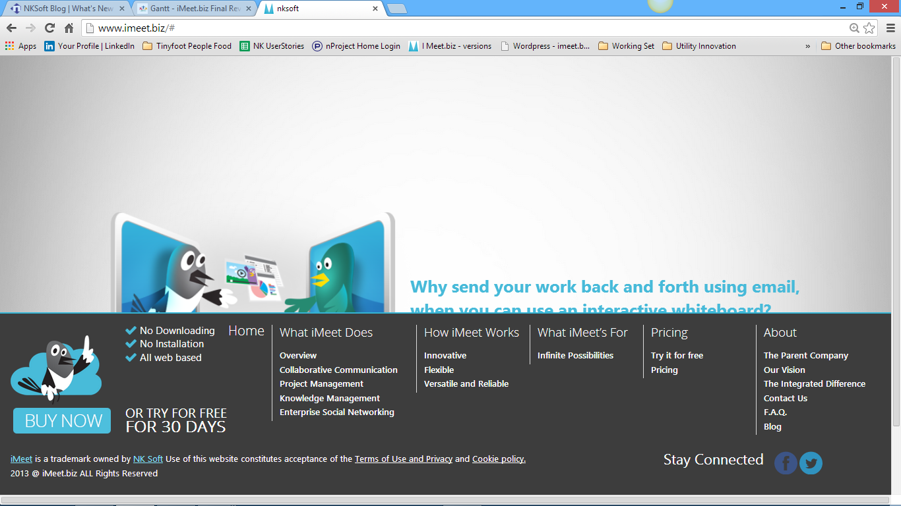
See how much space is here. It is because of sub-menu size on “What iMeet Does”, “Pricing” spaces can be reduced.
iMeet.biz is a trademark owned by NKSoft. Use of this website constitutes acceptance of the Terms of Use, Copyright and Trademark, and Privacy policy
Maybe the only thing we can do here is move the “Pricing” area line to match sub-menu size.
Just make it look “neater and cleaner” the best way you can.

