Slide 1
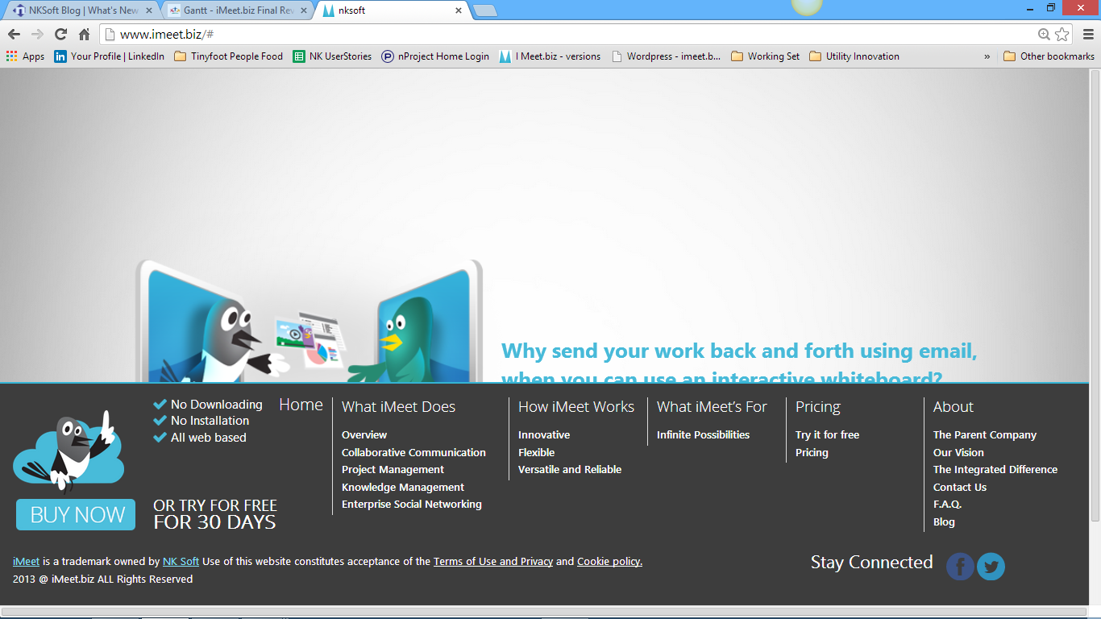
iMeet.biz is a trademark owned by NKSoft. Use of this website constitutes acceptance of the Terms of Use, Copyright and Trademark, and Privacy policy
iMeet.biz is a trademark owned by NKSoft. Use of this website constitutes acceptance of the Terms of Use, Copyright and Trademark, and Privacy policy

