Slide 1
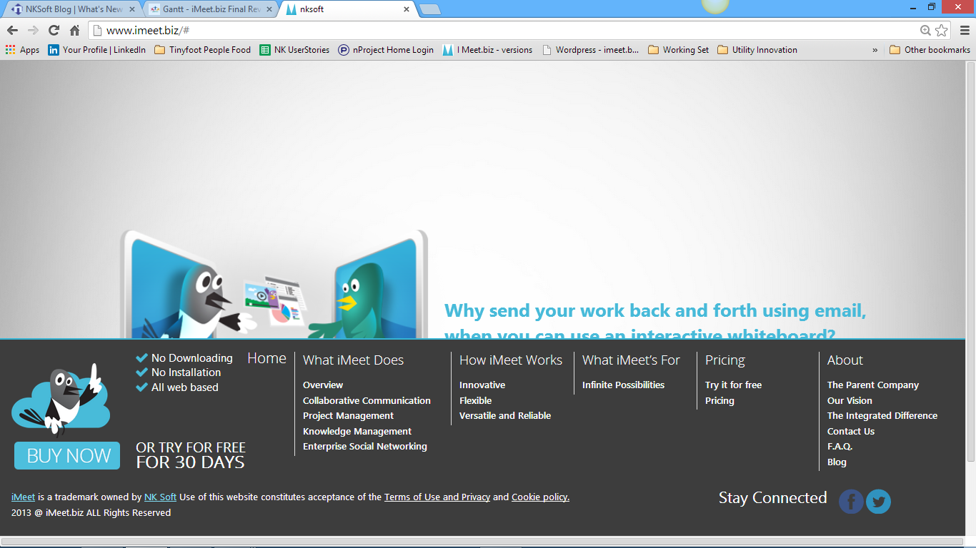
iMeet.biz is a trademark owned by NKSoft. Use of this website constitutes acceptance of the Terms of Use, Copyright and Trademark, and Privacy policy
Our proper page links here: add our LinkedIn page, and Google+ too. Use the latest symbols for each also, see nksoft.com.

