Slide 1
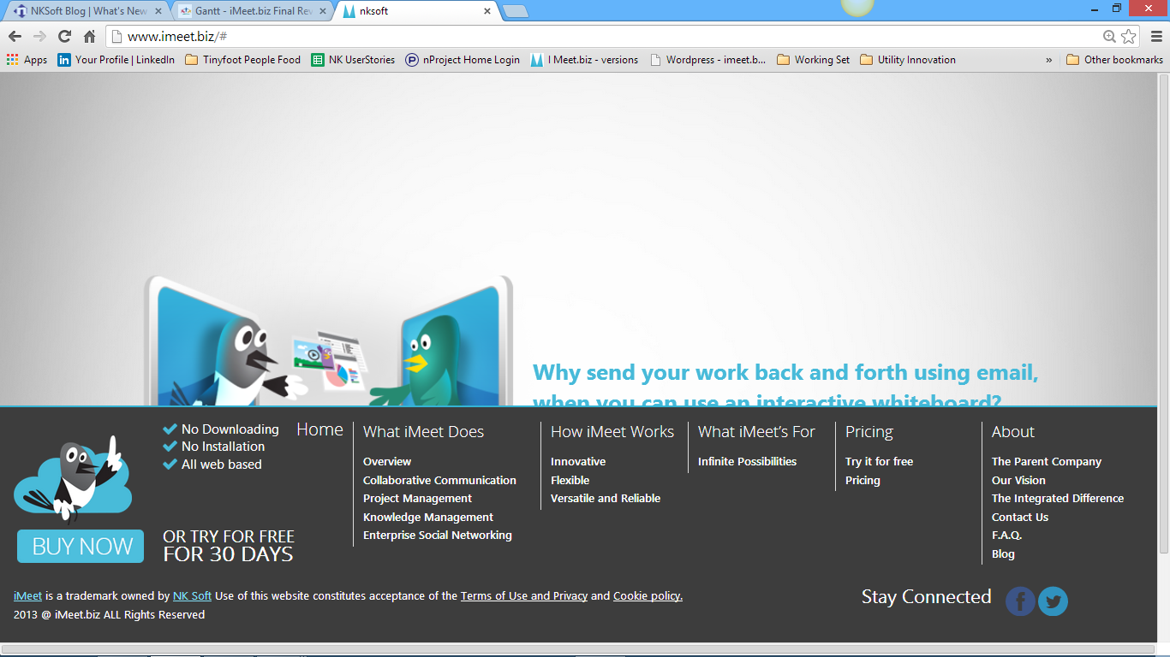
iMeet.biz is a trademark owned by NKSoft. Use of this website constitutes acceptance of the Terms of Use, Copyright and Trademark, and Privacy policy
Highlight blue on hover, Link goes to Try it Free page
Highlight on hover, Link goes to Pricing page

