Slide 1
COMET: A COgnitive Radio Multimedia NEtwork Testbed for Multimedia Communication
Team Members:
Eric Pires
Jeffrey KobzA
Kevin Francois
Tobias Young
Sponsored By:
Dr. Honggang Wang
Dr. Dayalan Kasilingam
Dr. Liudong Xing

Slide 2
Project Goal
Develop a communications testbed using software defined radio technologies and apply it to transmit data
SDR allows for traditional radio hardware to be defined in software
Requires strong computing resources (FPGA, CPLD) to handle analog signal processing
Antenna also required for transmitting / receiving radio signals over a specified frequency
Sample files will be provided by customer
Encoding/Decoding not expected for final implementation, static data to be provided for basic transmission.
Minimal goals
Define a working transmitter and a receiver through SDR software and test the communication between both devices
Expanded goal
Attempt a more reliable network testbed by combining multiple transmitters and receivers in a larger schematic

Slide 3


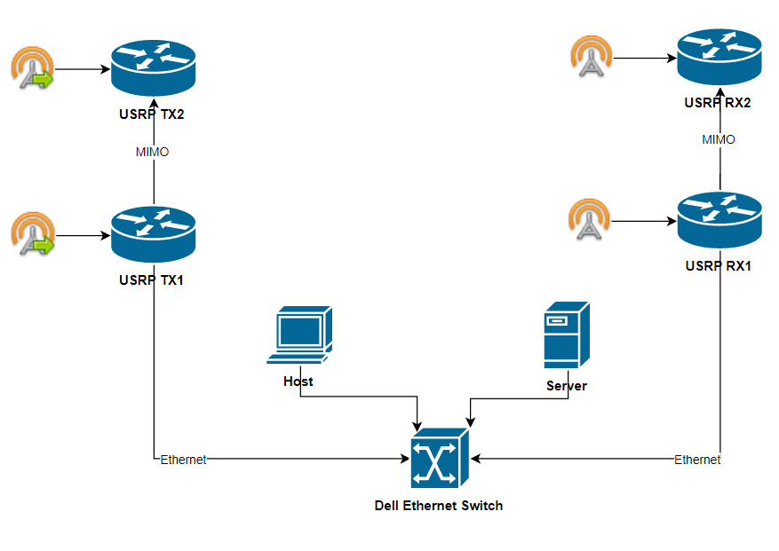



System Diagram

Slide 4
Customer Requirements
No. | Customer Requirement | Requirement Description
1 | Setup network testbed for multimedia communication | Using the USRP N210 SDR device, design an implement a reliable communication network capable of wirelessly transmitting and receiving data from one device to another over a common but reliable frequency.
2 | Improve the testbed to implement more networking devices | Improve on the base testbed by adding multiple transmission and receiving components that can communicate synchronously.

Slide 5
Engineering Requirements
Customer Requirement No. | Engineering Requirement No. | Engineering Requirement Description | Justification/ Comments | Test Method
1 | 1.a | Map out a network in which one end user sends a file through the Transmitter and is received and shared to the other end user through the receiver over the 2 - 2.4Ghz frequency range. | Transmission errors expected over common frequency channel, reliability aspect covered in second semester. | Inspection
 | 1.b/c | Configure one USRP to function as a Transmitter/Receiver. Benchmark sampling results of transmitted and received packets. | In order for data to be wirelessly shared, one USRP must act as a transmitter to send data over a specified frequency and another to capture that transmission | Demonstration/ Analysis
2 | 2.a | Add additional transmitters and receivers through MIMO configuration. | MIMO (Multiple Input Multiple Output) allows for optimization of network speed by synchronizing device computation between multiple units rather than depending on one. | Test/Inspection
 | 2.b | Attach main transmitter and receiver to ethernet switch to connect all devices within network testbed. Benchmark sampling results of transmitted and received packets | Number of added devices will increase throughout the year, therefore a network switch will be utilized to accommodate all device traffic within the network. | Demonstration/ Analysis

Slide 6
Constraints and Applicable Standards
U.S. Code of Federal Regulations
Title 47 (Telecommunication)
Chapter 1 (Federal Communications Commission)
Subchapter B (Common Carrier Services)
Part 27 (Miscellaneous Wireless Communications Services)
Customer specified general range in transmission frequency as defined by the Wireless Communications Service (WCS)
2000 - 2690 MHz
Ultra High Frequency (UHF) range preferred despite capabilities of Super High Frequency (SHF) communications
Ethernet driver on USRP supports speeds up to 1Gbps
Utilize cabling accordingly

Slide 7
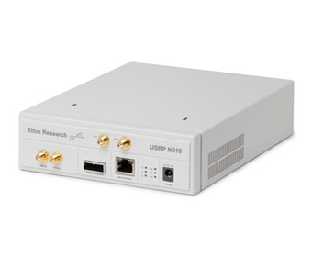
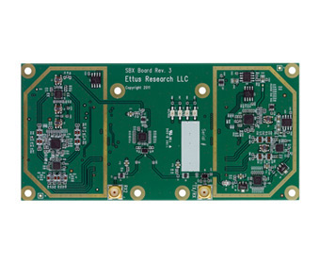
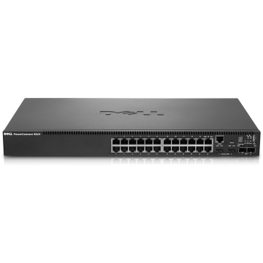

Equipment Estimate
Hardware
Four Universal Software Radio Peripheral (USRP) N210 devices
Each with one RF Daughterboard SBX 400-4400 MHz Rx/Tx
Each with one LP0965 Antenna
Two Desktops PCs
Linux system preferred, but Windows is also compatible
Dell Networking 5524 Gigabit Ethernet Switch
Additional Ethernet Cat5e Cables
Software
USRP Hardware Driver (UHD)
GNU Radio
Both open-source and provided on GitHub repositories

