Slide 1
Getting Started with Quest
Daniel Russ and Nick Ruggieri
Data Science Research Group/DCEG/NCI

Slide 2





Why Quest?
Questionnaire are ubiquitous in epidemiological research
and others
None really satisfy all our needs

Slide 3
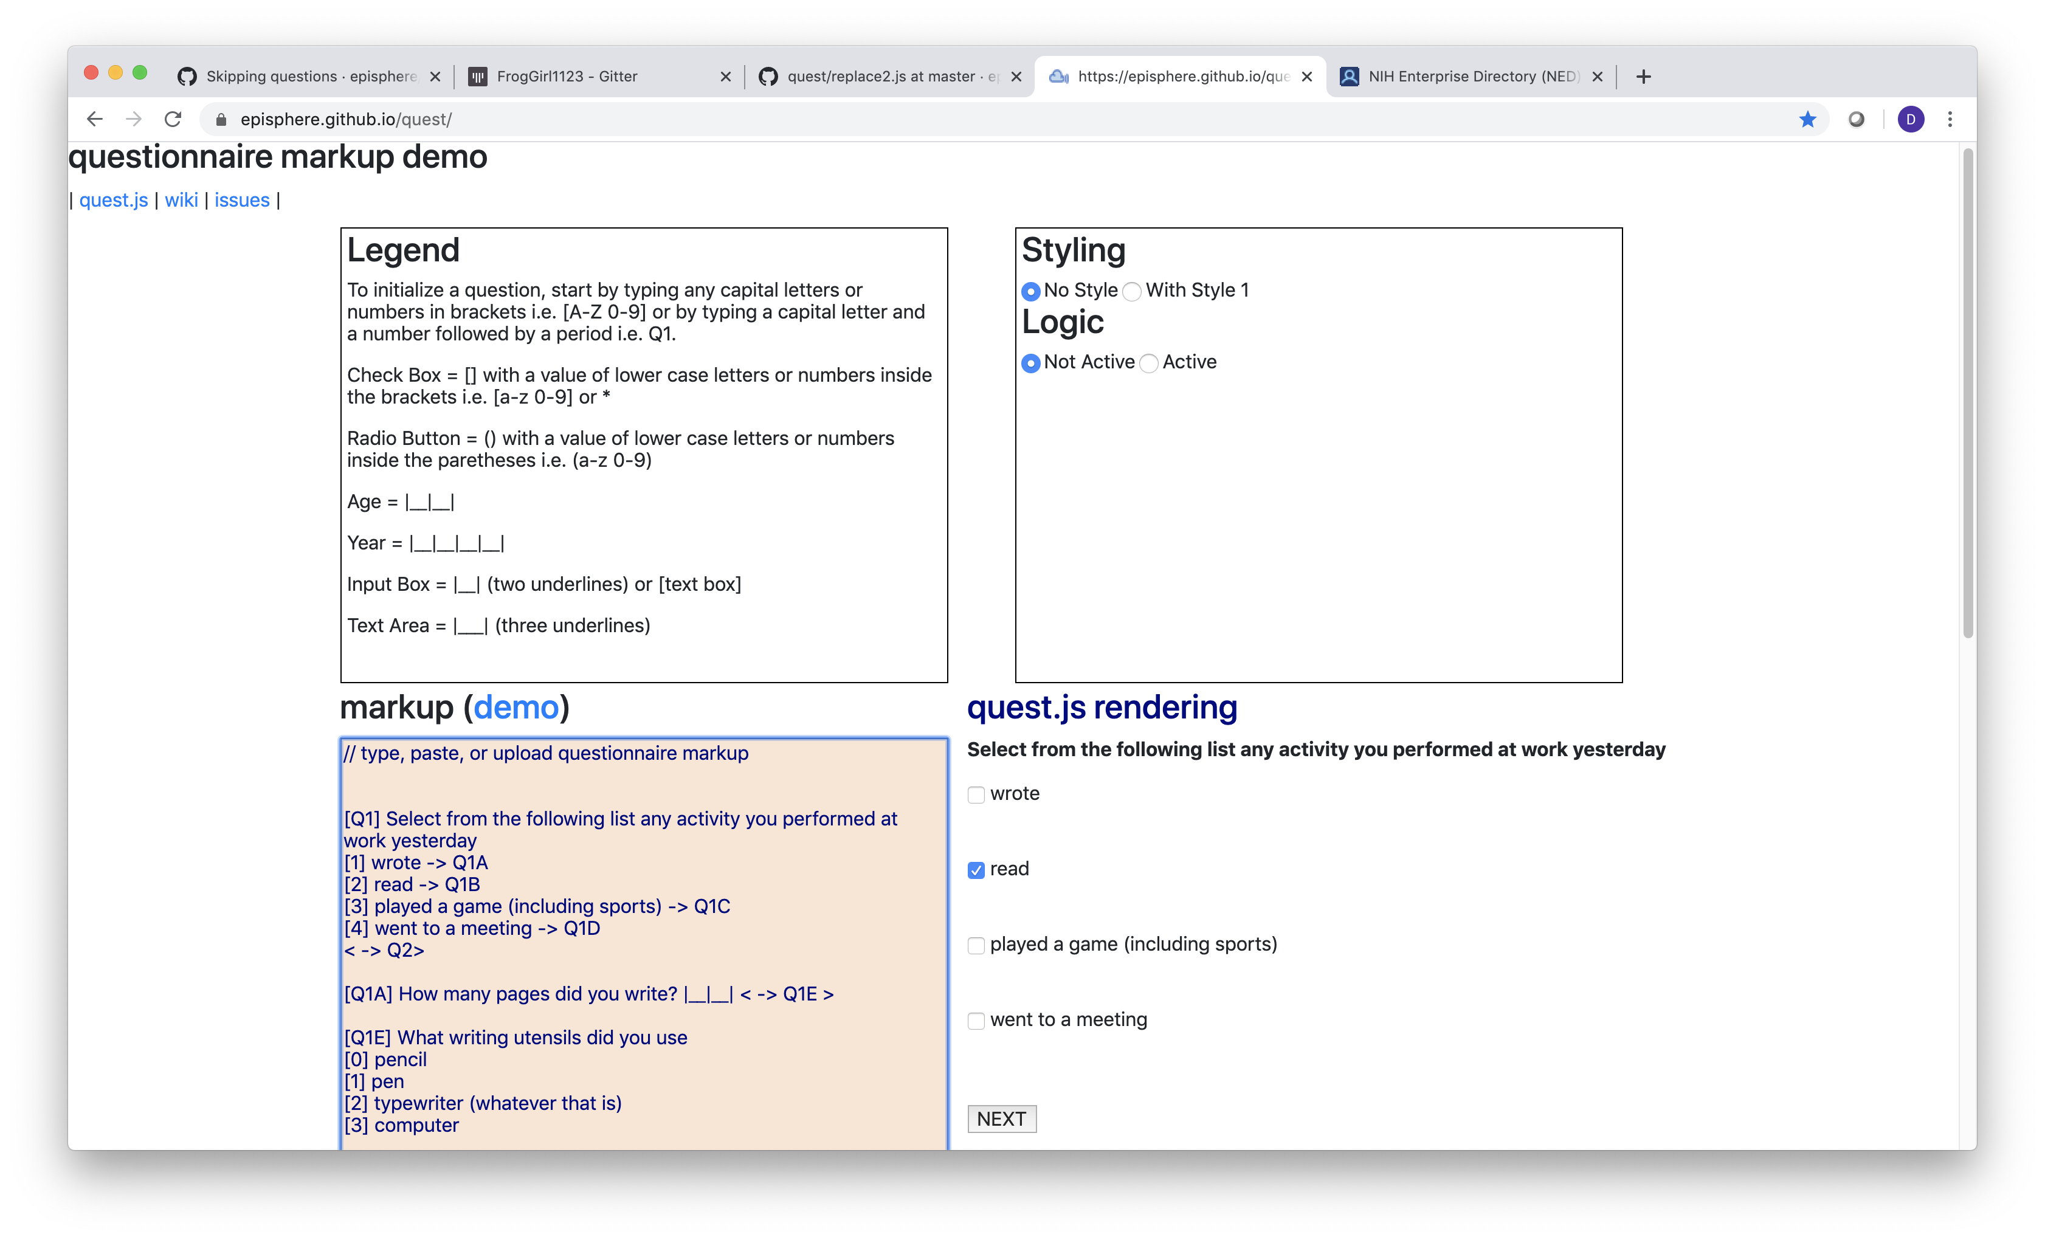
View as you Design

Slide 4
Type of Questions
Question Type | HTML element
one of many | input[type=radio]
multiple of many | input[type=“checkbox”]
numeric | input[type=“number”]
text | input[type=“text”]
answer this or that | ?
follow up questions | ?
no response | ?
looping | ?
hard/soft edits | ?

Slide 5
Terms
Term | Definition | example
Variable name | name that adds meaning to a response value. | AGECOR
question id | An identifier for the question, often associated with the variable name. | [AGECOR]
id (element id) | an id that specifies an HTML tag in the questionnaire | id="AGECOR_1"
value | value of the response | 1
Radio buttons are the EASIEST example
<input type="radio" name="AGECOR" value="1" id="AGECOR_1">

Slide 6
Markdown Simple Questions
https://github.com/episphere/quest/wiki/Simple-Questions
[Q1] How old are you? |__|__|participantAge|
Question
Id
Question
Text
Numeric response
Element Id
Both cases:
Variable name = Question Id
[Q2] What your father's first name? |__|dadFirstName|
Question
Id
Question
Text
text response
Element Id

Slide 7
Questionnaire Logic, Skipping Question
https://github.com/episphere/quest/wiki/Skipping-questions
[Q1] Do you like chocolate?
yes
(0) no -> Q2
[Q1A] Which type of chocolate do you prefer?
(0) dark chocolate
milk chocolate
white chocolate
[Q2] Do you wear socks at work?
yes
(0) no
If you selected no, There is no need to ask question 1A, GOTO Q2

Slide 8
No Response
CASE 1 | Hard edit: stop and ask them to answer question, they may not continue without answering. Add an exclamation point after the question id (e.g. [Q1!] )
CASE 2 | Soft edit: stop and ask them to answer question, they may continue without answering. Add an question mark after the question id (e.g. [Q1?] ) There is a No Response (#NR) answer.
CASE 3 | Just let them go to the next question. Also an #NR
skip to question q3 when there is no response < #NR -> Q3 >

Slide 9
Always go to < -> >
[Q1] Select from the following list any activity you performed at work yesterday
[1] wrote -> Q1A
[2] read -> Q1B
[3] played a game (including sports) -> Q1C
[4] went to a meeting -> Q1D
< -> Q2>
[Q1A] How many pages did you write? |__|__| < -> Q1E >
[Q1E] What writing utensils did you use
[0] pencil
[1] pen
[2] typewriter (whatever that is)
[3] computer
[Q1B] How many pages did you read? |__|__|
[Q1C] What game did you play |__|
[Q1D] How did that work our for you? |__|
[Q2] Do you have any children (1) yes (0) no
If the user selects [1] and [3]
No need for #NR when < -> > is used

Slide 10
Looping and DISPLAYIF
Id of the response
[Q1] how many kids do you have
|__|__|NKIDS|
<loop max=5>
[Q2,displayif=greaterThanOrEqual(NKIDS,#loop)] is your child # #loop alive?
(1) Yes
(0) No -> _CONTINUE
[Q3,displayif=greaterThanOrEqual(NKIDS,#loop)] how old is child # #loop?
|__|__|KIDAGE|
</loop>
loop Iteration (quest defines this variable)
known functions (see wiki)
Note: The loop is unrolled max times – make sure it is big enough, but not too big.

