Slide 1
Team 2
Oliver Stidwell, Toby Ross, Kornel Tomasiak,
Marcus Peacock, Yosef Teklai

Slide 2
Team Organisation
Ollie Stidwell - Project Manager
Yosef Teklai - Business Analyst
Kornel Tomasiak - Designer
Toby Ross - Software Developer
Marcus Peacock - Software Developer

Slide 3
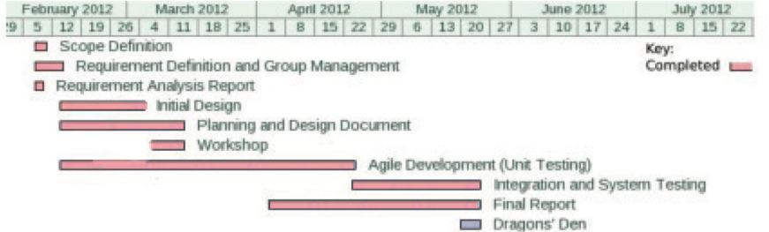
Project Schedule

Slide 4
Data Sources
Facebook
Twitter
RSS

Slide 5

Data Sources

Slide 6
Time
Number of Articles

Slide 7
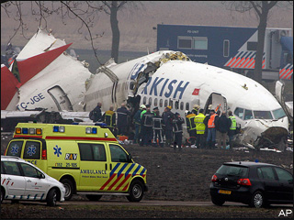
Time
1
Number of Articles
Bhoja Air Boeing 737 crashes in Pakistan, 127 passengers killed
127 people on board a Bhoja Air Boeing 737 have been killed after the plane crashed several kilometers short of Islamabad airport.
http://www.rt.com/news/plane-crash-pakistan-boeing-580/

Slide 8
ALERT
Time
1
5
23
Number of Articles
Bhoja Air Boeing 737 crashes in Pakistan, 127 passengers killed
Keywords
Plane Crash Boeing Bhoja Air Pakistan Cause Unknown Survivors
Cause of Boeing Crash Unknown
Reports of Boeing Crash in Pakistan
Boeing say they are investigating cause
Companies
Boeing | $68.14 (-2.1)
Emergency services rush to aid of Boeing survivors
Articles in last hour = 23
Total articles = 23

Slide 9
ALERT
Time
1
5
23
34
45
90
Number of Articles
Bhoja Air Boeing 737 crashes in Pakistan, 127 passengers killed
Keywords
Plane Crash Boeing Bhoja Air Engine fault Rolls Royce Survivors
Cause of Boeing Crash Unknown
Rolls Royce linked to plane crash
Investigation launched into Rolls Royce
Companies
Boeing | $68.14 (-2.1)
RR | $12.36 (-1.4)
Plane engines made by Rolls Royce
Articles in last hour = 27
Total articles = 90

Slide 10
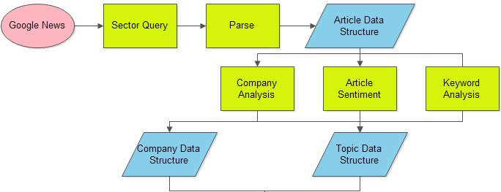
Data Flow

Slide 11
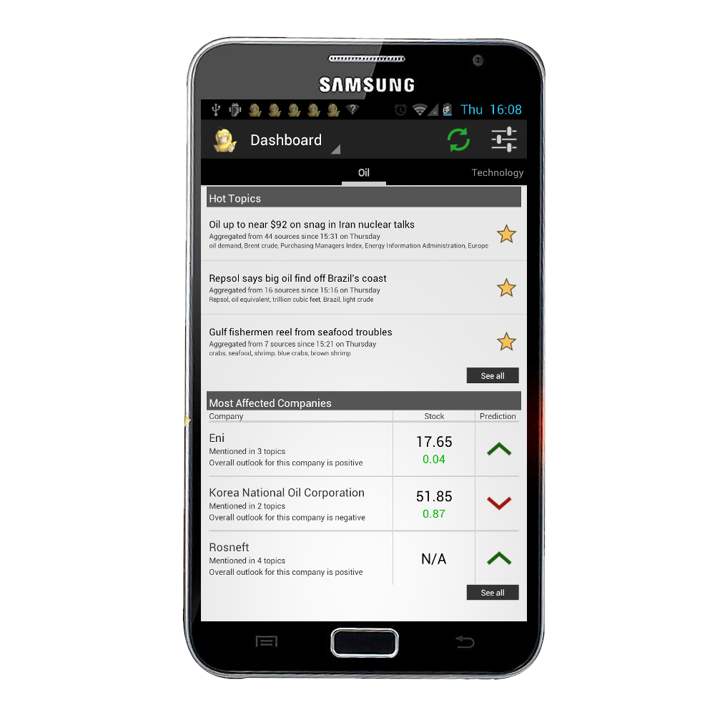

Notifications
Android 4.0

Slide 12
Dashboard
Topics
Companies
Refresh

Slide 13

Topics
Sorted by importance
Main information for each topic
Starring functionality

Slide 14

Starred
A list of all the topics the user starred
Easy access
Starred topics stay even when data is refreshed

Slide 15
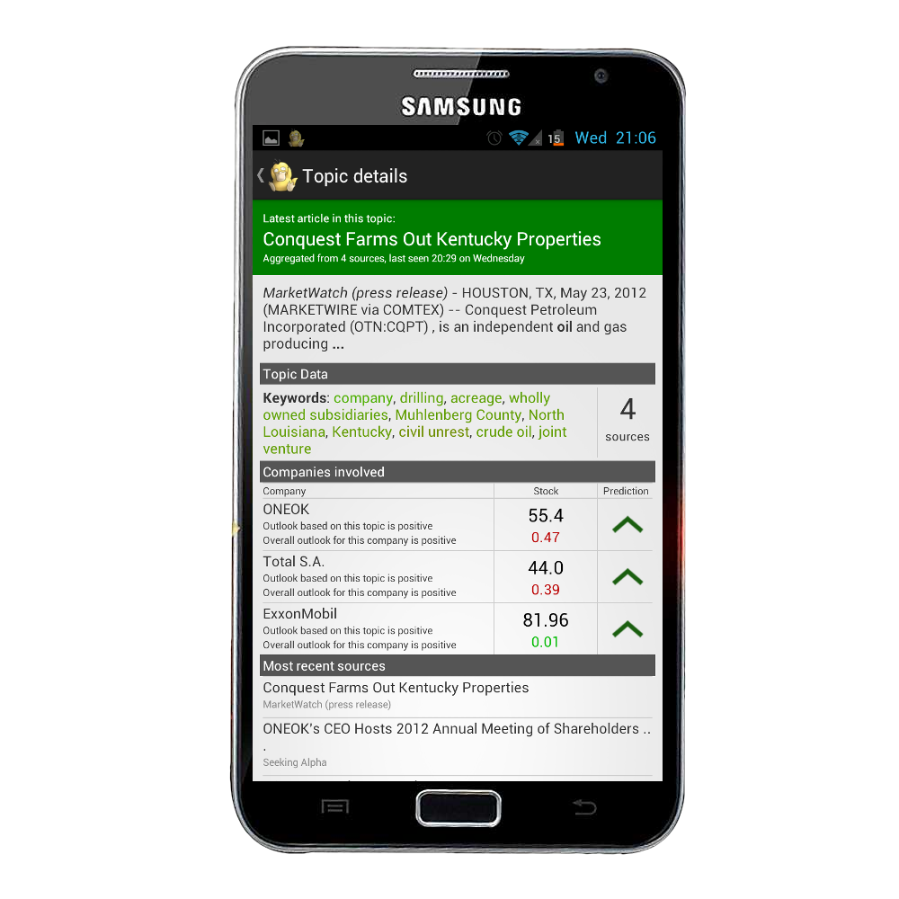
Topic Detail
Colour coded by sentiment
List of keywords
Companies
Sources

Slide 16
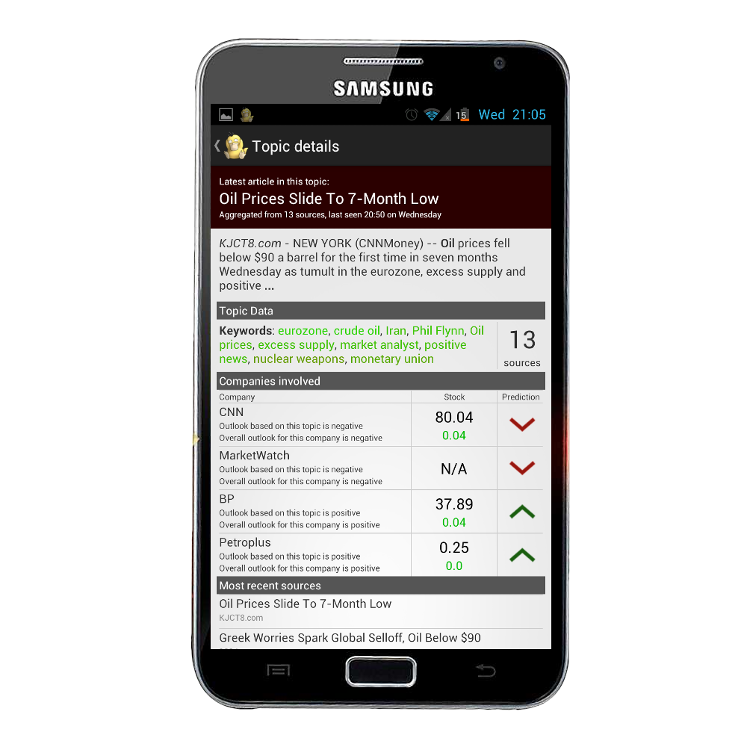
Topic Detail
Colour coded by sentiment
List of keywords
Companies
Sources

Slide 17
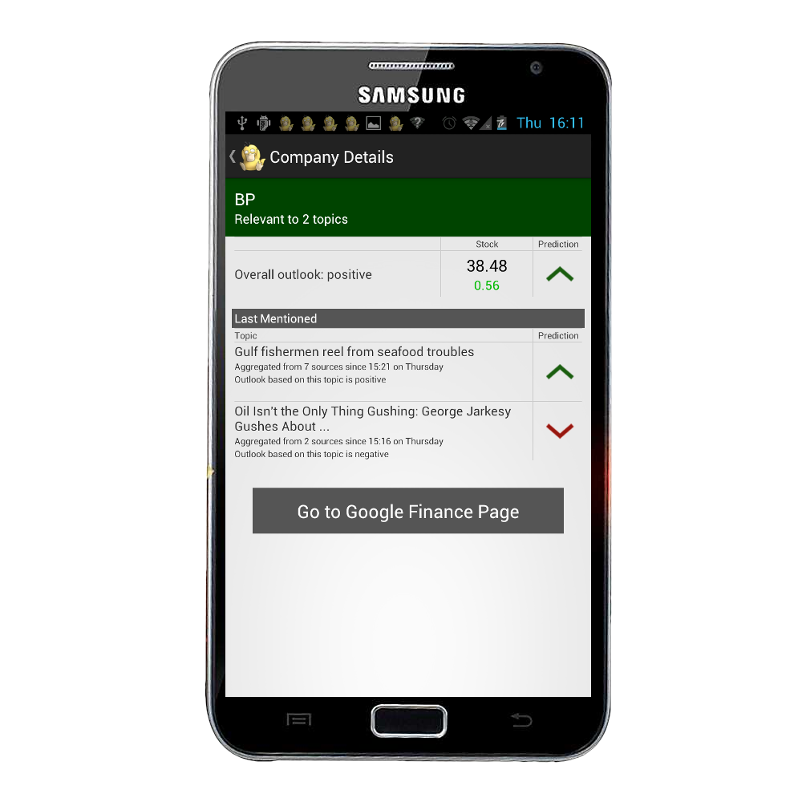
Company Details
Prediction
Stock value
Topics
Google Finance link

Slide 18
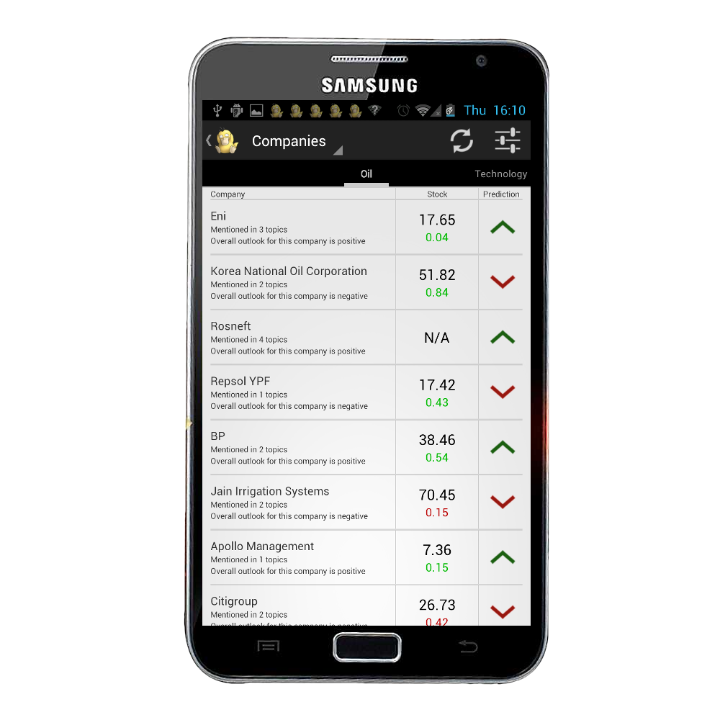
Companies
Divided into respective sectors
Companies can appear in multiple sectors

Slide 19
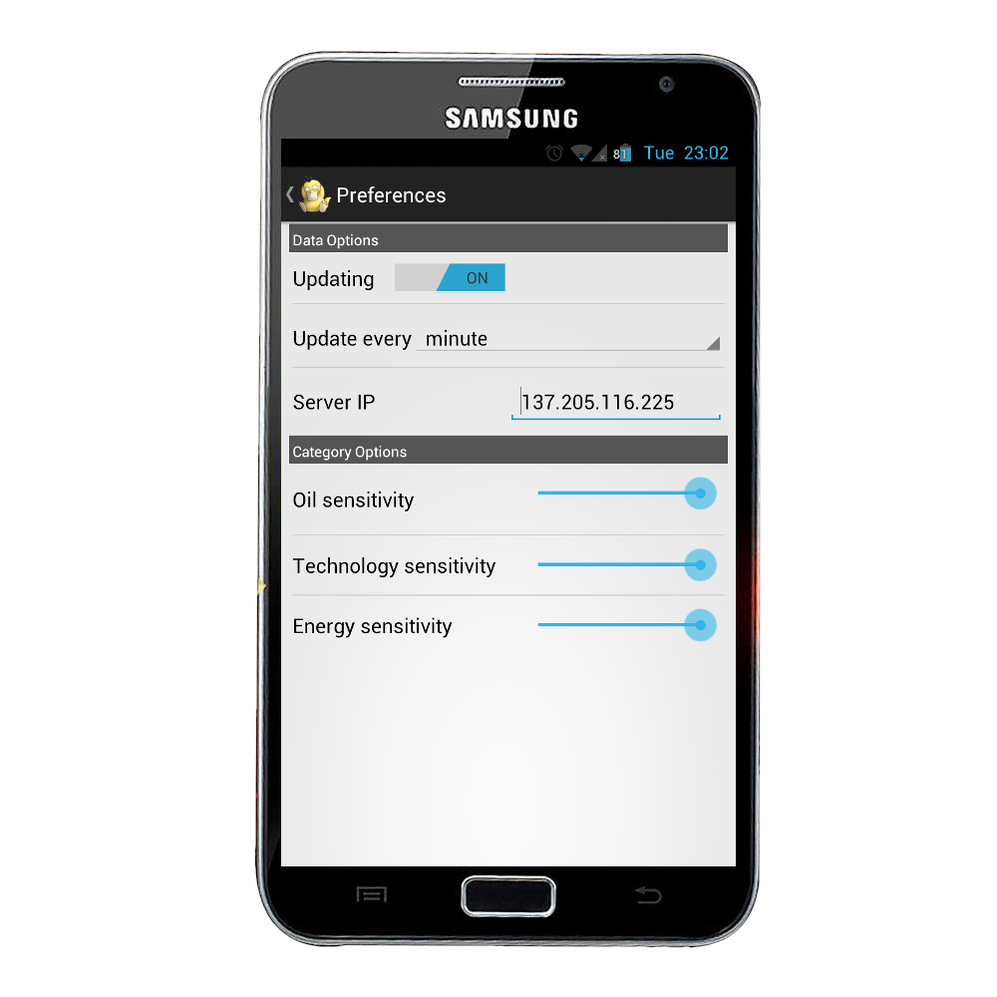
Preferences
Customize the app
Set server IP

Slide 20


Slide 21
Questions?

