Slide 1
Introduction
Chapter 1
CSI 2121, Winter 2000
Lecture Notes Written by Mario Marchand
http://www.site.uottawa.ca/~marchand/

Slide 2
The Bottom-up Approach
We can study computer architectures by starting with the basic building blocks
  Transistors and logic gates
To build more complex circuits
  Flip-flops, registers, multiplexors, decoders, adders, ...
From which we can build computer components
  Memory, processor, I/O controllers…
Which are used to build a computer system
This was the approach taken in your first course CSI 2121: computer architecture I

Slide 3
The Top-bottom Approach
In this course we will study computer architectures from the programmer’s view
We study the actions that the processor needs to do to execute tasks written in high level languages (HLL) like C/C++, Pascal, …
But to accomplish this we need to:
  Learn the set of basic actions that the processor can perform: its instruction set
  Learn how a HLL compiler decomposes HLL command into processor instructions

Slide 4
The Top-bottom Approach (Ctn.)
We can learn the basic instruction set of a processor either
  At the machine language level
    But reading individual bits is tedious for humans
  At the assembly language level
    This is the symbolic equivalent of machine language (understandable by humans)
Hence we will learn how to program a processor in assembly language to perform tasks that are normally written in a HLL
  We will learn what is going on beneath the HLL interface

Slide 5
Levels and Languages
High-level
language
program
Assembly
language
program
Machine
language
program
Compiler
Assembler
The compiler translates each HLL statement into one or more assembly language instructions
The assembler translate each assembly language instruction into one machine language instruction
  Each processor instruction can be written either in machine language form or assembly language form
  Example, for the Intel Pentium:
    MOV al, 5 ;Assembly language
    10110000 00000111 ;Machine language
Hence we will use assembly language

Slide 6
Assembly Language Today
A program written directly in assembly language has the potential to be smaller and to run faster than a HLL program
But it takes too long to write a large program in assembly language
  Only time-critical procedures are written in assembly language (for speed optimization)
Assembly language are often used in embedded system programs stored in PROM chips
  Computer cartridge games, micro controllers, …
Remember: you will learn assembly language to learn how high-level language code gets translated into machine language
  i.e. to learn the details hidden in HLL code

Slide 7
The Platform We Will Use
Assembly language and machine language are processor specific
  We will write code for Intel’s x86 (x>=3)
The assembler places its machine code into an object file which is OS specific
  Our code will run (only) on Windows 95/98/NT
    And it will crash on DOS
  Our programs will be Win32 console applications
    These are programs for which all I/O operations are character-based
    They run into a MS-DOS box but they are not DOS programs (they do not use DOS calls)

Slide 8
The Intel X86 Family
Pentium
. . .
80486
80386
80286
8086
The instruction set of the x86 is backward compatible with any one of its predecessors
  New additional instructions are introduced with each new processor

Slide 9
Registers
Registers are the fastest memories
  Located directly on the processor
  Manipulated directly by processor instructions
The registers for the 8086 and 80286 are only 16-bit wide
Most of these registers have been extended to 32 bits for the 80386 and higher processors
  But very few extra registers have been added
The Pentium has very few registers
  Only 8 registers are available to the programmer (apart from the segment and FPU registers)

Slide 10
General Purpose Registers
31
0
15
0
EAX
AH
AL
EBX
BH
BL
AX
BX
7
0
EDX
DH
DL
ECX
CH
CL
CX
DX
Used by the programmer for arithmetic and data movement
AX is the least significant part of EAX and can be accessed independently (by its name)
AH and AL can also be accessed independently
This is also true for EBX, ECX and EDX
Only the 16-bit part are present in the 8086 and 286

Slide 11
Index Registers
31
0
ESI
SI
ESP
SP
15
0
EDI
DI
EBP
BP
The least significant half can be accessed independently (since it has a name)
Only the lower 16-bit was present in 8086 and 286
Used often to carry the offset part of the logical address (more on that later)
  ESI and EDI for the data segment
  ESP and EBP for the stack segment

Slide 12
The Instruction Pointer EIP
31
15
0
EIP
IP
EIP always contains the offset address of the instruction to be executed next
  This is the program counter for the x86
  The offset address is 32-bit wide when the processor runs in 32-bit mode (ie: for 32-bit segments)
  It is 16-bit wide in 16-bit mode
Only the lower 16-bit was present in the 8086 and 80286 (called IP)

Slide 13
EFLAGS and Condition Codes
31
15
0
EFLAGS
FLAGS
The condition codes of the processor are stored in the EFLAGS register
They consist of individual bits indicating either:
  The mode of operation of the CPU. Ex:
      DF: indicates if arrays are processed in the direction of increasing addresses
  The outcome of an arithmetic operation. Ex:
      ZF: indicates if the result is zero
      SF: indicates if the result is negative
      CF: indicates if there is an unsigned overflow
      OF: indicates if there is a signed overflow

Slide 14
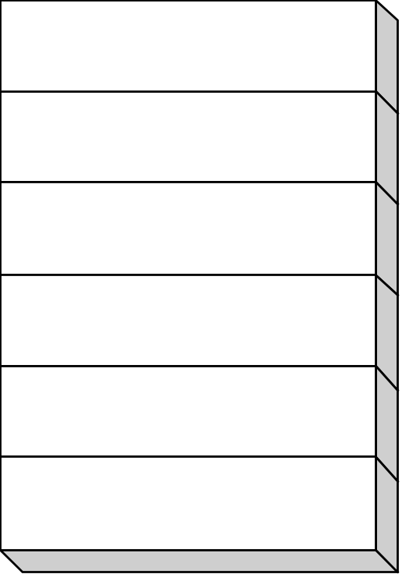
Segment Registers
Each program is subdivided into logical parts called SEGMENTS
  Code segment (CS)
  Stack segment (SS)
  Data segments (DS, ES, FS, and GS)
Segment registers hold the “base address” of these program segments
Segment registers are 16-bit wide
CS
SS
DS
ES
FS
GS

Slide 15
Logical and Physical Addresses
Addresses specify the location of instructions and data
Addresses that specify an absolute location in main memory are physical addresses
  They appear on the address bus
Addresses that specify a location relative to a point in the program are logical (or virtual) addresses
  They are addresses used in the code and are independent of the structure of main memory
Each logical address for the x86 consist of 2 parts:
  A segment number used to specify a (logical) part of the program
  A offset number used specify a location relative to the beginning of the segment

Slide 16
Address Translation and Running Modes
The translation from logical to physical addresses is done at run time
The way in which this address translation is done depends on the running mode of the x86
Two different running modes exist for the x86:
  Real mode (supported by every x86)
  Protected mode (all x86 except the 8086)

Slide 17
Address Translation in Real Mode
The 16-bit segment number (contained in a segment register) is first multiplied by 16
  Ex: if CS contains 15A6h (in hexadecimal), we obtain the 20-bit value 15A60h
Then we add to this a 16-bit offset number to obtain a 20-bit physical address
  Ex: if the offset number is 0012h, we obtain the physical address 15A60h + 0012h = 15A72h

Slide 18
Characteristics of (Archaic) Real Mode
Can address only up to 1MB of physical memory
Does not support multitasking
  Only 1 process at a time is active
No protection is provided: a program can write anywhere (and corrupt the operating system)
The 8086 runs only in this mode
DOS is a real-mode operating system
Our programs will not run in this archaic mode
  They will run in protected mode which does not suffer any of these limitations

Slide 19
Address Translation in Protected Mode
The logical/virtual address of a referenced word is given by a pair of numbers (segment, offset)
The segment number is contained in a segment register and is used to select (or index) an entry in a segment table (called a descriptor table)
  Hence, a segment resister is also called a selector
The selected entry (the descriptor) contains the base address and length of the referenced segment
The 32-bit base address is added to the 32-bit offset to form a 32-bit linear address (P1,P2,D)
  P1 indexes a directory page table (in memory) to obtain the base address of a second page table which is indexed by P2 to give the physical address of the referenced word

Slide 20
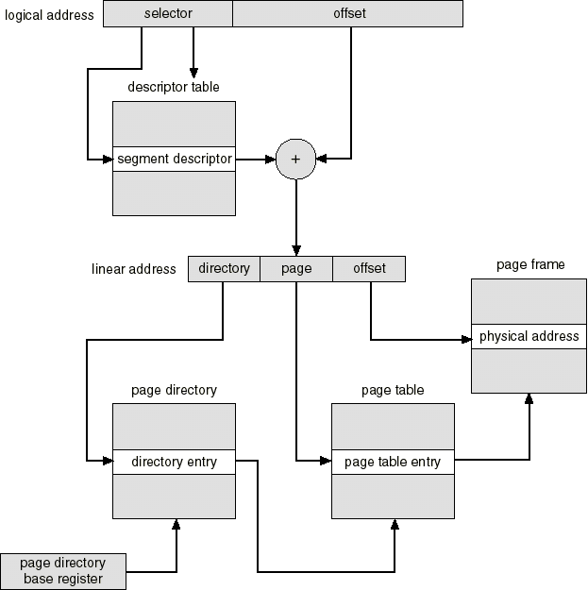
Intel 386
Address
Translation
P1
P2
D

Slide 21
The FLAT Memory Model
The segmentation part is “effectively disabled” when the base address of each segment descriptor is the same
  Each selector then points to the same segment so that code, data, and stack share the same segment
  Protection bits (read-only, read-write) in each descriptor can still be used
  Done by Windows 95/98/NT, Linux, FreeBSD…
The offset part of the logical address is then equivalent to the linear address (P1,P2,D).
  Only the offset part of the logical address is used to specify the location of a referenced word
  The address space is then said to be FLAT
  All our programs will use the FLAT memory model

Slide 22
Memory Units for the x86
The smallest addressable unit is the BYTE
  1 byte = 8 bits
For the x86, the following units are used
  1 word = 2 bytes
  1 double word = 2 words (= 32 bits)
  1 quad word = 2 double words

Slide 23

Data Representation
To obtain the value contained in a block of memory we need to choose an interpretation
Ex: memory content 0100 0001 can either represent:
  The number
  Or the ASCII code of character “A”
Only the programmer can provide a interpretation

Slide 24
Character Representation
Each character is represented by a 7-bit code called the ASCII code
ASCII codes run from 00h to 7Fh (h = hexadecimal)
  Only codes from 20h to 7Eh represent printable characters. The rest are control codes (used for printing, transmission…).
An extended character set is obtained by setting the most significant bit (MSB) to 1 (codes 80h to FFh) so that each character is stored in 1 byte
  This part of the code depends on the OS used
    For Windows: we find accentuated characters, Greek symbols and some graphic characters

Slide 25
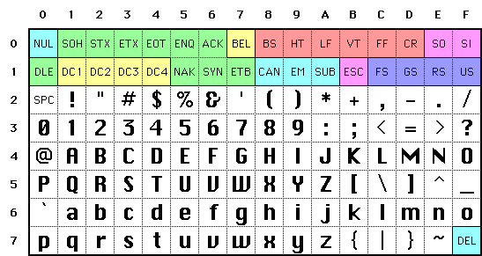
The ASCII Character Set
CR = “carriage return” (Windows: move to beginning of line)
LF = “line feed” (Windows: move directly one line below)
SPC = “blank space”

Slide 26
Text Files
These are files containing only ASCII characters
But different conventions are used for indicating an “end-of line”
  Windows: <CR>+<LF>
  UNIX: <LF>
  MAC: <CR>
This is at the origin of many problems encountered during transfers of text files from one system to another

Slide 27
Number Systems
A written number is meaningful only with respect to a base
To tell the assembler which base we use:
  Hexadecimal 25 is written as 25h
  Octal 25 is written as 25o or 25q
  Binary 1010 is written as 1010b
  Decimal 1010 is written as 1010 or 1010d
You already know how to convert from one base to another (if not, review 1st year class notes)

Slide 28
Integer Representations
Two different representations exists for integers
The signed representation: in that case the most significant bit (MSB) represents the sign
  Positive number (or zero) if MSB = 0
  Negative number if MSB = 1
The unsigned representation: in that case all the bits are used to represent a magnitude
  It is thus always a positive number or zero

Slide 29
Twos Complement Notation
Used to represent negative numbers in the signed representation
The twos complement of a number X, denoted by NEG(X), is obtained by complementing all its bits and adding +1
Hence, by definition: NEG(X) = NOT(X) + 1
  Ex: NEG(10) = NOT(10) + 1
  = NOT(0000 1010b) + 1
  = (1111 0101b) + 1 = 1111 0110b
  = NEG(10) = -10
We always have: X + NEG(X) = 0
  i.e. NEG(X) is the additive inverse of X
To perform the difference X - Y:
  the machine executes the addition X + NEG(Y)

Slide 30
Twos Complement Notation (Cont.)
Note that we have NEG(10) = 1111 0110b when we use 1 byte of storage
But NEG(10) = 1111 1111 1111 0110b when we use 1 word of storage
Exercise: compute the twos complement of the following numbers and mention if there is an overflow (i.e. when the given storage is not large enough to hold the result)
  A) 16 on 1 byte of storage
  B) -16 on 1 byte of storage
  C) -128 on 1 byte of storage
  D) -128 on 1 word of storage
  E) 0 on 1 word of storage

Slide 31
Maximum and Minimum Values
The MSB of a signed integer is used for its sign
  fewer bits are left for its magnitude
Ex: for a signed byte
  smallest positive = 0000 0000b
  largest positive = 0111 1111b = 127
  largest negative = -1 = 1111 1111b
  smallest negative = 1000 0000b = -128
Exercise: give the smallest and largest positive and negative values for
  A) a signed word
  B) a signed double word

Slide 32
Signed and Unsigned Interpretation
To obtain the value of a integer in memory we need to chose an interpretation
Ex: a byte of memory containing 1111 1111 can represent either one of these numbers:
  -1 if a signed interpretation is used
  255 if an unsigned interpretation is used
Only the programmer can provide an interpretation of the content of memory

