Slide 1
Floating Point: Representation and Instructions
Chapter 7

Slide 2
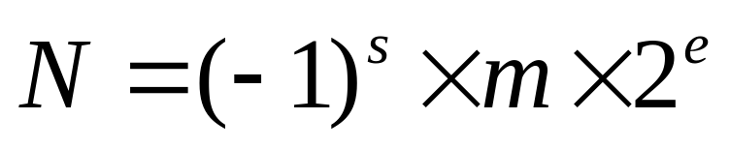
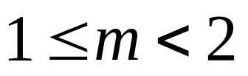
Floating Point Representation
Floating point numbers are finite precision numbers used to approximate real numbers
We will describe the IEEE-754 Floating Point Standard since it is adopted by most computer manufacturers: including Intel
Like the scientific notation, the representation is broken up into 3 parts
  A sign s (either 0 or 1)
  An exponent e
  A mantissa m (sometimes called a significand)
So that a floating point number N is written as:
Where the mantissa is normalized so that:

Slide 3
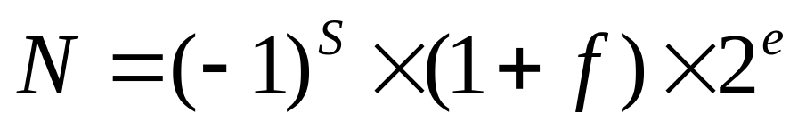
Floating Point Representation (cont.)
Hence we can write N in terms of fraction f: 0 <= f < 1
The IEEE-754 standard defines the following formats:
Sign bit s
Sign bit s
8 bits
23 bits
11 bits
52 bits
Exponent
Fraction
Exponent
Fraction
Single precision (32 bits)
Double precision (64 bits)
Hence, the value 1 in 1+f (= 1.f) is NOT stored: it is implied!
Extended precision formats (on 80 bits and more), with more bits for the exponent and fraction are also defined and used inside FPUs for more precision

Slide 4
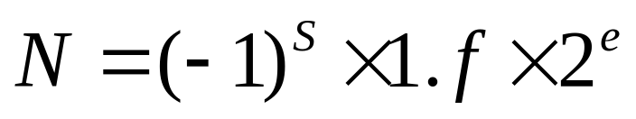
Representation for the Exponent
The exponent e uses a biased representation: a (unsigned) number E is stored in the « Exponent field » such that:
  e = E –127 for single precision (0 <= E < 256)
  e = E – 1023 for double precision ( 0 <= E < 2048)
To obtain E (and the fraction) from a floating point value N, we must first write N as:
Where the fraction f must satisfy 0 <= f <1. Single precision examples:
  Floating point number 1.27 has exponent e = 0. Hence: E = e + 127 = 127 = 7Fh is stored in the exponent field
  Floating pt number 12.3 = 1.537..x 2^3 has e = 3. Hence: E = e + 127 = 130 = 82h is stored in the exponent field
  Floating point number 0.15 = 1.2 x 2^{-3} has e = -3. Hence: E = e + 127 = 127 - 3 = 124 = 7Bh.

Slide 5
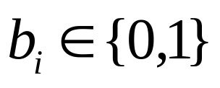
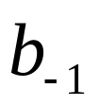
Representation for the Fraction
In base-2, any fraction f < 1 can be written as:
Where each
is a bit
and
is the most significant bit (msb) of the fraction
Given a fraction f in decimal (ex: f = .6), we want to find each of its bits; starting from the msb.
The msb of the fraction is 1 iff f >= ½. Hence the msb = 1 iff 2f >= 1.
Let f’ be the fraction part of 2f. Then the next msb of f is 1 iff 2f’ >= 1.
Let f’’ be the fraction part of 2f’. Then the next next msb of f is 1 iff 2f’’ >= 1. This is the algorithm to find all the bits of a fraction.

Slide 6
Representation for the Fraction (cont.)
Example: find all the bits of fraction f = .15
2 x 0.15 = 0.30 msb = 0
2 x 0.30 = 0.60 0
2 x 0.60 = 1.20 1
2 x 0.20 = 0.40 0
2 x 0.40 = 0.80 0
2 x 0.80 = 1.60 1
2 x 0.60 repeat of last 4 bits
Hence: 0.15 = 0.001001 = 0.001001100110011001...
ten
two
two
When truncation is used, the following 23 bits will be stored in the single precision fraction field: 00100110011001100110011

Slide 7
Defining Floating Point Values in ASM
We can use the DD directive to define a single precision floating point value. Ex:
    float1 dd 17.15 ;single precision float
    float2 dd 1.715E+1 ;same value as above
The bits will be placed in memory according to the IEEE standard for single precision. Here we have:
  17 = 10001b and 0.15 = 0.001001b
  17.15 = 10001.001001b = 1.0001001001b x 2^{4}
  Hence e=4. So E = 127+4 = 131 = 10000011b
So if truncation is used for rounding, we have:
    MOV eax,float1
    ; eax = 0 10000011 00010010011001100110011
    ; eax = 41893333h
We can use the DQ directive to define a double precision floating point value. Ex:
    double1 dq 0.001235 ;double precision value
    double2 dq 1.235E-3 ;same value as above

Slide 8
Rounding
Most of the real numbers are not exactly representable with a finite number of bits.
  Many rational numbers (like 1/3 or 17.15) cannot be represented exactly in a IEEE format.
Rounding refers to the way in which a real number will be approximated by another number exactly representable in a given format
  Ex: if a format uses only 3 decimal digit to represent a fraction, should 2/3 be represented as 0.666 or 0.667 ?
Truncation is only one of the methods used for rounding. Three other methods are supported by the IEEE standard:
  Round to nearest number (the default for IEEE)
  Round towards +infinity
  Round towards –infinity
Rounding to nearest is usually the best rounding method so it is chosen as the default. But since other methods are occasionally better, the IEEE standard specifies that the programmer can choose one of these 4 rounding methods.

Slide 9
Representation of Specific Values
Recall that exponent e uses a biased representation. It is represented by unsigned int E such that e = E – 0111...1b
Let F be the unsigned integer obtained by concatenating the bits of the fraction f .
Hence a floating point number N is represented by (S,E,F) and the “1” is implied (not represented).
Then note that we have no representation for zero!!
Because of this, the IEEE standard specifies that zero is represented by E = F = 0
  Hence, because of the sign bit, we have both a positive and a negative zero
Only a few bits are allocated to E. So, a priori, numbers with very large (and very low) magnitudes cannot be represented.

Slide 10
Representation of Specific Values (cont.)
Hence, the IEEE standard has reserved the following interpretation when E contains only ones
  +infinity when S = 0, E = 111..1, and F = 0
  -infinity when S = 1, E = 111..1, and F = 0
  Not a Number (NaN) when E = 111..1, and F != 0
Hence “normal” floating point values exist only for E < 111..11.
The +/- infinity value arises when a computation gives a number that would require E >= 111..11
The +/- infinity value can be used in operands with predictable results. Ex:
  +infinity + N = +infinity
  -infinity + N = -infinity
  +infinity + +infinity = +infinity
Undefined values are represented by NaN. Examples:
  +infinity + -infinity = NaN
  +infinity / +infinity = NaN
  0 / 0 = NaN

Slide 11
Denormalized Numbers
Now, the smallest non-zero magnitude would be when E = 0 and F = 00..01. This would give a value of 1.00…01 x 2^{-127} in single precision.
To allow smaller magnitudes to be represented, IEEE has introduced denormalized numbers:
A denormalized number has E=0 and F!=0. The implicit “1” to the left of “.” now becomes “0”.
  Hence, the smallest nonzero single precision denormalized number is 0.00…01 x 2^{-127} = 2^{-23} x 2^{-127} = 2^{-150}
  The largest single precision denormalized number is then 2^{-127} x (1 - 2^{-23}).
Hence normal numbers, called normalized numbers, use E such that 0 < E < 11…1.
  The smallest (positive) single precision normal number is then 1.00…0 x 2^{-126}.

Slide 12
Summary of IEEE Floating Point Numbers
Each number is represented by (S,E,F)
  S represents the sign of the number.
  The exponent “e” of the number is: e = E – 011..1b
  F is the binary number obtained by concatenating the bits of the fraction.
Normalized numbers have: 0 < E < 11..1
  The implicit bit on the left of the decimal point is 1
Denormalized numbers have: E = 0 and F != 0
  The implicit bit on the left of the decimal point is 0
Zero is represented by E = F = 0
S-Infinity is represented by E = 11..1 and F = 0
NaN is represented by E = 11..1 and F != 0

Slide 13
Exercises
Find the IEEE single precision representation, in hexadecimal, of the following decimal numbers (assume that truncation is used for rounding):
  1.0
  0.5
  -83.7
  -1.1xE-135
  Note: you can verify your results by first storing these values in a variable defined by a DD directive and then moving the variable content into a register. However, note that ‘rounding to the nearest’ is used instead of truncation…
Give the decimal value represented by the IEEE single precision representation given below in hexadecimal:
  45AC0000h
  C4800000h
  3FE00000h

Slide 14
The Floating Point Unit (FPU)
An FPU unit, designed to perform efficient computation with floating point numbers, is built (directly) onto the Pentium processors:
  It is backward compatible with later numerical coprocessors that were provided on a separate chip (ex: 387, 487).
  Use the .387, or .487, or .587, or .687 to enable assembly of FPU/coprocessor instructions.
There are 8 general-purpose FPU registers; each is 80-bit wide.
  Single-precision or double-precision values are placed within those 80 bits in an extended format specified by Intel.

Slide 15
General-Purpose FPU Registers
They are organized as a stack maintained by the FPU
The current top of the stack is referred by ST (Stack Top) or ST(0). ST(1) is the register just below ST and ST(n) is the nth register below ST.
15 bits are reserved for the exponent: e = E – 3FFFh
The “1” in the mantissa 1.f is stored as an explicit 1 bit at position 63. Hence f is stored from bit 0 to bit 62.
79
78
64
63
0
ST or ST(0)
S
Exponent
Fraction
ST(1)
ST(2)
ST(3)
ST(4)
ST(5)
ST(6)
ST(7)

Slide 16
Data Transfer Instructions
The FLD source instruction can be used to transfer data from a memory source onto ST.
The mem operand can either be:
  Double word (32 bits): defined with the DD directive
  Quad word (64 bits): defined with the DQ directive
  Ten bytes (80 bits): defined with the DT directive
Example:
    .data
    A dq 4.78E-7
    B dt 5.6E+8
    .code
    fld A
    fld B
The FPU stack after
loading A and B
ST(0)
B
ST(1)
A
ST(2)
ST(3)
ST(4)
ST(5)
ST(6)
ST(7)

Slide 17
Data Transfer Instructions (cont.)
ST(n) can be used as an operand of FLD.
In that case FLD ST(n) copies the content of ST(n) onto ST.
Example: If we now execute FLD ST(1) after the previous instructions. We get the following FPU stack:
ST(0)
A
ST(1)
B
ST(2)
A
ST(3)
ST(4)
ST(5)
ST(6)
ST(7)

Slide 18
Data Transfer Instructions (cont.)
The FST destination instruction can be used to transfer data from ST to a memory destination.
  The mem operand can either be 32 bits, 64 bits, or 80 bits.
The CPU and FPU are executing concurrently
  This is why we normally cannot directly transfer data between CPU registers and FPU registers
  When the FPU transfers data into memory that is to be manipulated by the CPU, we should instruct the CPU to wait until the FPU completes the data transfer.
Example:
    .data
    float1 dd 1.75
    result dd ?
    .code
    fld float1
    ...FPU instructions...
    fst result
    FWAIT
    mov eax,result
FWAIT tells the CPU to wait so that the FPU finishes the instruction just before FWAIT
  If FWAIT is not used, EAX may not contain the result returned by the FPU !!

Slide 19
Data Transfer Instructions (cont.)
ST(n) can be used as operand of FST. Ex:
    fst st(3)
    ;copies ST to ST(3)
FST does not change ST
But FSTP destination copies ST onto destination and pops ST
Example:
    fld A
    fld B
    fld C
    fstp result
    finit ;clears stack
ST(0)
C
ST(1)
B
ST(2)
A
Before fstp result
ST(0)
B
ST(1)
A
ST(2)
After fstp result
ST(0)
ST(1)
ST(2)
After finit

Slide 20
Data Transfer Instructions (cont.)
The FXCH instruction swaps the content of two registers. It can be used either with zero or one operand.
  If no operands are used, FXCH swaps the content of ST and ST(1)
  If one operand is used, then it must be ST(n). Example:
    fld A
    fld B
    fld C
    fxch ST(2)
ST(0)
C
ST(0)
A
ST(1)
B
ST(1)
B
ST(2)
A
ST(2)
C
Before fxch ST(2)
After fxch ST(2)

Slide 21
IEEE Format Conversion
The FLD source instruction loads a memory floating point value onto ST in an extended 80 bit format regardless of whether source is a single precision, double precision, or extended precision floating point value.
The FST(P) destination instruction stores ST into memory regardless of whether destination is 32, 64, or 80 bits.
Hence we can convert from one IEEE format to another simply by pushing onto and popping from the FPU stack. Ex:
    .data
    Adouble dq –7.77E-6 ; double precision value
    Afloat dd ? ; single precision value
    .code
    FLD Adouble ; double to extended precision
    FSTP Afloat ; extended to single precision

Slide 22
Displaying Floating Point Values
The csi2121.inc file contains two macros for displaying floating point values.
The macro putdbl source will display the double precision floating point value contained in the quad word source
  The display will be in decimal with 14 digits after the decimal point
The macro putfp source will display the single precision floating point value contained in the double word source
  The display will be in decimal with 6 digits after the decimal point
  This will also reset (and clear) the FPU stack
    .data
    Adouble dq –7.77E-6 ; double precision value
    Afloat dd 24.63 ; single precision value
    .code
    putdbl Adouble ; -7.77000000000000E-06
    putch 10 ; go to next line
    putfp Afloat ; 2.463000E+01

Slide 23
Arithmetic Instructions
We first describe the instructions for performing addition, subtraction, multiplication, and division
They can have up to two operands as long as one of them is an FPU register.
CPU registers are not allowed as operands.
A memory operand can be 32, 64, or 80 bits.
Memory-to-memory operations are not allowed.
Several addressing modes are provided. They are presented on the next slide --

Slide 24
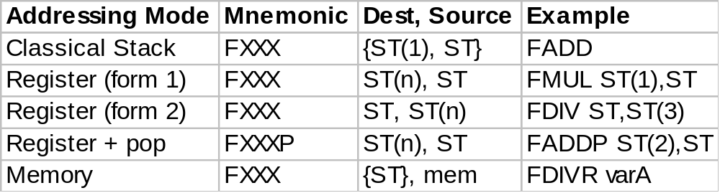
Addressing Modes for Arithmetic Instructions
Keyword XXX may be one of:
  ADD : add source to destination
  SUB : subtract source from destination
  SUBR : subtract destination from source
  MUL : multiply source into destination
  DIV : divide destination by source
  DIVR : divide source by destination
The result is always stored into the destination operand.
Operands surrounded by {…} are implicit operands: not coded explicitly by the programmer.

Slide 25
Classical Stack Addressing Mode
The classical stack addressing mode is invoked when we use FXXX without operands:
  ST is the implied source operand
  ST(1) is the implied destination operand
  The result of the instruction is temporarily stored into ST(1) and then the stack is popped. Hence, ST will then contain the result. Example:
    FLD A
    FLD B
    FLD C
    FSUB
Note: ST(0) would contain C-B if FSUBR was used instead.
ST(0)
C
ST(0)
B - C
ST(1)
B
ST(1)
A
ST(2)
A
ST(2)
Before FSUB
After FSUB

Slide 26
Register Addressing Mode
Uses explicitly two registers as operands where one of them must be ST.
  ST can either be the source or the destination operand so two forms are permitted: ST, ST(n) or ST(n), ST.
  In fact, both operands can be ST.
The stack is not popped after the operation. Ex:
    FLD A
    FLD B
    FLD C
    FMUL ST(2),ST
ST(0)
C
ST(0)
C
ST(1)
B
ST(1)
B
ST(2)
A
ST(2)
A x C
Before FMUL
After FMUL

Slide 27
Register + Pop Addressing Mode
Uses explicitly two registers as operands.
The source operand must be ST and the destination operand must be ST(n) where n must be different from 0.
The result of the operation is first stored in ST(n) and then the stack is popped (so the result is then in ST(n-1). Ex:
    FLD A
    FLD B
    FLD C
    FMULP ST(2),ST
ST(0)
C
ST(0)
B
ST(1)
B
ST(1)
A x C
ST(2)
A
ST(2)
Before FMULP
After FMULP

Slide 28
Memory Addressing Mode
.386
.387
.model flat
include csi2121.inc
.data
pi dd 3.14159
radius dd 2.0
area dd ?
.code
main:
fld pi
fld radius
fmul radius ;mem addr.
; ST = radius*radius
; ST(1) = pi
fmul ; ST = area
fstp area
fwait
putfp area
ret
end
ST is an implicit destination operand.
The source operand is either a 32, or a 64 bit memory operand.
Here is an example program that computes the area of a circle:

Slide 29
Exercise
Suppose that we have the following FPU stack content before each instruction below: ST(0) = 1.1, ST(1) = 1.2, ST(2) = 1.3, and the rest of the FPU stack is empty. Give the stack content after the execution of each instruction:
  fstp result ; result is a dword variable
  fdivr st(2),st
  fmulp
  fsubrp st(1),st
  faddp
  fdivp st,st(1)

Slide 30

The FPU Status Word Register
15
14
13
11
10
9
8
7
0
C3
Stack Top
C2
C1
C0
The FPU Status Word register contains:
  Exception flags (bits 0 to 7) that signal division by zero, overflow, underflow, stack overflow and underflow...
  A Stack Top pointer that indicates which register is the top of the stack.
  Four condition bits: C0, C1, C2, and C3 that are set by certain instructions like fcom, ftst, and fxam.

Slide 31
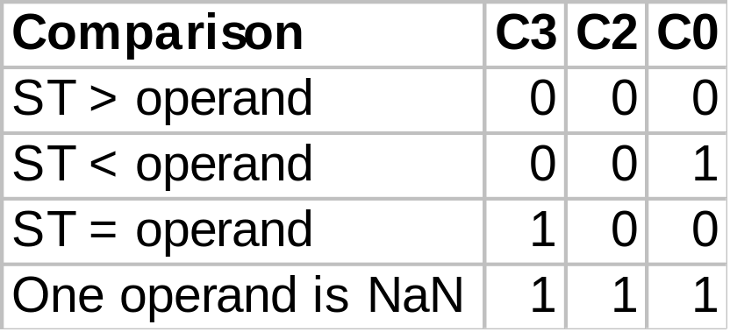
The FPU Condition Codes
The FCOM source instruction compares the source operand with ST and sets the FPU condition codes according to the table below. Source is either mem or ST(n)
The FTST instruction (no operands) compares ST against 0.0 and sets the condition codes according to the same table.
To perform a decision based on the settings of the FPU condition codes we can use the FSTSW AX instruction to transfer the FPU Status Word into AX and then test the content of AX with CPU instructions;
  This is the only instruction that provides direct communication between the FPU and CPU via a general purpose CPU register.

Slide 32
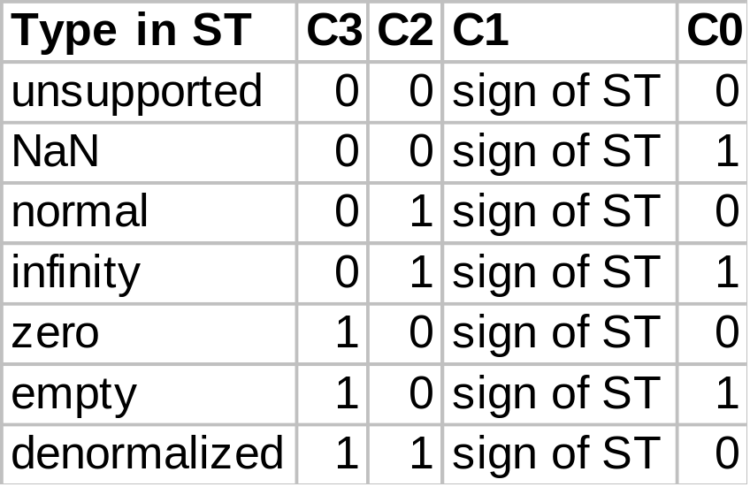
The FPU Condition Codes (cont.)
The FXAM instruction (no operands) examines ST and sets the conditions codes according to the table below:
  It provides a clean way to check if a representation is a special value like NaN.

Slide 33
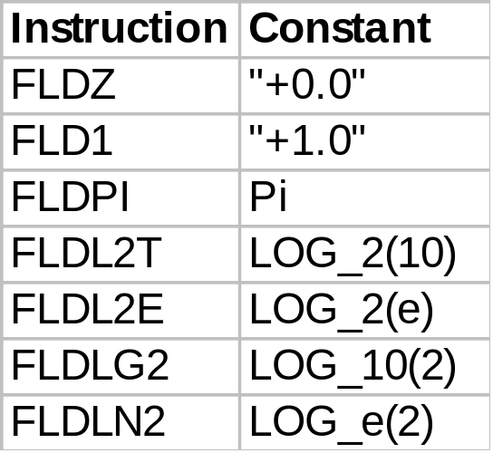
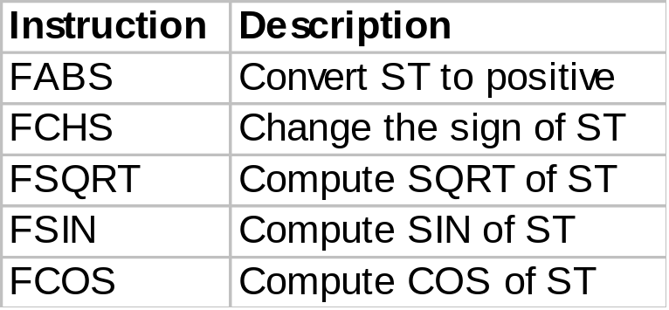
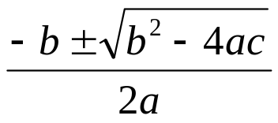
Other FPU Instructions
These instructions use ST as an
implicit operand and store the result
back into ST:
These instructions push
a constant onto ST:
Example: Finding the roots of a
quadratic equation using:
For more instructions see Intel’s Documentation at:
http://www.intel.com/design/litcentr/index.htm
In particular, see Intel’s Architecture Software Developer’s Manual Vol. 1 & 2

