Slide 1
I/O and Interrupts
Chapter 9

Slide 2
Input and Output
Computers must be able to communicate with their peripherals (ie: I/O devices). Examples:
  Keyboard
  Video display
  Disks (HD, CD Rom, Floppy, Zip, Jazz, DVD…)
  Network…
I/O devices vary a lot in the speed at which they can transfer data and in the amount of data they can transfer in a single I/O operation. Ex:
  Keyboards are character oriented
  Disks are block oriented
The communication between the Processor and a I/O device is done via a piece of hardware called an I/O controller
I/O
Controller
I/O
Device
Processor

Slide 3
I/O Ports on I/O Controllers
The registers on I/O controllers are often called I/O ports.
  The Processor reads and writes data only to the I/O ports (not to the I/O device itself)
  The number of I/O ports varies from a few (ex: a keyboard controller) to several million (ex: a video controller)
  An I/O port can either contain data, status, or control information
Data to/from the Processor are buffered in data registers/ports
A status register/port holds status information of the I/O device. Ex:
  A busy bit that indicates if the I/O device is currently busy transferring data to/from an I/O port
  An error bit that indicate if there was an error done in the last I/O operation
A control register/port holds detailed control information from the Processor and affects the mode of operation of the I/O device

Slide 4
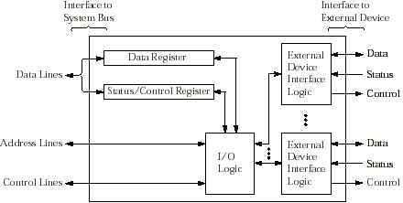
A Generic I/O Controller
The I/O logic interacts with the CPU via the control bus
The interface with the I/O device contains logic specific to each I/O device it is controlling

Slide 5
I/O Addressing
The Intel processors allow I/O ports to be addressed in two different ways:
  Through a separate I/O address space accessed using I/O instructions. This is called isolated I/O.
  Through memory-mapped I/O, where I/O ports appear in the physical (and virtual) memory address space.

Slide 6
Isolated I/O
Here, I/O ports are placed in an address space distinct from the memory address space
The M/IO# pin (on the control bus) indicates if the number on the address bus is a memory address or an I/O address
  Each I/O controller is programmed to respond only to I/O addressed within a given range.
Only the 16 lowest ordered pins of the address bus are used to specify an I/O address (I/O addresses are 16-bit wide)
  There are 2^{16} (64K) individually addressable 8-bit ports
  A 16-bit port is two-consecutive 8-bit ports and must start at an even address.
  A 32-bit port is two-consecutive 16-bit ports and must start at an address which is a multiple of 4.

Slide 7
I/O Ports Assignment
The manufacturer can configure I/O controllers to respond to any I/O address in the I/O address space: from 0 to FFFFh
To avoid having more than one device responding to the same I/O address, PC manufacturers have reserved port numbers 0 to 3FFh for commonly used devices
Common I/O ports for the PC
Port Address Description
0-0Fh DMA controller
20h-21h Interrupt controller
40h-43h Timer
60h-63h Keyboard contr.
0F8h-0FFh Reserved by Intel
2F8h-2FFh COM2 serial port
320h-32Fh Hard Disk
378h-37Fh LPT 1
3C0h-3CFh EGA
3D0h-3DFh CGA
3F0h-357h Floppy Disk
3F8h-3FFh COM1 serial port

Slide 8
I/O Instructions (for Isolated I/O)
The IN instruction transfers a byte, word, or double word from an input port to the AL, AX or EAX register
    IN reg,DX
  DX contains the 16-bit address of the port (also known as the port number) and reg is either AL, AX, or EAX
The OUT instruction transfers a byte, word, or double word from the AL, AX or EAX register to an output port
    OUT DX,reg
Instead of DX, we can provide an immediate 8-bit operand to specify the port number. Ex:
    IN AL,60h ;loads AL with content of port 60h
    OUT 61h,AL ;loads port 61h with content of AL

Slide 9
Memory-Mapped I/O
Memory
(physical and virtual)
An I/O device that responds like memory components can be accessed through the memory address space
Processors communicate with the I/O ports of such devices by using any instruction that references memory
  MOV, OR, TEST ...
  Does not use the IN and OUT instructions
This is very convenient for the programmer and some processors (ex: SPARC) only support this method of I/O addressing
I/O Ports
Example: the Video Display.
To display characters on the
screen, we simply write them at
at certain memory locations

Slide 10
Restricted Access to I/O Ports
Direct access to I/O ports (both with Memory-Mapped I/O and Isolated I/O) is restricted to OS code and device driver code
  This is true for protected OS like Windows, Linux, and Unix—not for DOS.
Hence, user code can only perform I/O by performing a System Call (in protected environments)
  Our programs are using macros which are calling C library functions which, in turn, are calling the OS.
Now let us investigate what the OS must do to perform (and manage) I/O operations

Slide 11
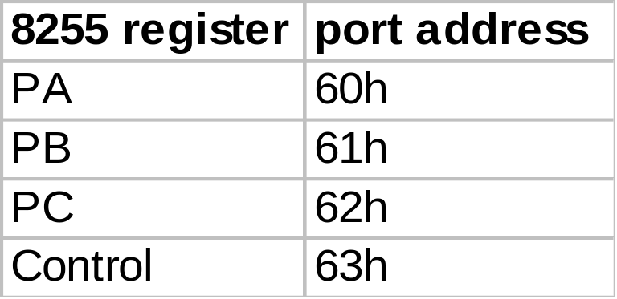
The Keyboard Controller
Lets try to construct a (naïve) procedure that the OS could use to read a single key that has been pressed on the keyboard
The keyboard is controlled by Intel’s 8255 Programmable Peripheral Interface Chip (PIC)
  This chip can be used to control other devices, including output devices. It has four 8-bit ports:

Slide 12
The Keyboard Controller (cont.)
The control register selects the operation mode for the three ports PA, PB, and PC
In one mode of operation (not the one chosen by BIOS at startup), the ports are configured as follows:
  PA is an input port. Whenever a key is pressed or released, the keyboard sends a 8-bit scan code to PA.
  PB is an output port: the CPU sends data there to be displayed by a device (ex: CRT, printer…)
  PC is a bidirectional port used to control devices attached to PA and PB. Hence PC can carry handshaking signals.

Slide 13
The Keyboard Controller (cont.)
The keyboard sends a “data ready” signal to the 8355 by setting to 1 the bit #4 of PC whenever it places a scan code on PA
The CPU acknowledges the reading of PA by setting momentarily PC5 to 1 and then to 0. In that case, the keyboard clears PC4
8255 PPI
Keyboard
PA0
PA1
PA2
PA3
Only part of
the 8255 is
shown here
Port
PA
PA4
PA5
PA6
PA7
Port
PC
PC4
PC5
Data Ready
Acknowledge

Slide 14
Keyboard Scan Codes
Each key on the keyboard has a 8-bit scan code
When a key is pressed a scan code with the most significant bit (msb) cleared to 0 is sent to port PA: this is called a make code
When a key is released a scan code with the msb set to 1 is sent to PA: this is called a break code
See the list of all the keyboard scan codes
Translation from scan codes to ASCII code is done by software
  Ex: to build the ASCII code 41h of “A” we need to read from PA a sequence of two consecutive scan codes: the make code of a shift key and then the make code of the key labeled A

Slide 15
Programmed I/O
get_scode:
; returns in DL the scan code of
; a key that has been pressed
; or released
in al,62h ; read PC
test al,10h ; is PC4=1?
jz get_scode ; no, test again
; a key has been pressed or
; released
in al,60h ; scancode in AL
mov dl,al ; now in DL
; now acknowledge and return
in al,62h ; read PC
or al,20h ; set bit 5
out 62h,al ; set PC5=1
and al,DFh ; clear bit 5
out 62h,al ; clear PC5
ret
Here is a (naive) procedure for getting the scan code of a key that has been pressed or released
We need to repeatedly test PC4 to see if there is a valid scan code on PA
This spinning loop is called a busy waiting loop since the CPU is most of the time just busy waiting
This method of performing I/O operation is called Programmed I/O

Slide 16
Drawbacks of Programmed I/O
During a Programmed I/O operation, the CPU spends almost all its time spinning and executing non-productive instructions
  This is acceptable if the computer is dedicated to run a single program like a embedded system.
  But it is catastrophic for a normal computer that works in a multiprogrammed (multitasking) environment where several processes are active and waiting to get CPU attention.
This problem is solved by permitting controllers to interrupt the CPU when they need immediate attention (ex: when data arrives on some ports)
  Indeed, when the OS tries to read, on behalf of a user program, data that as not yet arrived on a I/O port, the OS could decide to suspend momentarily this program and go on executing another process. When the data finally arrives on the port, an interrupt will be sent to the CPU and the CPU could then resume execution of the suspended program.

Slide 17
What is an Interrupt ?
A (hardware) interrupt is a signal that is sent by a hardware device (like an I/O controller) to the CPU
  On a Pentium, the signal is sent to an IRQ line of Intel’s 8259 Programmable Interrupt Controller (PIC) which manages interrupt requests. Then the PIC sends a signal to the INTR line of the CPU.
After executing an instruction, the CPU checks the INTR line to see if an interrupt is pending.
It continues with the next instruction of the running program if no interrupt is pending.
If an interrupt is pending, then it extracts an 8-bit interrupt number on the data bus that was placed by the PIC
  It uses this interrupt number to index the Interrupt Descriptor Table and get the descriptor entry for that interrupt number.
  The descriptor contains the address of an Interrupt Service Routine (a routine part of the OS that is responsible for managing that interrupt) and transfers control to it.

Slide 18
Interrupt Service Routine
An Interrupt Service Routine (ISR) is a program written explicitly for the purpose of dealing with an interrupt
  There is one ISR per type of interrupt, which is identified by an interrupt number — also called a vector number.
  The control is transferred to a ISR when the corresponding type of interrupt has occurred.
However, control must be transferred back to the interrupted program so that it can be resumed from the point of interruption
  This point of interruption can occur anywhere in the program.
  Hence the state of the program must be saved somewhere so that it can resume execution as if it was never interrupted!
  It is thus crucial that an ISR preserves all register values.

Slide 19
Other Types of Interrupts
A timer sends an interrupt at fixed time intervals.
  Used by the OS to preempt a process that has exhausted its allocated time slice (usually 10 to 100 ms). The ISR then transfers the control to the OS Kernel which will decide what code to execute next.
When a user program tries to execute a privilege instruction or trys to access a memory location outside of its range, the processor will detect this and transfer control to an ISR which will terminate the program.
  This kind of interrupt is often called a trap or exception. Its cause is internal: due to the currently executing code. The ISR is then called a trap or exception handler.
Finally a ISR can be explicitly called (by OS code) by using the INT instruction with 8-bit imm operand. This is called a software interrupt. Usage:
    INT imm8

Slide 20
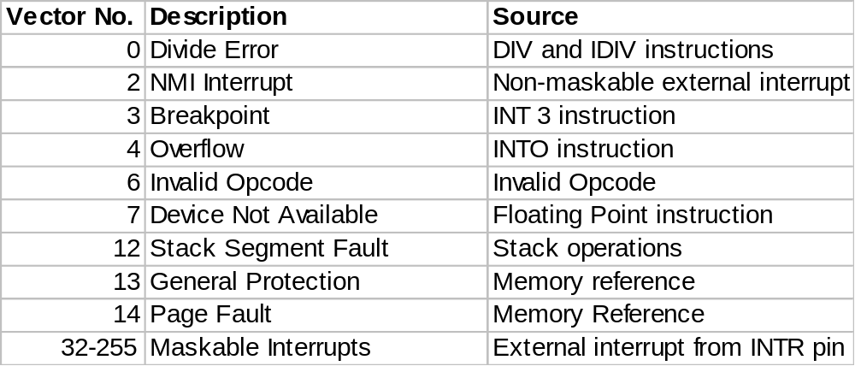
Some Interrupts and Exceptions
Vectors 32-255 are not reserved by Intel and are generally assigned to external I/O devices. These interrupts are maskable (by the CLI instruction).
The non-maskable interrupt is used to report hardware failure. The signal is sent on a separate NMI pin.

Slide 21
The Interrupt Descriptor Table (IDT)
IDT
Descriptor for
Vector No. n
IDTR
Descriptor for
Vector no. 1
Vector No.
Descriptor for
Vector no. 0
The vector number is used to index the IDT to obtain the descriptor for that interrupt. The base address of the IDT is contained in the Interrupt Descriptor Table Register (IDTR)
Each descriptor is called a Gate and contains the segment and offset address of the interrupt handler for that vector.

Slide 22
Privilege Levels for Protection
Each gate descriptor also contains the Descriptor Privilege Level (DPL) for that descriptor
There exists four privilege levels:
  Level 0 (most privilege) : for the OS Kernel
  Level 1 : for OS services (ex: device drivers)
  Level 2 : for OS services (ex: device drivers)
  Level 3 (least privilege) : for User Applications
Privilege levels are used for protection of memory access
  The privilege level of the currently executing code is called the Current Privilege Level (CPL)
  When code tries to access memory, the segment address of that memory location will index a Segment Descriptor Table (similar to the IDT) and get the DPL of that memory segment.
  The access to memory will be accepted only if CPL < DPL. Otherwise, a general protection error exception will be generated and the IDT will be indexed with that Vector No.

Slide 23
Use of DPL for Interrupts and Exceptions
The DPL of an Interrupt Gate Descriptor is used differently than the DPL of segment descriptors
The DPL of an Interrupt Gate will determine how the state information of the interrupted program will be saved.
There exists one stack per privilege level. (Up to now, we have been using only the stack of privilege level 3.)
  If the interrupted code has a CPL equal to the DPL of the Interrupt Gate, then state information will consist (only) of the content of the EFLAGS, CS and EIP registers and it will be saved on the current stack.
  If the CPL is different from the DPL of the Interrupt Gate, then there will be a stack switch (to the stack of the privilege level of the Interrupt Handler) and the state information that will be saved on the new stack will also include SS and ESP since these registers are used to access any stack.

Slide 24
Saving and Restoring State Information
Apart from EFLAGS, CS, and EIP (and also SS and ESP in the case of a stack switch), no other state information of the interrupted program is saved by the hardware when the control is transferred to an interrupt handler (ISR).
This state information will be restored when the ISR returns with a IRET instruction
  Hence, the ISR must preserved the content of all registers. Otherwise, the interrupted program would be affected when its execution resumes.
  (In fact, some exceptions result in a complete task (process) switch (slower to perform). In that case all the context (including all registers) of the interrupted task is saved into a Task State Segment for later resumption of the task.)
For more information consult the Intel Architecture Software Developer’s Manual Vol.3 at Intel’s Literature Web Site
  Chap 5 for Interrupts and Exception Handling
  Chap4 for Protection and Privilege Levels

Slide 25
Returning to the Keyboard Input Problem
Let us return to our problem of finding what the OS might do to read keys that are typed on the keyboard
  Instead of wasting CPU time inside a busy-waiting loop (as in the Programmed I/O method), the OS can exploit the fact that an Interrupt will be generated by the keyboard controller (ie: the 8255 PPI) whenever a key is either pressed or released.
  In that case the 8255 will instruct the 8259 PIC to send an Interrupt signal to the CPU (on the INTR pin) and then place a vector number on the data bus
  The CPU will then use this vector to index the IDT to obtain the address of the corresponding ISR and transfer control to it after saving the state of the interrupted program on the the stack used by the ISR.
  The keyboard ISR will perform its task of reading the I/O port and saving this scan code in a safe place and then return with IRET. The interrupted program will then resume.
Let us first design a keyboard ISR and then look at what the OS must provide in addition to this.

Slide 26
A Keyboard ISR
The task of this ISR is to read the I/O port PA of the keyboard controller (PPI) and store an ASCII code into a 1-byte buffer that we call key_buff
For simplicity, a value of FFh in key_buff indicates that the keyboard buffer is empty. Assume that we have done the necessary actions to have key_buff = FFh before any key has been pressed.
Note that the keyboard ISR is executed iff there is a scan code in PA.
We need a key_flag variable that will be 1 if a shift key has been pressed. Otherwise, key_flag = 0.

Slide 27
A Keyboard ISR (cont.)
Functionally the keyboard ISR will do the following:
  If the scan code in PA is a break code (ie: a key was released), then we clear key_flag and return. So the scan code is ignored and key_buff is not updated.
  If key_buff is not empty, we ignore the scan code in PA and return. The scan code is lost so we should avoid this.
  If the scan code in PA is a make code of a shift key, then key_flag is set to 1 and we return (and wait for another scan code).
  If the scan code in PA is a make code of a key representing a printable character, then we translate this scan code into the ASCII code of a lower case letter if key_flag=0 or into the ASCII code of an upper case letter if key_flag=1 and store that value into key_buff. We clear key_flag and return.
  If the scan code in PA is a make code of a key not representing a printable character, then we assign key_buff and key_flag to 0 and return.

Slide 28
Interrupt-Driven I/O
Equipped with this keyboard ISR, the OS permits user programs to read the keyboard by doing a get_key system call
Here is the pseudo-code:
If there is a ASCII code in key_buff, it transfers it to AL (making it available to the caller of get_key) and clears key_buff
If key_buff is empty, then it busy waits until the keyboard ISR fills it with an ASCII code (what else could it do?)
This is a Interrupt-Driven I/O method: it relies on a Interrupt Handler to transfer the data between a I/O port and a buffer
get_key:
while (key_buff == 0FFh)
{ do nothing }
mov AL, key_buff
mov key_buff,0FFh
ret
get_key only checks key_buff: not the I/O ports

Slide 29
Interrupt-Driven I/O (cont.)
The previous code for get_key is not satisfactory in a multi-programming environment
  Indeed, two user programs that are running get_key concurrently might read a key that was input to the other program.
Hence, before attempting to read key_buff, get_key should acquire a lock on the key_buff
The OS will grant the lock to only one process at a time: buffer access will be mutually exclusive
The OS request to acquire the lock is acquire_key_buff
The OS will agree to grant the lock only if the process interface is interacting with the user
So here is a better version:
get_key:
while (acquire_key_buff == false)
{ do nothing }
If (key_buff == 0FFh) {
release_key_buff;
jump get_key
}
mov AL, key_buff
mov key_buff,0FFh
ret

Slide 30
Interrupt-Driven I/O (cont.)
The busy waiting loop in get_key to acquire the lock does not waist CPU time anymore
  If the lock is refused, the process is going to be suspended and put in a queue of processes waiting to get the key_buff. Such a process is said to be blocked.
  By effectively eliminating busy-waiting, this gives more efficient CPU usage than programmed-I/O.
When a process acquires the lock on key_buff, it will release it immediately if the key_buff is empty
  This may also suspend the process.
A characteristic of interrupt-driven I/O is that an interrupt is required for each byte read (or written) and that byte must be processed by the CPU
  This substantial overhead for transferring a single byte is not a problem for a slow I/O device like a keyboard.
  But it is a problem for fast I/O devices like Hard Drives and Video displays that are used to transfer several bytes at once.

Slide 31
Direct Memory Access I/O
For transferring a block of data to/from fast I/O devices it is more efficient to ask a DMA controller to perform this task
A DMA controller can transfer a block of data directly to/from memory (or I/O device) without the help of the CPU
  It just interrupts the CPU when the transfer is completed.
A DMA controller has usually at least:
  A register containing the starting address of the block of data to be transferred.
  A register containing the number of bytes to be transferred.
  A register that specifies the I/O device or the I/O controller to be used.
  Control lines to specify the function to perform (ex: read / write)
The DMA controller for the PC is the 8237 chip (found among the controller chip sets on the motherboard)
  It can be programmed to control the Video Display, the Hard Disk, the printer, the sound card, …

Slide 32
Direct Memory Access I/O (cont.)
The CPU does the following to read/write data:
  Sets the address of the I/O port of the desired device (in the appropriate DMA register).
  Sets the base address of the memory location to be written or read (in the appropriate DMA register).
  Sets the number of bytes to be written or read (in the appropriate DMA register).
  Sets the control lines to the function to be performed (ex: reading or writing).
Then the CPU continues with other work. It has delegated this I/O operation to the DMA
  However both the CPU and DMA must compete to access the Data Bus. The DMA is stealing bus cycles from the CPU to perform data transfers.
The DMA sends an interrupt to the CPU when it has finished
  Hence only a single interrupt is performed for transferring a block of several bytes.

