Slide 1
The Software Engineering Process
(CASE-Based)
1. Capturing Requirements (English)
2. Identifying Actors and Messages (Protocols)
3. Writing Use Cases
4. Building the Model
5. Generating MSCs from Use Cases
6. Generating MSCs from Model
7. Validating MSCs
Message
Sequence
Charts
Interaction
Diagrams

Slide 2
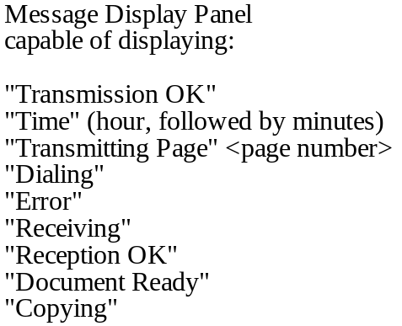


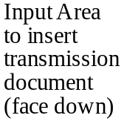
FPS 2000 # 1: Human Machine Interface
Your organization has acquired by a corporate buy-out, a new product called the “Fax-Plain and Simple” FPS 2000. This product consists of sensors, motors, and lamps which are all entirely controlled by software. An overhead view of the FPS 2000 is shown below. The documentation is poor to non-existent. Your task is to recapture customer requirements and design, and then to re-engineer the product to fit your product line.
1
E
I/E
I
4
9
1
2
3
STOP BUTTON
3
4
5
6
7
8
9
5
*
0
GO AHEAD BUTTON
Telephone
6
7
Key Pad
Selection Button
Manual/Auto
8
2 Output Area for Received/Copied Document

Slide 3
FPS 2000 REQTS. 2: Natural Language Primary Use Case
The purpose of the FPS 2000 is to send and receive facsimile documents in either manual or automatic (auto) mode. To send a document to a destination telephone number (optional 3 digit area code, followed by 7 digit number), a customer performs the following sequence of steps:
i) insert document face down into input area (8). The document should be automatically pulled part way into the machine, and the message panel (1) should display “Document Ready”.
ii) enter the destination telephone number on the telephone key pad (3):
- if a local call, enter seven digits (not beginning with 0)
- if a long distance call in the sender’s area code, enter “1”, followed by the seven digits of the number
- if a long distance call outside the sender’s area code, enter “1”, followed by the 10-digit destination phone number.
Hit the GO AHEAD button (5). The message panel (1) should display “Dialing” and the destination phone will be ringing.
iii) when the destination phone answers, the message panel (1) should display “Transmitting Page 1” and the document should be automatically pulled into the machine. If another page is inserted into the input area (8) before the first page is completely inside the machine, this next page will also be automatically pulled into the machine after the first page, and the message panel (1) will display “Transmitting Page 2”. This can be repeated for successive pages of transmission. Each page is transmitted electronically to the destination fax machine.
iv) at the end of a successful, complete transmission, the message panel (1) will display “Transmission OK” for 5 seconds, then display the time of day.
This is the normal sequence of interactions between the user and the machine.
If any step is unsuccessful, or if the user hits the STOP button (4), the message panel (1) displays “Error” for 5 seconds, and then displays the time of day.
Whenever the machine is on, but not transmitting or receiving, the message panel (1) displays the time of day.
Note that Telephone Receiver/Speaker (9), Manual/Auto Selection Button (6), and Manual Mode Lamp (7) are not described here -- they will be described if needed.

Slide 4
ROSE/RT (ObjecTime) for FPS2000
Determine Actors
- user - keypad - stopButton
- sendingFax - inputArea - outputArea
- receivingFax - goButton - display
Determine Interfaces
1) Between user and sending Fax
userInputR1 (goButton)
userInputR2 (inputArea)
userInputR3 (keypad)
userOutputR1 (display)
2) Between sendingFax and receivingFax
commSignal (conReq, data, disconnect)
commSignal (ring, answer, transOK, busy)

Slide 5


Slide 6


Slide 7




Slide 8


Slide 9


Slide 10




Slide 11
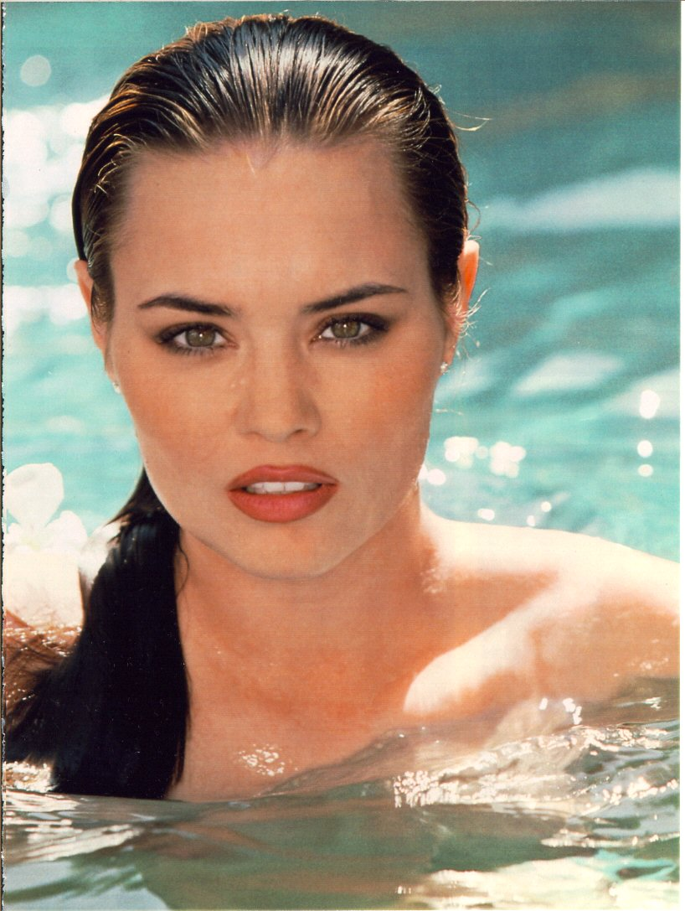

Slide 12


Slide 13


Slide 14


Slide 15


Slide 16


Slide 17




Slide 18





Slide 19


Slide 20


Slide 21


Slide 22


Slide 23



Slide 24


