Slide 1
IMPLEMENTATION PHASE:
Code, Test and Release [Ch. 13, 14]
Implementation:
Design Product Components
Integration:
Product Components Product (System)
System Test:
Product System Product Release
when we refer to a product, we mean an integrated collection of components
a system is broken into subsystems, and subsystems into components
individual designers build components (clusters of collaborating classes)

Slide 2
Implementation Considerations
Choice of Programming Language [13.1]
  cost-benefit analysis
  risk analysis
  3GL vs 4GL [13.2] Fig. 13.1
Good Coding Practice [13.3]
  consistent, meaningful variable names
  appropriate in-line documentation
    prologue/in-line
  parameters, not constants
  indentation tools
  nested logic [Fig. 13.2, 13.3, 13.4, 13.5]
Coding Standards [13.4]

Slide 3
CODE INSPECTIONS of a FUNCTIONAL COMPONENT
Fast Prototyping (Ch. 9) helped pin down customer requirements including GUI requirements
Design Engineers do Design Inspections for -- Consistency
-- Completeness
with respect to functional requirements
After first clean compile, carry out Code Inspections [13.9 - 13.11]
- look for defects (faults) in code and style
violations
- moderator
- produce defect log and requirements for rework

Slide 4
TESTING of a
FUNCTIONAL COMPONENT
Select (and derive) test cases from use cases to cover functional requirements (Black Box Testing) [13.7]
Execute test cases and measure code coverage
Add more test cases to achieve code coverage (White Box Testing) [13.8]
branches
loops

Slide 5
BLACK BOX or WHITE BOX TESTING? [13.6]
Testing to Specs. - can’t cover all cases
Testing to Code - can’t cover all paths [Fig. 13.6]
  control flow coverage alone does not guarantee correctness [Fig. 13.7] (not reliable)
    missing paths can’t be tested

Slide 6
Equivalence Testing
?
?
?
Questions
?
1. Can we partition the input (import) domain of a software component (module) into equivalence classes according to program behavior
2. We need one test case per equivalence class, do we?
?
?
?
Answers
?
1.
Yes
?
?
?
2.
No
(Consider degree of risk)
Notes:
Black-box Test Design

Slide 7
Black Box (Functional Testing) Principles (13.7)
Boundary Value Analysis (13.7.1)
1. Think like a client - Use Cases
2. Identify Normal Behaviors
- Primary Scenarios - Valid Equivalence
Classes
- very low-yield test cases (not likely to
find bugs), but necessary
3. Identify Exception Handling Scenarios
- Secondary Scenarios - Invalid
Equivalence Classes
- high-yield test cases (very likely to find
some bugs)
- very cost-effective

Slide 8


Equivalence Class Domain Partitioning
Method
1. Identify input (external import) conditions which may occur, and for each condition, list all valid and invalid equivalence classes.
  Assign a unique number to each equivalence class.
+
Notes:
Black-box Test Design

Slide 9
Equivalence Testing Example
Specifications for a database product
can handle any number of records from 1 through 16,383 (2¹⁴ - 1)
Chances of detecting a fault are equally good for 1 through 16,383 records
Conversely, if the product works correctly for any one test case in the range form 1 through 16,383, it will probably work.
Range from 1 through 16,383 is an equivalence class (any one member of the class is as good as any other member of the class)
Test Conditions Valid Invalid
Equivalence Class Equivalence class
Number of ≥ 1 < 1
Records and ≤ 16,383 > 16,383

Slide 10

Equivalence Class Testing
2. Identify test cases
to cover the input equivalence classes so that normal cases (valid) are broadly covered and that exceptional cases (invalid) are covered in depth:
• Construct test cases such that:
Each new test case covers as many currently uncovered valid equivalence classes as possible.
Each additional test case covers no more than one invalid equivalence class.
Notes:
Black-box Test Design

Slide 11
How to Apply
Equivalence Class Domain Partitioning:
Select important class attributes or method parameters.
e.g. for POST System, UPC is a very important parameter.
Suppose UPC is specified to be a bar-code corresponding to the following pattern:
o <start> [<type code> <separator>] <item code> <stop>
where:
1. The UPC must start with o (lower case O),
2. Followed by two thin vertical bars (start symbol)
3. Optionally followed by a type code and a separator (")
4. Followed by an item code
5. Followed by three thin vertical bars (stop symbol)
6. Followed by o (lower case O)
The type code and item code are each integers of up to 6 digits not starting with 0.
The phrase in square brackets is optional.
e.g. of a normal UPC: o||640941|||o

Slide 12
Equivalence Class Domain Partitioning - UPC
1) Identify equivalence classes and assign unique class numbers ()
Input Condition Valid Equivalence Invalid Equivalence
Class Class
initial character (o) * present (1) * absent (2)
start symbol * present (3) * absent (4)
* 2 thin bars (5) * < 2 thin bars (6)
* > 2 thin bars (7)
* 2 thick bars (8)
type code and * both absent (9) * one absent (11)
separator * both present (10)
* valid type code (12) * invalid type code (13)
* invalid separator (14)
* length ≤ 6 (15) * length > 6 (16)
* 1st digit non-zero (17) * 1st digit zero (18)
and so on.
.
.
.
.
.
.
.
.
.

Slide 13
2) Construct test case data to cover valid (normal low-yield) classes as efficiently as possible:
Test-Case Data Covers Equivalence Classes
o||53024"640941|||o 1,3,5,10,12,15,17,...
and so on and so on

Slide 14
3) Construct test case data to cover invalid (exceptional high-yield) classes very carefully
(one class at a time)
Test Case Data Covers Equivalence Class
o||||640941|||o (7)
and so on.

Slide 15

Boundary-Value Analysis
Enhance yield over Equivalence Class Domain Partitioning by:
i) selecting elements just on , or just beyond the borders of each equivalence class,
ii) in addition to the input space, derive test cases by considering output (results) equivalence classes as well.
I
B
I
B
I
B
I
I
B
B
B
I
I - Equivalence Test Case
B - Boundary-Value Test Case
Notes:
Black-box Test Design

Slide 16
Boundary Value Testing Example 1
Test case 1: 0 records Member of equivalence class 1 and adjacent to boundary value
Test case 2: 1 record Boundary value
Test case 3: 2 records Adjacent to boundary value
Test case 4: 723 records Member of equivalence class 2
Test case 5: 16,382 records Adjacent to boundary value
Test case 6: 16,383 records Boundary value
Test case 7: 16,384 records Member of equivalence class 3
and adjacent to boundary value
[Also Fig. 13.14]

Slide 17

Requirements Analysis & Generation of Test-Case Data
Boundary-Value Analysis Example 2
1) Examine the UPC Equivalence classes and note from the specification that the UPC is parsed from left to right.
2) Identify equivalence classes as they appear from left to right, and create test-case data which are on the boundary and beyond the boundary as follows:
(also known as “On by one/off by one” testing)
  i) Generate shortest possible strings and longest possible strings to cover all valid equivalence classes.
  ii) Generate off-by-one instances to cover one invalid equivalence class at a time.
  iii) Re-arrange components in wrong order.

Slide 18
Example for UPC Use Cases of BOUNDARY-VALUE ANALYSIS
Test Case (Data only) Covers Equivalence Class
VALID EQUIVALENCE CLASSES
O||1|||O 1,3,5,9,12,15,17,...
[shortest possible smallest UPC]
and so on
o||999999"999999|||o 1,3,5,10,12,15,17,...
[largest possible UPC]
INVALID EQUIVALENCE CLASSES
||999999|||o [initial character absent] (2)
o999999|||o [start symbol absent] (4)
o|999999|||o <2 start bars (6)
and so on

Slide 19
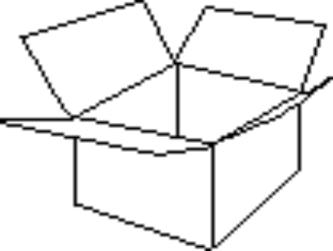
White Box Test Design
[13.8]
Structural testing focuses directly on the internal logic
to verify that the code is executing as intended.

Slide 20
White Box Test Design
Remember: Simply exercising the code does not mean that the program is being adequately tested.
Software
Structural testing does not ensure that the correct features have been implemented or that the code meets functional requirements.
Missing code cannot be tested for correctness !!

Slide 21
Consider Coverage Goals
For Completeness
^
a
Statement Coverage
No
A > 1
Yes
100% by abdfg
b
B = 0
c
(set A<-- 1, B <-- 1)
Branch Coverage
d
100% by 2 test paths
A = 1
(you find them!)
No
&
Yes
B = 1
Path Coverage
e
f
100% not possible
path
acdfg
is
infeasible
g

Slide 22
Why at least Branch Coverage? Why is STMT
Coverage not adequate
1. Minimal practical coverage
-every decision taken at least once
T
X>0
F
Test case with X=1
achieves statement
coverage, not branch
coverage
S1
2. Cannot always determine branch coverage from STMT coverage

Slide 23
Comparison of Coverage Levels
[13.8.1]
statement coverage inadequate [Fig. 13.9]
branch coverage includes statement coverage
path coverage
  not practical
  infeasible paths [Fig. 13.10]
possible - all definition - use paths
a challenge: class & object testing
[Fig. 13.12]

Slide 24

Comprehensive Testing
White box test design is most appropriate at the completion of black box test execution.
+
Software
Software
Designers should first test using black box test design methods to test the software features, and then measure the level of coverage obtained by the black box tests to detect gaps in exercising the code.
Then, white box test cases are added to increase code coverage appropriately.
The reason for this is to maximize code stability before starting white box testing--a more efficient allocation of resources!

Slide 25
Integration, Test and Release
[Ch. 14]
Integration Strategy [Fig. 14.1]
  Top-Down
  Bottom-Up
  Mixed (Sandwich) [Fig. 14.2, 14.3]
Product Testing [14.3, 14.4, 14.5]
  GUI Testing [14.3]
  Product Testing [14.4]
  Acceptance Testing [14.5]
    Regression Testing
    Reliability Testing [14.12]

Slide 26

System Testers
System testers test for reliability by
failure-directed methods:
Stress and performance tests [14.4]
“Soak” tests over Customer Operations Profile *
Product Functional Tests [14.4]
Regression tests [2.7.1, 15.8]
Acceptance Tests [14.5]
* Testing according to Customer Operations Profile leads to higher perceived (and real) software reliability:
  - this catches problems in the lab before the customer discovers them in the field.
  The challenge is to capture the customer’s profile!

Slide 27
Product Test Philosophy:
1. Identify and validate key customer
expectations.
2. Develop high-yield, high-level test scenarios
to cover:
      normal customer behavior
    high-risk exceptional customer behavior
    high-risk exceptional system behavior
3. Develop executable test cases to cover
scenarios.
4. Execute tests, analyze results for correctness
and coverage.
5. Add scenarios/test cases to achieve full
coverage objectives.

Slide 28
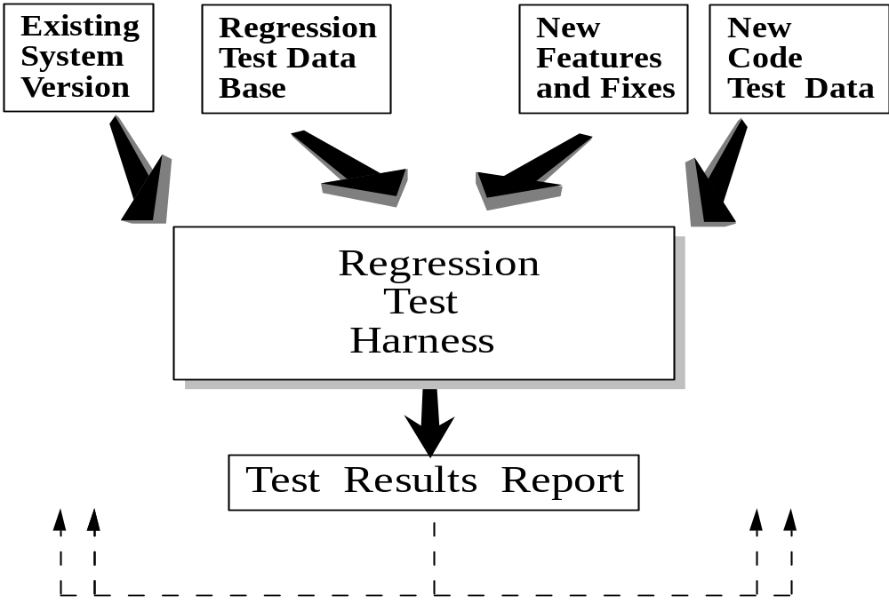
System (Regression) Testing
System testing tests that a system has not 'regressed' due to changes.
May involve a few thousand tests

Slide 29
Regression Testing
New Software
System Testing
Base
Software
Regression
Testing
Does the base still work and meet spec?
Did we break any functionality in existing version?
Requires test automation
Scalability

Slide 30

System Test and Design Teamwork
• Tester recommends test strategy
• Tester participates in all design reviews (functional specifications, design document, design test plan)
• Tester identifies required test tools early in design and gives guidelines for use or implementation
• Tester reviews designer testing documentation and test results
(first test plan, then test cases, then test results report)
Teamwork Ensures Excellence !

