Slide 1

Programming Languages
The birds and animals are all friendly to each other, and there are no disputes about anything. They all talk, and they all talk to me, but it must be a foreign language for I cannot make out a word they say. -- Mark Twain
  Why?
    computers, programming, abstraction
    programming languages
    courses about programming languages
  Background
    classes of languages
    history
  Housekeeping
1.1
1.2, 1.5, 2.*

Slide 2

Computers, Programming
The computer is a very general purpose machine, capable of any number of special purpose tasks.
  special purpose machine
    a small number of complex operations
    user as director of complex operations
  general purpose machine
    a small number of very simple operations
    programmer as architect, building complex operations by combining simple operations in meaningful ways
    user as director of complex operations
    can be used to simulate many different special purpose machines
Examples of special purpose machines? General purpose?
Notes:
special purpose machine examples:
VCR
synthesizer
word processor
sewing machine
fighter jet
general purpose machine examples:
computer
lego mindstorms (also a computer)

Slide 3
Example
Let’s say we have a very simple general purpose machine with the following basic operations:
  move(Const, X) store Const in X
  incr(X) increment the value in X
  sign(X) change the sign of the value in X
  rept(Op, X) repeat Op operation X times
We can invent new operations by combining operations:
  rept(incr(Y), X)
  sign(X); incr(X); sign(X)

Slide 4
Abstraction
By giving our new operations names we can use them without ever having to consider the details of their implementation:
  add(X, Y) rept(incr(Y), X)
  decr(X) sign(X); incr(X); sign(X)
We now have a slightly more powerful machine with more operations.
Abstraction is the reduction of a complex object or process to a simple form that can be used without considering the inner complexities.

Slide 5
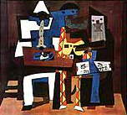
Examples of Abstraction
  add(X, Y)
  Y := Y + X;
  x := sqrt(y);
  today = (99,12,31);
  today++;
  “the queen is pregnant”
  :^7
Notes:
the add operation is an abstraction of the details involved in adding two numbers (repeated increment, for example)
the assign and add does the same thing, at a slightly higher level of abstraction (a higher level mathematics-like notation)
sqrt is actually a fairly complicated thing to implement on a computer; there are a ton of details abstracted away by allowing the programmer to say sqrt().
today seems to be some complex date type; performing arithmetic on dates is a level more complex than performing arithmetic on integers; again the details are abstracted away, making this programming language more powerful and simpler to use
the phrase “the queen” is an abstraction of the person who is the queen; it suffices to say “the queen” in this situation without referring to her name, her height, the hair on her upper lip, etc.; the term “pregnant” is certainly an abstraction of a large number of details; the phrase “the queen is pregnant” is a hugely simplified symbol for all the meaning that the phrase conveys
the circle, square, triangle is one abstraction of the course logo; it reduces the green cylinder, red cube and blue triprism to (what may be sufficient) generalizations; but maybe in some situations, green, red, blue is a better abstr.
Picasso’s “Three Musicians” abstracts away unimportant details to offer a simplified view; the simplification stresses only what Picasso wanted to stress
the smiley conveys emotion in an almost ultimately abstract form

Slide 6
Programming Languages
  A computer has a small set of primitive operations and a small set of primitive data types.
  A Programming Language is a set of more complex operations and data types along with rules for combining them. The operations and types are given names so that they can be used without regard for the complexities of their implementation.
  That is, programming languages provide abstractions of combinations of operations and data.
    Different languages approach abstraction in different ways, with different emphases.
    Programming languages also allow the programmer to create procedural and data abstractions (to varying degrees)

Slide 7
Programming Language Courses
Learning a programming language is like learning to drive. Learning a new language is like learning to drive something else:*
  sometimes it’s like learning to drive a standard
  sometimes it’s like learning to drive a boat
  sometimes it’s like learning to ride a motorcycle
Possibly the most important reason to study programming languages is to learn that programming goes way beyond the superficial syntax of any particular language.
*(Learning assembly language is like learning to build a car).

Slide 8
Programming Language Courses (cont.)
What’s the point of studying programming languages independently of any particular language?
  Expressiveness
    built-in features in one language can inspire implementation ideas in a language without those features
    char myarray[16], upperarray[16];
    …
    map(uppercase, 1, myarray, upperarray);
    …
    uppercase(char c)
    {
    return((c > 96 && c < 123) ? c - 32 : c);
    }
    map(void *funcptr(), int arity, …
Notes:
the example is C, mapping a single argument function repeatedly to each of a list of single arguments; the technique is learned from functional programming languages like Lisp

Slide 9
Programming Language Courses (cont.)
  The “Right” Language
    things that are difficult to program in one language may be simple to program in a different language
    qsort [] = []
    qsort (x:xs) = qsort smalls ++ [x] ++ qsort bigs
    where
    smalls = [y | y <- xs, y < x]
    bigs = [y | y <- xs, y >= x]
    things that are inefficient in one language may be efficient in a different language
Advantages/disadvantages of writing quicksort in Haskell?
Notes:
the example is Haskell, a purely functional language; think of how many lines it takes to write a quicksort in C or Pascal; now look at how elegant the Haskell solution is; the language you know is not necessarily the best for any given problem (though C may in fact be better for quicksort, if you measure goodness of programs on space/time efficiency only; but which would be easier to debug, maintain, etc.?)

Slide 10
Programming Language Courses (cont.)
  The Learning Curve
    learning many languages and things common to all languages makes learning new languages easier
    OUTER:for i in 1 .. MAX loop
    j := 1;
    INNER:loop
    prod := prod * (i + j);
    exit OUTER when prod > 2**12;
    j := j + i;
    exit INNER when j > 10;
    end loop INNER;
    end loop OUTER;
Notes:
the example is Ada; probably the most general and powerful loop in a high-level language, yet without even knowing Ada (knowing only languages with much more restricted loop contructs, in fact), you can figure out the new syntax

Slide 11
Programming Language Courses (cont.)
  Programming Insight
    knowing how languages are implemented gives a better understanding when using them
    …
    dothis();
    …
    }
    dothis()
    {
    register tmpvar = 0L;
    …
    }
may crash here!
Notes:
the example is C; it _may_ crash because
1. the compiler may not use a register for tmpvar, even though the programmer requested one;
2. if a register is not used, the compiler will probably use the runtime stack for the variable;
3. the runtime stack is also used to store the return address (where execution continues after the function call);
4. if registers are 16-bit, the compiler may only reserve16 bits on the stack;
5. if long integers are 32 bits, the assignment may write 32 bits of zeros to the stack, possibly overwriting the return address
By knowing about variables, parameters, function calls, return addresses, runtime stacks, execution, etc. (all things we’re going to see), you have a better chance of catching this bug

Slide 12
Programming Language Courses (cont.)
  Language Description
    learning how to describe the form and meaning of programming languages allows you to:
      learn new languages quickly and fully
      understand ambiguity in languages
      evaluate languages
      write parsers for languages
      use language tools (e.g., compiler compilers)
      develop new languages
        command languages, scripting languages, full-blown programming languages
      prove properties of programs
Notes:
how do you describe _unambiguously_ the legal syntax of, say, Pascal? When you call a function in C, exactly what effect does that have on execution and the variables in a program?

Slide 13
Classes of Programming Languages
There are different ways of grouping programming languages together based on their similarities:
  by domain
    business languages, scientific languages, AI languages, systems languages, scripting languages
  by generality
    general purpose vs. special purpose
  by paradigm
    a paradigm is a way of viewing programming, based on underlying theories of problem solving styles
    programming languages grouped in the same paradigm are similar in their approach to problem solving
    imperative, object-oriented, logic-based, functional

Slide 14
Classifying Languages by Domain: Business
Historically, languages were classified most often by domain.
  Business (sometimes a.k.a. data processing)
    language features emphasize file handling, table lookup, report generation, etc. (high level of abstraction)
    weak language support for math functions, graphics, recursion, etc. (low level of abstraction)
    Cobol
    now mostly handled by database systems, spreadsheets, etc. (which often include their own special purpose languages, by the way)
Examples of business applications?

Slide 15
Classifying Languages by Domain: Scientific
  Scientific
    language features emphasize math functions, graphics, recursion, concurrency, programmer defined abstraction, etc.
    weak language support for file manipulation, table lookup, report generation, etc.
    often low-level, efficient
    Fortran, Algol, Pascal, etc.
Examples of scientific applications?

Slide 16
Classifying Languages by Domain: AI
  Artificial Intelligence
    high level of abstraction for symbol manipulation, linked lists (often built-in), recursion, self-modification, etc.
    basic support only for file manipulation, graphics, user interface, etc.
    often high-level, inefficient
    Lisp, Prolog, Scheme, ML, etc.
Examples of AI applications?

Slide 17
Classifying Languages by Domain: Systems
  Systems
    language support for hardware interface, operating system calls, direct memory/device access, etc.
    little or no direct support for programmer defined abstraction, complex types, symbol manipulation
    very low-level, very efficient
    very few restrictions on programmer (access to everything)
    macro assembler, C
Examples of systems applications?

Slide 18
Classifying Languages by Domain: Scripting
  Scripting
    language support for system calls (to execute commands, programs, etc.), string manipulation, file handling
    basic support only for numeric types, loops, user interface, etc.
    csh, .bat, awk, Perl, etc.
Examples of scripting applications?

Slide 19
Classifying Languages by Generality
  General Purpose
    languages with features that allow implementation of virtually any algorithm
    roughly uniform level of abstraction over language features
    Pascal, C, C++, Java, Lisp, Prolog, Delphi, etc., etc., etc.
  Special Purpose
    languages with a very restricted set of features
    high level of abstraction among features
    SQL, WordBasic, etc.

Slide 20
Classifying Languages by Paradigm
Now probably the most common way of classifying languages.
more procedural abstraction
functional;
logic-based
object-oriented
imperative
more data abstraction
Notes:
I put functional and logic paradigms higher in procedural abstraction than OO: control in functional/logic paradigms is abstracted to the point of nonexistence (recursion is control, but is declarative in these paradigms); in OO you still have loops, functions (methods), blocks of sequential code in which order of execution matters, etc.

Slide 21
Classifying Languages by Paradigm: Imperative
  Imperative Languages
    a computer functions by executing simple instructions one after another
    imperative languages mirror this behaviour at a slightly higher level of abstraction
      the programmer specifies operations to be executed and specifies the order of execution to solve a problem
      the imperative language operations are themselves just abstractions of some sequence of lower-level machine instructions
    programmer must still describe in detail how a problem is to be solved (i.e., all of the steps involved in solving the problem)
    Assembly, Fortran, Algol, Ada, Pascal, C, etc.

Slide 22
Classifying Languages by Paradigm: Object-Oriented
  Object-Oriented Languages
    a problem is solved by specifying objects involved in the problem
      objects in OO correspond roughly to real-world objects in the problem
      objects are instances of classes (abstract data types)
      classes are arranged in hierarchies, with subclasses inheriting properties of superclasses
      operations (called methods) are defined specific to each class
      problem solving is accomplished through message passing between objects (a message is a call to a method of a specific object)
    Smalltalk, Dylan, Java, etc.
    hybrids: Delphi, Ada95, C++, Prolog++, CLOS, LIFE, etc.
Notes:
OO is considered a paradigm, but it’s usually not implemented that way; OO is often implemented by adding support for objects to languages that belong to another paradigm, usually imperative; for example, almost all OO languages have loops and have variables whose value can change; these are staples of imperative languages.

Slide 23
Classifying Languages by Paradigm: Logic-Based
  Logic-Based Languages
    a problem is solved by stating the problem in terms of logic (usually first-order logic, a.k.a. predicate calculus)
      a program consists of known facts of the problem state as well as rules for combining facts (and possibly other rules)
      program execution consists of constructing a resolution proof of a stated proposition (called the goal)
      the entire theorem prover is built-in to the language and is not visible to the programmer (major procedural abstraction!)
    Prolog, Goedel, Mercury
Notes:
truly different from imperative languages; cannot assign values to variables or change a variable’s value; no loop construct; order of execution of statements supposed to be irrelevant (and unknown)

Slide 24
Classifying Languages by Paradigm: Functional
  Functional Languages
    a problem is solved as the evaluation of a function
      a program consists of a set of function definitions, where a function is simply a mapping from elements of one set to elements of another set
      program execution consists of evaluating a top-level function (i.e., applying a function to specified elements of a set)
      the language itself is the function evaluator; the evaluation mechanism is not visible to the programmer (major procedural abstraction!)
      no variables, no assignment
      “everything is a function”
        can apply functions to functions too!
    Lisp, Scheme, Common Lisp, ML, CAML, Haskell
Notes:
truly different from imperative languages; cannot assign values to variables or change a variable’s value; no loop construct; order of execution of statements supposed to be irrelevant (and unknown)

Slide 25

History
1955
1960
1965
1970
1975
1980
1985
1990
1995
2000
Fortran I
Lisp
Fortran II
Algol 58
Algol 60
Cobol
Fortran IV
Simula I
Basic
PL/I
Simula 67
Algol 68
Pascal
C
Prolog
Fortran 77
Modula-2
Scheme
Smalltalk 80
ML
Ada
Common
C++
QuickBasic
Oberon
Fortran 90
Visual Basic
Haskell
Delphi
Goedel
Ada 95
Java
Dylan
CAML
Mercury
Notes:
Sebesta logo means check the book

Slide 26
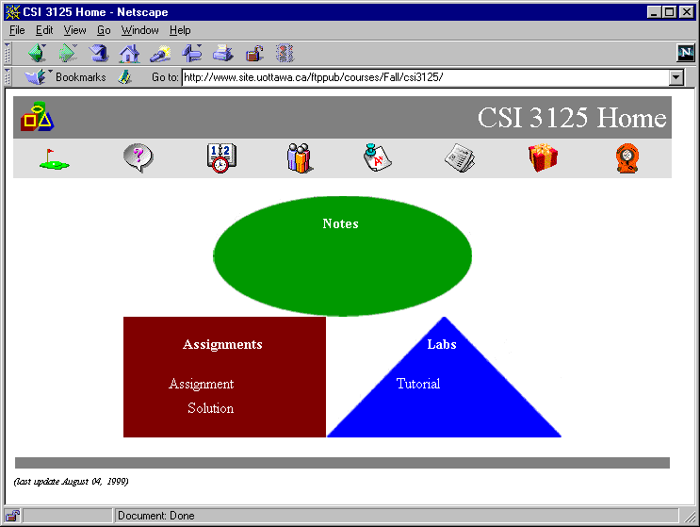
CSI 3125 Home

Slide 27
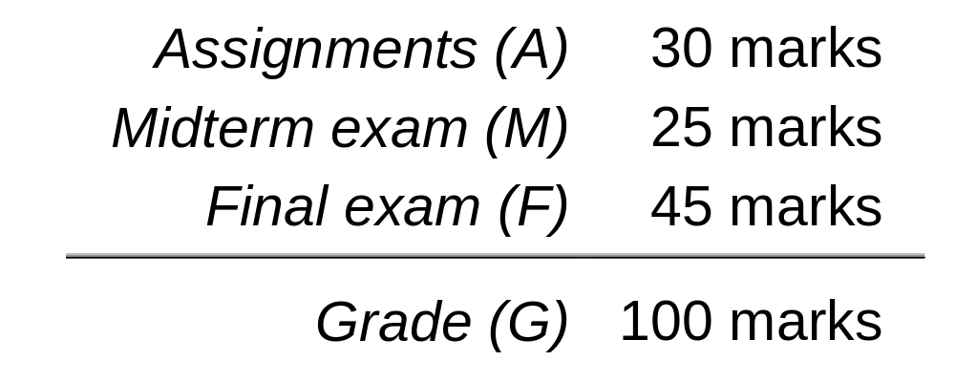
Marks
As usual, if you get a failing mark on the exams (< 35/70),
you get a failing grade in the course
(28 ≤ E < 35; F < 28)

Slide 28
Tutorials
DGD1
Wed 16:00-18:00
DGD2
Wed 16:00-18:00
DGD3
Tue 08:30-10:30

