Slide 1

Language Design
“What’s one and one and one and one and one and one and one and one and one and one?”
“I don’t know,” said Alice. “I lost count.”
“She can’t do Addition,” the Red Queen interrupted. -- Lewis Carroll
  Language evaluation
    readability
    writability
    reliability
    cost
  Language implementation
    language processing
    compilation/interpretation
    execution
    environment
1.3
1.7, 1.8

Slide 2
Criteria for Language Evaluation
Why are there so many languages?
What makes a language “better” than any other language?
  Readability
    maintenance a major consideration in software development
    maintenance almost always means reading somebody else’s code
  Writability
    a language should invite good programming practice
  Reliability
    programs should perform as expected under all circumstances
  Cost
    learning curve, coding, execution, maintenance, etc.

Slide 3
Criteria for Language Evaluation: Readability
  Abstraction
    procedural abstraction, data abstraction
  Absence of ambiguity
    and of too much choice
  Orthogonality
    unrestricted combinations of concepts
  Expressivity of control and data structures
    tradeoff between power and simplicity
  Appearance
    intuitive keywords
    formatting
    style of comments

Slide 4
Criteria for Language Evaluation: Writability
  Abstraction
    easier to write at a high level, maybe more difficult to learn
  Expressivity
    what is built-in and what must be explicitly constructed
  Orthogonality
    freedom to combine concepts in novel ways
  Modularity
    making more code more manageable
  Support
    help resources, code resources, language community
  Development tools
    development environments, visual programming, libraries, debuggers

Slide 5
Criteria for Language Evaluation: Reliability
  Type checking
    automatic checking that the right types are used in operations
  Error and exception handling
    automatic?
    graceful?
  Unambiguous naming
    same name, different scope
    pointers
    variable structures
  Compilers and runtime environments
    tested and bugfree

Slide 6
Criteria for Language Evaluation: Cost
  Learning curve
    programmers may not know the language yet
  Development time
    ease of programming
    availability of shared code, reuse
  Efficiency of the language processor
    compiler, interpreter
    runtime environment
  Portability and translatability
    easy to move code to a new platform?
    easy to translate to a different language
  Maintainability
    Y2K

Slide 7
Language Processing
  Machine language is the set of native operations performed by computer hardware.
    machine language is the only set of operations that can be executed by the computer
    mov, add, in, rol, and, etc.
  A programming language includes a set of more complex operations suitable for problem solving by programmers.
    computers can be programmed using machine language, but in general, programming languages are the only way for humans to program the computer
    read, write, while, DrawMenuBar, PostMessage, etc.

Slide 8
Language Processing (cont.)
In order to execute programs written in some programming language, the programming language operations must be translated into corresponding machine language instructions
  A language processor understands and can execute programs in a programming language.
    by translating a programming language into machine instructions
    translation is the process of mapping a source language into a target language
    often, translation from a high-level programming language to machine language is done in several steps
      the programming language is translated by a language processor to an intermediate language
      a second language processor understands and can execute programs in the intermediate language

Slide 9
Language Processing (cont.)
  A virtual machine is a software simulation of a language processor.
    a high-level programmer is usually not concerned with any details below the level of the high-level programming language
    as far as a Java programmer is concerned, the target machine is a Java machine (i.e. a machine that understand Java directly)
  It is desirable for high-level languages to be independent of any given hardware platform
    instead of building a separate Prolog virtual machine for every brand of computer, build one that translates to some intermediate language
    instead of building a separate intermediate virtual machine for all languages, have the different languages use the same intermediate machine

Slide 10
Language Processing (cont.)
Often there are several layers of virtual machines sitting above the physical hardware
* Not every layer is always present
more abstraction
input data
application program
programming language
machine-independent code
operating system routines
machine language
microcode
hardware

Slide 11
Compilation and Interpretation
Instructions written in the language of one level must be translated into the language of the level below in order to be understood.
  Compilation
    translate all of the instructions in a program into the language of a lower level virtual machine language
    execute the translated program later
  Interpretation
    translate some small number of instructions to the target language, then execute immediately, then translate some more.
Often a program is compiled into a lower level language and stored; the lower level program is then interpreted.

Slide 12
Compilation
source
program
lexical analyzer
tokens
syntactic analyzer
parse trees
Execution
semantic analyzer
symbol table
abstract program
target
program
input
data
code optimizer
optimized program
computer
code generator
object program
output
data
linker

Slide 13
Interpretation (+ Execution)
source
program
interpreter
input
data
output
data

Slide 14
What is Intermediate Code?
Pascal
  if I < N + 1 then
  K := I
Intermediate Code
  reg1 = I
  reg2 = N
  reg3 = reg2 + 1
  reg4 = reg1 - reg3
  if reg4 >= 0 goto L1
  reg5 = I
  K = reg5
  L1:…
Optimized Intermediate Code
  reg1 = I
  reg2 = N
  reg2 = reg2 + 1
  reg2 = reg2 - reg1
  if reg2 <= 0 goto L1
  K = reg1
  L1:…
Object Code
  mov AX, I
  mov BX, N
  inc BX
  sub BX, AX
  js L1
  mov K, AX
  L1:…

Slide 15
Programming Environments
The programming environment is the collection of tools available to a programmer using a particular language:
  editor
  compiler
  linker
  runtime environment
  debugger
  libraries, library manager
  help files
  graphical development tools
  command line interpreter

Slide 16
Integrated (and not-so-Integrated) Environments
Different languages (and different implementations of the same language) integrate more or fewer of these tools into a single package.
  “Disintegrated”
    assembly
      no editor, no runtime environment, no tools, no interpreter, no debugger (though sometimes the OS has one), libraries rare
      online documentation: ya right!
    Microsoft C for DOS
      no editor (use your fav), no runtime environment, no graphical development tools, no interpreter
      compiler, linker, debugger: separate DOS programs
      libraries included as separate object files, managed using linker
      ASCII text help files, no browser (or standard DOS browser)
      graphics schmaphics!

Slide 17
Integrated Environments (cont.)
  Towards integration
    Unix
      C compiler combines compiler and linker
      Emacs editor facilitates C programming
    Turbo C for DOS
      shipped with proprietary editor
      compiler, linker: separate programs that could be invoked from within the editor separately or together
      debugger integrated with editor
      help files online in editor along with help browser

Slide 18
Integrated Environments (cont.)
  Full integration
    Smalltalk
      editor, language processor, runtime environment, class browser all integrated
      windows? we invented windows!
  Visual programming
    Delphi, JDK, MS Visual C++, WinProlog, etc.
      full integration of editor, language processor, class browser, etc.
      plus code generators for drag’N’drop GUI development

Slide 19
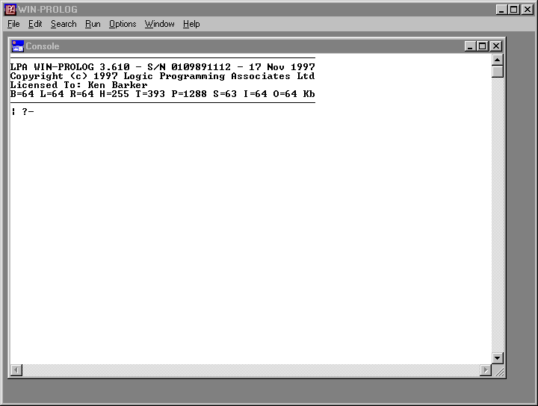
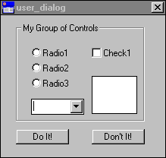
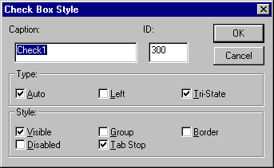
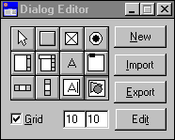
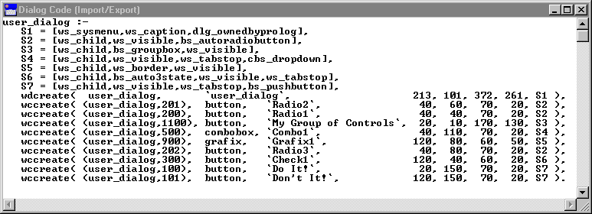
Integrated Environments (cont.)

Slide 20
Environments for Interpreters
Interpreters (as opposed to compilers) often have their own special environment features (in addition to the tools already discussed):
  command line interpretation of single commands
  commands to load programs from disk
  runtime intervention
  built-in “compiler”
    usually saves the entire language processor (interpreter) to an executable file that contains the user program as internal data
    huge executable programs
    not usually much more efficient than using the full interpreter
    better for distribution

